Slide 1

MULTIVALENT DEOXYRIBOZYME CONSTRUCTIONS FOR EFFICIENT CLEAVAGE OF TARGETED RNA
Completed by:
student of group # A42424
Batsa M.
Supervised by:
Professor PhD, Vladimir Vinogradov
Co-supervised by:
Professor PhD, Dmitry Kolpashchikov

Slide 2


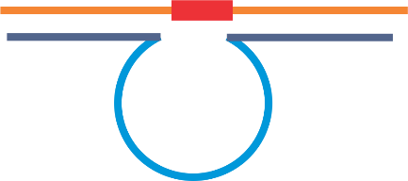

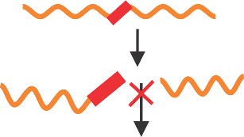


Therapeutic nucleic acid for gene therapy
RNA-cleaving DNAzymes (DZ)
Therapeutic effect
siRNA
Gene down regulation
ASO
mRNA
Aptamer
Protein
Advantages of DZs
high selectivity
Independent of any additional
protein interaction
Gene knockdown tools
Limitations of therapeutic nucleic acid approaches
Off-target effects
Low efficiency
High cost of synthesis
Limitations of DZs
Weak affinity to folded targets
Inefficient cleavage activity
Levin, 2019; Xiong et al., 2021
How do we tackle the limitations of DZs?
Chemical modification and computational prediction
Multivalent based RNA-cleaving DNAzymes
Fokina et al., 2015

Slide 3
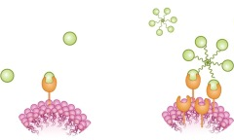
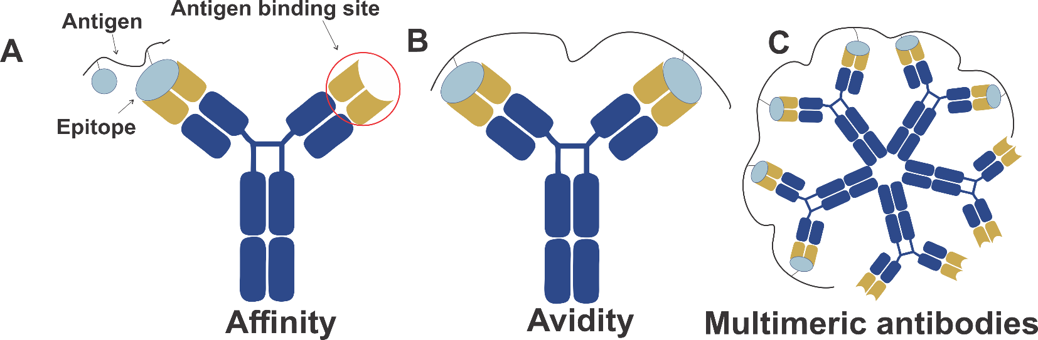
Multivalent system
Monovalent versus multivalent binding
Monovalent
binding
Multivalent
binding
Monovalent binds to a single ligand while multivalent binds to several ligands
The number of ligands and the core structure (linear, circular, or radial) strongly influence the
degeneracy coefficient, which is a measure of the energy states of the possible binding interactions
Böhmer et al., 2021

Slide 4
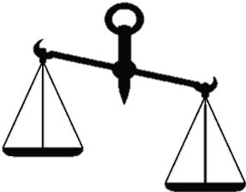
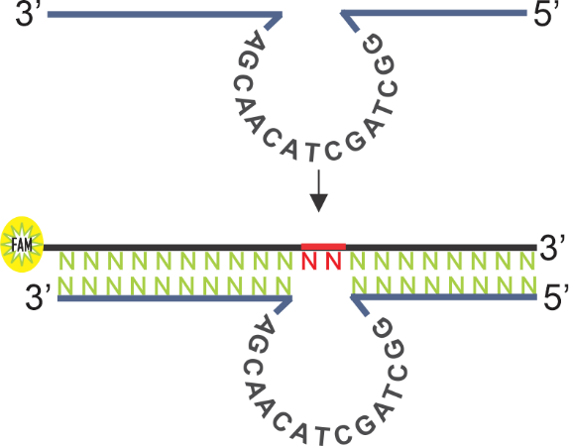
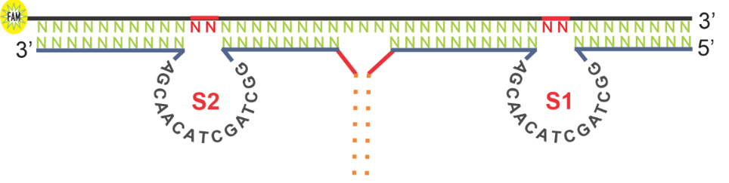
Aim and Objectives of Research
The weak affinity of RNA-cleaving DNAzymes near physiological
conditions could be enhanced through multivalent DNA models
Hypothesis
Aim
To design bivalent RNA-cleaving DNA-enzymes and compare
their catalytic activities with monovalent 10-23 DNAzymes
To demonstrate that multivalent systems cleave targeted
RNA more efficiently than monovalent systems
To determine if two RNA-cleaving DZs covalently linked
in a single nanostructure provide advantages in RNA
cleaving activity in comparison to two separate DZs
To investigate the kinetics of the optimized RNA-cleaving DNAzymes
Objectives
1
2
3
Monovalent system
Multivalent system

Slide 5
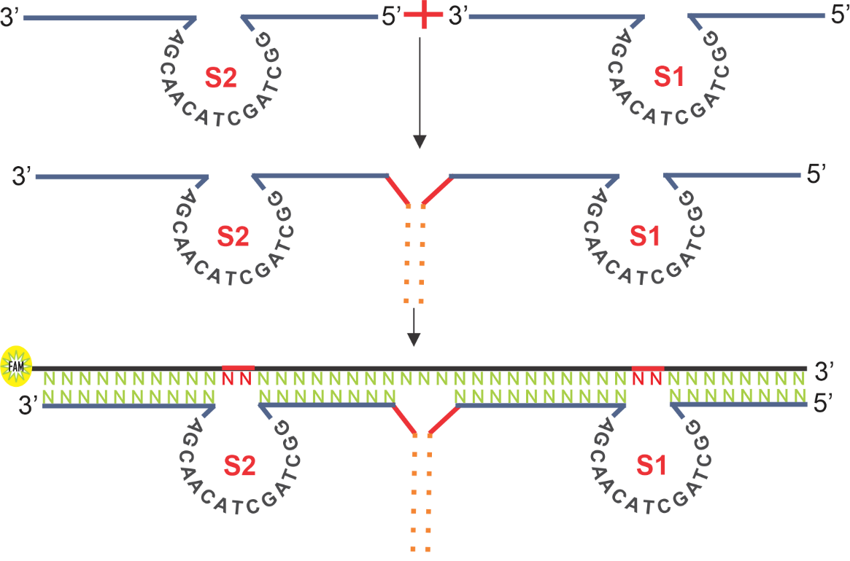
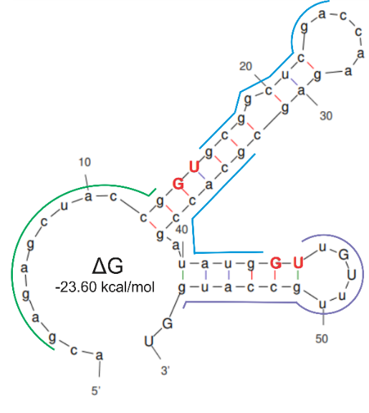
Design Concept
Monovalent DZ
DZ = DNAzymes
Bivalent DZ
S = Subunit
Conjugation of two oligonucleotides by HEG linker
Binding arm
Binding arm
DZ 10-23
Separate DZ
catalytic core
STR-58
Cleavage site 2
Target RNA
Cleavage site 1
Cleavage site 2
heg
Cleavage site 1
Fluorescein amidites (FAM)
2nd catalytic core
1st catalytic core
Binding tiles
STR-58 is a fragment from streptomycin resistance cassette strA
HEG (hexaethylene glycol modification) can be conjugated at the 5’ or 3’ end of oligonucleotides

Slide 6
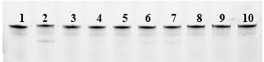
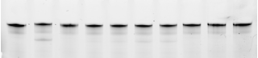

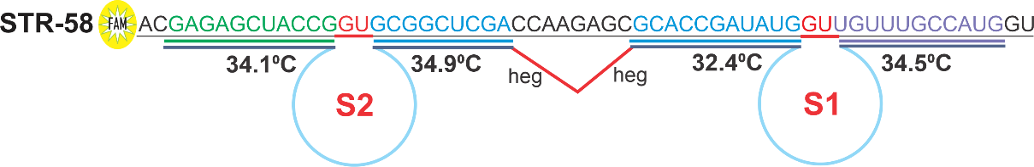
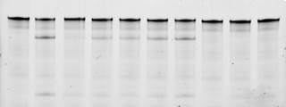
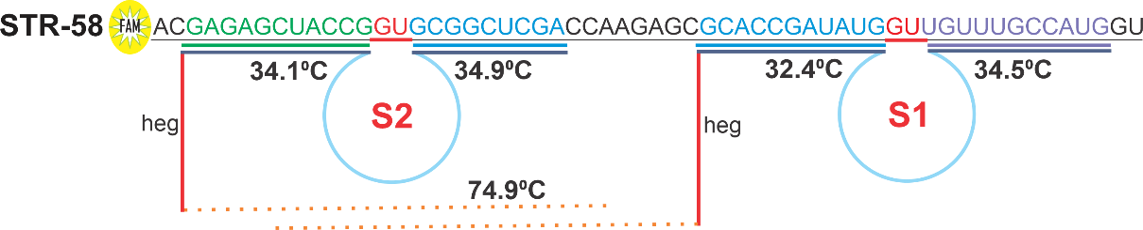
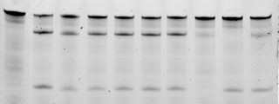
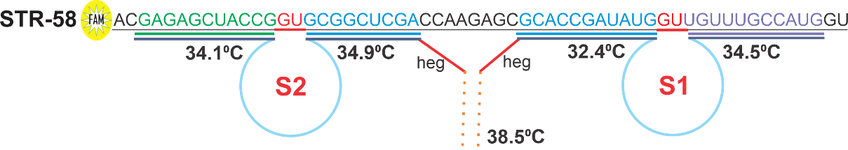
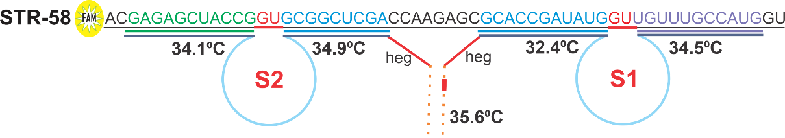
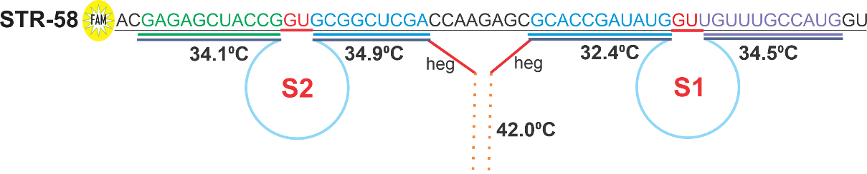
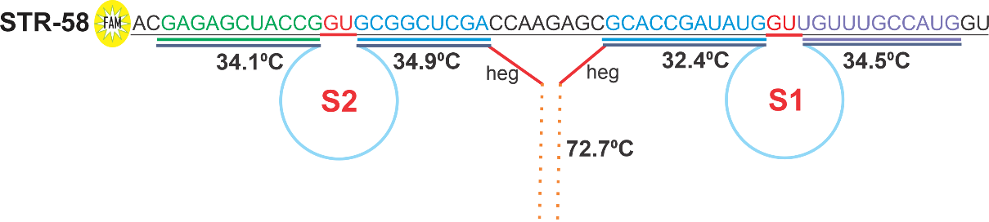
Bivalent and monovalent under multiple turnover conditions
1- Control
2- BD1
3- BD2
4- BD3
5- BD4
6- BD5
7- BD6
8- DZ1
9- DZ2
10- DZ1-DZ2
Monovalent DZ
BD = Bivalent Deoxyribozyme
Initial RNA
5’
3’
1h
3’
5’
DZ1
BD1
cleavage product 1
5h
5’
3’
3’
cleavage product 2
BD2
5’
cleavage product 1
24h
DZ2
5’
3’
cleavage product 2
3’
BD3
5’
70
At 5h of incubation
BD1 = 44.5% (0.89 h⁻¹)
Dz1 = 2.6% (0.05 h⁻¹)
Dz2 = 3.3% (0.07 h⁻¹)
DZ1-DZ2 = 6.5% (0.13 h⁻¹)
5’
3’
60
3’
5’
44.5
1h
BD4
50
5h
5’
3’
24h
40
3’
5’
STR-58 cleavage (%)
BD5
30
5’
3’
20
6.5
3’
5’
BD6
10
BD1
BD2
BD3
BD4
BD5
BD6
DZ1
DZ2
DZs conjugated with linker
increased catalytic activity
DZ1-DZ2
Bivalent and monovalent DNAzymes

Slide 7
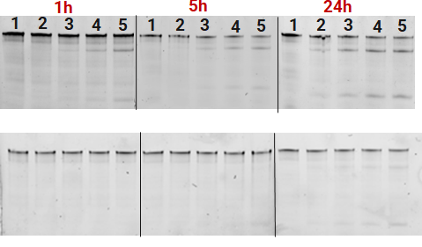
Catalytic efficiency of DZ1-DZ2 and BD1
1- control
2- 10nM
3- 25nM
4- 50nM
5- 100nM
Initial RNA
Initial RNA
cleavage product 1
cleavage product 1
cleavage product 2
cleavage product 2
60
60
50
50
1h
1h
5h
40
5h
40
24h
33
STR-58 cleavage (%)
24h
21
STR-58 cleavage (%)
30
30
20
8.0
20
10.9
10
10
10nM
25nM
50nM
100nM
10nM
25nM
50nM
100nM
DZ1-DZ2 Efficiency
BD1 Efficiency
5’
3’
DZ1
DZ2
3’
5’
BD1
BD1 demonstrated higher catalytic efficiency at 25 nM as
compared to DZ1-DZ2 at 100 nM after 5 h of incubation

Slide 8
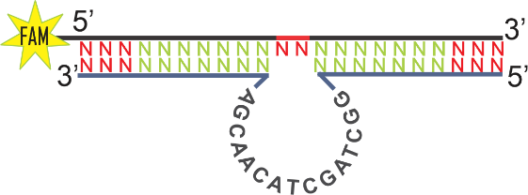
Optimization of monovalent DZs
Separately working monovalent DZs (-1/+1 or +2 nt)
Increasing the length of the binding
arms, increased cleavage activity
25
5h
25
20
DZ1
16.5
5h
20
15
STR-58 cleavage (%)
STR-58 cleavage (%)
DZ2
2.0
15
1.9
8.8
10
10
5
5
DZ1_10/10
DZ1_10/11
DZ1_11/11
DZ1_12/12
DZ1_13/12
DZ1_13/13
DZ1_11/10
DZ1_11/12
DZ1_12/11
DZ1_12/13
DZ2_8/11
DZ2_9/11
DZ2_11/12
DZ2_9/10
DZ2_10/11
DZ2_10/13
DZ2_11/13
DZ2_8/10
DZ2_9/12
DZ2_10/12
DZ1 optimization
DZ2 optimization
Cooperatively working DZ1-DZ2 association (-/+1 or +2 nt)
25
21.0
5h
20
DZ1
DZ2
15
3.8
STR-58 cleavage (%)
10
5
DZ1_11/10-DZ2_9/10
DZ1_11/10-DZ2_8/11
DZ1_11/10-DZ2_9/11
DZ1_11/11-DZ2_8/10
DZ1_11/11-DZ2_8/11
DZ1_10/11-DZ2_9/11
DZ1_11/11-DZ2_9/10
DZ1_12/11-DZ2_9/11
DZ1_12/12-DZ2_9/11
DZ1_11/10-DZ2_8/10
DZ1_10/11-DZ2_8/11
DZ1_10/10-DZ2_9/11
DZ1_10/11-DZ2_9/10
DZ1_10/11-DZ2_8/10
DZ1_10/10-DZ2_8/11
DZ1_11/11-DZ2_9/12
DZ1_12/12-DZ2_9/12
DZ1_10/10-DZ2_8/10
DZ1_11/12-DZ2_9/11
DZ1_12/11-DZ2_9/12
DZ1_12/12-DZ2_10/11
DZ1_12/13-DZ2_9/12
DZ1_12/11-DZ2_10/11
DZ1_12/12-DZ2_10/12
DZ1_10/10-DZ2_9/10
DZ1_12/12-DZ2_11/13
DZ1_12/12-DZ2_10/13
DZ1_12/13-DZ2_10/13
DZ1_12/11-DZ2_10/12
DZ1_12/13-DZ2_10/12
DZ1_13/13-DZ2_10/12
DZ1_11/11-DZ2_10/12
DZ1_12/12-DZ2_10/12
DZ1_11/11-DZ2_9/11
DZ1_11/12-DZ2_9/12
DZ1_12/13-DZ2_11/13
DZ1_13/12-DZ2_11/12
DZ1_13/12-DZ2_10/12
DZ1_11/11-DZ2_10/11
DZ1_13/12-DZ2_9/12
DZ1_13/13-DZ2_9/12
DZ1_13/12-DZ2_10/13
DZ1_13/12-DZ2_10/13
DZ1_11/11-DZ2_10/12
DZ1_13/12-DZ2_11/13
DZ1_13/13-DZ2_11/13
DZ1_11/12-DZ2_10/11
DZ1_12/13-DZ2_11/12
DZ1_13/12-DZ2_11/12
DZ1-DZ2 optimization

Slide 9
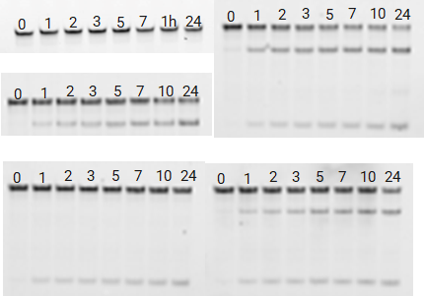
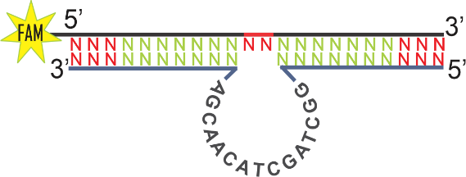
Kinetics of optimized DZs and BD1
At 5 h of incubation
BD1 = 51.8% DZ2 opt = 10.7%
DZ1 opt = 21.1% DZ1-DZ2 opt = 29.2%
Control
BD1
DZ1_12/13
control
Opt = optimize
BD1
DZ1 opt
DZ2_11/12
DZ1_12/13-DZ2_11/12
80
DZ2 opt
Initial RNA
DZ1_DZ2 opt
cleavage product 1
70
60
cleavage product 2
50
5’
3’
STR-58 cleavage (%)
3’
5’
40
BD1
30
20
DZ1 opt
DZ2 opt
10
DZ1_12/13
DZ2_11/12
0
2
4
6
8
10
12
14
16
18
20
22
24
Covalently linked BD1in a single nanostructure increased hybridization of the cleavage agent to the substrate
Time of incubation

Slide 10

Conclusion
1
2
3
Multivalent system
RNA cleavage efficiency
Optimization
BDs have demonstrated higher cleavage activity
in cleaving STR-58 than monovalent constructions
Two DZs covalently linked
in a single nanostructure increased DZ hybridization
and affinity to substrates, resulting in higher catalytic activity at low concentrations
than monovalent DZs at high concentrations
Although increasing the length
of the binding arms increased
the efficiency of monovalent constructions, covalently linked
DZs in single nanostructures
are the most efficient constructions for RNA cleavage activity
Our multivalent DZ models demonstrated efficient catalytic cleavage activity, indicating a promising path for future DZ research

Slide 11

Future Plans
Looking for
Molecular Biology,
Biotechnology,
and related fields
in
Research Interest
Contact Details
kmichaelbatsa@gmail.com
Genetic engineering
Genomics
Molecular mechanisms
Bioinformatics
+79117580878

Slide 12





Thank you for your attention
kmichaelbatsa@gmail.com
Supervisor
Ph.D. Dmitry Kolpashchikov
Assisted by
Mikhail Dubovichenko
Prepared by
Michael Batsa

Slide 13
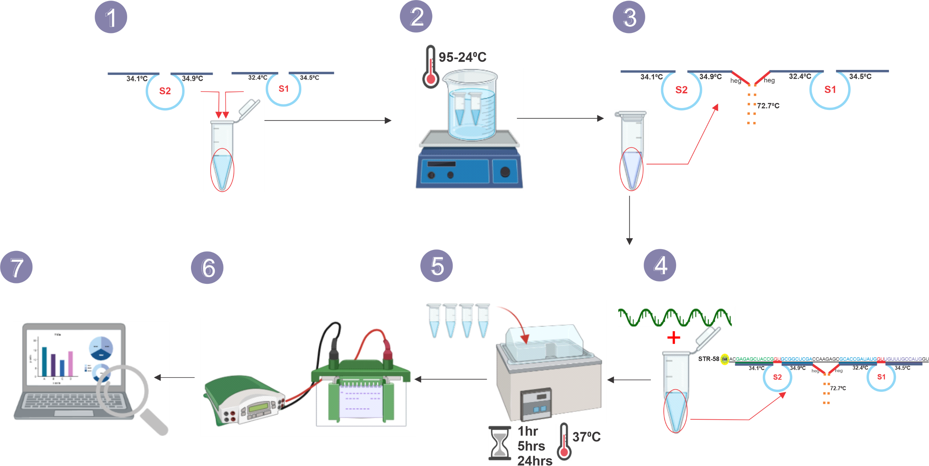
APPENDIX 1 - Experimental reaction
Near physiological conditions
KCl = 150 mM,
NaCl = 15 mM,
MgCl2 = 2 mM,
HEPES = 50 mM,
pH = 7.5 + 37°C)
Combining nucleic acids
Heating
Bivalent construct
Binding tile
Cleavage buffer
Data analysis
Electrophoresis
Incubation
Adding target RNA
20% polyacrylamide gel (40% AA:BA, TBE, Urea, APS, TEMED)

Slide 14
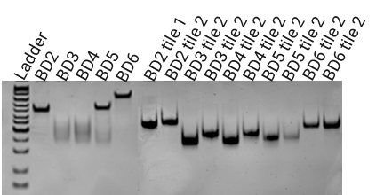
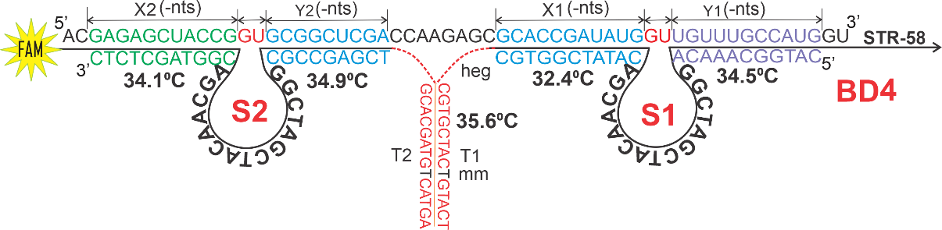
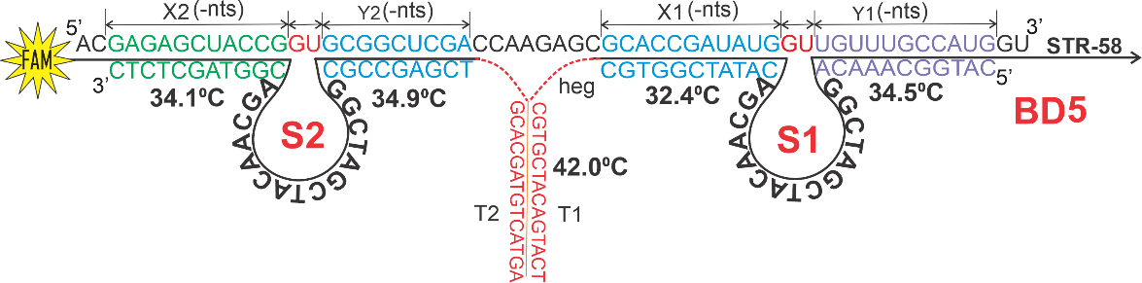
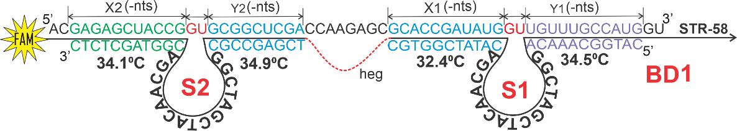
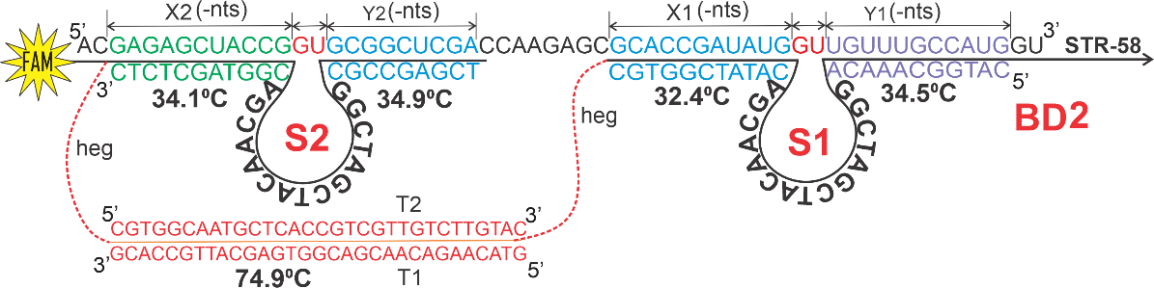
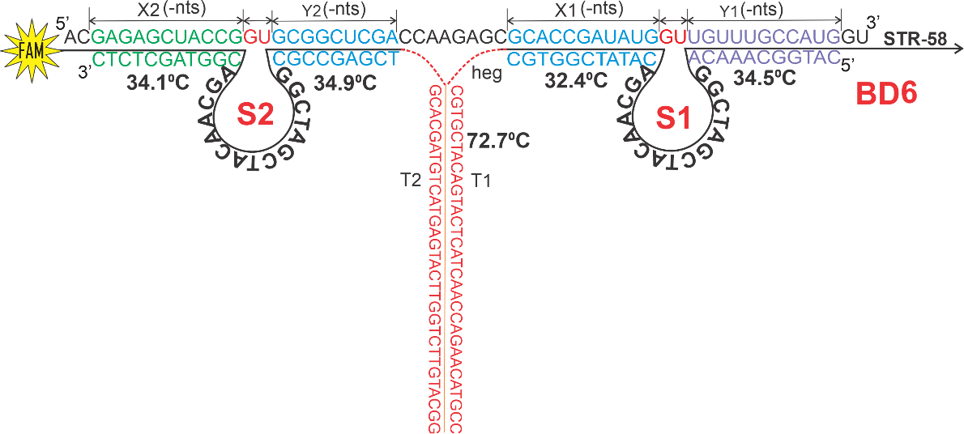
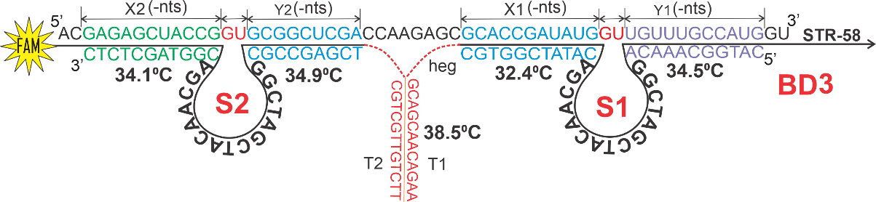
APPENDIX 2 - Assembled BDs

Slide 15
APPENDIX 3 – BDs Efficiency
70
60
1h
50
5h
24h
40
STR-58 cleavage (%)
30
20
10
BD1
BD2
BD3
BD4
BD5
BD6
DZ1
DZ2
DZ1-DZ2
Bivalent and monovalent DNAzymes

