Slide 1
The 26th International Electronic Conference on Synthetic Organic Chemistry
Modifications in Thermal and Anticorrosive Characteristics of
Haemoglobin-doped Polyindole
Komal Khati
Submission ID-066299
Department of Higher Education,
RHGPG College Kashipur,Uttarakhand, India

Slide 2
Introduction
Polyindole(PIN) and associated polymers have accepted emergent notice over decades for scientific and biomedical applications.
It has extensively been considered as prophetic material due to its synthesis ease, cheapness, light weight, flexibility, thermal stability, tuneable conductivity, environmental stability, quick charge–discharge property, that can be regulated by doping and potential blending property confer them better hand to be exploited as a good challenger.
Hb is porphyrin-originated haeme complex with well-known commercial availability and judicious price. Recently, hemeproteins immobilized metal based electrodes showed interesting electrochemical behavior and greater charge/discharge cycling stability.
These properties prompts to exploit Hb as dopant to develop the PIN-based HPC for potential application in the development of working electrodes for supercapacitors .

Slide 3
Objectives
The present analysis deals with development of an environmentally gentle process of HPC through surfactant-assisted in-situ polymerization of indole (IN) in the presence of Hb(1%w/w) concentration.
The formation of HPC was ascertained through scanning electron microscopy (SEM), thermogravimetric-differential thermal analysis-differential thermogravimetry (TG-DTA-DTG) and electrochemical impedance spectra (EIS).
The corrosion protective performance of PIN and HPC over the Stainless steel(SS) substrates in a 1.0 M KOH solution was investigated as a function of immersion time through Potentiodynamic Polarization measurements.

Slide 4
Experimental
Synthesis of HPC
The route of synthesis was accomplished through CTAB (1.15 g, 3.50×10⁻³ mol dl⁻¹)-assisted dilute solution polymerization of Indole (0.12 mol dl⁻¹) in the presence of ferric chloride (FeCl₃ 30 ml, 1.85×10⁻² mol dl⁻¹) along with essential concentrations of Hb 1% (w/w).
The contents were under mechanical stirring at the rate of 500 rpm over 24 h at 30 ± 1◦C. HPC was obtained through centrifugation at 3000 rpm over 20 min, followed by filtration, washing and drying at 50 ±1◦C/400 mmHg for over 5 h.
PIN was also synthesized under identical reaction conditions and served as the control.
Preparation of sulphonated polysulphone (SPS)
SPS exploit as a binder and one of the constituents in the matrix was synthesized through sulphonation of polysulphone resin (PSO) with chlorosulphonic acid in dichloromethane (DCM).

Slide 5
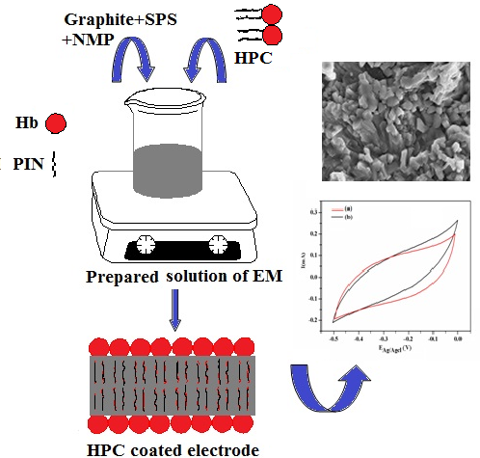
Fabrication of Working Electrodes
Scheme 1. Coating of SS with HPC to developed working electrode

Slide 6
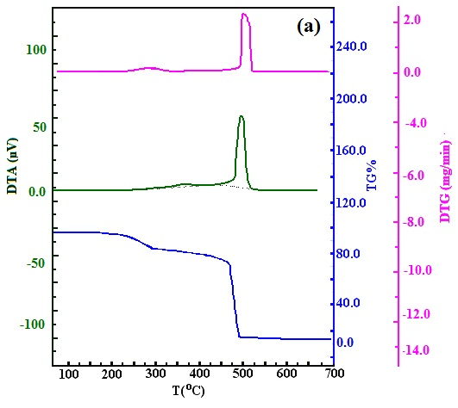
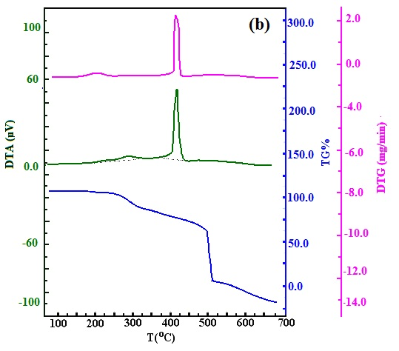
Results and discussion
Thermal Properties
The thermal characteristics of PIN and HPC have been investigated through simultaneous TG-DTA-DTG . Due to the existence of Hb, the HPC are accountable for high-thermal stability contrast with the polymer.
Figure1. TG–DTA–DTG curves of (a) PIN (b) HPC

Slide 7
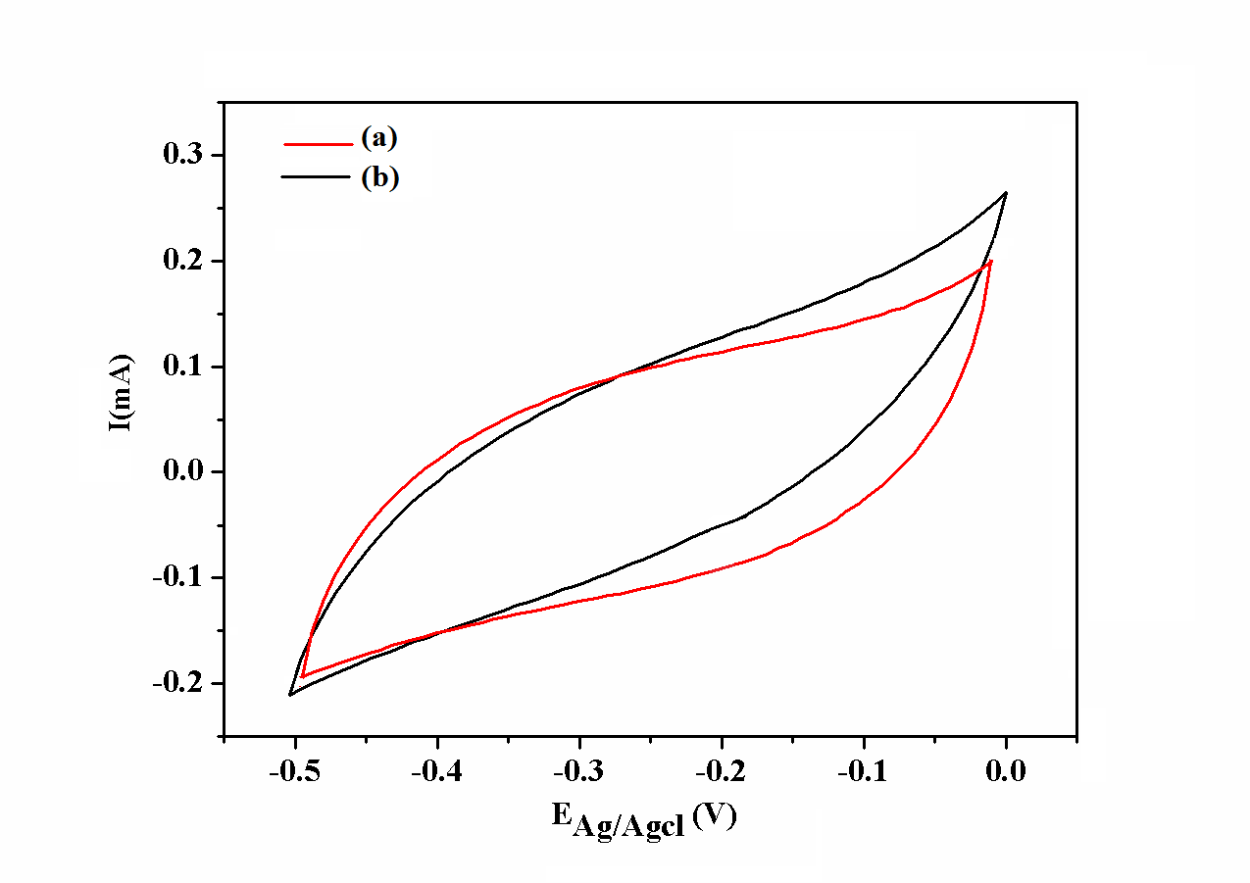
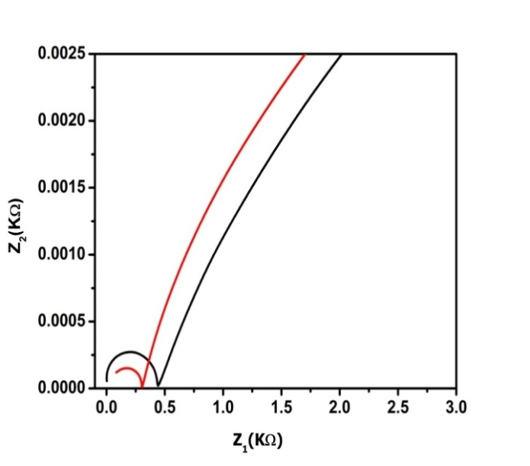
Cyclic Voltammetry
The electrochemical performance of PIN and respective HPC electrodes synthesized at Hb concentrations 1% (w/w) has been investigated for electrochemical supercapacitors. PIN and respective HPC (1%), the Cs (Fg⁻¹) of electrodes has been 21.60 and 39.40 respectively.
The EIS spectra were represented through Nyquist plot to study the stability or any loss in the protective properties of the coating over the SS surface in KOH (1.0M). The electrolyte resistance( Rs) and charge transfer resistance (Rct) for HPC is less than the PIN, which conclude that HPC is vastly conductive as well as moderately stable as an electrode material.
Figure 2. CV of (a) PIN and (b) HPC at scan rate (VS⁻¹) with reference to Ag/AgCl and Nyquist plot of PIN (red) and HPC (black 1%) in KOH

Slide 8
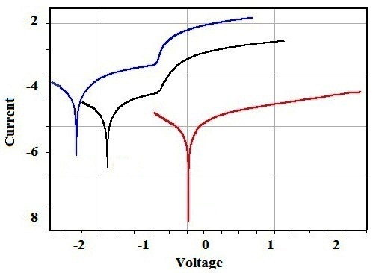
Corrosion Analysis
The extent of corrosion inhibition ability of PIN and HPC coatings deposited over SS substrate has been investigated through the Tafel plot. The electrochemical data has been presented in terms of Ecorr (V), Icorr (A/cm²) and CR (mm/year) under potentiodynamic conditions from −1.0V to 1.0V, 0.1Vs⁻¹ at room temperature.
Figure.3 Tafel plot @0.1(Blue-bare SS, Green-PIN and HPC (Red-1%) in KOH
Table 1. Corrosion parameters (Ecorr, Icorr, Rp, CR) obtained from Tafel plots of bare SS electrode, PIN and HPC(1%)
Substrate | Ecorr (V) | Icorr (Acm⁻²) | Rp (Ohm) | CR (mm yr⁻¹)
Stainless Steel PIN HPC(1%) | -1.27 -0.77 -0.63 | 1.90X10⁻⁴ 1.19X10⁻⁴ 1.82X10⁻⁵ | 1.22 X10⁻² 6.48 X10⁻² 1.28 X10⁴ | 6.219 0.389 0.059

Slide 9
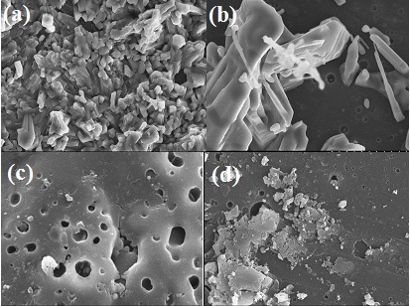
Microstructure
Figure.4 SEM images of (a) PIN and (b) HPC before recording polarization experiment (c) PIN and (d) HPC SEM images after recording EIS data and polarization experiment in KOH

Slide 10
Conclusions
Development of HPC for supercapacitor electrodes were through CTAB (1.15 g, 3.50 X10⁻³ mol/dL) assisted dilute solution polymerization of Indole (0.12 mol/dL) in presence of FeCl₃ (30 mL, 1.85X10⁻² mol/dL) at concentration of Hb(1%, w/w) at 30±1 ºC over 24 h.
From thermal analysis, PIN and HPC shows two step decompositions which onset from 201 to 398 ºC and 207 to 411ºC. Hence, it can be concluded that incorporation of Hb in PIN steadily increases its thermal stability.
PIN and respective HPC (1%), the Cs (Fg⁻¹) of electrodes has been 21.60 and 39.40 respectively..
The Rs and Rct for HPC is less than the PIN, which conclude that HPC is immensely conductive as well as judiciously stable as an electrode material.
PIN and HPC shows granular and rod shape morphology which changes to phase separated morphology. Thus SEM based observations indicate that after the polarization experiments; the surface of the electrodes has been tarnished.
Present finding has been made and open new avenues for the fabrication of a new generation of supercapacitors. The current research reflects its usefulness towards economically viable development of electrode material for electrochemical supercapacitors.

Slide 11
THANK YOU

