Slide 1
A spatially resolved temperature measurement system for a honeybee colony brood box
Adam McVeigh, Michael I Newton, Costas Tsakonas and Martin Bencsik
3rd International Electronic Conference on Applied Sciences 1-15 Dc 2022
Notes:
Slide 1
Hello, my name is Adam and I am a Research Assistant at Nottingham Trent University.
I work on the B-GOOD project for Dr Martin Bencsik.
As part of the project, we have been taking spatially resolved temperature measurements of a honeybee colony.
In this presentation we present some of our data and work.

Slide 2
A spatially resolved temperature measurement system for a honeybee colony brood box Adam McVeigh, Michael I Newton, Costas Tsakonas and Martin Bencsik
Honeybee colonies need suitable temperatures.
Require 32-35°C for brood rearing.
A single sensor provides a snapshot of colony.
More sensors provides a clearer picture.
Colony temperature management.
High resolution sensor array.
480 negative coefficient temperature sensors.
3rd International Electronic Conference on Applied Sciences 1-15 Dc 2022
Notes:
Slide 2
We know honeybee colonies need suitable temperatures for development.
For instance, it is well known they require around 35°C to successfully rear brood.
Using a single sensor could measure such temperatures, but it only provides a snapshot of the whole colony.
Using multiple sensors increases the resolution and can help provide a picture of colony thermal dynamics.
We explored using a high-resolution temperature sensor array, consisting of 480 thermistors to take high-quality and reliable spatially resolved temperature measurements of a honeybee colony.

Slide 3
A spatially resolved temperature measurement system for a honeybee colony brood box Adam McVeigh, Michael I Newton, Costas Tsakonas and Martin Bencsik
British National Hive
Roof
Adapted Super with electronics
Cables joining frames to electronics
Brood Box with frames inside with thermistors
Cable linking system to Raspberry Pi
3rd International Electronic Conference on Applied Sciences 1-15 Dc 2022
Notes:
Slide 3
This is a picture of a British National Hive at Nottingham Trent University which was used for our study.
The hive consists of a floor, a brood box, a super, and a roof.
The super is adapted to house the electronics of the system which collect and process the data.
Cables connect the frames with temperature sensors to the microprocessors in the super.
USB wires then link the system to a Raspberry Pi which is inside a nearby building.

Slide 4
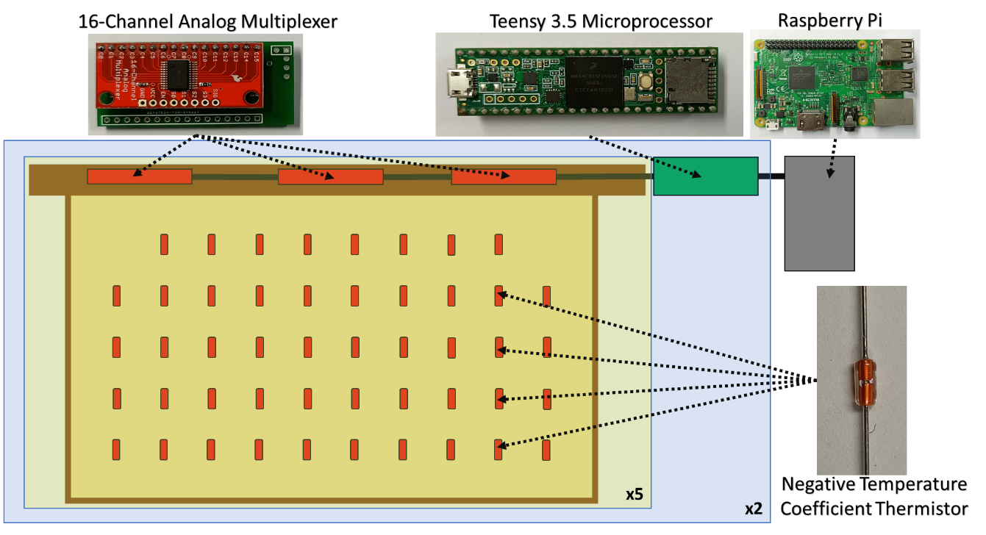
A spatially resolved temperature measurement system for a honeybee colony brood box Adam McVeigh, Michael I Newton, Costas Tsakonas and Martin Bencsik
Schematic of electronics.
10 frames each with 48 negative temperature coefficient thermistors.
Each frame connects to three 16-Channel Analog Multiplexers.
Multiplexers connect to Teensy 3.5 microprocessors.
Two Teensy 3.5s
Linked to a Raspberry Pi
3rd International Electronic Conference on Applied Sciences 1-15 Dc 2022
Notes:
Slide 4
This schematic shows the electronic setup of the system.
Inside the hive are 10 frames, each with 48 negative temperature coefficient thermistors.
Each frame has 3 16-channel analogue multiplexers which handles each sensor.
The multiplexers are connected to Teensy 3.5 microprocessors which digitise the temperature data.
We used 2 Teensys to handle 5 frames each.
Teensys link to a Raspberry Pi which automatically saves the data with a corresponding timestamp.
Once setup, the system runs autonomously and continuously.

Slide 5
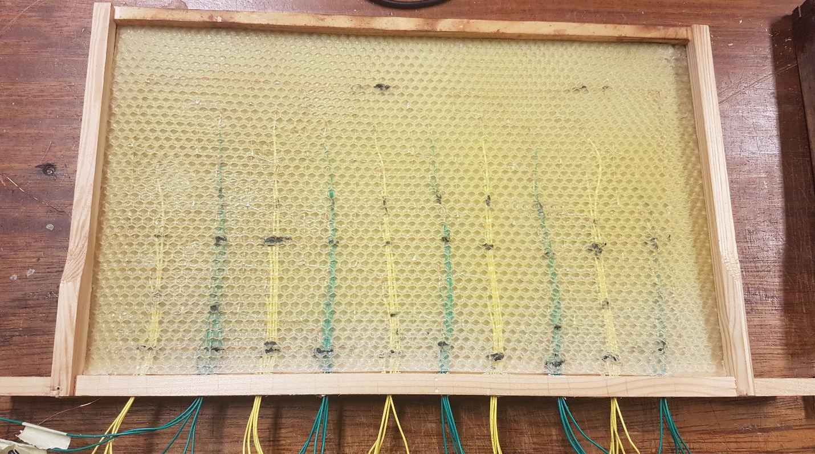
A spatially resolved temperature measurement system for a honeybee colony brood box Adam McVeigh, Michael I Newton, Costas Tsakonas and Martin Bencsik
A prototype system.
Sensors embedded between four sheets of foundation wax.
Protect electronics.
More appealing to bees.
3rd International Electronic Conference on Applied Sciences 1-15 Dc 2022
Notes:
Slide 5
On each frame we have the 48 sensors.
Initially, we designed a prototype which embedded these sensors between four sheets of foundation wax.
We expected that this would place the electronics as far away as possible from the bees and protect them.
We also thought that this would make the frames more appealing to the bees.

Slide 6
A spatially resolved temperature measurement system for a honeybee colony brood box Adam McVeigh, Michael I Newton, Costas Tsakonas and Martin Bencsik
First system of frames introduced to a colony.
Bees chewed away foundation wax.
Exposing electronics, which still collected data.
Not normal frame use.
Wax too thick.
Cells not aligned suitably.
Electronics?
3rd International Electronic Conference on Applied Sciences 1-15 Dc 2022
Notes:
Slide 6
We introduced a colony to this first system and the bees chewed away the wax.
Thereby exposing the electronics, before the colony slowly began to build new honeycomb, but this was irregular, and the frames were not used normally.
We think that the foundation wax was too thick for the bees or, maybe, the cells did not line up well enough.
At this point, we were aware that the presence of electronics may have influenced the refusal.

Slide 7
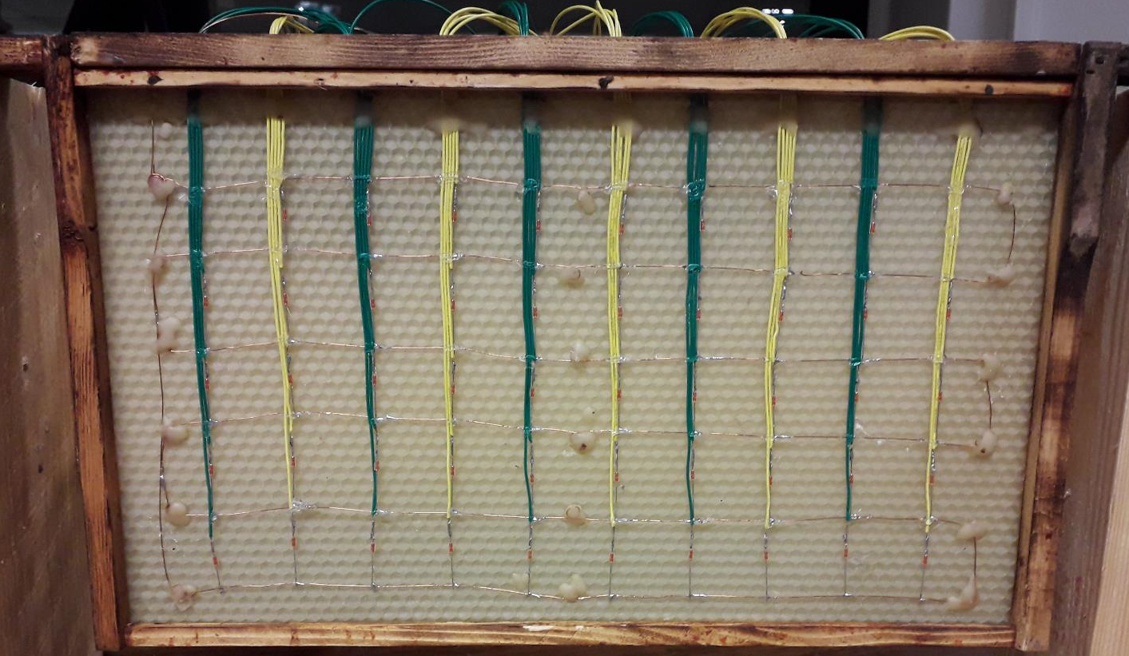
A spatially resolved temperature measurement system for a honeybee colony brood box Adam McVeigh, Michael I Newton, Costas Tsakonas and Martin Bencsik
Second version.
Sensors laid on foundation wax.
1 sheet of foundation wax.
Expected that less sheets of foundation wax would improve appeal to a colony.
3rd International Electronic Conference on Applied Sciences 1-15 Dc 2022
Notes:
Slide 7
Following our experiences with the initial prototype, we developed a second, improved, version of the spatially resolved temperature measurement system.
This time, we laid the sensor array of 48 thermistors upon a single sheet of foundation wax and secured it using small amounts of molten wax.
We expect the reduced thickness will be more appealing to the colony than the first design.

Slide 8
A spatially resolved temperature measurement system for a honeybee colony brood box Adam McVeigh, Michael I Newton, Costas Tsakonas and Martin Bencsik
The second system with a swarm.
Built normal honeycomb.
Including the side with electronics.
Cells were built over the sensors.
Used for brood rearing.
Eggs were observed.
The system is accepted by the colony and is suitable for normal use.
Electronics did not cause refusal.
3rd International Electronic Conference on Applied Sciences 1-15 Dc 2022
Notes:
Slide 8
A swarm was introduced to the second system in May 2022.
The colony quickly began to build normal honeycomb on the frames, on both sides, including the side with the exposed electronics.
The cells were built over the wires and over the sensors.
These were used for brood rearing, and we observed eggs being laid on this frame.
We now know that a colony will use such a frame with 48 sensors laid upon it.
Additionally, we now have more confidence that it was the thickness and layout of the wax in the first system which caused the refusal, and not the electronics.

Slide 9
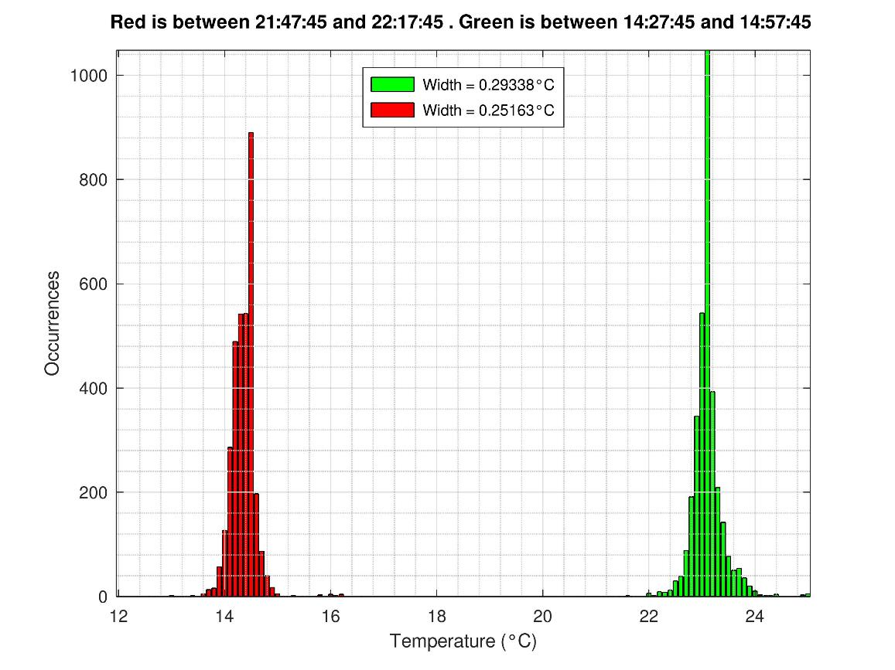
A spatially resolved temperature measurement system for a honeybee colony brood box Adam McVeigh, Michael I Newton, Costas Tsakonas and Martin Bencsik
Sensors tested before the colony introduced.
Consistent measurements.
Small error in line with quoted tolerances.
Figure displays measurements from all sensors in the afternoon (green) and evening (red).
Consistent with ambient air temperatures.
Data has been linear scaled to compensate for systematic and random errors. We assume the scaling factors remain constant.
3rd International Electronic Conference on Applied Sciences 1-15 Dc 2022
Notes:
Slide 9
Prior to introducing a colony to the second system, we tested it for several days without bees.
We found our measurements to be consistent across the hive, with some sensors displaying a small error which was in line with the manufacturer’s quoted tolerances.
The figure here shows the measurements from all sensors on 30th April at two separate times.
Once in the afternoon which are the green bars, and once in the evening which are the red bars.
These measurements are meaningful and reflect the ambient air temperatures.

Slide 10
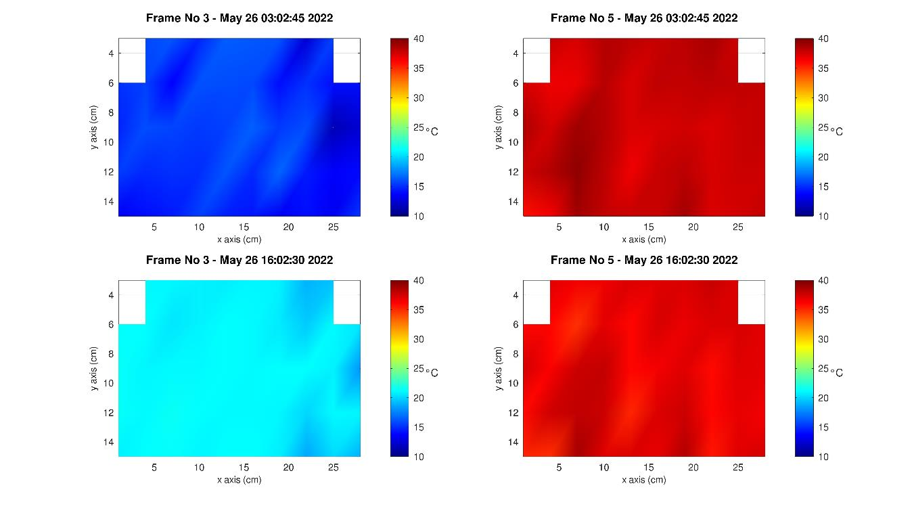
A spatially resolved temperature measurement system for a honeybee colony brood box Adam McVeigh, Michael I Newton, Costas Tsakonas and Martin Bencsik
Spatially resolved temperature measurements collected.
Figure shows temperatures on two frames.
Two time points on the same day.
Frame 5 is being used for brood rearing.
Frame 3 is not being used by the colony.
Spatial variation in temperature on both frames.
3rd International Electronic Conference on Applied Sciences 1-15 Dc 2022
Notes:
Slide 10
The system collected spatially resolved temperature measurements from all of the frames in the colony.
This figure displays the measurements on two frames on 26th May.
We have chosen these two frames to highlight the capacity of the system to measure the temperature data.
The colony had built honeycomb on frame 5 and they are using it for brood. The temperatures recorded reflect this and they are around 35°C which is a signature for brood rearing.
Frame 3 was not being used, yet, by the bees and the cooler temperatures recorded demonstrate this.
Additionally, we detected spatial variation in temperature on both frames. They have areas which are warmer and some which are cooler.
Frame 5 at 3am exhibits areas of temperatures nearer 35°C interspersed with patches nearer to 38°C.
Frame 3 at 4pm in the afternoon records temperatures around 21°C across most of the frame with a few smaller patches which are cooler and nearer to 18°C.

Slide 11
A spatially resolved temperature measurement system for a honeybee colony brood box Adam McVeigh, Michael I Newton, Costas Tsakonas and Martin Bencsik
Spatially resolved temperature measurements of a colony.
Temperature measurements using an array of thermistors on a sheet of foundation wax.
Using a single sheet of wax is important in determining acceptance.
Second system was accepted and used normally.
Minimal disruption of the foundation wax is optimum.
Recording distinctive features such as brood temperatures.
Quantify spatial temperature variation across the colony.
Data to aid understanding of colony thermal dynamics.
3rd International Electronic Conference on Applied Sciences 1-15 Dc 2022
Notes:
Slide 11
In summary, our investigation demonstrates the use of a system to take high resolution temperature measurements of a honeybee colony.
We show that it is possible to introduce an array of hundreds of sensors to collect this data.
We found that a single sheet of foundation wax, rather than multiple, is more appealing to a colony.
Our second system highlights this showing that minimal disruption to the foundation wax is optimal in encouraging the colony to accept our frames and use them normally.
The system can also measure distinctive features, such as those consistent with brood rearing.
Furthermore, we can capture the spatial variation in temperatures across the colony.
We believe that an array of thermistors, such as those we have developed, would be able to provide highly valuable temperature data which can be used to further our understanding of honeybee colony thermal dynamics and provide an insight into how the colony develops.

Slide 12
A spatially resolved temperature measurement system for a honeybee colony brood box
Adam McVeigh, Michael I Newton, Costas Tsakonas and Martin Bencsik
3rd International Electronic Conference on Applied Sciences 1-15 Dc 2022
Notes:
Slide 12
Thank you for listening to our presentation and reading our work.
We also would like to thank the conference organisers for accommodating our study.

