Slide 1
Co-axial wet-spun fibers: an innovative strategy for chronic wound healing applications
Catarina S. Miranda^{1,*}, A. F. G. Silva², S. M. M. A. Pereira-Lima², S. P. G. Costa², N. C. Homem³, H. P. Felgueiras¹
¹Centre for Textile Science and Technology (2C2T)
²Centre of Chemistry (CQ)
³Digital Transformation CoLab (DTx)
University of Minho, Portugal
*catarina.miranda@2c2t.uminho.pt

Slide 2
Antimicrobial peptides
Antimicrobial Peptides
Low MW molecules
Composed of amino acid residues
Control microbial proliferation
Modulate immune response
Alanine-Alanine-Proline-Valine
(Ala-Ala-Pro-Val or AAPV)
Inhibits human neutrophil elastase (HNE), which levels are abnormally high in the case of inflammatory processes related to CWs.
Low stability in physiological media
Incorporation within polymeric structures
Santos, F.C. et al. Amino Acids, 49 (2017).
2

Slide 3
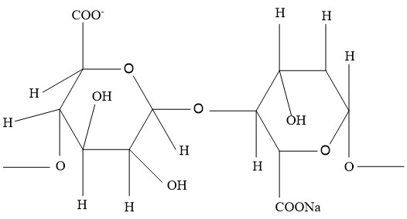
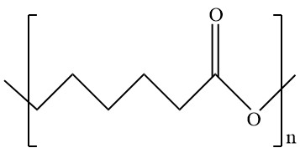
Polymers
Sodium alginate (SA)
Polycaprolactone (PCL)
Biocompatible; Biodegradable
Antiseptic properties;
Water absorbent (elevated swelling capacity);
Creates a moist environment.
Synthetic polymer;
Excellent mechanical properties;
Slow degradation rate.
Plotczyk, M. et al. Elsevier. 1 (2019)
Eskandarinia, A. et al. Scientific Reports. (2020)
3

Slide 4
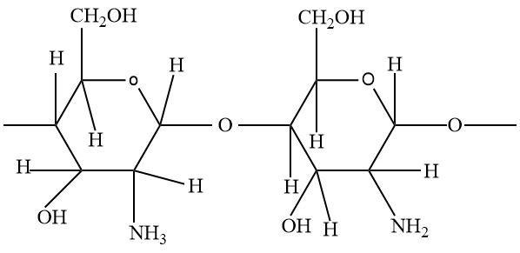
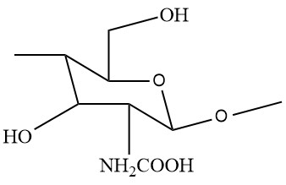
Polymers
Chitosan (CS)
N-carboxymethyl chitosan
(NCMC)
Chemically modified
Biocompatible; Biodegradable
Strong tissue adhesive properties;
Accelerates tissue repair;
Acts as a hemostatic agent.
Non-toxic;
Soluble at neutral to basic pH’s;
Antimicrobial activity.
Plotczyk, M. et al. Elsevier. 1 (2019)
Song, Q.; Zhang, Z.; Gao, J.; Ding, C. J. Appl. Polym. Sci. 2011, 119, 3282–3285
4

Slide 5
Wet-spinning
Technique based on a non-solvent-induced phase inversion process, in which a polymeric solution is extruded into a coagulation bath composed of a poor solvent or a non-solvent, giving rise to a continuous polymeric fiber, with a diameter of tens to hundreds of micrometers.
Miranda, C. et al. Pharmaceutics, 2022, 14. 164
5

Slide 6
Co-axial wet-spinning
Co-axial spinneret
Sheath solution
Core-sheath fibers
Sheath
Core solution
Core
Co-axial fibers
Hollow fibers
Two polymer solutions are injected together into a co-axial spinneret and co-extruded towards a coagulation bath, generating a core-shell structure. In case of hollow fibers, air or coagulation bath is introduced through the innermost port.
Sheath
Hollow interior
Mirabedini, A. (2017). A thesis submitted in the fulfilment of the. 1–235.
Gao, L., Zhou, Y., Peng, J., Xu, C., Xu, Q., Xing, M., & Chang, J. (2019). NPG Asia Materials, 11(1), 66.
McKeen, L. W. (2012). Permeability Properties of Plastics and Elastomers, 59–75.
6

Slide 7
Goal
Engineer AAPV-loaded microfibers doped with NCMC via wet-spinning for human neutrophil elastase control and Staphylococcus aureus inhibition.
In chronic wounds, neutrophil elastase is 10-40% more abundant than in acute wounds.
According to the World Health Organization, S. aureus is one of the most prevalent bacteria in chronic wounds.
Felgueiras, H. et al. Colloids Surf B Biointerfaces 2017
https://www.who.int/
7

Slide 8
Co-axial wet-spun fibers
Side view
Cross-section view
SA 2% w/v +
NCMC 2xMBC
0.15 mL/min
Sheath
Core
PCL 10% w/v + AAPV IC
0.10 mL/min
Goal of Each Microfiber Component:
AAPV: regulate HNE enzymatic levels
SA: create and maintain a moist environment
PCL: maintain fibers’ structural integrity
NCMC: antimicrobial activity
Produced fibers:
SA hollow (core: coagulation bath; shell: SA);
SA-NCMC hollow (core: coagulation bath; shell: SA combined
with NCMC);
PCL (core: PCL; shell: coagulation bath);
PCL-AAPV (core: PCL combined with AAPV; shell: coagulation
bath);
SA-PCL (core: PCL; shell: SA);
SA-PCL-AAPV (core: PCL combined with AAPV; shell: SA);
SA-NCMC-PCL (core: PCL; shell: SA combined with NCMC);
SA-NCMC-PCL-AAPV (core: PCL combined with AAPV; shell:
SA combined with NCMC)
Coagulation bath: 2% w/v CaCl₂
MBC – Minimum Bactericidal Concentration
IC - Concentration providing maximum % of inhibition of HNE activity
8

Slide 9
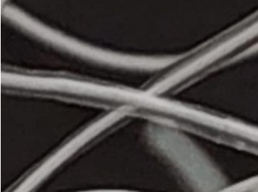
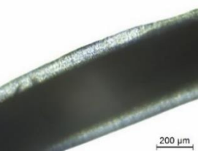
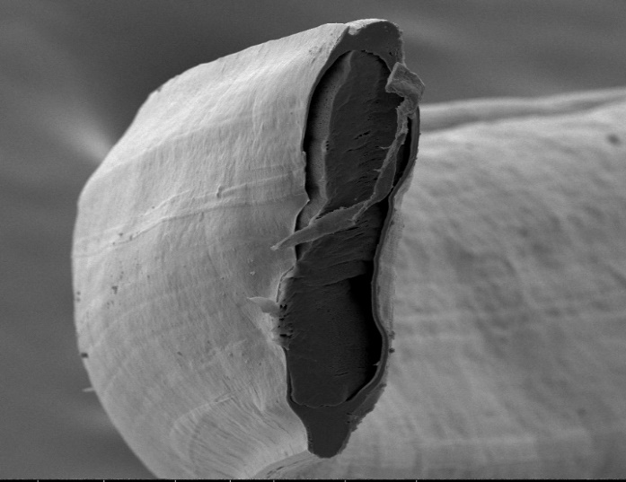
Fibers morphology
Macroscopic view
Microscopic view
SEM observation
SEM – Scanning Electron Microscopy
9

Slide 10
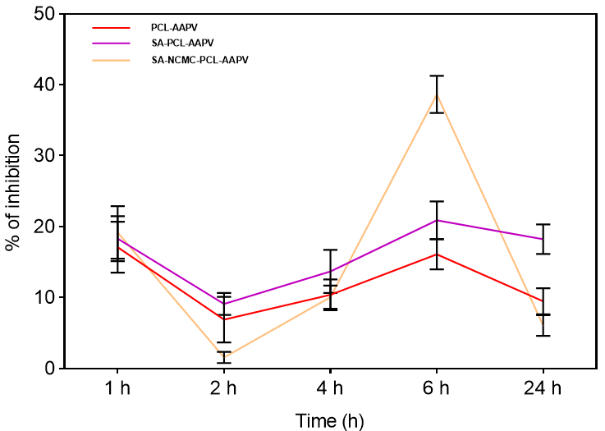
Inhibition of HNE activity
Evaluate AAPV’s action towards HNE’s enzymatic levels
Soybean tripsin inhibitor solution
(to stop the reaction)
Testing Substrate:
- Tris-HCl-buffer
- N-MeO-Suc-Ala-Ala-Pro-Val-p-NA
AAPV
HNE
Spectroscopy readings (405 nm)
45 mU/mL, [HNE] in chronic wounds
t = 1 h: initial burst release
SA-NCMC-PCL-AAPV fibers presented the highest HNE inhibition at the 6 h mark.
Santos, F.C., et al. Amino Acids 2017, 49, 1077–108; Castro, V.I.B., et al. Tetrahedron 2016, 72, 1024–1030.
10

Slide 11
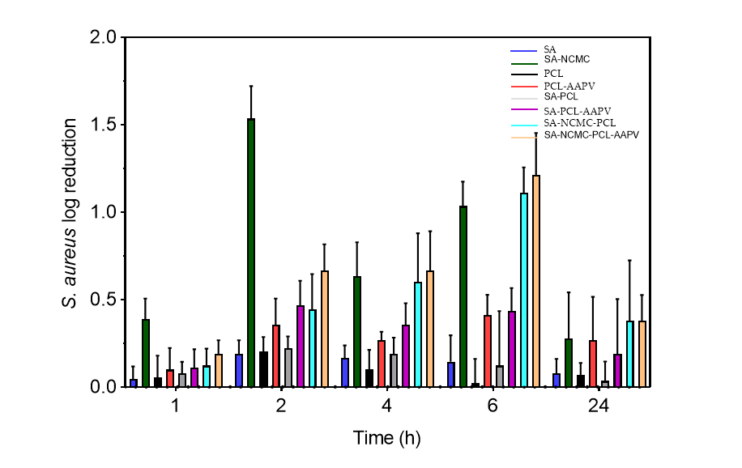
Antimicrobial activity
Testing Parameters:
1 × 10⁵ CFUs/mL S. aureus suspension in Mueller Hinton Broth
Samples of 10 mg immersed in 1 mL of bacteria suspension and incubated at 37 ºC and 120 rpm, for 1, 2, 4, 6 and 24 h;
At each time point, bacteria suspensions were serially diluted in PBS and incubated at 37 ºC for 24 h;
Grown colonies were counted, and results were expressed in log reduction.
NCMC-loaded fibers inhibited the most bacteria growth.
S. aureus activity was reduced by 90-99% at the 6 h mark.
Homem, N.C. et al. Int. J. Mol. Sci. 2021
11

Slide 12
Conclusions
The potential of the engineered co-axial fibers to serve as controlled release platforms for AAPV was demonstrated, along its inhibitory effect against HNE, particularly after 6 h of incubation.
The NCMC antibacterial activity against S. aureus was also established.
Data confirmed the potential of this system to function as a multi-action delivery platform, suitable for prospective wound healing applications.
12

Slide 13
Acknowledgements
2C2T and CQ Teams
Thank you for your attention.
This work is financed by FEDER funds through COMPETE and by national funds through FCT via the projects POCI-01-0145-FEDER-028074 (PEPTEX) and UID/CTM/00264/2021. C.S.M. acknowledges FCT for the PhD grant with reference 2020.08547.BD.
13

