Slide 1
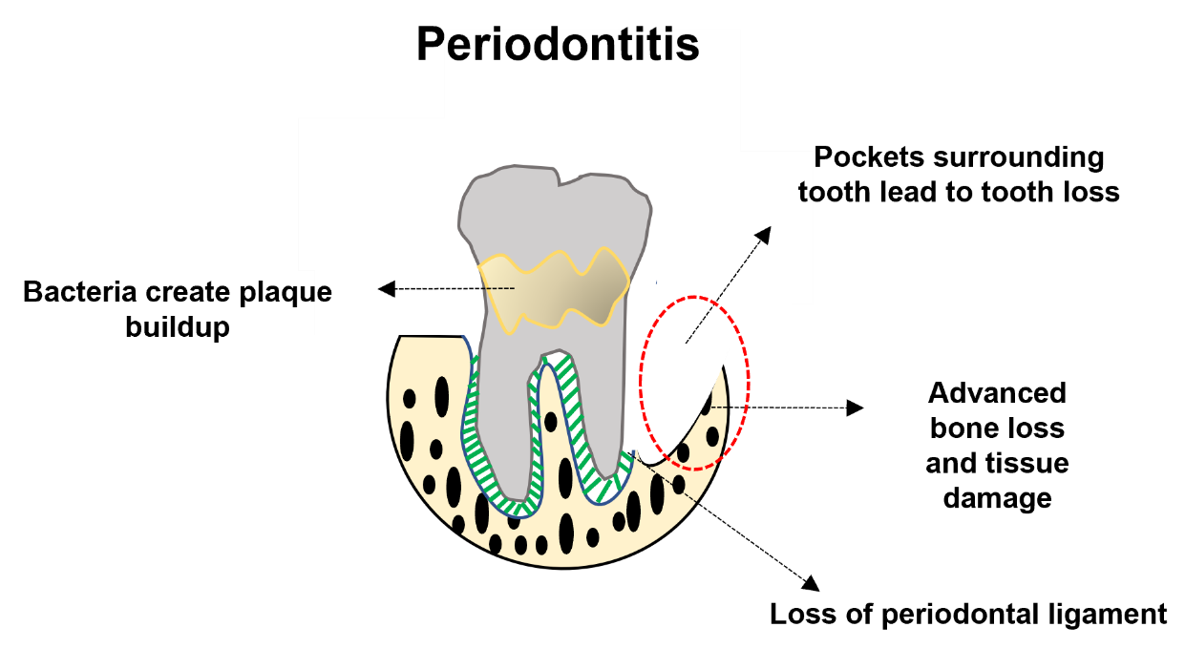
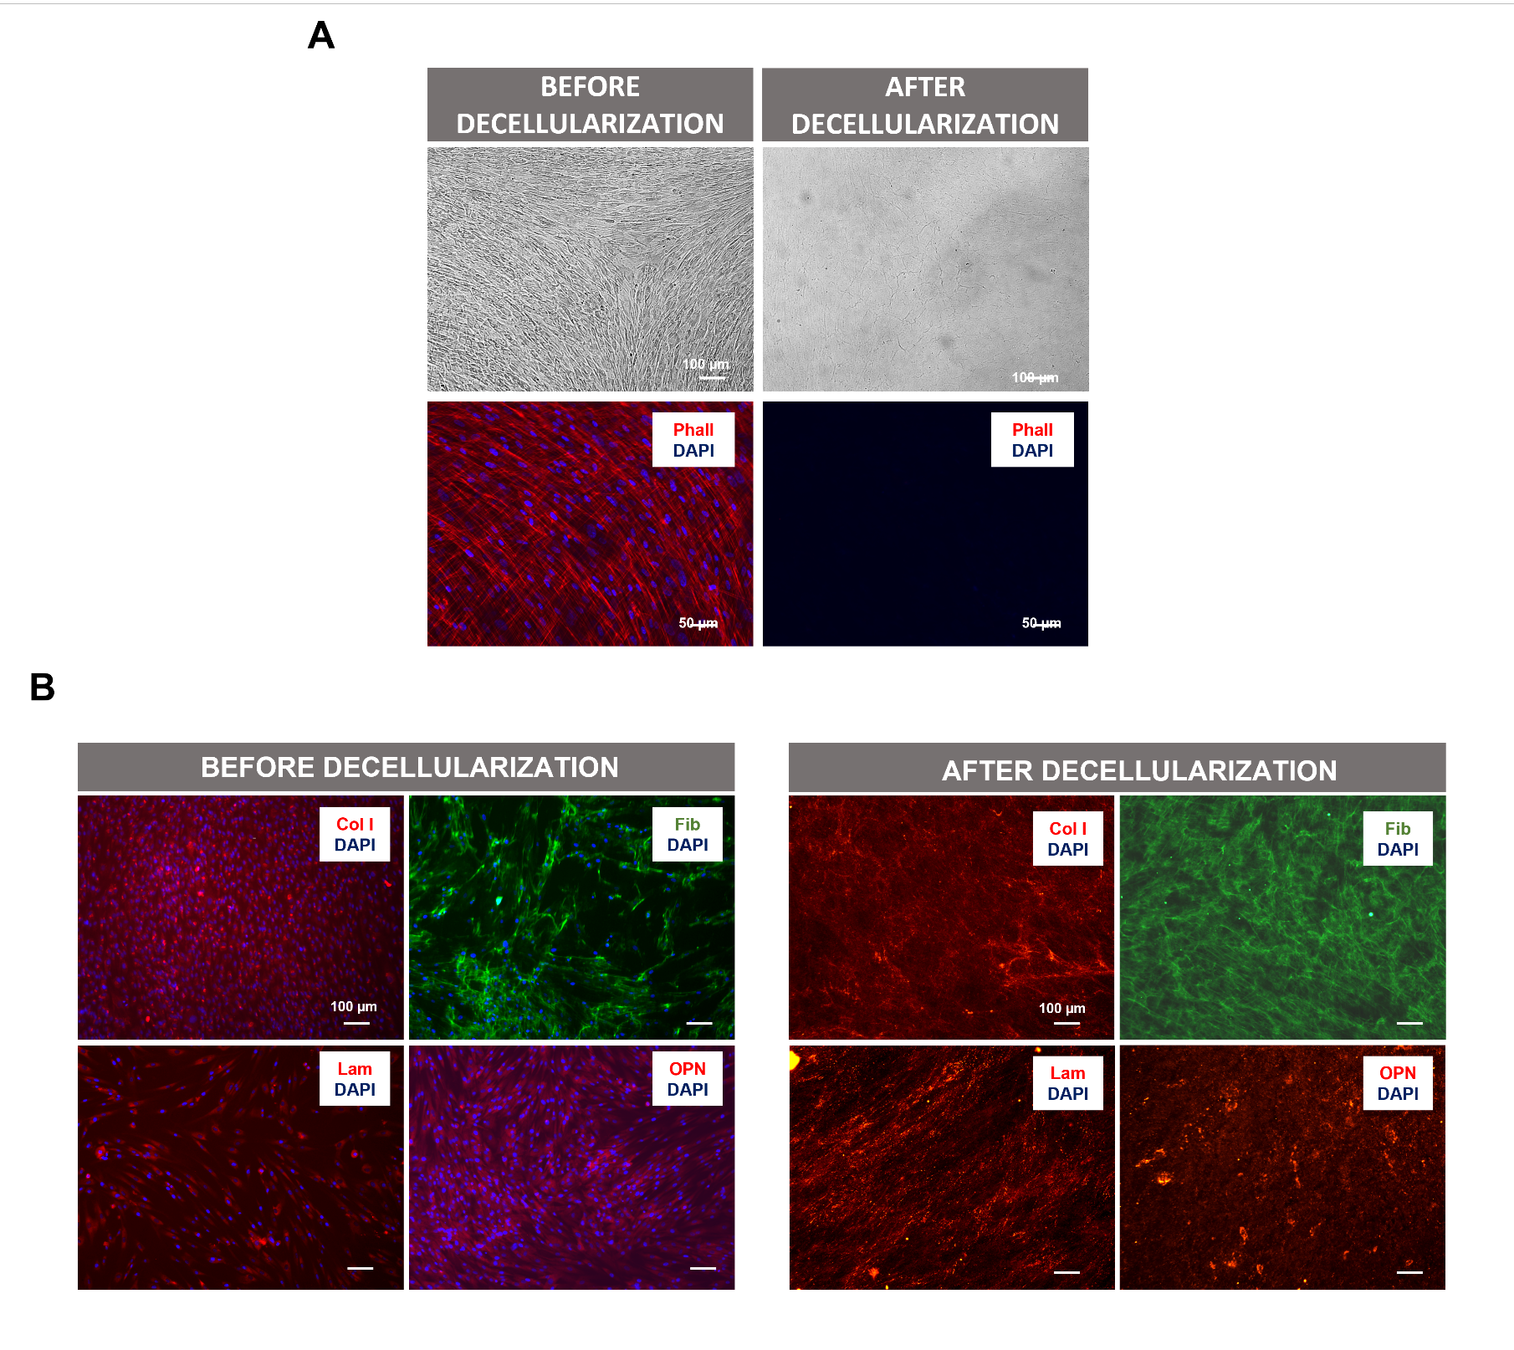
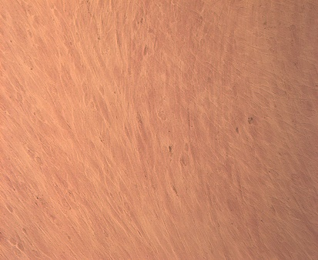
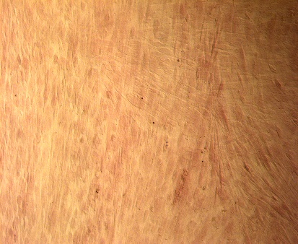
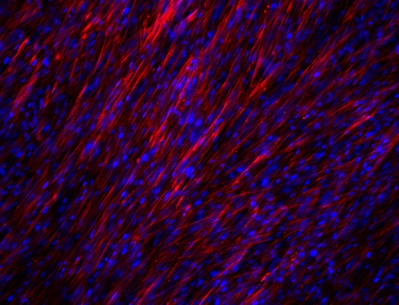
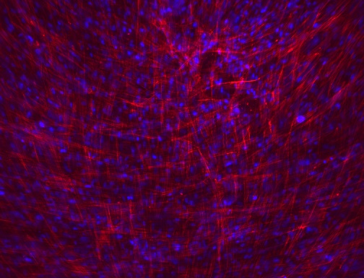
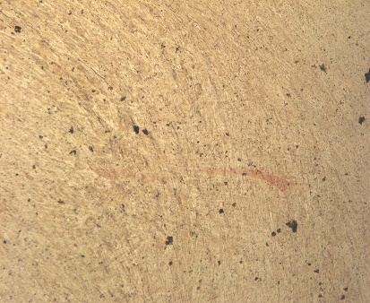
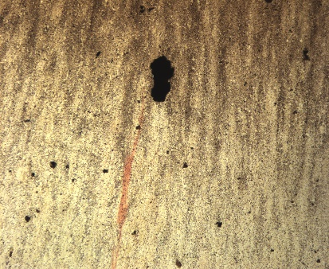
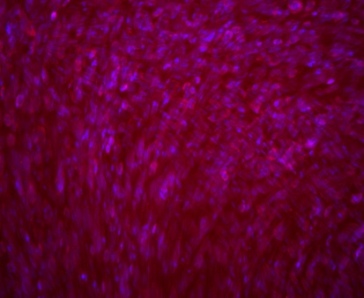
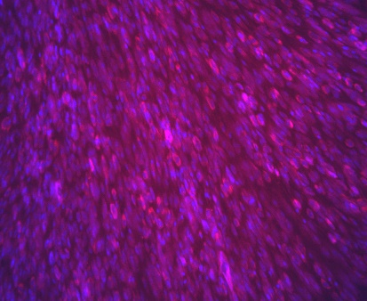
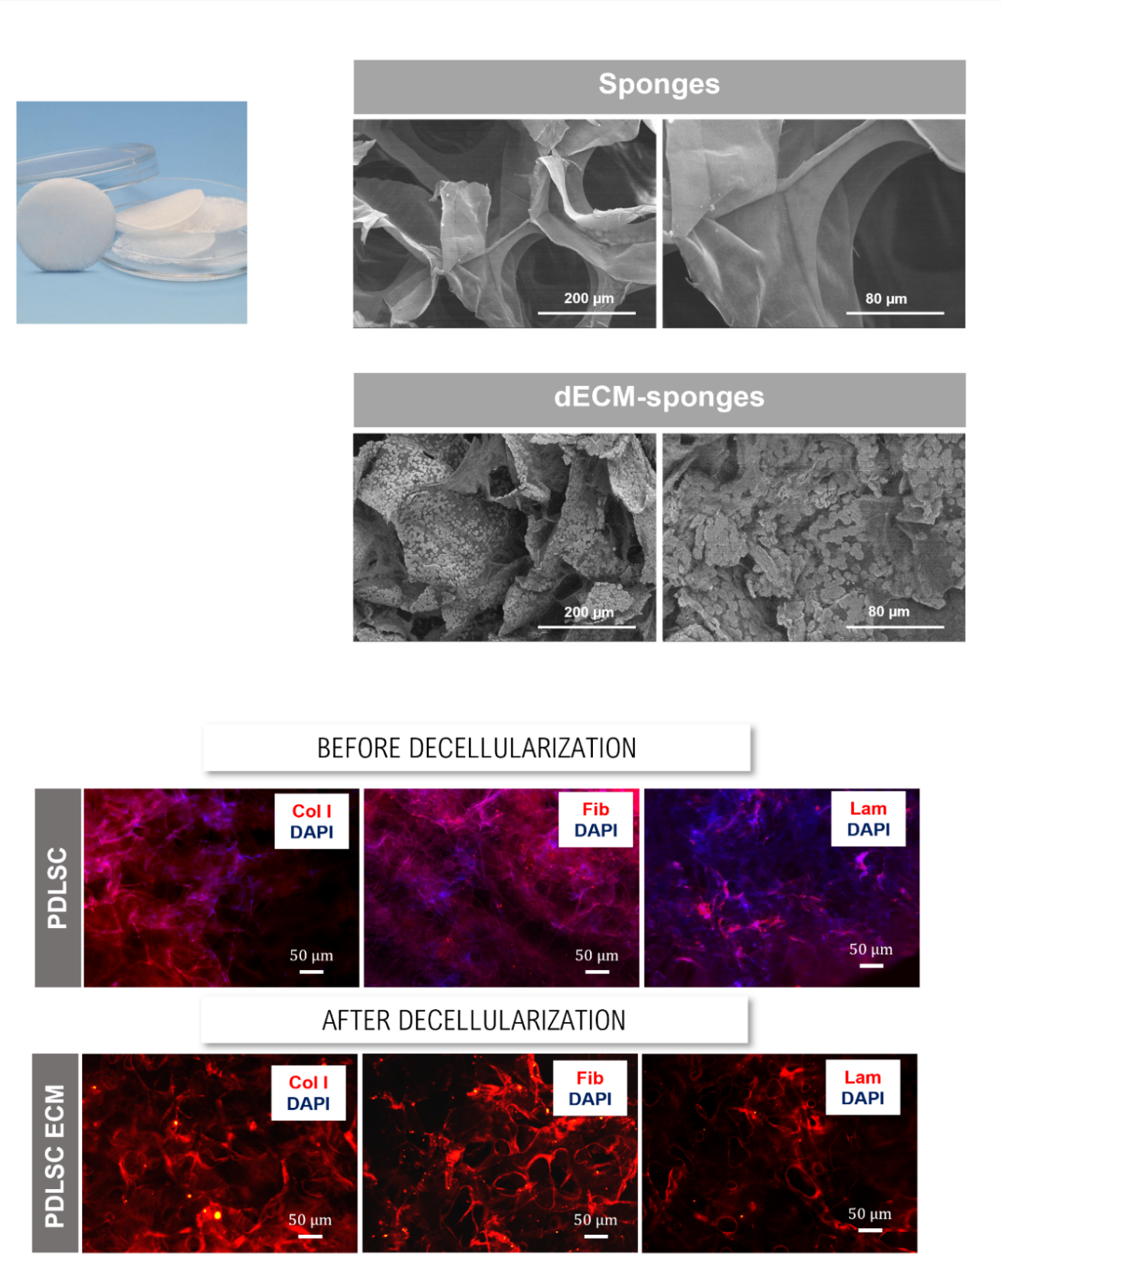
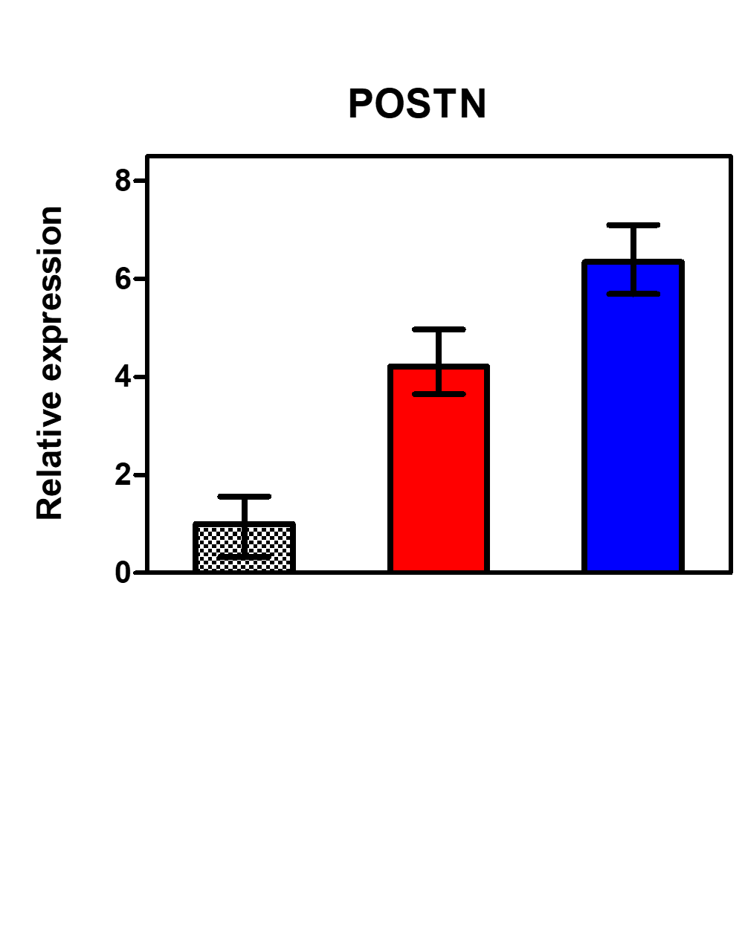
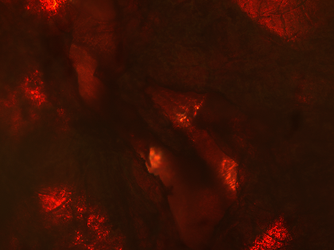
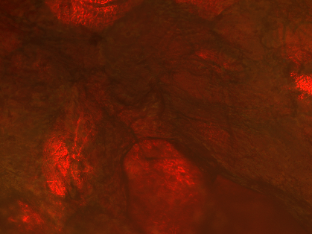
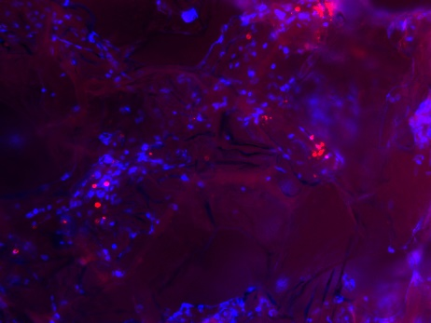
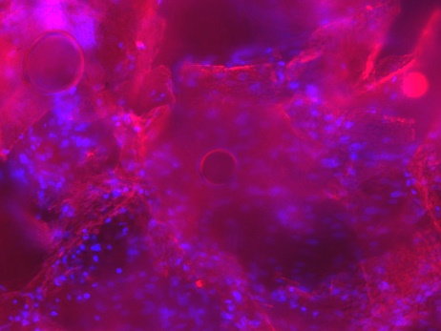
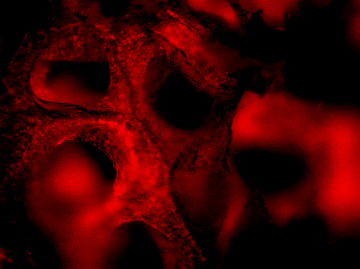
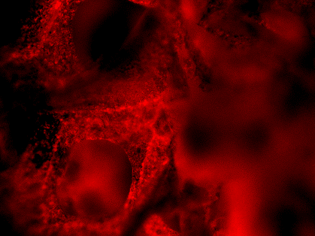
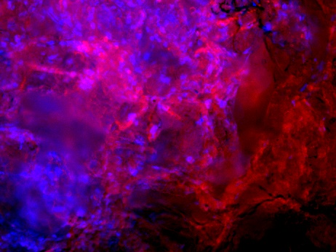
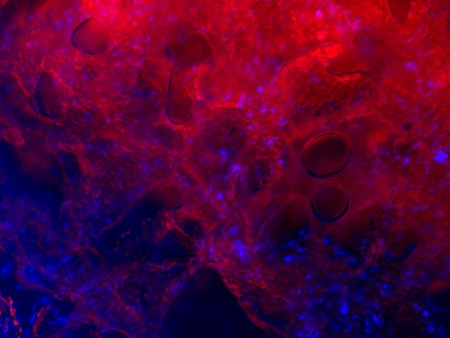
Exploiting the power of decellularized ECM for periodontal tissue regeneration
Marta S. Carvalho^{1,2}
1. Department of Bioengineering and iBB-Institute for Bioengineering and Biosciences, Instituto Superior Técnico, Universidade de Lisboa, Av. Rovisco Pais, 1049-001 Lisbon, Portugal
2. Associate Laboratory i4HB-Institute for Health and Bioeconomy, Instituto Superior Técnico, Universidade de Lisboa, Av. Rovisco Pais, 1049-001 Lisbon, Portugal
Motivation
Background
Periodontitis is a prevalent disease worldwide that causes the destruction of periodontal tissues (periodontal ligament, cementum and alveolar bone) and ultimately can lead to tooth loss.
Most of the treatments, such as the use of membranes and bone grafts, lack bioactive signals that accelerate the process of tissue regeneration, leading to tooth loss.
In this work, we exploit alternative strategies to repair all periodontal tissues by using decellularized extracellular matrix (ECM) from periodontal ligament stem cells (PDLSCs). We hypothesized that the PDLSC ECM incorporated into collagen sponges would enhance the biofunctionality of the scaffold and periodontal regeneration.
Cell-derived ECM creates a biomimetic microenvironment that provides physical, chemical and mechanical cues for cells and supports cell adhesion, proliferation, migration and differentiation, mimicking the in vivo cell niche.
100 µm
Results and Discussion
50 µm
50 µm
Effect of decellularized ECM derived from PDLSCs
Cell-derived ECM characterization
Cell proliferation
Mineralization
B
A
B
ECM
*
DAPI/Phalloidin
No ECM
ECM
A
Alizarin Red
No ECM
*
100 µm
$$50 μm$$
$$50 μm$$
**
ALP/von Kossa
$$50 μm$$
$$50 μm$$
100 µm
Figure 2: Effects of cell-derived ECM (PDLSC ECM) on PDLSC proliferation. (A) Cell numbers after 7 days of expansion. (B) PDLSC morphology after 7 days of expansion on PDLSC ECM (control-No ECM). Values are expressed as mean ± SD (n=3); *p < 0.05. Scale bar, 100 μm.
Xylenol Orange
$$50 μm$$
$$50 μm$$
Gene expression
$$50 μm$$
$$50 μm$$
*
*
Figure 4: Osteogenic differentiation of PDLSCs cultured on decellularized ECM derived from PDLSCs. (A) Calcium deposition quantification of PDLSCs cultured on PDLSC ECM and without ECM after 21 days under osteogenic differentiation conditions (OSTEO) (control-DMEM). (B) Alizarin Red, ALP/von Kossa and Xylenol Orange stainings of PDLSCs differentiated on PDLSC ECM after 21 days. Alizarin Red staining confirmed the presence of calcium deposits (reddish areas). ALP/von Kossa staining demonstrated ALP activity of PDLSCs cultured on PDLSC ECM (reddish areas) and the presence of mineralized deposits (darker areas). Xylenol Orange fluorescent staining confirmed the presence of calcium deposits. DAPI was used to counterstain the cell nuclei in blue. Values are expressed as mean ± SD (n=3); *p < 0.05, **p < 0.01. Scale bar, 100 μm.
Figure 1: Characterization of decellularized ECM derived from PDLSCs. (A) Bright field and DAPI/Phalloidin images of PDLSCs before and after decellularization treatment. (B) Immunofluorescent staining images of ECM proteins collagen I (Col I), fibronectin (Fib), laminin (Lam) and osteopontin (OPN) before and after decellularization. DAPI was used to confirm the complete decellularization Scale bar, 100 μm.
Figure 3: Effects of PDLSC ECM on OPN, Runx2 and CMP-1 gene expression by PDLSCs. Results are normalized to the endogenous control GAPDH and presented as fold change expression relative to PDLSCs at day 0. Values are expressed as mean ± SD (n=3); *p < 0.05.
ECM-derived sponges for periodontal regeneration
Scaffold characterization
Cell proliferation
Calcium quantification
Gene expression
A
*
*
Bone
**
*
*
B
Figure 6: Effects of ECM sponges on PDLSC proliferation. Values are expressed as mean ± SD (n=3); *p < 0.05, **p < 0.01.
Figure 7: Calcium deposition quantification of PDLSCs cultured on ECM sponges after 21 days under osteogenic differentiation conditions. Values are expressed as mean ± SD (n=3); *p < 0.05.
**
*
Osteogenic/Periodontal stainings
Figure 8: Osteogenic/Periodontal differentiation of PDLSCs cultured on ECM sponges. (A) Alizarin Red and Xylenol Orange stainings confirmed the presence of calcium deposits (reddish areas). (B) Immunofluorescent staining of cementum and bone ECM proteins (CMP-1 and OPN) confirmed the production of important periodontal ECM proteins by PDLSCs cultured on ECM sponges. DAPI was used to counterstain the cell nuclei in blue. Scale bar, 50 μm.
A
No ECM
ECM
B
No ECM
CMP1
ECM
CMP1
Cementum
Periodontal ligament
Alizarin Red
Cementum
$$50 μm$$
Figure 9: Effects of ECM sponges on OPN, CMP-1 and POSTN gene expression by PDLSCs. PDLSCs cultured on ECM sponges upregulated the gene expression levels of bone (OPN)-, cementum (CMP-1)- and periodontal ligament (POSTN)-related genes. Results are normalized to the endogenous control GAPDH and presented as fold change expression relative to PDLSCs at day 0. Values are expressed as mean ± SD (n=3); *p < 0.05,**p < 0.01.
Figure 5: Decellularized ECM (dECM) – sponges for periodontal treatment. (A) SEM micrographs of collagen sponges enhanced with PDLSC ECM. (B) Immunofluorescent staining of collagen I, fibronectin and laminin produced by PDLSCs cultured on sponges before and after decellularization treatment. DAPI was used to confirm the complete decellularization. Scale bar, 50 μm.
Xylenol Orange
$$50 μm$$
Bone
OPN
OPN
Materials and Methods
Conclusions
PDLSC ECM production and fabrication of dECM-sponges
dECM-sponges have the potential to be used as novel “off-the-shelf” biomaterials, providing a biomimetic microenvironment that may contribute to improve health care of patients suffering with periodontal diseases.
PDLSC
ECM deposition
Decellularization
PDLSC seeding
PDLSC ECM
Periodontal TE sponge assessment
Decellularization
PDLSC seeding
Cell proliferation
Calcium production
Periodontal stainings
qRT-PCR analysis
Better mimicry of the in vivo periodontal ECM composition and structure
Collagen sponge
dECM- sponge
PDLSC ECM
Improved PDLSC proliferation
21 days of osteogenic differentiation
Enhanced periodontal performance
Acknowledgments: The authors acknowledge FCT- Fundação para a Ciência e Tecnologia for funding through iBB (UIDB/04565/2020 and UIDP/04565/2020), Laboratório Associado i4HB (LA/P/0140/2020) and DentalBioMatrix (PTDC/BTMMAT/3538/2020).

