Slide 1



3rd International Electronic Conference on Applied Sciences
1/13
Preparation of alginate hydrogels with carbonated water for wound dressings application
○Ryota Teshima*¹, Shigehito Osawa^{2,3}, Miki Yoshikawa⁴, Hidenori Otsuka^{1,2,3}, Yayoi Kawano*⁴, Takehisa Hanawa*⁴
¹ Department of Chemistry, Graduate School of Science, Tokyo University of Science, Japan.
² Department of Applied Chemistry, Faculty of Science, Tokyo University of Science, Japan.
³ Water Frontier Science and Technology Research Center, Research Institute for Science and
Technology, Tokyo University of Science, Japan.
⁴ Department of Pharmacy, Faculty of Pharmaceutical Sciences, Tokyo University of Science, Japan.
*Corresponding Authors: Ryota Teshima (1322595@ed.tus.ac.jp), Yayoi Kawano, Takehisa Hanawa

Slide 2
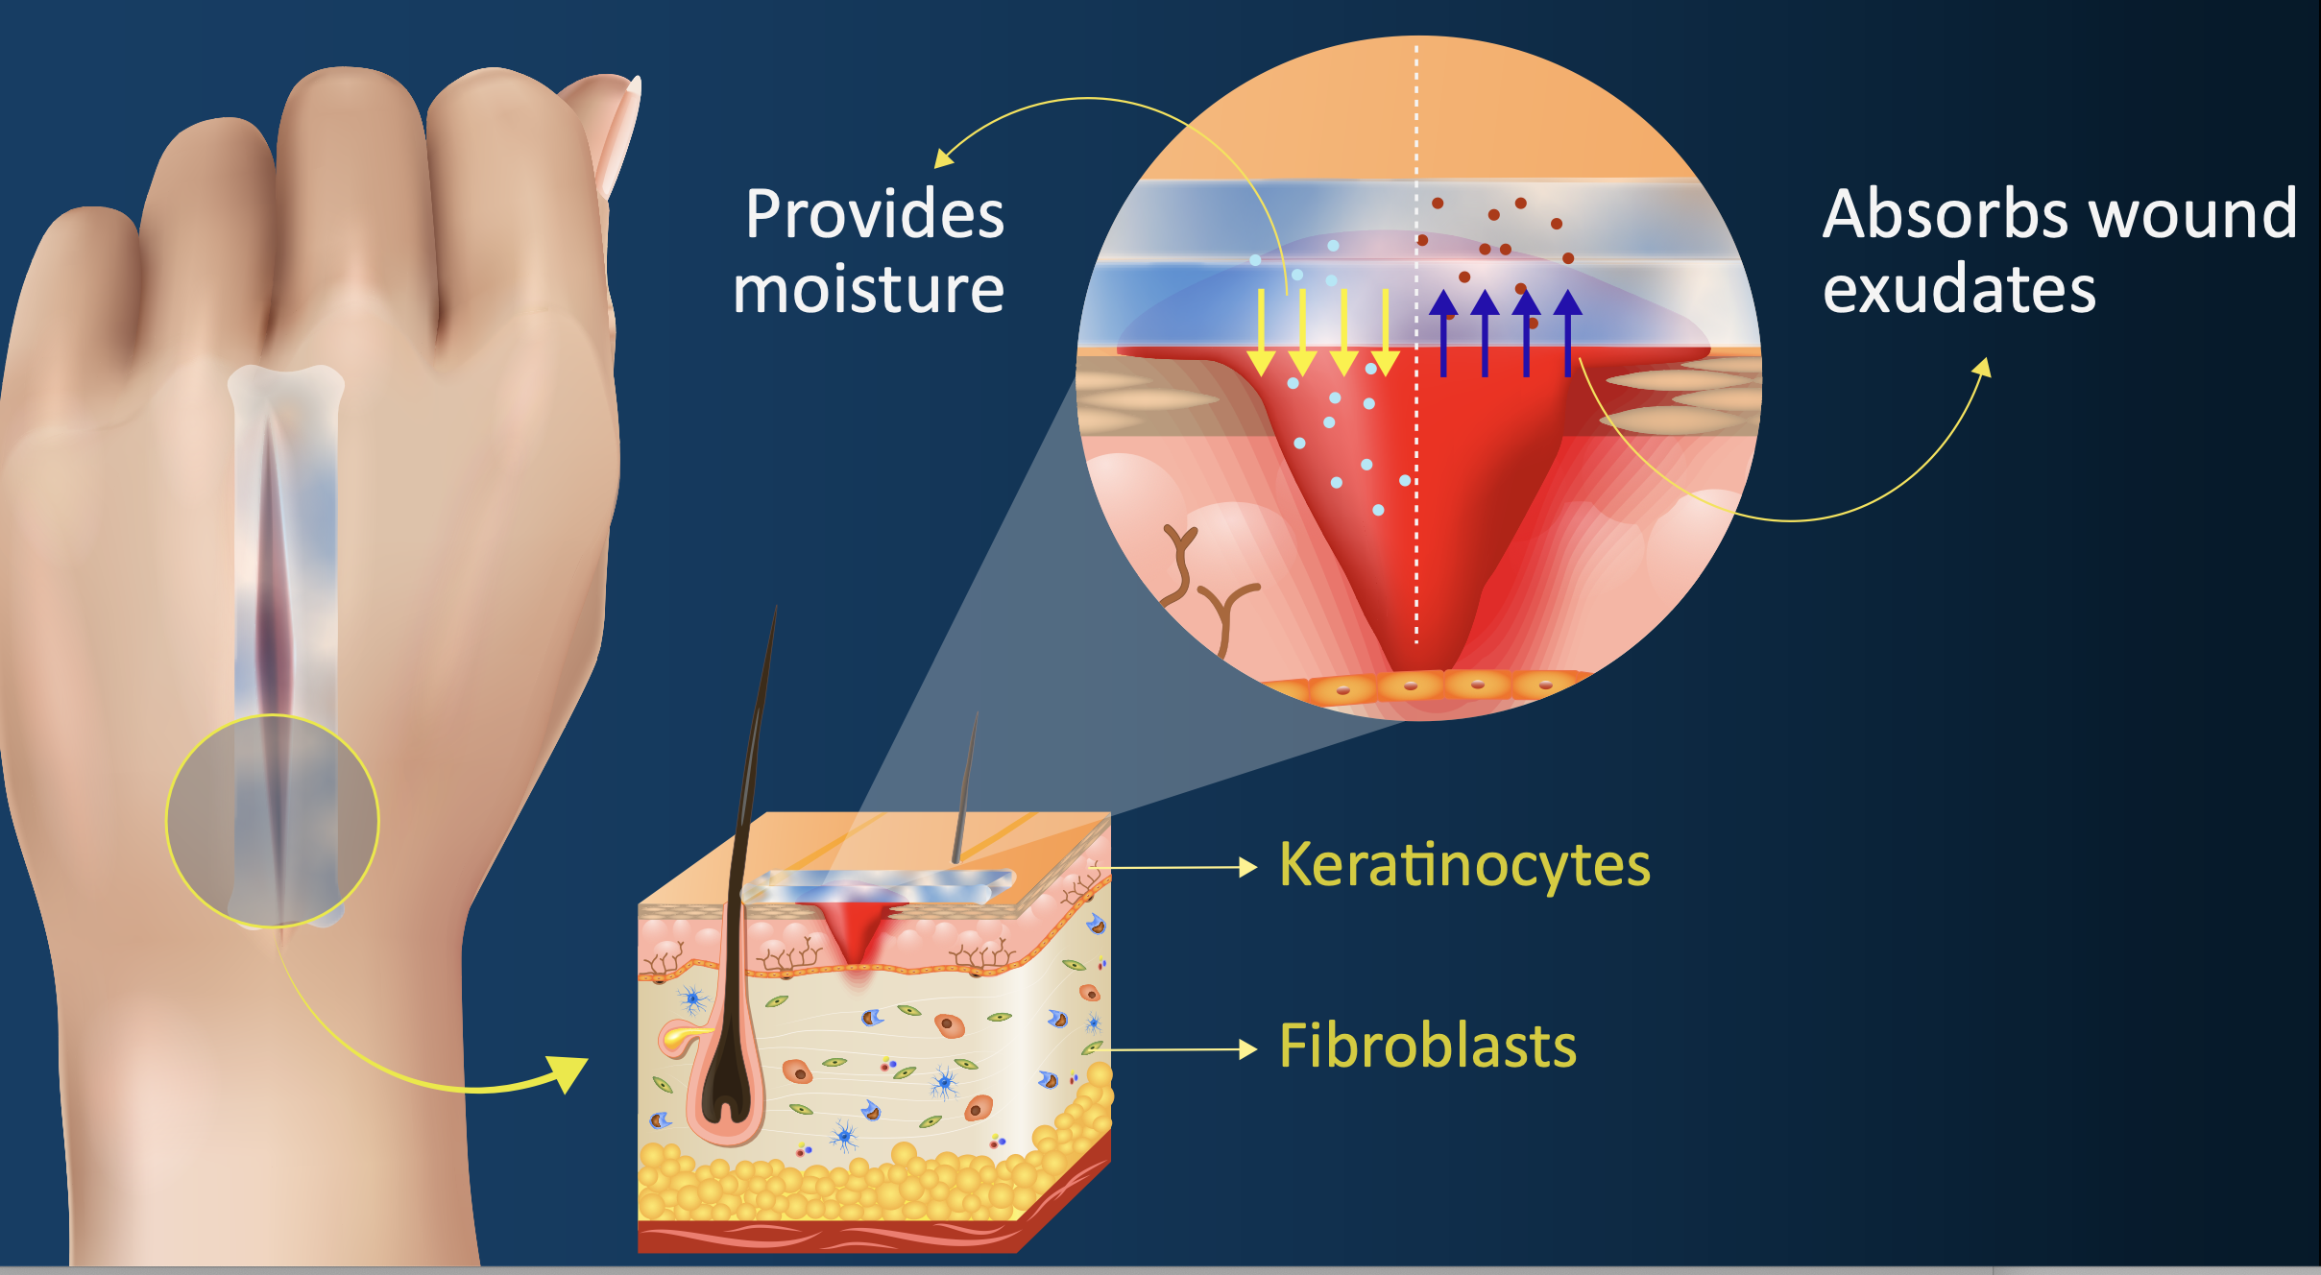
Introduction
2/13
Wound healing with hydrogels
The skin is the largest organ in our body and very vulnerable to external damage.
Depending on the type of the wound site, wound healing can last several years.
Wound healing is promoted by keeping the moist environment of wound site¹.
Hydrogels have a three-dimensional polymer network structure that contains numerous water molecules.
Hydrogel has attracted attention as a wound dressing^{2,3}.
1. K. Nuutila et al. Adv in Wound Care, 2021. 10. 685-698.
2. Z. Xu et al. Adv. Healthcare Mater. 2020. 9. 1901502.
3. Y. Liang et al. ACS Nano. 2021. 15.12687-127222.
Image citation: https://www.tus.ac.jp/en/mediarelations/archive/20200826_0087.html
Hydrogel provides moist environment for the wound site
and can promote wound healing.

Slide 3
Introduction
3/13
Alginate
Alginate is an anionic polysaccharide extracted from brown algae.
Alginate has high biocompatibility and reacts with Ca²⁺ to form hydrogels.
Alginate hydrogels are widely applied as biomaterials⁴.
Preparation method of alginate hydrogel⁵
Acid Solution
In these methods…
Residual acidic agent
in the hydrogel
CaCO₃ + 2H⁺ → Ca²⁺ + H₂O + CO₂
Alginate + Ca²⁺→ Hydrogel formation
Acidification
of the hydrogel
Gelation
“Hydrogel”
Alginate/CaCO₃ solution
4. C. J. Maxwell et al. J Biomed Mater Res Part A. 2022. 110. 1621-1635.
5. M.C. Straccia et al. Mar. Drugs. 2015. 13. 2890-2908.
The low pH of hydrogel can inhibit cell proliferation
and limit the applicability for wound dressings.

Slide 4
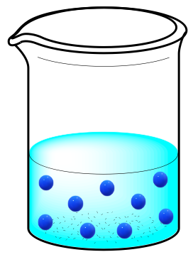

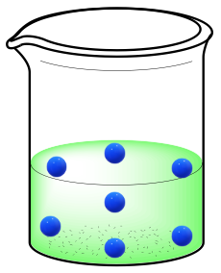
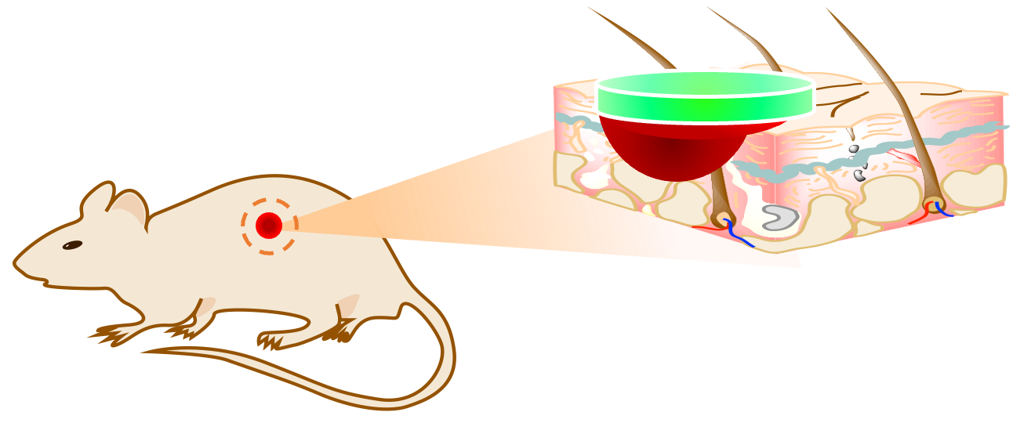
Purpose of this study
4/13
Carbonated water
Alginate hydrogels
without acidification
Gelation
Volatilization of CO₂
from hydrogels
Alginate/ CaCO₃
mixed solution
Hydrogels
In vivo wound healing
CO₂ in carbonated water induces gelation by dissolving CaCO_{3.} with temporary pH decrease and volatilizes from the hydrogel⁶.
→This methods accelerate gelation without acidification of final hydrogel.
6. R. Teshima et al. Polym Adv Technol. 2020. 31. 3032-3038.
In this study, the physicochemical properties and wound-healing effects of hydrogels were evaluated.

Slide 5
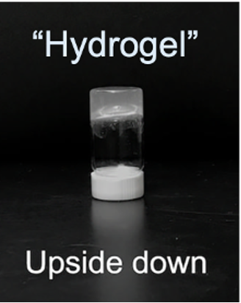
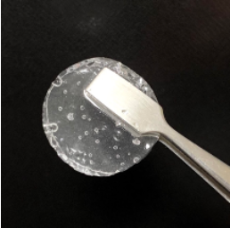
Results and Discussion
5/13
Hydrogel preparation
Gelation time
Gel volume: 5 mL, Temperature: 23-25℃, Values are expressed as the mean±SD; n=3 (Error bars were smaller than the plot size).
Carbonated water 10 mL
(pH=3.81±0.08, n=19)
Tip width = 6 mm
Gelation
2.0 (w/v%) Alginate /
0.15-0.30(w/v%) CaCO₃
mixed solution 20 mL
Prepared hydrogel
The prepared gel was transparent
and could be handled with tweezers.
The gelation time can be controlled with CaCO₃ concentration.
The mixed solution transited to a hydrogel within 4 min.

Slide 6
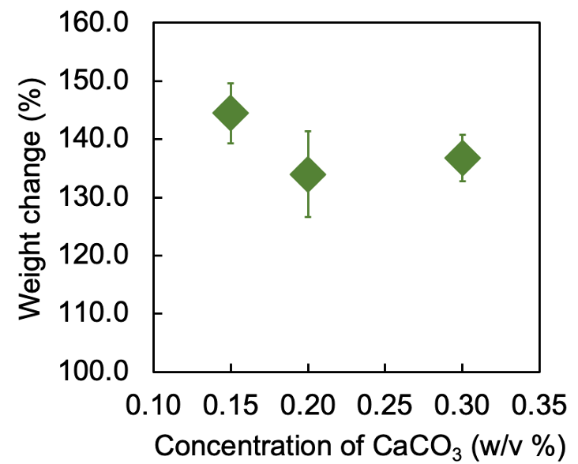


Results and Discussion
6/13
Water absorption test
Water contents
Hydrogel disk: φ17.5 mm×3.5 mm, Temperature: 23-25℃, Values are expressed as the mean±SD;n=3.
Hydrogel disk: φ17.5 mm×3.5 mm, Values are expressed as the mean±SD; n=3.
$$\begin{aligned}&Weight change \left(\%\right)=\frac{W_{s}}{W_{p} }×100\#\end{aligned}$$
$$\begin{aligned}&Water content \left(\%\right)=\frac{W_{w}−W_{d}}{W_{w}}×100\#\end{aligned}$$
W_{p}= the weight of prepared gel, W_{s}= the weight of the swollen gel
W_{w}= the weight of prepared gel, W_{d}= the weight of dry gel.
Hydrogel disk
CaCO₃ conc.(w/v%) | Water content(%)
0.15 | 98.6±0.2
0.20 | 98.7±0.1
0.30 | 98.5±0.1
24 h
immersion
×1 PBS
30 mL
All hydrogels had high water content (~99%).
All hydrogels absorbed ×1 PBS solution.
The hydrogel provides an adequate moist environment
to the wound site and can maintain exudate.

Slide 7
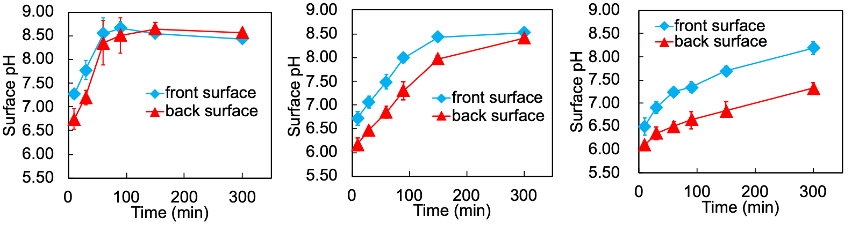
Results and Discussion
7/13
Surfaces pH measurements of hydrogels
Hydrogel disk: φ17.5 mm×3.5 mm, CaCO₃ concentration: 0.20 (w/v%), Temperature: 23-25℃, Values are expressed as the mean±SD; n=3-6.
The surfaces pH was measured
by flat electrode over time.
Gel thickness= 1.23±0.38 mm, 3.46±0.32 mm, 5.89±0.29 mm
Thickness = 1.23±0.38 mm
Thickness = 3.46±0.32 mm
Thickness = 5.89±0.29 mm
Convergent pH =~8.5
Convergent pH =~8.5
No convergence
CO₂ volatilizes through the front surface of hydrogels and
final pH is suitable for fibroblast and epidermal cell growth.

Slide 8
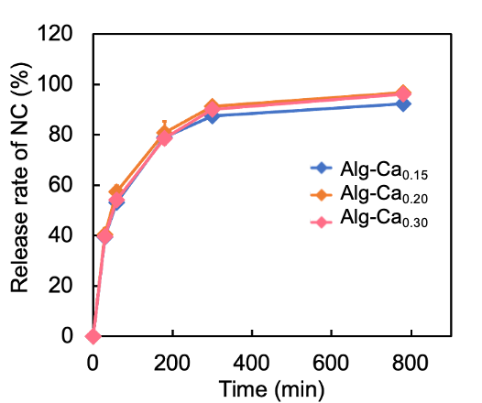
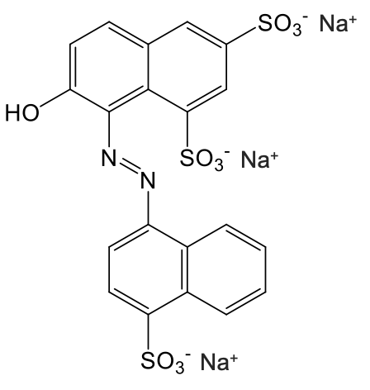
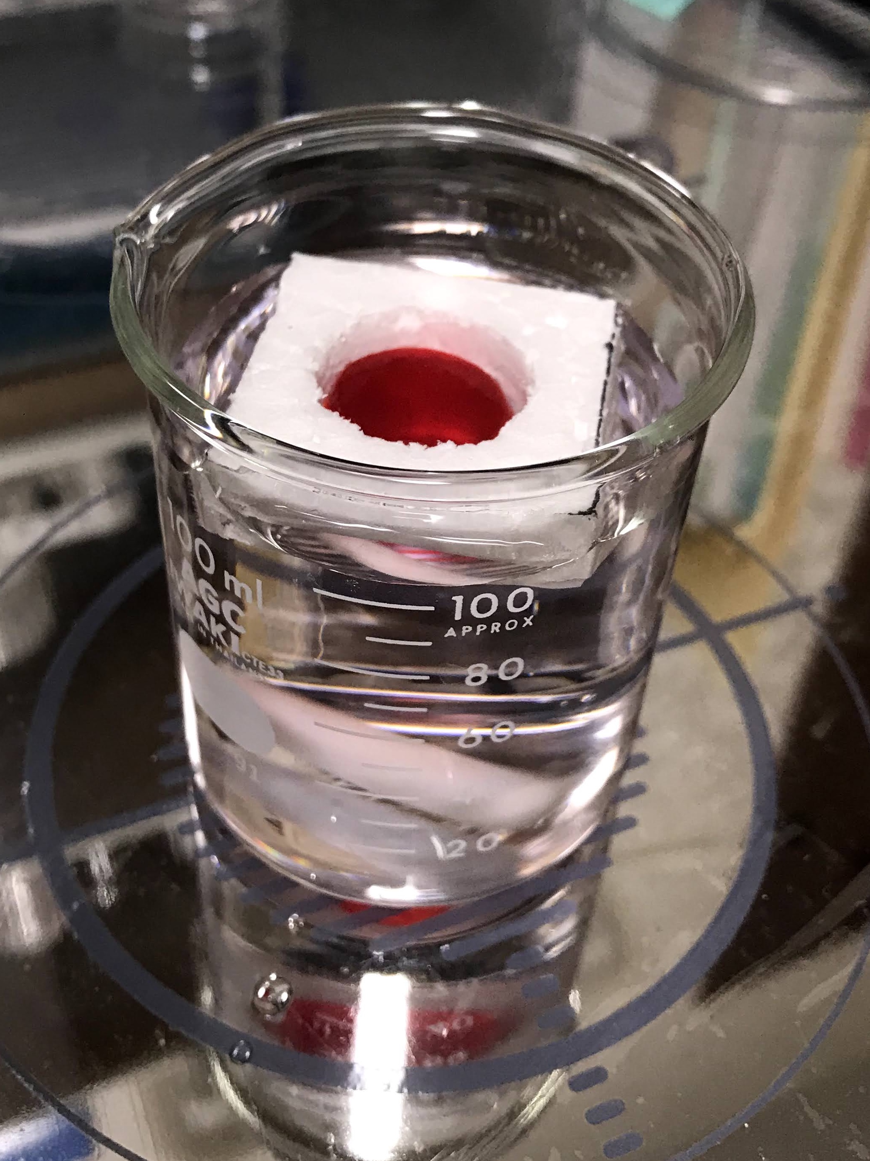
Results and Discussion
8/13
Release behavior of New Coccine from hydrogel
Hydrogel disk: φ17.5 mm×3.5 mm, New Coccine (NC) concentration in gels: 1.98 mg/g-gel, Temperature: 23-25℃, Physiological saline volume: 100 mL, Stirring speed: 200 rpm, Values are expressed as the mean±SD; n=2.
New Coccine (NC)
The hydrogel with NC
(1.98 mg/g-gel)
Release devise
Molecular Weight = 604.5
Physiological saline
100 mL
Alg-Ca_{x} : x = CaCO₃ concentration
The hydrogel released ~90% of NC from hydrogel surface within 300 min.
The hydrogels have potential application for
drug delivery material on wound site.

Slide 9
Results and Discussion
9/13
Biocompatibility of hydrogels
Hydrogel disk: φ11.5 mm×3.5 mm, CaCO₃ concentration: 0.20 (w/v%), Cell: Normal Human Dermal Fibroblasts (NHDF), Passage: p15 ,Cell density: 2.5×10⁴ cells/well, pre-Incubation time: 12 h (37℃, 5% CO₂), Incubation time: 24 h (37℃, 5% CO₂), Values are expressed as the mean±SD ;n=4.
CCK-8 Assay
Control
Hydrogel disk
(immersed in DMEM)
DMEM 360 μL
24 h culture
NHDF
NHDF
DMEM 1 mL
(10% FBS, 2% PS)
DMEM 1 mL
(10% FBS, 2% PS)
Alg-Ca_{0.15}
Alg-Ca_{0.20}
Alg-Ca_{0.30}
Control
Alg-Ca_{x} : x = CaCO₃ concentration
Hydrogels prepared in this study do not inhibit NHDF cells proliferation.
The hydrogels have biocompatibility.

Slide 10
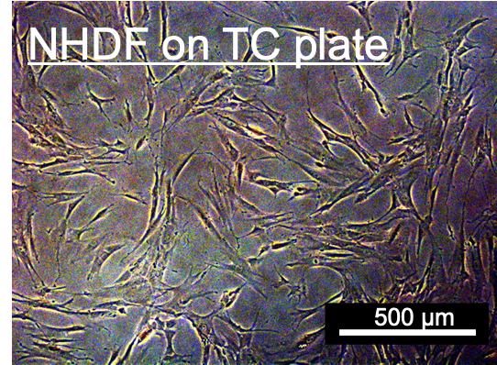
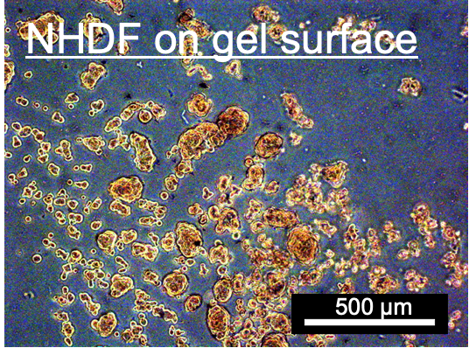
Results and Discussion
10/13
Cell adhesion test of hydrogels
Gel volume: 250 μL, CaCO₃ concentration: 0.20 (w/v%), Cell: Normal Human Dermal Fibroblasts (NHDF) Passage: p11 ,Cell density: 2.0×10⁴ cells/well, Incubation time: 17 h (37℃, 5% CO₂)
Control
NHDF
NHDF
Hydrogel disk
(250 μL)
Spheroids
DMEM 1 mL
DMEM 1 mL
Cells were cultured
on TC plate.
Cells were cultured
on gel surface.
NHDF formed aggregation structures (“Spheroids”) on the gel surface.
→ NHDF do not adhere to hydrogel surface.
Hydrogel can be exchanged without damaging tissue.

Slide 11
Results and Discussion
11/13
Experimental model with full-thickness skin defects
Excisional wound formation
Attachment of dressings
TegadermTM (3M)
(Secondary dressing)
Dressings
(Gauze and hydrogels)
Wound site
C57BLKS/JIar- +Lepr^{db}/ +Lepr^{db} mice
Wound average area = 29.8 mm²
Weight average = 34.6 g
Dry Gauze (Libatape, Japan)
VIEW GEL®︎(clinical hydrogel dressings, Nichiban, Japan)
Alginate hydrogels prepared in this study
(Gel thickness = ~1.2 mm, CaCO₃ concentration = 0.20 w/v%)
Wound Dressings
This animal experiment was approved by
Ethical Committee of Tokyo University of Science, Japan (Protocol Y21024).

Slide 12
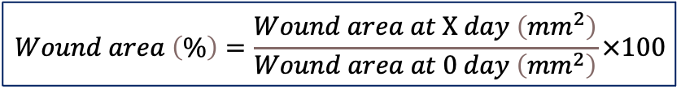
Results and Discussion
12/13
Change of wound area
$$\begin{aligned}&Wound area \left(\%\right)=\frac{Wound area at X day \left({mm}^{2}\right)}{Wound area at 0 day \left({mm}^{2}\right)}×100\#\end{aligned}$$
*
45.3%
10.0%
6.3%
Gauze
VIEW GEL®︎
Alginate gels
Values are expressed as the mean±SE ;n=4. *p<0.05
Alginate hydrogel promoted wound healing compared to dry gauze.
The hydrogel prepared in this study showed excellent wound healing effects.

Slide 13
Conclusions
13/13
This study thoroughly evaluated the property of alginate hydrogel
with carbonated water and its wound healing effects.
The addition of carbonated water induced gelation of alginate hydrogel in short time.
The prepared hydrogels have high water content (~99%).
The surfaces pH of hydrogels are suitable for skin cell growth.
The hydrogels have biocompatibility and can be exchanged without damaging tissue.
The hydrogels prepared in this study showed excellent wound healing effects.
Hydrogels
Acknowledgment
Kimica Corporation (Tokyo, Japan) for supplying alginate in this study.
Prof. Akihiko Kikuchi, Tokyo University of Science, for valuable discussions.
This work was supported by Masason Foundation and Kouyoukai (Tokyo University of Science).

