Slide 1
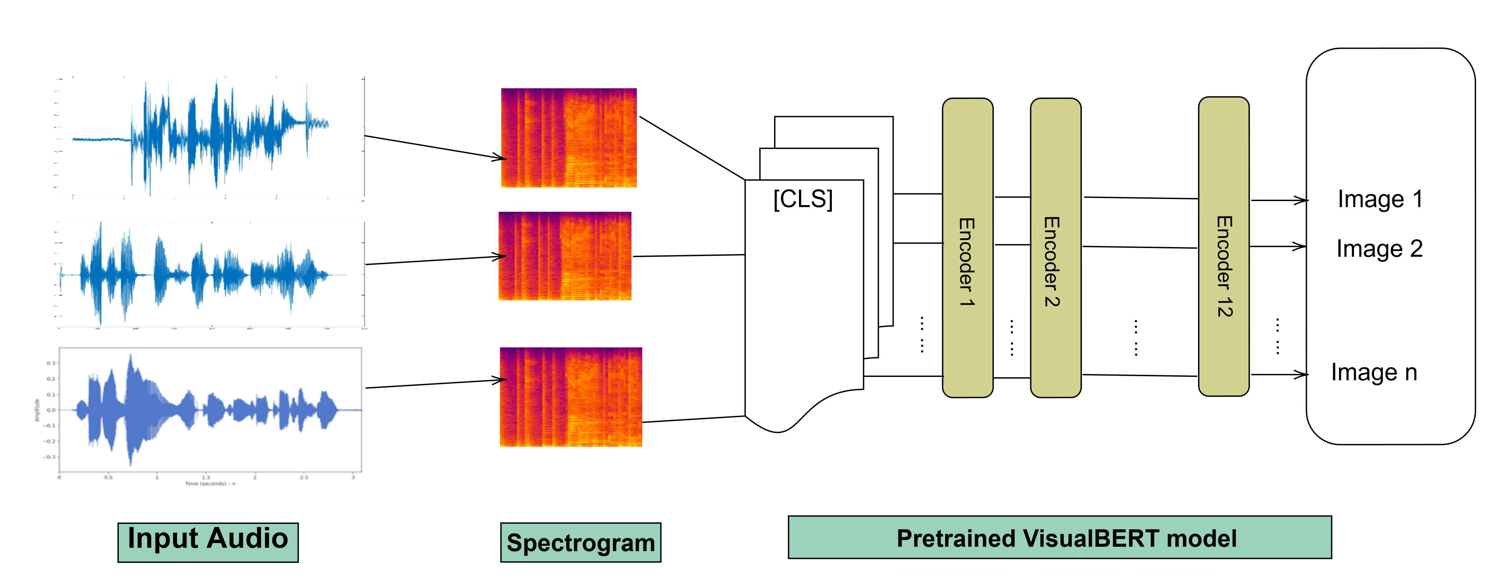
"Aedes Vigilax" Detection from Buzz: Deep Learning Classification
Saugata Bose
PhD candidate, University of Wollongong
Poor or excessive nutrient management may result in generation of mosquitos in vineyard which is a potential impact of vineyard on residential area. Thus, continuous effective monitoring system is required to ensure mitigation of mosquito borne diseases originated from orchards and vineyards. I am proposing a deep learning base machine learning approach to detect “Aedes Vigilax” mosquitoes.
Background Context
Mosquitoes are the vectors of numerous deadly diseases including Yellow Fever, Malaria, Dengue fever, Zika and Chikungunya[2].
Approximately 7 million people get infected with mosquitoes-borne diseases every year, causing 1 million deaths worldwide[2].
Some species of mosquitos are real threat for human society. For instance, a linkage was observed between vineyards and West Nile virus which spreads via mosquitos [1]. “Aedes vigilax ” is one of the abundant mosquitos in Australian vineyards.
Aedes vigilax (Skuse) is a pest and vector species associated with wet vineyards and the abundance of this mosquito has been identified as contributing to increased risk of mosquito-borne disease outbreaks.
Recently, numerous image-based machine learning (ML) approaches has been utilized in mosquito systematics, but considering the small body size, these models often required high resolution images and sophisticated pre-processing algorithm to result in high accuracy.
Wing-beating sounds of mosquito showed potential to be used as a classifier in mosquito systematics which has been advised previously by [2].
No previous research was conducted upon identifying “Aedes vigilax” mosquito using deep neural network.
Research Contributions
Deep learning approach ables to classify “Aedes vigilax” mosquito from other mosquitoes.
Deep learning approach outperforms the baseline models.
Methodology
R. Hendra’s Findings
Preliminary Results of MRes Project
36
HPLC
Figure 1: Proposed framework
Experimental Setup
Downloaded mosquito wing-beating raw audio sounds from website and split into training (80%), validation (20%) and testing (20%) data.
Pre-processed training data to remove noisy background and uninformative sounds.
Convert sound to spectrogram.
Pretrained VisualBERT model[3] has been applied. In addition to all the components of BERT, VisualBERT introduces a set of visual embeddings, F , to model an image. Each f ∈ F corresponds to a bounding region in the image, derived from an object detector.
Results
Model | Accuracy
ResNet-18 | 81.1%
ResNet-34 | 78.3%
VisualBERT | 86.7%
Conclusion
Through comprehensive experiments, I found that although BERT was designed for NLP, it could be an ideal choice for the audio classification. I experimented with several state-of-the-art methods and with publicly available datasets. Results demonstrated that the proposed model offered the best detection and generalization results.
I will evaluate the proposed architecture on multidomain settings.
References
[1] Crowder, David W.,Dykstra, Elizabeth A., Brauner, Jo Marie, Duffy, Anne, Reed, Caitlin, Martin, Emily, Peterson, Wade, Carrière, Yves, Dutilleul, Pierre and Owen, Jeb P. (2013). West Nile Virus Prevalence across Landscapes Is Mediated by Local Effects of Agriculture on Vector and Host Communities. PLOS ONE, 8:1, 1-8.
[2] Wei X., Hossain, M. Z.,Ahmed, K. A.(2021). How Unique Is Wing-beating Sound? Classifying Mosquitoes from Wing-Beating Sounds. The 1st International Electronic Conference on Entomology.
[3] Li L. H.,Yatskar M., Yin D., Hsieh C.-J., Chang K.W. (2019).VisualBERT: A Simple and Performant Baseline for Vision and Language.arXiv.org
Notes:
Draft 4

