Slide 1
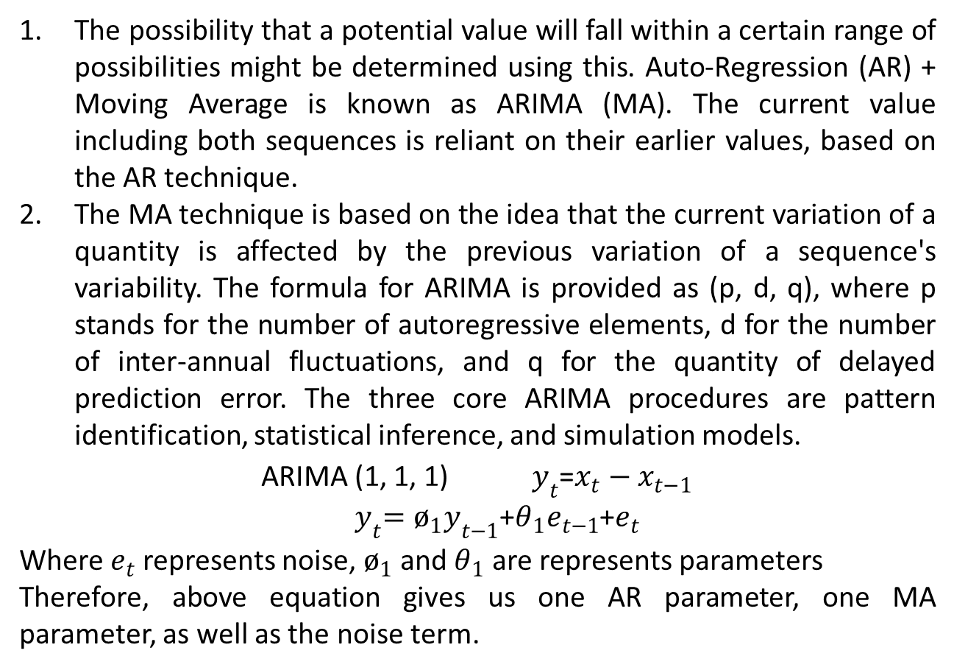
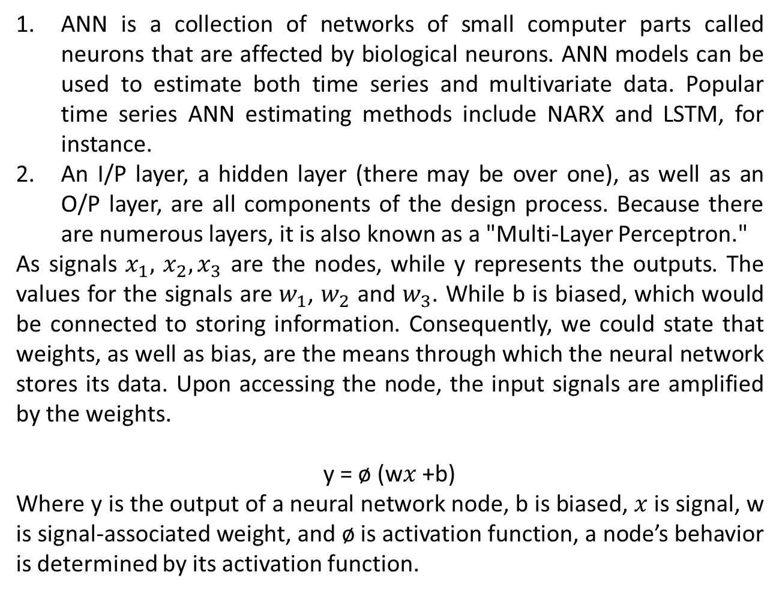
Various Models for Predicting Wind Energy Production
Seemant Tiwari ¹ ¹ Southern Taiwan University of Science and Technology, Tainan City 71005, Taiwan
INTRODUCTION
METHOD - ARIMA
CONCLUSION
Windmills are one of the virtually limitless sources of energy that may be used to generate electricity. It is regarded as a renewable source, but more investigation is indeed required to design the scientific knowledge and techniques that guarantee homogeneity in creation, increasing the contribution of this origin to the electricity sector. This is because the wind exhibits sudden variants in speed, surface area, and other crucial factors. Comprehensive data collection methods of wind speed and phase are required for the assessment of wind resources in a location. Wind energy happens when the wind makes contact well with the wind turbine's rotors. These rotor rotates, converting wind speed into kinetic energy that powers the wind generator's rotor and produces energy. In addition to assessing the energy production for the coming periods, which is valuable knowledge in the deployment of the producing units and the regulation of the power system, it is crucial to estimate the forecasts of wind activity a minimum of one day in advance.
This study creates a wind speed forecasting model for the ultra-short, short, medium, as well as long-term development of computational techniques. Utilizing wavelet-based prediction, artificial neural network approaches, Autoregressive Integrated Moving Average (ARIMA), and other hybrid models.
The possibility that a potential value will fall within a certain range of possibilities might be determined using this. Auto-Regression (AR) + Moving Average is known as ARIMA (MA). The current value including both sequences is reliant on their earlier values, based on the AR technique.
The MA technique is based on the idea that the current variation of a quantity is affected by the previous variation of a sequence's variability. The formula for ARIMA is provided as (p, d, q), where p stands for the number of autoregressive elements, d for the number of inter-annual fluctuations, and q for the quantity of delayed prediction error. The three core ARIMA procedures are pattern identification, statistical inference, and simulation models.
ARIMA (1, 1, 1) $y_{t}$=$x_{t}­−x_{t−­1}$
${ y}_{t}=ø_{1}y_{t­−1}$+$θ_{1}e_{t−­1}$+$e_{t}$
Where $e_{t}$ represents noise, $ø_{1}$ and $θ_{1}$ are represents parameters
Therefore, above equation gives us one AR parameter, one MA parameter, as well as the noise term.
Developing windmills and the functioning of transmission circuits rely on dependable wind speed predictions. Numerous predicting strategies were put out to enhance the precision of wind speed prediction; nevertheless, such methods often do not take the significance of data or before into consideration and are constrained by the usage of specific methods.
The estimate of wind energy capacity can be summed up as wind speed forecast because wind energy is related to wind speed squared. There must be numerous simple as well as hybrid wind speed prediction models, however, none of them completely cover the scope of prediction capabilities from very short-term projections to several years out.
We could conclude that hybrid methods work well. The most frequently employed input features in the research that were analyzed were temperatures, wind direction, humidity levels, and air pressure in addition to wind speed.
The ideal prediction model will produce an accurate result, which represents the optimum efficiency, to resolve wind power forecasts. Furthermore, because of the stochastic environment of wind, all wind energy prediction methods have flaws, thus in reality there is no such thing as a perfect rating. Numerous elements, including the volumes and sample frequencies of the training, testing, and validation collections, the methods employed, and methods modifications can affect predicted accurateness.
Within the recent research field, there is no commonly acknowledged standard approach for projecting wind energy. To create a reference model that can be relied upon to assess various forecasting techniques, more research is still needed.
METHOD - HYBRID
Several hybrid methods are being utilized today that integrate previous versions with the application of wavelets. Regarding temp. time series, an evaluation is made among two methodologies: wavelet-ARIMA as well as wavelet-ANN methods.
The application of wavelets for data analysis or for predicting in conjunction with other methods like ARIMA or neural networks remains a topic of much debate. Wavelets do not greatly enhance time series with such categories depending on the element; instead, a de-noising phase combined with ARIMA prediction is recommended if the long-term architecture is more significant than the short-term fluctuation.
METHOD - ANN
ANN is a collection of networks of small computer parts called neurons that are affected by biological neurons. ANN models can be used to estimate both time series and multivariate data. Popular time series ANN estimating methods include NARX and LSTM, for instance.
An I/P layer, a hidden layer (there may be over one), as well as an O/P layer, are all components of the design process. Because there are numerous layers, it is also known as a "Multi-Layer Perceptron."
As signals $x_{1},$ $x_{2}, x_{3}$ are the nodes, while y represents the outputs. The values for the signals are $w_{1}$, $w_{2}$ and $w_{3}$. While b is biased, which would be connected to storing information. Consequently, we could state that weights, as well as bias, are the means through which the neural network stores its data. Upon accessing the node, the input signals are amplified by the weights.
y = ø (w$x$ +b)
Where y is the output of a neural network node, b is biased, $x$ is signal, w is signal-associated weight, and ø is activation function, a node’s behavior is determined by its activation function.
REFERENCES
RESULTS AND DISCUSSION
AH Nury, K. Hasan, MJB Alam: Comparative Study of Wavelet-ARIMA and Wavelet-ANN Models for Temperature Time Series Data in Northeastern Bangladesh. Journal of King Saud Univ.-Science, 29(1), pp. 47–61, 2017.
F. Bonanno, G. Capizzi, G. Lo Sciuto, C. Napoli: Wavelet Recurrent Neural Network with Semi-Parametric Input Data Preprocessing for Micro-Wind Power Forecasting in Integrated Generation Systems. International Conference on Clean Electrical Power (ICCEP), Taormina, Italy, 16–18 June 2015.
Seemant Tiwari: Wind Speed Forecasting Methods for Wind Energy Generation. 1st International Conference on Informatics (ICI), Noida, India, pp. 143-147, 2022.
Power predicting would continue to play a bigger and bigger part in the different phases of wind farm operation as strong windmills evolve continuously. To accurately identify the power provided by massive wind fields, more sophisticated and affordable prediction techniques must be created. More precisely, novel hybrid techniques, which incorporate neural networks and computer models.
The development of suitable techniques for offshore wind predicting, including the identification of elements in coastal and oceanic regions to combine precision and efficiency, must be the primary emphasis of upcoming wind power forecast systems. Hybrid models do well in terms of prediction.
The 3rd International Electronic Conference on Applied Sciences
01-15 DECEMBER
https://asec2022.sciforum.net/

