Slide 1
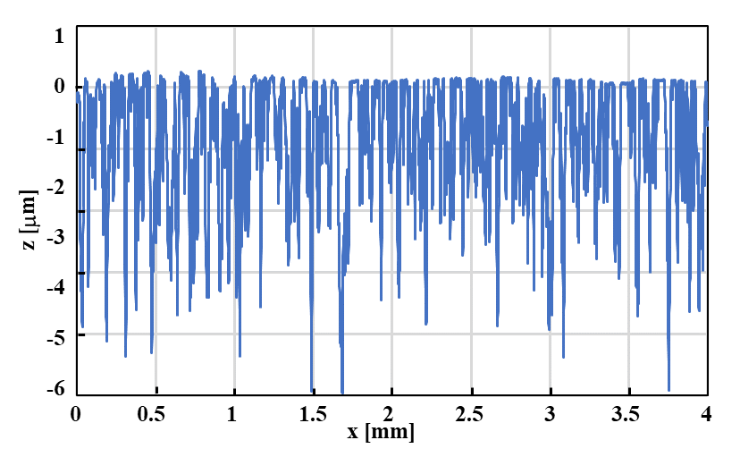
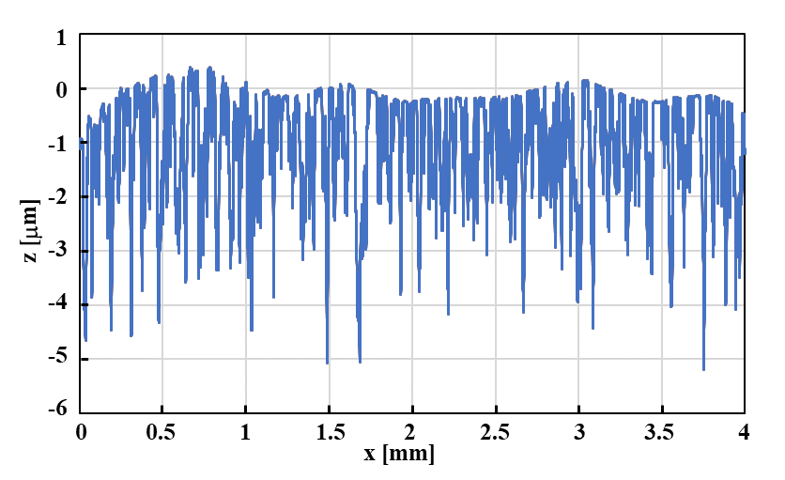
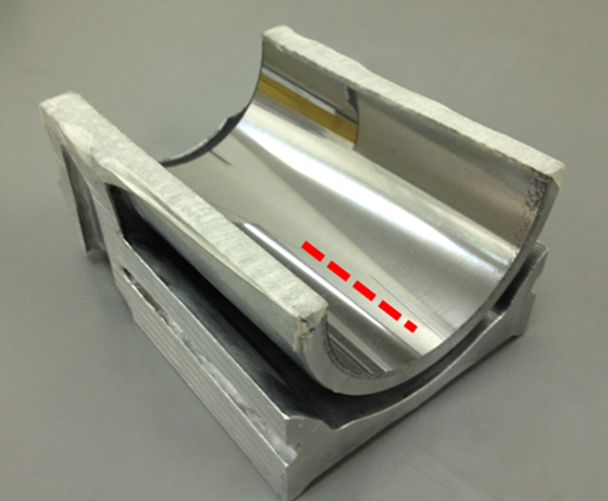
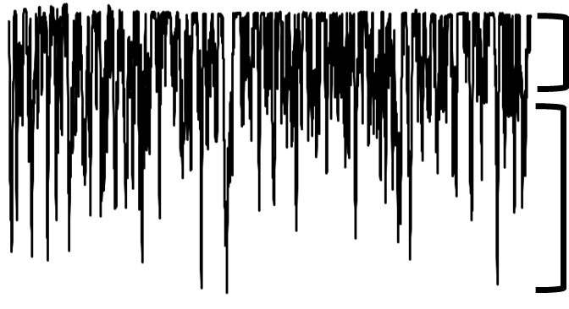
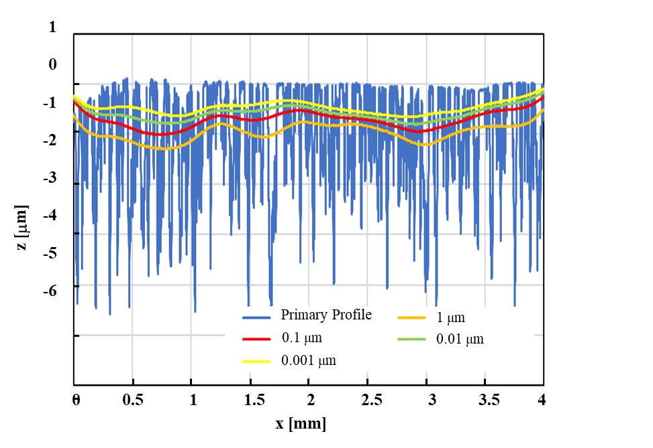
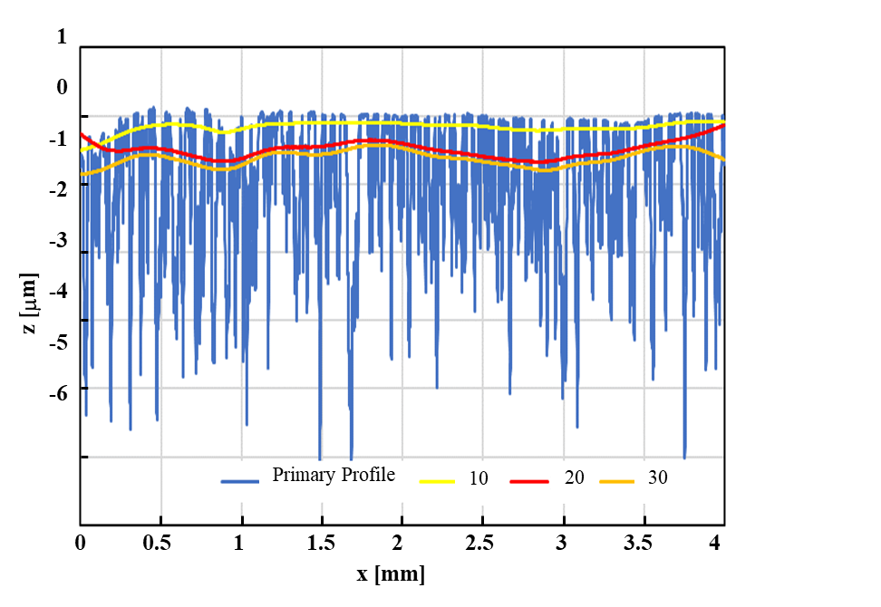
Behavior of Gaussian Profile Filters for Plateau Surface Structure, and Optimum Parameters.
Ryo SAITO¹, Ichiro YOSHIDA²
Major in Mechanical Engineering, Graduate School of Science and Engineering, HOSEI University,
Department of Mechanical Engineering, Faculty of Science and Engineering, HOSEI University
Background
Automobiles are required to improve the fuel economy and performance.
To achieve this requirement, the inner surface of engine parts has a plateau structure.
For highly valid roughness evaluation of the plateau surface, filtering method is important.
However, the output of ISO 16610-31 is distorted, which prevents accurate evaluation.
In this study, we investigate the behavior of the filter for the plateau surface to improve production efficiency in automotive measurement sites.
Plateau surface and ISO 16610-31
Parallel to red line
Distortion
Plateau :
Plateau :
the formation of lubricant film
The Surfaces of automotive parts
Valley : lubricant basin
Ideal shape
Roughness profile of ISO 16610-31
Current approach
Behavior of Gaussian profile filters for plateau surface structure, and optimum parameters.
Establishment of filtering methods for plateau surfaces.
Contributing to improve production efficiency in measurement sites.
Output of GRF at each threshold
Output of FMGF at each basic width
Correspondence: Ichiro Yoshida, HOSEI University, E-mail: yoshida.ichiro@hosei.ac.jp
© Copyright Hosei University

