Slide 1
Role of land-surface hydrology schemes in simulating the global incident solar radiation of Tropical Africa using the RegCM4
Prepared by
Samy A. Anwar
Egyptian Meteorological Authority, Qobry EL-Kobba, Cairo, Egypt, P.O. Box 11784

Slide 2
Motivation
Surface solar irradiance (SSI) is a key variable in the dynamic process that occurs in the boundary layer. Indeed, SSI influences photosynthesis, hydrological processes, energy generation, agriculture and water resources management.
Sawadogo et al. (2021) examined the current and future potential of solar and wind energy over Africa using the RegCM4 within the framework of the CORDEX‑CORE ensemble (Coordinated Output for Regional Evaluations; CORE; Ashfaq et al. 2021). They found that the RegCM4 model has a good capability in reproducing the spatial pattern of the SSI against satellite products (SARAH-2).
Recently, regional climate models (e.g. RegCM4) were used to examine the role of different aspects of the land surface in simulating the surface climate (Wang et al. 2015; Erfanian et al. 2016). In particular, the role of runoff parameterization has been examined in simulating the surface climate, terrestrial carbon cycle and potential evapotranspiration of Tropical Africa (Anwar et al. 2019).
However, the potential influence of the two land-surface hydrology schemes TOP and VIC on the simulated SSI was not examined over Tropical Africa till present day. This is the purpose of the present study.

Slide 3
RegCM4 model description and Experiment Design
In this study, version 4.5.0 of the International Centre for Theoretical Physics (ICTP) regional climate model (RegCM-4.5.0; Giorgi et al 2012; hereafter RegCM4) was used. The RegCM4 uses a terrain-following σ-pressure vertical coordinate system and an Arakawa B-grid finite differencing algorithm. Different physical configurations and schemes of the RegCM4 can be found in Giorgi et al (2012).
In the present study, we used the CLM45 as the land surface model because it offers important updates such as: reducing the excessive tropical GPP, a revised canopy radiation scheme and canopy scaling of leaf processes (Bonan et al. 2011).
The RegCM4 simulations were driven by the National Center for Environmental Prediction / National Center of Atmospheric Research reanalysis product version 2 (NCEP/NCAR2; Kanamitsu et al. 2002) as the initial and lateral boundary condition; and the 1.5 × 1.5-degree resolution ERA-Interim reanalysis (EIN15; Dee et al. 2011) as the Sea Surface Temperature (SST). The physical configuration of this study is documented in Anwar and Diallo (2021).
To account for changes in the vegetation cover, the CN module was enabled in the two simulations. The first simulation was designated as CN-TOP, and the second simulation was referred to as CN-VIC. To properly initialize the regional coupled RegCM4-CLM45-CN-TOP/VIC model, a long-term spinning up of the CN was used (Fang et al. 2015; Ghimire et al. 2016).

Slide 4
Observational Dataset
Solar Radiation Budget (SRB; Riihela et al. 2017) reanalysis product to evaluate the SSI from the two simulations. The SRB is part of the World Climate Research Programmer's (WCRP) Global Energy and Water Exchanges (GEWEX) framework and it covers the period of July 1983 to November 2007. The data set is constructed on a 1º x 1º global grid using satellite-derived cloud parameters and ozone fields, reanalysis meteorology, and a few other ancillary data sets.
To facilitate the comparison between the simulated and observed datasets, the SRB was bilinearly interpolated onto the RegCM4-CLM45 horizontal grid as recommended by Krishnan and Bhaskaran (2020).

Slide 5
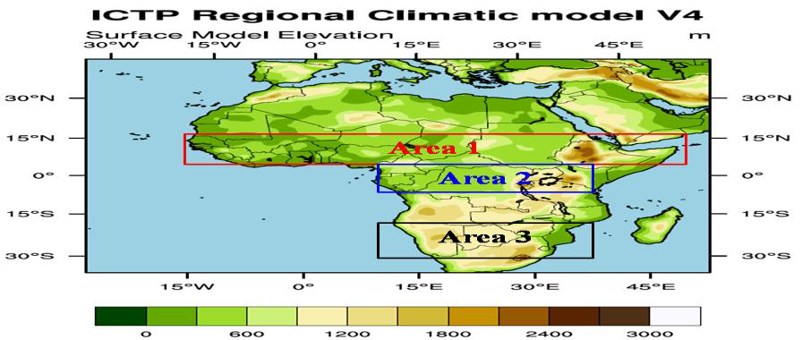
Figure 1 shows the model domain topography (in meters) including three sub-area averages: Area 1 for the Northern Savannah (18ºW-50ºE, 5-15ºN; red box), Area 2 for the Evergreen Forest (10-40ºE, 5ºS-5ºN; blue box) and Area 3 for the Southern Savannah (10-40ºE, 15-30ºS; black box) to quantitatively evaluate the RegCM4 model performance with respect to SRB reanalysis product

Slide 6
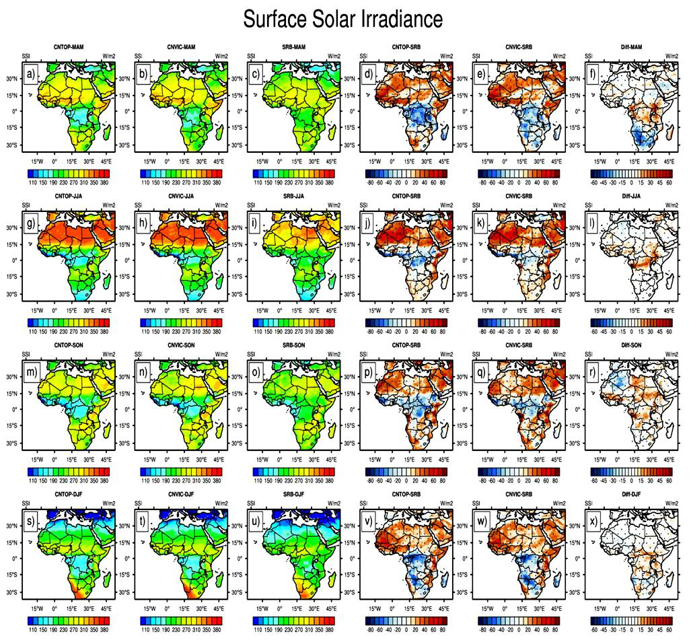
Figure 2 shows the Surface Solar Irradiance (SSI) over the period 1998–2007 (in W.m⁻²) for: MAM season in the first row (a-f); JJA in the second (g-l); SON in the third (m-r) , DJF in the fourth (s-x). For each row, CN-TOP is on the left, followed by CN-VIC, SRB is in the third from left, CN-TOP minus SRB, CN-VIC minus SRB and the difference between CN-VIC and CN-TOP. Significant model bias is indicated in black dots using student t-test with alpha equals to 95.

Slide 7
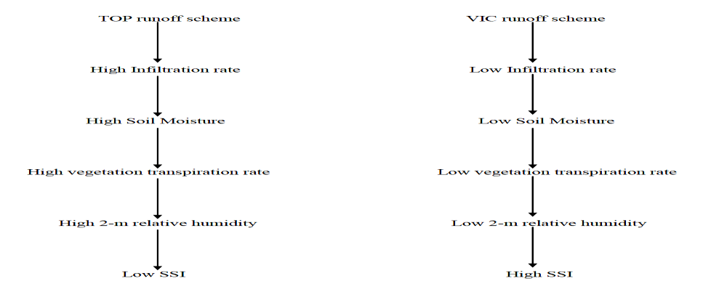
Figure 3 a simple chart describes the influence of the land-surface hydrology scheme (TOP/VIC) on the simulated SSI

Slide 8
Figure 4 Averaged spatial correlation between SSI and different hydrological and meteorological variables. (a) Correlation between SSI and infiltration rate (QINFL_Corr), (b) Correlation between SSI and Soil moisture of depth 10 cm (SM10_Corr), (c) Correlation between SSI and 2-m relative humidity (RH2M_Corr). Areas with black dots are statistically significant at 95% confidence level of student t-test.

Slide 9
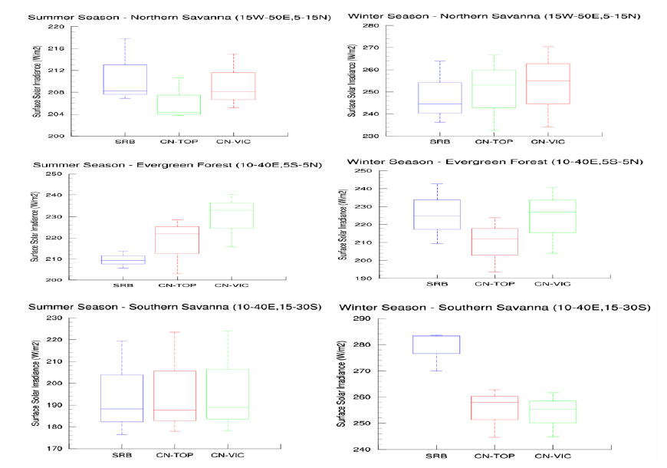
Figure 5 Box-and-Whisker plot to show the simulated Surface Solar Irradiance (SSI; in W.m⁻²) spread for the CN-TOP (in red) and CN-VIC (in green) with respect to the SRB reanalysis product (in blue) for the winter (right column) and summer (left column) seasons over three sub-area averages highlighted in Figure 1.

Slide 10
Discussion and Conclusion
In this work, the influence of two land-surface hydrology schemes (CN-VIC and CN-TOP) on SSI of Tropical Africa was assessed using simulations from the RegCM4 model, and their ability to reproduce SSI seasonal and annual patterns in regard to reanalysis products.
The results showed that the VIC land-surface hydrology scheme performs better than the TOP scheme, particularly in the JJA season in comparison with the SRB reanalysis product - in agreement with the results reported by Wang et al. (2021).
Quantitatively, the RegCM4 model performance varies with space and time. For instance, the CN-VIC shows a better agreement than the CN-TOP over Northern Savanna (Evergreen Forest) during the summer (winter) season. In addition, there is no considerable difference between the two simulations over Southern Savanna.
In summary, we can recommend using the VIC land-surface hydrology scheme for future studies concerning the SSI over Tropical Africa. Also, for a better performance of the regional coupled RegCM4-CLM45-CN-VIC model, it is necessary to calibrate the four parameters of the VIC surface dataset against in-situ observations of Africa as recommended by Anwar et al. (2019).
Future study will address the following points:
Examining the role of aerosols and various clouds cover schemes which notably affect the simulated SSI.
Downscaling CMIP5 General Circulation Models (GCMs) participating in the CMIP5/CMIP6 simulations (e.g., Erfanian et al. 2016; Mehboob et al. 2020) using the regional coupled RegCM4-CLM45-CN-VIC model with enabling the dynamic vegetation (DV) module and LULCC to assess the possible future changes in the simulated SSI under the moderate scenario (RCP4.5) and extreme scenario (RCP8.5).

Slide 11
Thank you, any questions??

