Slide 1
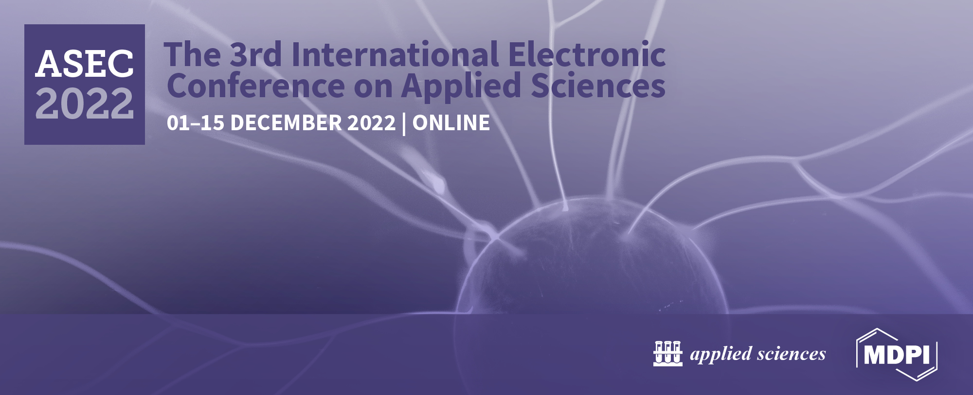
Artificial Intelligence Implications in Engineering and Production
SEEMANT TIWARI

Slide 2
Contents
Introduction
Ai enablers and techniques
Artificial intelligence research areas
Ai application concepts
Conclusion

Slide 3
Introduction
The broad adoption of the latest generations of machinery for information and communication like Ai, IoT(Internet of Things), and block-chain, is hastening the global technology as well as manufacturing transformation.
Ai technology had piqued the interest of administration, business, and academics.
The discipline of Ai technology is referred to as Ai. It simulates humans' intelligent performances with computing and trains systems to acquire human characteristics like thinking, judgment, and selection.

Slide 4
Ai is just a cognitive endeavor that accepts information like its objective, obtains information, examines and investigates conceptual modeling techniques, and applies such ways to simulate human cognitive operations.
Ai is a synthesis of computer engineering, mathematics, physiology, economics, and numerous other fields that have yielded impressive breakthroughs in areas like voice recognition, natural language processing, automated theorem proof, and smart robots.
Ai is critical to social growth, it has produced breakthrough achievements in boosting worker productivity, lowering labor costs, optimizing people management organization, and making new work demands.

Slide 5
Ai enablers and techniques
Algorithms
Big data
Machine learning
Hardware
Vision computing
Natural language processing

Slide 6
Artificial intelligence research areas
Machine learning
Data science
Expert system
Prediction
Robotics
Pattern recognition
Network of Decision Support

Slide 7
Ai application concepts
Smart house
Payment systems
The entertainment business
Industry of Healthcare
Automobile sector
Platforms for financial instruments
The retail sector

Slide 8
Conclusion
Ai is just a interdisciplinary field that includes knowledge, reasoning, psychology, perception, networks, and biological.
Its been utilized in the synthesis of information, pattern classification, computer vision, as well as language processing.
Several submissions have been created including automated computing, intelligent agents, perspectives, and smart robotics.

Slide 9
References
Veloso de Melo, V., and Banzhaf, W.: Automatic feature engineering for regression models with machine learning: An evolutionary computation and statistics hybrid. Information Sciences, 287–313, (2018).
Wang, J., Ma, Y., Zhang, L., Gao, R. X., Wu, D.: Deep learning for smart manufacturing : Methods and applications. Journal of Manufacturing Systems, (2018).
Wang, Z., Ma, G., Gong, D., Sun, J., and Zhang, D.: Application of mind evolutionary algorithm and artificial neural networks for prediction of profile and fatness in hot strip rolling process. Neural Processing Letters, 50(3), 2455–2479, (2019).
Ward, L., O’Keefe, S. C., Stevick, J., Jelbert, G. R., Aykol, M., Wolverton, C.: A machine learning approach for engineering bulk metallic glass alloys. Acta Materialia, 159, 102–111, (2018).
Wei, L., Luo, W., Weng, J., Zhong, Y., Zhang, X., and Yan, Z.: Machine learning-based malicious application detection of android. IEEE Access, 5, 25591–25601, (2017).

