Slide 1
CO₂ Absorption Using Potassium Carbonate as Solvent
Dimitra Karali*, Konstantina Peloriadi, Nikolaos Margaritis and Panagiotis Grammelis
Centre for Research & Technology Hellas, Chemical Process and Energy Resources Institute,57001 Thessaloniki, Greece; *Corresponding author: karali@certh.gr (D.K.)

Slide 2
Outline
Introduction
Materials and Methods
Rate based method
Simulation
Results & Discussion
Conclusions

Slide 3
The combustion of fossil fuels produces a large amounts of CO₂, one of the main greenhouse gases, which impacts global warming.
Tackling climate change requires reducing CO₂ emissions, either through the use of alternative fuels or through the use of carbon capture technologies.
One of the well-known CO₂ capture technologies is chemical absorption in an amine-based solvent (mono- ethanolamine (MEA), me-thyldiethanolamine (MDEA) etc.) followed by desorption.
Amines are widely used mainly because of their reactivity with CO₂ under mild temperature (absorber: 40-65ºC; stripper: 100-120ºC) and pressure (1-2bar) conditions.
Amines are corrosive and cause equipment problems and through their easy degradation by oxidation reaction can be potentially toxic to the environment.
A major drawback of amines is the high reboiler heat duty for desorption.
In this study,
The absorption of CO₂ using K₂CO₃ solution is investigated, as well as its regeneration. ASPEN PLUS® software is used to evaluate the operating parameters of the CO₂ capture pilot unit.
K₂CO₃ is less toxic and less corrosive than amines, and is considered a particularly attractive wet chemical absorbents as it has fewer energy requirements for its regeneration.

Slide 4
Rate based method
The methodology for a rate model is used.
The rate of absorption and desorption is determined by two mechanisms,
mass transfer and
chemical reaction,
The mass and energy balance equations determine the concentration and temperature along the column.
The electrolyte NRTL method is chosen for computing liquid phase properties and RK equation of state is chosen for computing vapor phase properties.
CO₂, H₂S, N₂, O₂, CO and H₂ are selected as Henry-components to which Henry’s law is applied, while the activity coefficient basis is aqueous.
Reactions
CO₂ + 2H₂O ↔ H₃O⁺ + HCO₃⁻
HCO₃⁻ + H₂O ↔ H₃O⁺ + HCO₃⁻²
2H₂O ↔ H₃O⁺ + OH⁻
H₂O + H₂S ↔ HS⁻ + H₃O⁺
H₂O + HS⁻ ↔ S⁻² + H₃O⁺
KOH → K⁺ + OH⁻
All the data are retrieved from Aspen Plus® databank and chemical equilibrium is assumed.
In post-combustion capture applications, the absorber is operated close to atmospheric pressure, which is similar to input stream of flue gas.
When CO₂ is absorbed into K₂CO₃ solvents, particularly at high concentrations of K₂CO₃, both physical reactions and chemical reactions occur.
The summary of the reactions for the absorber and stripper specifications are shown in the table.

Slide 5
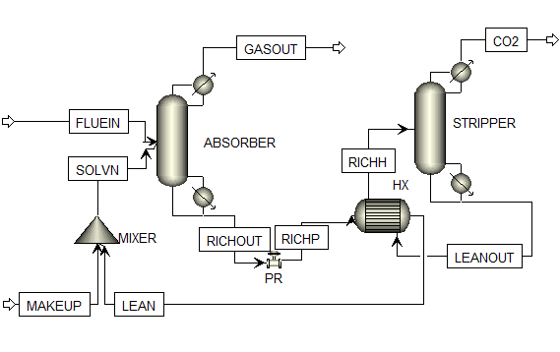
Simulation
The specifications and operating conditions are presented in Table. A schematic flowsheet developed in this study is presented in Figure.
 | Absorber | Stripper
Temperature (ºC) | 35 | 80, 85, 100
Pressure (bar) | 1 | 0.3, 0.7, 1
Gas flow rate (slpm) | 1
Solvent flow rate (slpm) | 0.1
Concentration of K₂CO₃ (%v/v) | 15, 20, 25
Concentration of CO₂ (%v/v) | 15

Slide 6
Two main streams were specified, the solvent stream named “SOLVN” and the flue gas stream “FLUEIN”.
The flue gas was considered to be composed of CO₂ and N₂ while other components like H₂O, O₂, and SO₂ are neglected.
A solvent makeup stream was added to the recycled stream before entering the absorber in order to compensate for the solvent loss during the absorption and stripping process.
The solvent was added at atmospheric pressure and at a temperature of 35ºC.
From the absorber, a gas stream containing almost no carbon dioxide is released.
Meanwhile, the liquid stream which is rich in solvent leaves the absorber and is pressurized and heated before entering the stripper.
From the stripper, a gaseous stream of CO₂ is produced, while the liquid solvent stream is recycled back to the absorber.

Slide 7
An analysis of variance (ANOVA) was performed with independent parameters:
stripper temperature;
stripper pressure and
concentration of solvent.
The results of the ANOVA analysis are presented in Tables.
All 27 cases were simulated based on the Aspen Plus flow sheet for two responses:
absorption of CO₂ efficiency and
regeneration of CO₂ efficiency.
The CO₂ absorption efficiency for all cases exceeded 99.8%
 | Sum of Squares | Mean Square | F Value | P Value
Stripper pressure | 1,69017 | 0,84508 | 101,3366 | 7,9357E-12
Stripper temperature | 0,31846 | 0,15923 | 2,03963 | 1,55624E-5
Error | 0,18347 | 0,00834
 | Sum of Squares | Mean Square | F Value | P Value
Solvent concentration | 2,14728E-6 | 1,07364E-6 | 20,07851 | 7,50939E-6
Error | 1,28333E-6 | 5,34721E-8

Slide 8
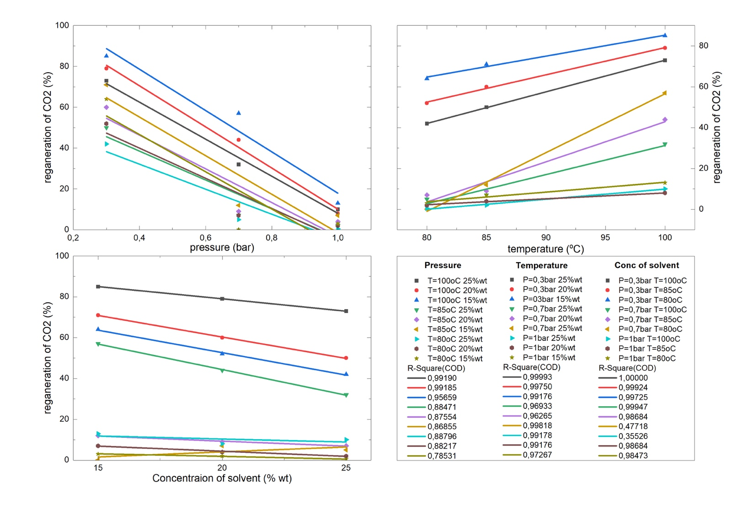
The simulation results for CO₂ recovery efficiency are shown in Figure.
The increase in potassium carbonate solvent has a subtle decrease in absorption of CO₂.
This is inconsistent with the parametric analysis of K₂CO₃ concentration carried out by Ayittey.
This differentiation is due to the small variation in CO₂ absorption values.
The regeneration CO₂ showed a large variation of values depending on the stripper operating conditions. Figure 2a shows that reducing the pressure of stripper significantly increases CO₂ recovery with a fine linear correlation (R²>0.785).
Greater regeneration of CO₂ is observed when the stripper temperature is higher, as confirmed in Figure 2b.
There is a perfect linear correlation of stripper temperature with regeneration of CO₂ (R²>0.963).
The concentration of potassium carbonate in the liquid absorber is not expected to affect the regeneration of carbon dioxide (Figure 2c).
a
b
c

Slide 9
An analysis of variance (ANOVA) was conducted to estimate the influence of parameters on the absorption of carbon dioxide and the CO₂ regeneration.
Stripper pressure and stripper temperature were chosen as independent variables, as they were suggested to influence CO₂ recovery.
The results of two-way ANOVA analysis were evaluated for CO₂ recovery as the p-value and F-factor.
The statistically significant parameters for the regeneration of CO₂ are the stripper pressure and the temperature of the stripper, with a p value lower to the level of 0.05.
A one-way ANOVA analysis showed that the concentration of K₂CO₃ is statistically significant for the ab-sorption of carbon dioxide.

Slide 10
An eco-friendly carbon dioxide capture process is studied in this research using ASPEN PLUS® software.
The capture and recovery of CO₂ were simulated in an absorption and a desorption column, using potassium carbonate.
The parameters examined were the concentration of Κ₂CO₃ and the temperature and pressure of the stripper.
Stripper pressure and stripper temperature influence the regeneration of CO₂, as shown in the analysis of variance (ANOVA).

Slide 11
THANK YOU
Funding: “This research was funded by Operational Program “Competitiveness, Entrepreneur-ship & Innovation” (EPAnEK), grant number Τ2ΕΔΚ-02899/ MIS5134532”.
Acknowledgments: We acknowledge support of this work by the project “CoCCUS” (https://co2coccus.gr/en/) which is co‐financed by the European Regional Development Fund of the European Union and Greek national funds through the Operational Program Competitiveness, Entrepreneurship and Innovation, under the call RESEARCH – CREATE - INNOVATE (project code:Τ2ΕΔΚ-02899/ MIS5134532)

