Slide 1
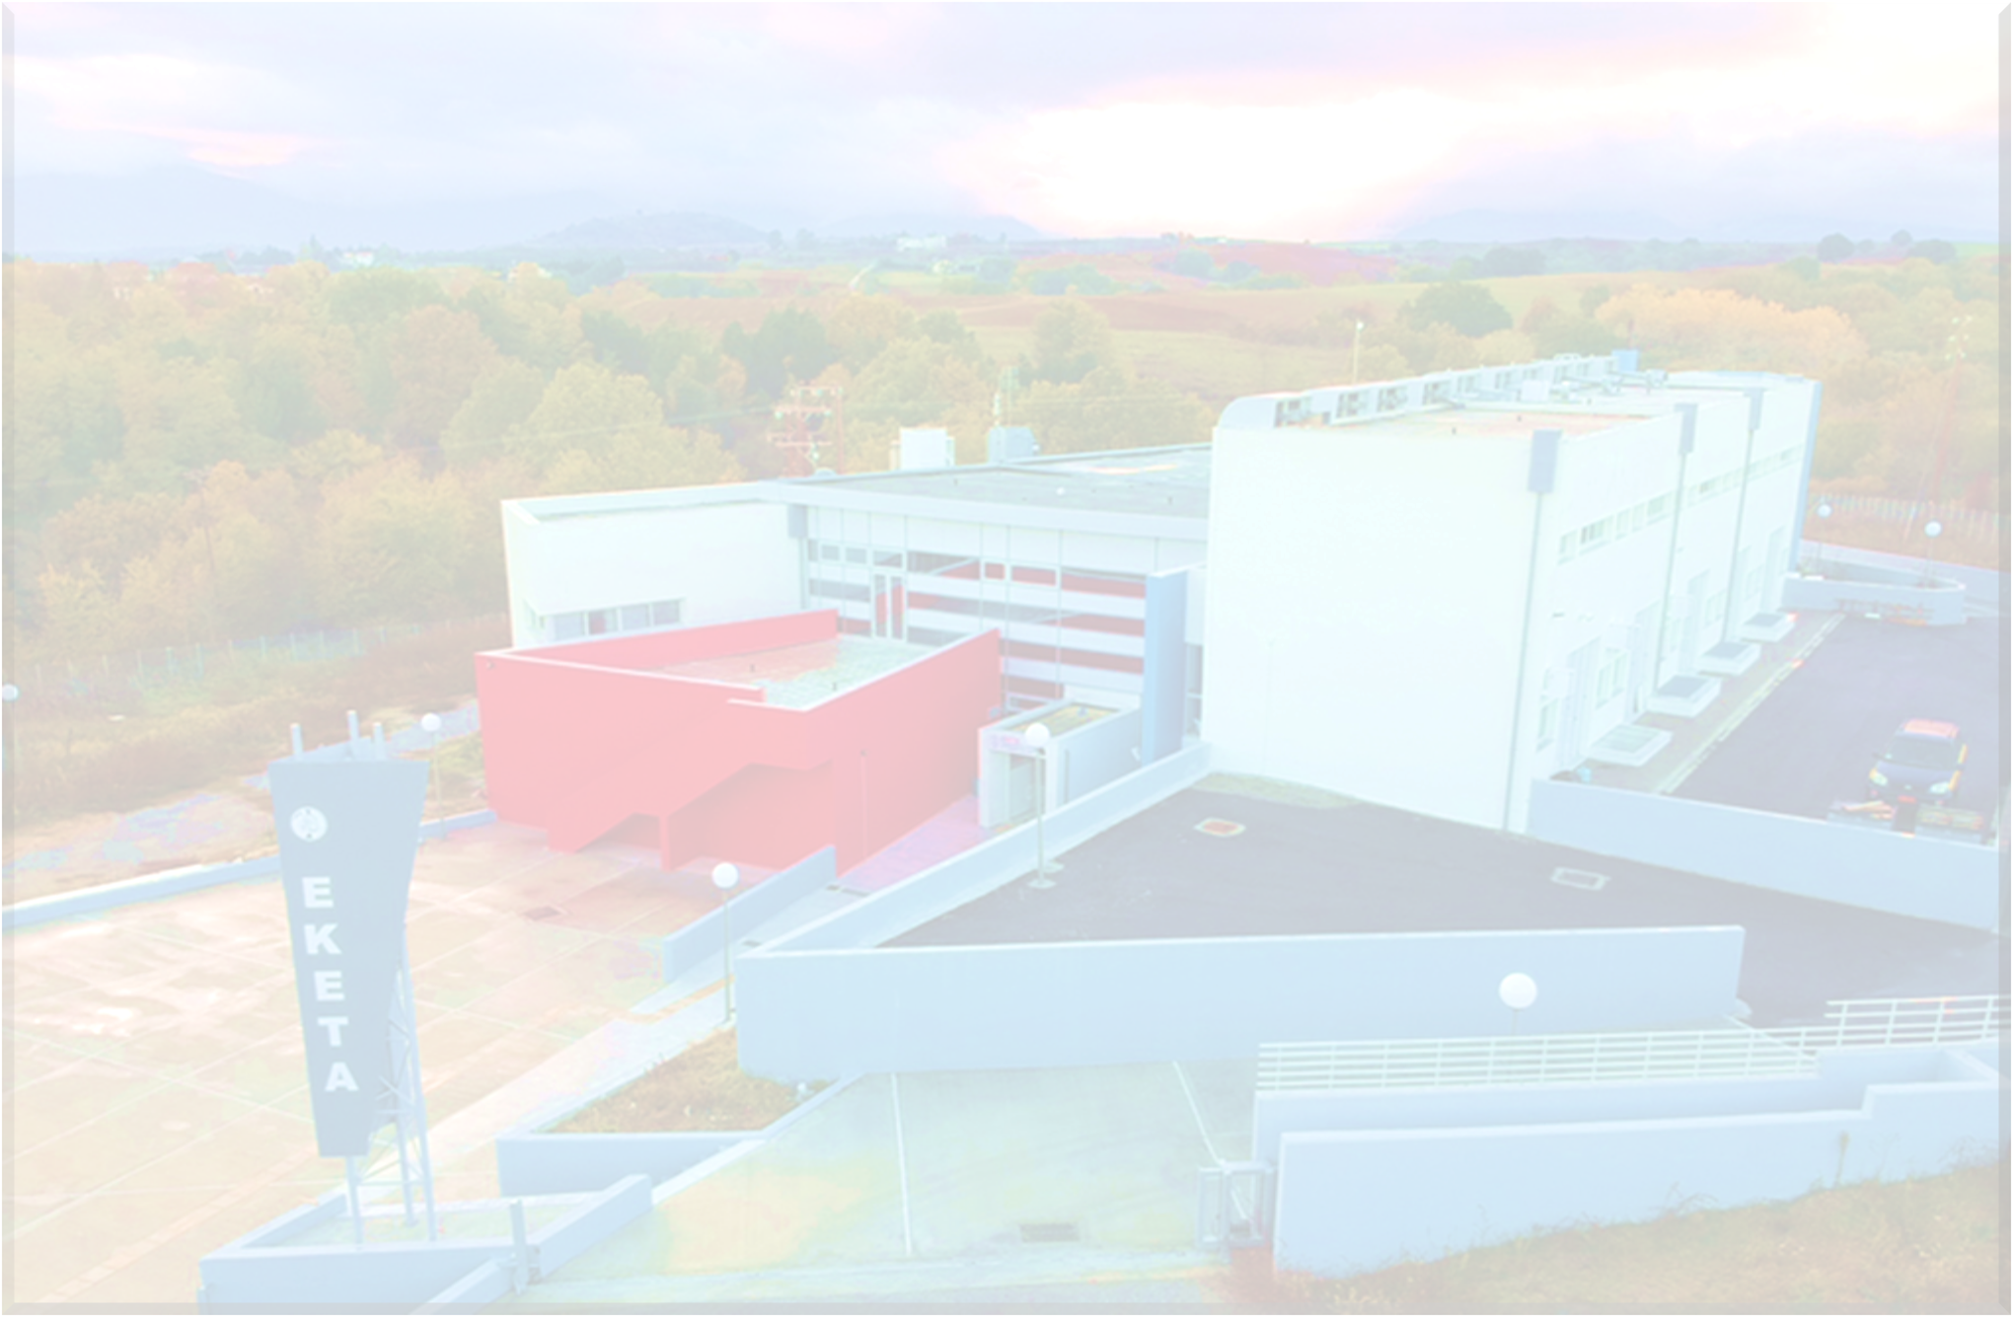
3rd International Electronic Conference on Applied Sciences
Part of the International Electronic Conference on Applied Sciences series
1–15 Dec 2022
Valorization of food waste leachates through anaerobic digestion.
Ioannis Kontodimos*, Chrysovalantis Ketikidis ,Panagiotis Grammelis
Centre for Research & Technology Hellas, Chemical Process and Energy Resources Institute,57001 Thessaloniki, Greece;
*Corresponding author: kontodimos@certh.gr

Slide 2
Contents
Introduction
Materials and Methods
Results
Conclusions

Slide 3
Anaerobic digestion:
is an environmentally favourable technology and the most widespread good practice for the biodegradation of household waste.
is a complex biochemical process in which organic material is decomposed by several groups of microorganisms in the absence of oxygen while renewable energy such as biogas is generated.
combines waste treatment and renewable energy recovery.
reduces the odor of waste material
digestate is rich in nutrients that can be used as fertilizer after the process of fermentation
Important to monitoring factors such as: pH, Total Solids, Volatile Solids, Ammonium, Chemical Oxygen Demand, Total Phosphorus, Alkalinity, Volatile Fatty Acids, Total Organic Carbon and Total Nitrogen.

Slide 4
Sampling
Compost leachates were collected during the period May 2020 to May 2021. Mainly consisting of fruits and vegetables, and their sampling procedure were from different stages of the composting process.
Description of the Samples
Date of Sampling | Sample Name | Description of Sample
1/6/2020 | S1 | Raw material from bucket of public market
12/6/2020 | S2 | Raw material from bucket of public market
22/6/2020 | S3 | Raw material from bucket of public market
22/6/2020 | S4 | Raw material from bucket of public market
3/11/2020 | S5 | Leachate from mechanical composting plants
22/12/2020 | S6 | Leachate from mechanical composting plants
17/3/2021 | S7 | Leachate from waste transfer station
17/3/2021 | S8 | Leachate from waste transfer station
28/4/2021 | S9 | Leachate from waste transfer station
28/5/2021 | S10 | Leachate from waste transfer station

Slide 5
Analytical methods
HPLC VFAs Analysis
Parameter | Standard Method
pH | 4500 H⁺,APHA 23th Ed
Alkalinity | 2320 B, APHA 23th Ed
NH₄⁺ | EPA 350.1
COD | EPA 410.1
TP | EPA 365.2+3
TS | 2540 B, APHA 23th Ed
VS | 2540 F, APHA 23th Ed
VFAs | Kapp (Titration)
ΤC,TOC,IC | 5310 B, APHA 23th Ed
TN | 2720 C, APHA 23th Ed
Isocratic elution
Mobile phase (0,02mol/l KH2PO4/methanol) 98:2
Acidified with H3PO4 to pH 2,88
50 min
Flow rate was 0,6 ml/min at 35 ºC
20μl injection volume
Standard stock solution containing 100mg/l :
Acetic Acid
Propionic Acid
Butyric Acid

Slide 6
Results of complete characterization of Food Waste Compost Leachates
Complete characterization of compost leachate. VFAs represent the cumulated concentration of acetate, propionic and butyric acid.
Parameter | S1 | S2 | S3 | S4 | S5 | S6 | S7 | S8 | S9 | S10
pH | 4,29 | 4,65 | 4,52 | 3,84 | 4,02 | 4,82 | 4,35 | 4,91 | 4,48 | 4,05
TS (g/l) | 118 | 24 | 69 | 114 | 36 | 18 | 33 | 26 | 41 | 60
VS (g/l) | 98 | 14 | 45 | 100 | 28 | 14 | 25 | 17 | 31 | 48
COD (mg/l) | 47202 | 49500 | 51800 | 38850 | 53924 | 16620 | 40154 | 25102 | 25601 | 31794
NH₄⁺ (mg/l) | 470 | 956 | 985 | 212 | 134 | 138 | 104 | 303 | 484 | 117
TOC (mg/l) | 15580 | 14150 | 14140 | 34430 | 13930 | 7368 | 9990 | 19885 | 16660 | 3692
TN (mg/l) | 2558 | 3435 | 3588 | 3973 | 579 | 267 | 314 | 511 | 771 | 273
VFAs (g/l) | 30508 | 18349 | 16041 | 37046 | 41780 | 8847 | 12768 | 14874 | 21613 | 24946
C/N ratio | 6,1 | 4,1 | 3,9 | 8,7 | 24,1 | 27,6 | 31,8 | 38,9 | 21,6 | 13,5

Slide 7
Results of complete characterization of Food Waste Compost Leachates
Major and minor trace elements of compost leachate
Parameter (mg/l) | S1 | S2 | S3 | S4 | S5 | S6 | S7 | S8 | S9 | S10
Na | 6208 | 7210 | 7506 | 7005 | 3980 | 2075 | 233 | 577 | 552 | 1251
K | 874 | 869 | 891 | 1329 | 145 | 280 | 1011 | 1320 | 1905 | 2779
Mg | 337 | 227 | 226 | 532 | 370 | 166 | 90 | 316 | 168 | 895
Zn | 1,4 | 2,1 | 2,1 | 4,3 | 4,0 | 1,4 | 12 | 27 | 18 | 16
Fe | 203 | 335 | 340 | 164 | 281 | 357 | 1,4 | 0,5 | 31 | 32
Cu | 0,3 | 0,3 | 0,5 | 0,6 | 0,6 | 0,2 | 0,6 | 0,3 | 1,1 | 1,6
Pb | nd | nd | nd | nd | nd | nd | nd | nd | nd | nd
Ni | nd | nd | nd | nd | nd | nd | 1,5 | 1,0 | 1,2 | 2,5
Cr | nd | nd | nd | nd | nd | nd | 1,2 | 3,4 | 3,3 | 2,6
Cd | nd | nd | nd | nd | nd | nd | nd | nd | nd | nd
Mn | nd | nd | nd | nd | nd | nd | 1,2 | 1,2 | 3,8 | 3,4

Slide 8
Results of complete characterization of Food Waste Compost Leachates
Samples from brown bin (S1-S4):
Rich in nutrients
C/N ratio not acceptable for composting (too low)
No presence of toxic metals
Samples Leachate (S5-S10):
Rich in nutrients
C/N ratio acceptable for composting
No presence of toxic metals
VFAs :
High Concentrations
Low pH values of the samples due to the high concentrations of VFAs
Contributor to odour nuisance
Precursor Compounds for methane production in anaerobic digestion process
Composting process is initial stages/raw compost material
Compost immature

Slide 9
BioMethane Potential Test
3 Different SIR
Composition of the SIR feedstocks and inoculum.
Main characteristics of each bench scale bioreactor during the start-up and after the end of the batch experiment. VFAs represent the cumulated concentration of acetate, propionic and butyric acid.
Parameter | Inoculum | FW (0,5) | FW (1,0) | FW (1,5)
Alkalinity (mg/l CaCO3) | 15000 | 3225 | 4150 | 5075
VS (mg/l) | 24000 | 2400 | 4800 | 7200
COD (mg/l) | 22820 | 8173 | 16047 | 23921
NH₄⁺ (mg/l) | 972 | 67 | 83 | 103
TOC (mg/l) | 6623 | 952 | 1940 | 2930
Parameter | FW (0,5) |  | FW (1,0) |  | FW (1,5)
 | Initial Concentration | Final Concentration | Initial Concentration | Final Concentration | Initial Concentration | Final Concentration
pH | 6,41 | 7,95 | 6,03 | 7,79 | 5,80 | 7,88
VS (g/L) | 19,54 | 2,65 | 31,6 | 4,24 | 47,38 | 4,71
VFAs (mg/L HACeq) | 4371 | 1678 | 5175 | 1076 | 9366 | 948
ΝmL CH₄/g VS | 512,00 |  | 511,76 |  | 333,02
COD (mg/L) | 7138 | 1204 | 12451 | 3349 | 26880 | 3983
NH₄⁺(mg/L) | 552 | 1053 | 818 | 1553 | 669 | 1355
Test Days | 32 |  | 60 |  | 60

Slide 10
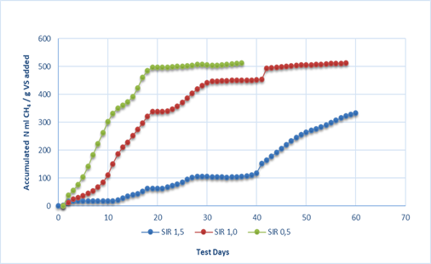
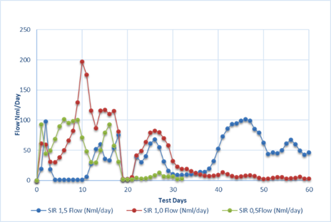
BioMethane Yield
Flow (Nml/day) of SIR 0,5, 1,0 and 1,5
Accumulated Nml CH4/g VS added of SIR 0,5, 1,0 and 1,5
SIR 1,5 : 330 Nml/g VS added in 60 days (Substrate:150mL)
SIR 1,0 : 512 Nml/g VS added in 60 days (Substrate:100mL)
SIR 0,5 : 512 Nml/g VS added in 32 days (Substrate:50mL)

Slide 11
Monitored the changes of Food Waste Compost Leachate
(Seasonality, Composting process time):
High Organic Load
Rich in nutrients
High Volatile Fatty Acids
No presence of toxic metals
Compost characterized as immature(in this stage of process)
The usage of Leachate recommended in low application rates or after dillution
BioMethane Potential Test of Food Waste Compost Leachate:
Ideal Substrate for Anaerobic digestion
The degradation of COD of the SIR 0,5, 1,0 and 1,5 were 83,13%, 73,11% and 85,18% respectively
SIR 0,5 produced higher biomethane yield (512 Nml CH₄/g VS) at the half days (32) of the procedure

Slide 12
Thank you for
your attention!
Website
https://www.cperi.certh.gr/el/research-areas-2/solid-fuel-techonology-application-sector-2

