Slide 1
MIP-based screen-printed electrode for irbesartan sensing
Riccardo Rovida, Camilla Zanoni, Giancarla Alberti, Lisa Rita Magnaghi and Raffaela Biesuz

Slide 2
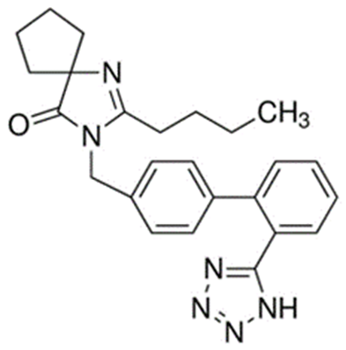
Introduction
Sartans are a category of drugs prescribed to treat hypertension and high blood pressure. They act as angiotensin II receptors antagonist. Many active principles belong to this family and we decide to focus on irbesartan, one of the most prescribed.
The EU has classified many drugs, including sartans, as ‘emerging pollutants’, making their determination of the outmost importance.
Sartans determination is usually carried out by HPLC-MS/MS analysis, a techinique that is both time consuming and expensive. Moreover, in situ analysis are impossible and sample pretreatments are required.

Slide 3
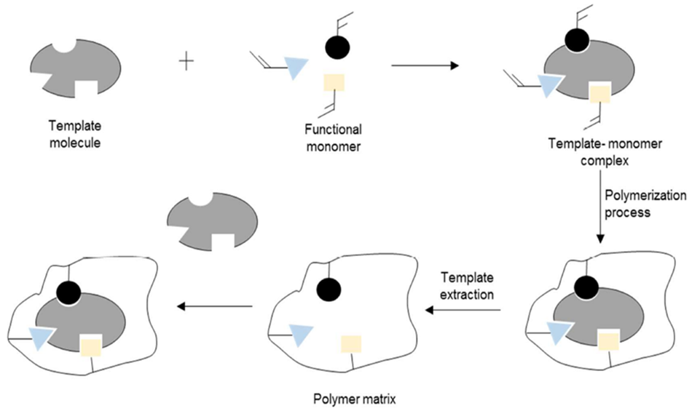
Molecularly Imprinted Polymers (MIPs)

Slide 4
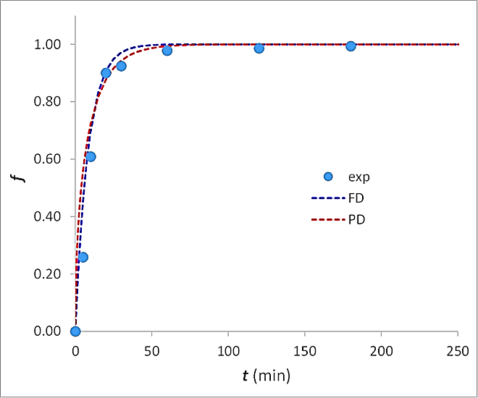
Polymer characterization
Polymer characterization was performed through sorption isotherms and kinetics experiments
Sorption isotherms
Kinetics experiments
 | q_{max} (mmol g⁻¹) | K_{L} (mol⁻¹ L)
MIP | 0.4 | 1.8 ∙10³
NIP | 0.07 | 5.3 ∙10³

Slide 5
Electrode functionalization and measurements
2 μL of prepolymeric mixture were drop-coated on the electrode surface. Polymerization occured at 70 °C overnight.
C=N reduction is monitored through Square Wave Voltammetry analysis.
Experimental conditions optimization was performed through experimental design. The procedure was applied to both bare and functionalized electrodes.

Slide 6
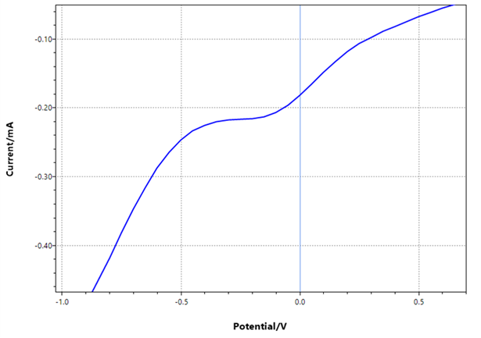
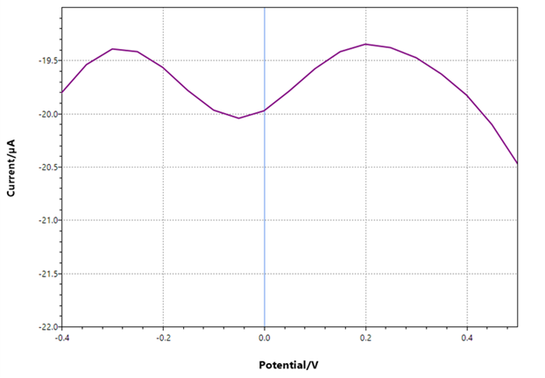
Square Wave Voltammetry
Bare electrode
MIP-electrode

Slide 7
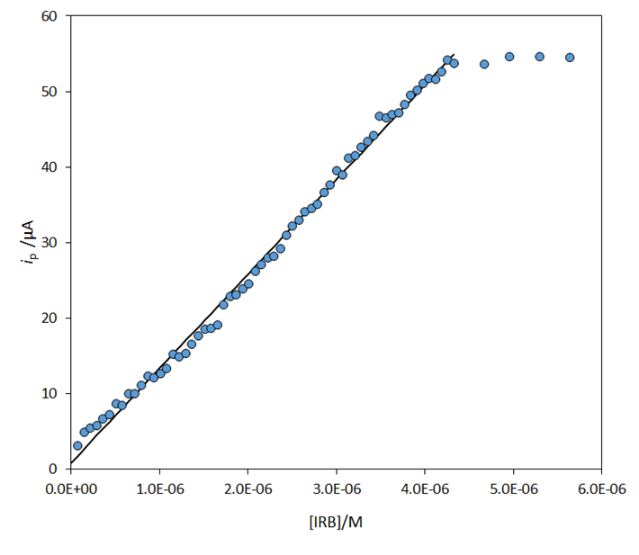
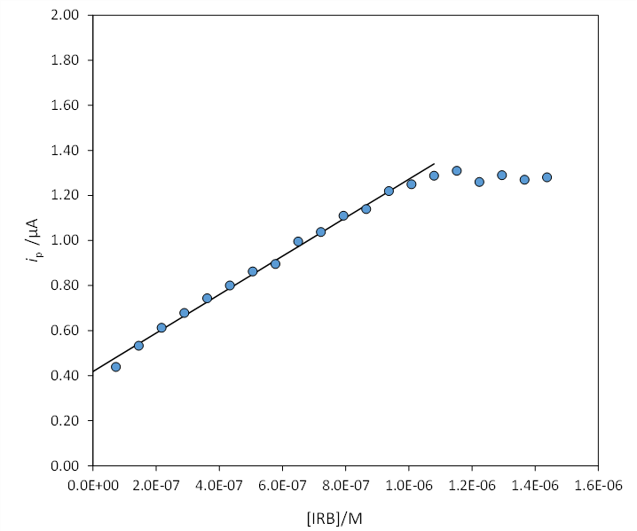
Calibration curves and results
Bare electrode: LOD 72 nM
MIP-electrode: LOD 44 nM
Tap water spiked with Irbesartan

Slide 8
Conclusions
A novel molecularly imprinted polymer (MIP) for irbesartan sensing was successfully developed and characterized.
A maximum sorption capacity of 0.4 mmol/g was achieved. From the kinetic profile, it can be seen that the time required to obtain quantitative analyte sorption was about 1 h.
Screen-printed cells, with the graphite working electrode modified with the MIP, were used for irbesartan determination by Square Wave Voltammetry (SWV), yielding a LOD only one order of magnitude higher than that found in real samples with traditional techniques.
Tests with fortified tap water samples of known analyte concentration yielded a recovery higher than 90%, making the electrode promising for trace analysis of real samples.
Further studies are ongoing, aiming to optimize the polymer formulation and lower the LOD.

