Slide 1
On the role of Leaf Area Index parameterization in simulating the terrestrial carbon fluxes of Africa using a regional coupled climate-vegetation model
Prepared by
Samy A. Anwar
Egyptian Meteorological Authority, Qobry EL-Kobba, Cairo, Egypt, P.O. Box 11784

Slide 2
Motivation
Performance of the offline land surface or regional coupled regional climate-vegetation models (for simulating LAI and GPP) has been evaluated over Africa (e.g., Erfanian et al. (2016)). For instance, Wang et al. (2016) showed that a coupled climate-dynamic vegetation model overestimates both GPP and LAI concerning the Machine Tree Ensemble (MTE).
Recently, Anwar and Diallo (2022) examined the role of LAI parameterization in controlling the surface energy balance and climate of Africa with RegCM4 coupled with Community Land Model version 4.5 (CLM45) including a module of carbon–nitrogen cycling (CN) (RegCM4-CLM45-CN). They reported that when the modified LAI formula is used, the model performance is improved relative to the original LAI formula and it shows a similar performance relative to the static vegetation case.
This study aims to examine the role of LAI parameterization in simulating the terrestrial carbon fluxes of Africa using a regional coupled climate-vegetation model (RegCM4-CLM45-CN).

Slide 3
RegCM4 model description and Experiment Design
Figure 1 shows the topography in meters over the domain.
The simulations shared the same initial, and lateral boundary condition from the National Centre for Environmental Prediction/National Centre for Atmospheric Reanalysis version 2 (NCEP/NCAR2; Kanamitsu et al. 2002) was used as the lateral boundary conditions and ERA-Interim data (Dee et al. 2011) was used as the sea surface temperature (SST).
The RegCM4 model simulations adopted the physical configuration of Anwar et al. (2021). Because the simulated terrestrial carbon fluxes are not sensitive to spatial resolution (Slevin et al. 2017), the 60 km horizontal grid spacing was used in this study.
The influence of different environmental factors such as: land use, CO2, DV, crops, aerosols (Kanniah et al. 2012), ozone (O3; Anav et al. 2011) and nitrogen deposition (Bala et al. 2013) on the simulated terrestrial carbon fluxes was not considered in the present study.
To bring the vegetation carbon and net ecosystem exchange to an equilibrium state, the two simulations were initialized by a long-term spinning up of CN (Fang et al. 2015; Ghimire et al. 2016). As noted, the two simulations (LAIorg and LAImod) were conducted for 13 years, from 01 January 1998 to 31 December 2010.
The analysis was performed from 2001 to 2010 based on the availability of the CARDAMOM product. Concerning the FLUXNET measurements, the study depends on the data availability of each station.

Slide 4

LAI Parameterization
The CLM45-CN land model adapts the formula of Thornton and Zimmermann (2007) to simulate LAI using knowledge of the leaf carbon content (CL; in gC m-2) and specific leaf area at the top of the vegetation canopy (SLAo; in m2 gC-1). Thornton and Zimmermann (2007) parameterize LAI as:
Equation 1 applies to multi-layered vegetation species (e.g., tropical evergreen forest). For short-height vegetation species (e.g., grass), the formula of Running and Coughlan (1988) is written as:
TLAI is the total projected leaf area index (m2 m-2), while m is a dimensionless parameter for a linear slope coefficient for each plant functional type. Previous studies (e.g., Wang et al. 2016; Yu et al. 2016; Erfanian et al. 2016) reported that LAI is overestimated concerning the MODIS. Ghimire et al. (2016) argued that the increasing SLA profile with canopy depth in CLM45 is partially responsible for overestimated LAI in some locations. To overcome this limitation of the overestimated LAI in Africa, Anwar and Diallo (2022) proposed a new LAI formula based on the BIOME-BGC model (Running and Coughlan 1988). Modifications were made to ensure that LAI is within a close range with respect to the MODIS. The new LAI formula over Africa for forest (TLAIforest) and grass (TLAIgrass) is written as:

Slide 5
Observational Dataset
This study used the CARbon DAta MOdel fraMework version 1.0 dataset (CARDAMOM; Bloom et al. 2016), and Fluxnet tower datasets (Pastorello et al. 2020). CARDAMOM is a reanalysis product based on assimilating a global MODIS-LAI, a tropical biomass map, a soil Carbon dataset and MODIS burned area into a diagnostic ecosystem C balance model (Data Assimilation Linked Ecosystem Carbon Model version two - DALEC2; Bloom et al. 2016).
For the present study, CARDAMOM products was bilinearly interpolated on the RegCM4-CLM45-CN curvilinear horizontal grid with the bi-linear interpolation method.
To further evaluate the two simulations, FLUXNET datasets at three sites in Africa of Demokeya (SD-Dem; Ardö et al. 2008), Mongu (ZM-Mon; Merbold et al. 2009) and Tchizalamou (CG-Tch; Merbold et al. 2009) were used to evaluate the simulated GPP on a monthly time scale.
Following Pastorello et al. (2020), data were quality controlled and processed using uniform methods, to ensure consistency and intercomparability.
Among eight available sites in Africa (namely, Demokeya, Skukuza, Nxarag, Guma, Mongu, Tchizalamou, Ankasa and Dahra), three sites of SD-Dem, ZM-Mon and CG-Tch were selected because data from other sites are limited with missing records.

Slide 6
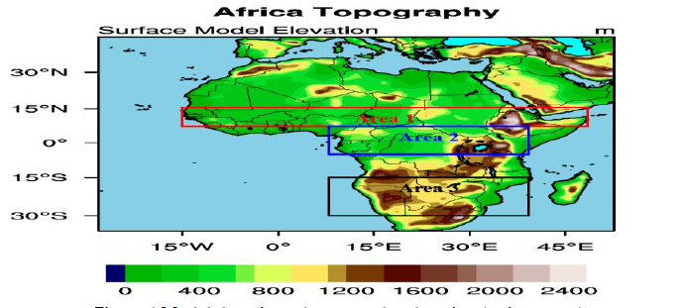
Figure 1 shows the model domain topography (in meters)

Slide 7
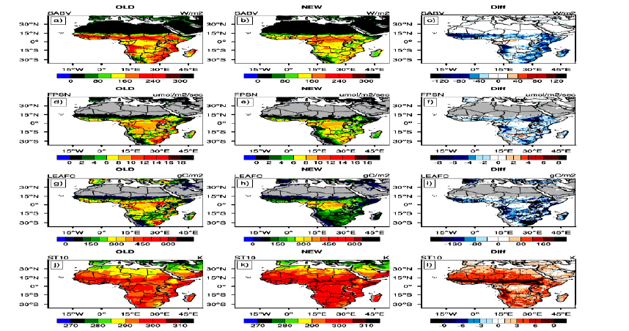
Figure 2 Spatial pattern of the solar radiation absorbed by the vegetation (SABV; in W m⁻²; a-c), photosynthesis rate (FPSN; in µmol m⁻² sec⁻¹; d-f), leaf carbon (LEAFC; in gC m⁻²; g-i) and soil temperature of depth 10 cm (ST10; in K; j-l) over the period 2001 - 2010 for the simulations LAIorg (OLD), LAImod (NEW) and the significant difference (Diff) between the two simulations. The significant difference was calculated using student t-test with α=0.05.

Slide 8
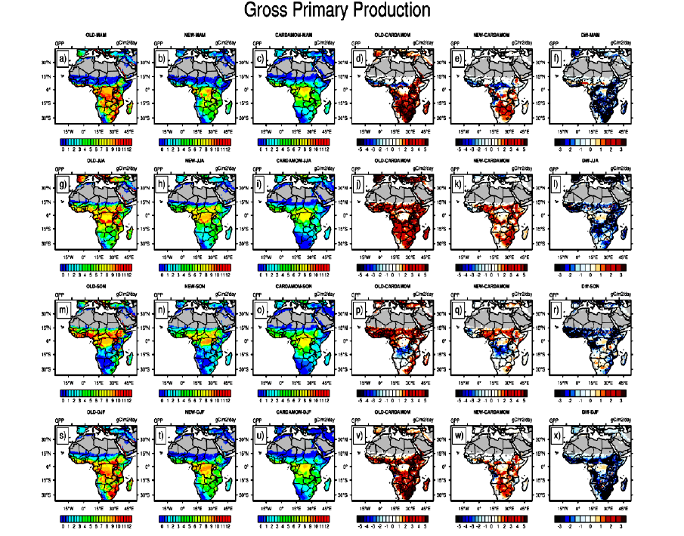
Figure 3 shows the Gross Primary Production (GPP) over the period 2001–2010 (in gC m⁻² day⁻¹) for: MAM season in the first row (a-f); JJA in the second (g-l); SON in the third (m-r), DJF in the fourth (s-x). For each row, LAIorg (OLD) is on the left, followed by LAImod (NEW), CARDAMOM is in the third from left, OLD minus CARDAMOM, NEW minus CARDAMOM and the difference between NEW and OLD. Significant model bias is indicated in black dots using student t-test with α=0.05.

Slide 9
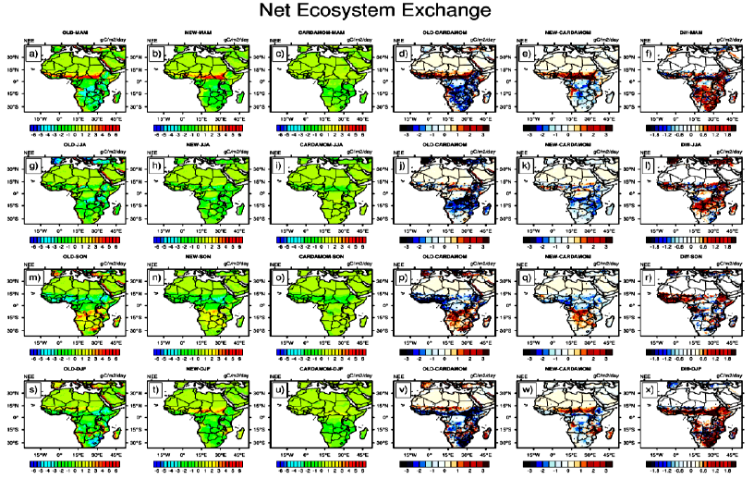
Figure 4 shows the Net Ecosystem Exchange (NEE) over the period 2001–2010 (in gC m⁻² day⁻¹) for: MAM season in the first row (a-f); JJA in the second (g-l); SON in the third (m-r), DJF in the fourth (s-x). For each row, LAIorg (OLD) is on the left, followed by LAImod (NEW), CARDAMOM is in the third from left, OLD minus CARDAMOM, NEW minus CARDAMOM and the difference between NEW and OLD. Significant model bias is indicated in black dots using student t-test with α=0.05.

Slide 10
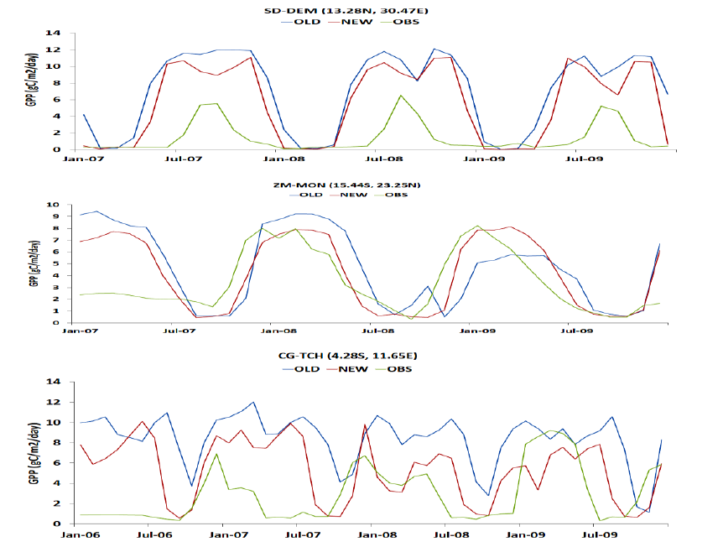
Figure 5 shows the monthly mean GPP (in gC m⁻² day⁻¹) for the LAIorg (OLD; in blue), LAImod (NEW; in red) and Fluxnet observation (in green) for the locations: SD-DEM (first row), ZM-MON (second row) and CG-TCH (third row)

Slide 11
Discussion and Conclusion
In the present study, two 13-year simulations (LAIorg and LAImod) were conducted to examine the potential influence of the LAI parameterization on the terrestrial carbon fluxes of Africa.
The results showed that switching between the two LAI formulas led to a notable influence on the ecological indicators as well as the terrestrial carbon fluxes.
Furthermore, LAImod outperforms the LAIorg in simulating the LAI and terrestrial carbon fluxes with respect to observational-based datasets. Compared with the results reported by Wang et al. (2016), LAImod reduces the LAI and GPP bias concerning reanalysis/satellite products.

Slide 12
Thank you, any questions??

