Slide 1
Yekaterinburg, Russia
Comparison of band structures of ErSb and ErNiSb intermetallics from ab initio calculations
Baidak S. T., Lukoyanov A. V.
Speaker: Baidak Semyon Timofeevich

Slide 2
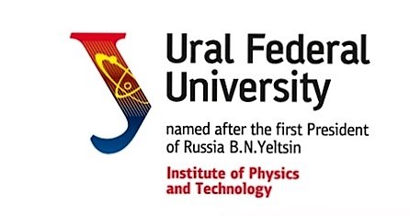
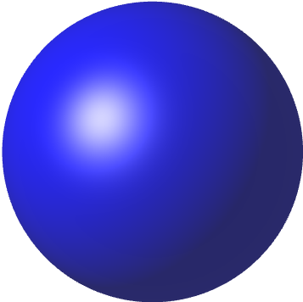
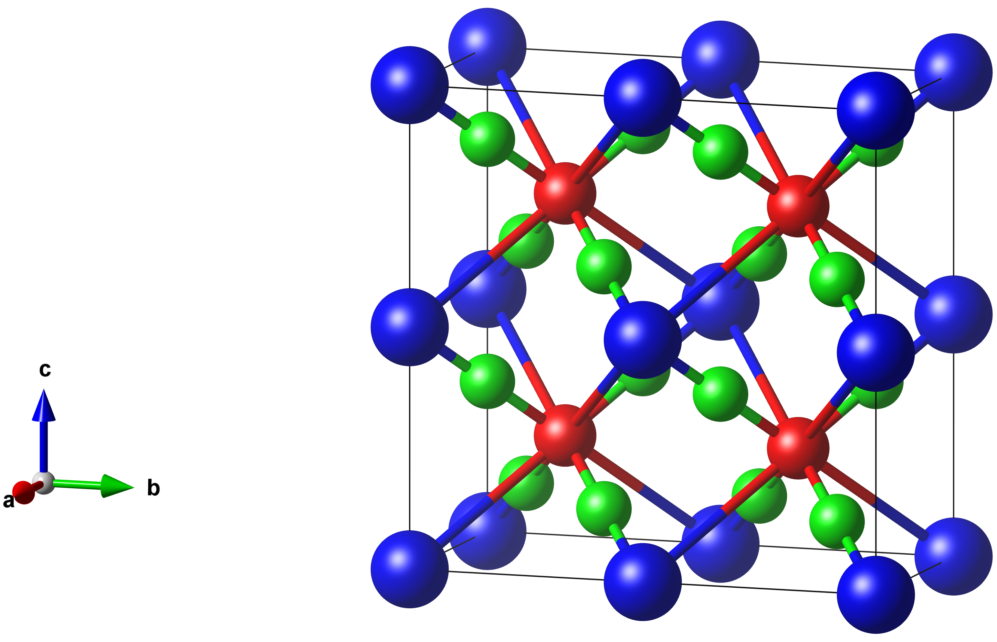
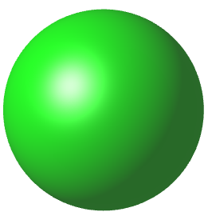
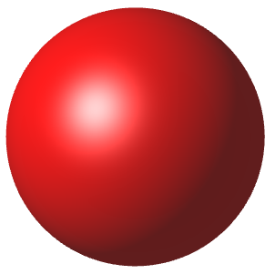
Crystal structure
- Er
ErNiSb
Lattice parameters
a($Å$) | b($Å$) | c($Å$)
6.247 | 6.247 | 6.247
- Ni
- Sb
ErSb
Lattice parameters
a($Å$) | b($Å$) | c($Å$)
6.110 | 6.110 | 6.110
Figure 1. Crystal structure of the ErNiSb compound.

Slide 3
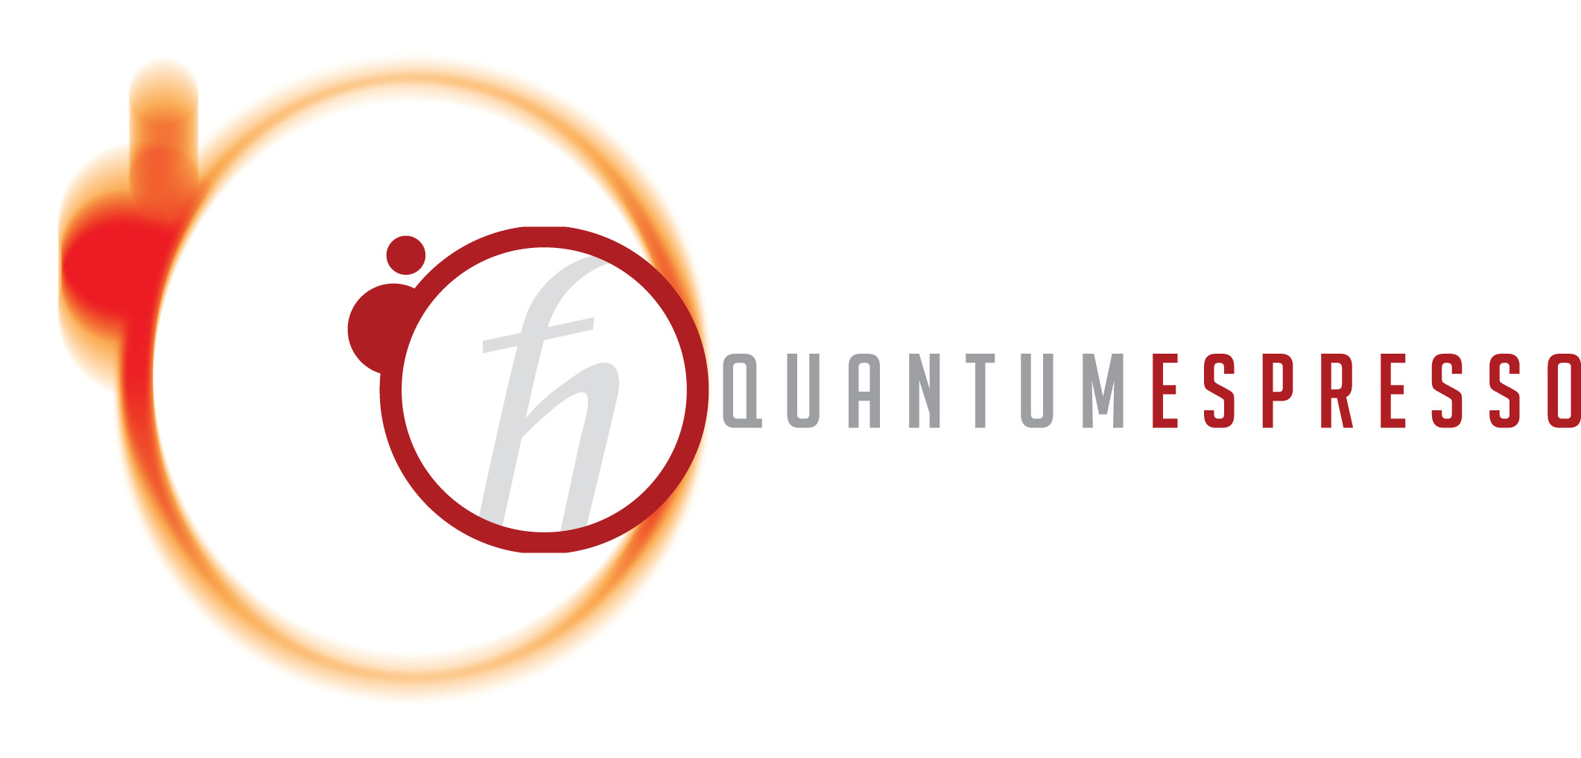
Computational method
Electronic structure calculations were conducted in Quantum Espresso package [1] using GGA+U version of LSDA+U method. The exchange correlation potential was employed in generalized gradient approximation (GGA) of Perdew-Burke-Ernzerhof (PBE) [2].
Hund’s exchange parameter: J = 0.7 eV.
Direct Coulomb interaction: U=4.9 eV.
[1] P. Giannozzi et al., J. Phys.: Condens. Matter. 21, 395502 (2009).
[2] J.P. Perdew, K. Burke, M. Ernzerhof, Phys. Rev. Lett. 77, 3865 (1996).

Slide 4
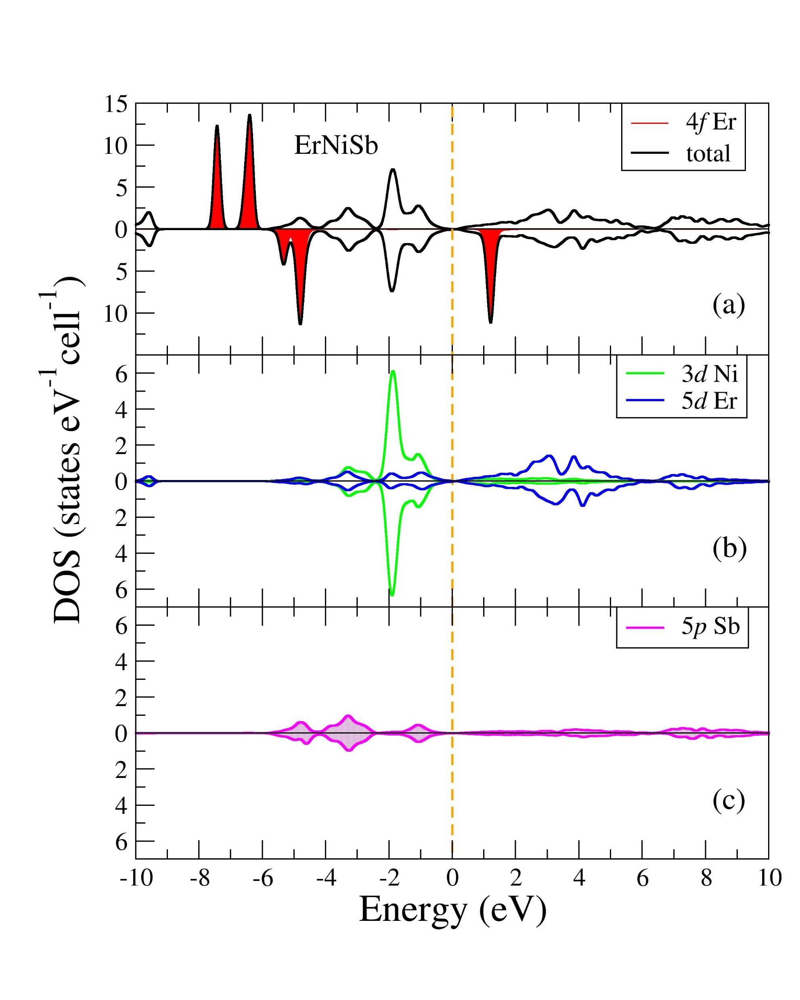
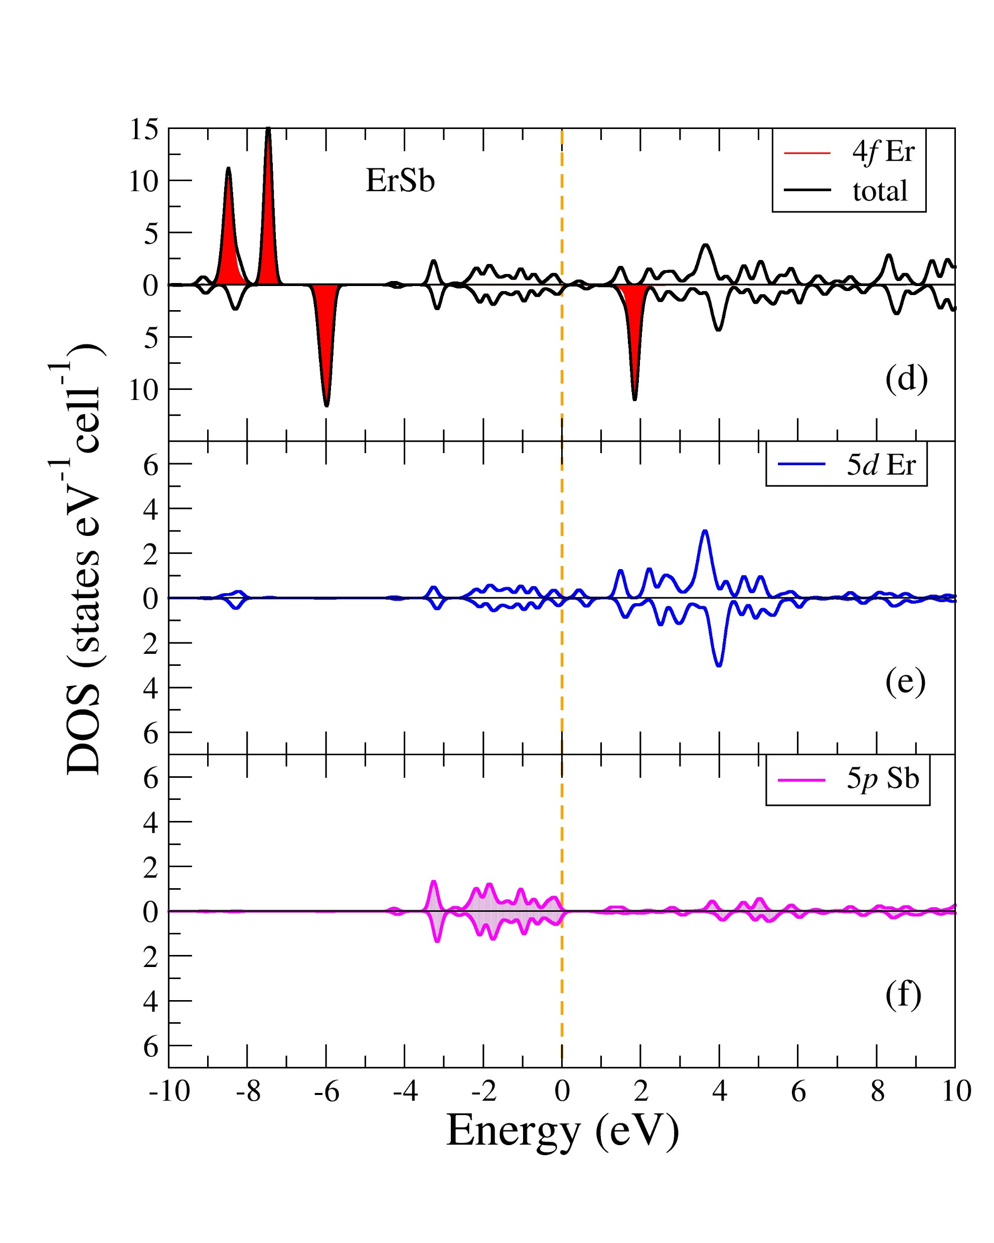
The electronic structure of the ErNiSb and ErSb compounds
Magnetic moment (μ_{B})
Experimental value for ErNiSb | Theoretical value as for the Er³⁺ ion in ErNiSb
9.7(3) | 9.58
Figure 2. Total and partial densities of states for ErNiSb (left) and ErSb (right).

Slide 5
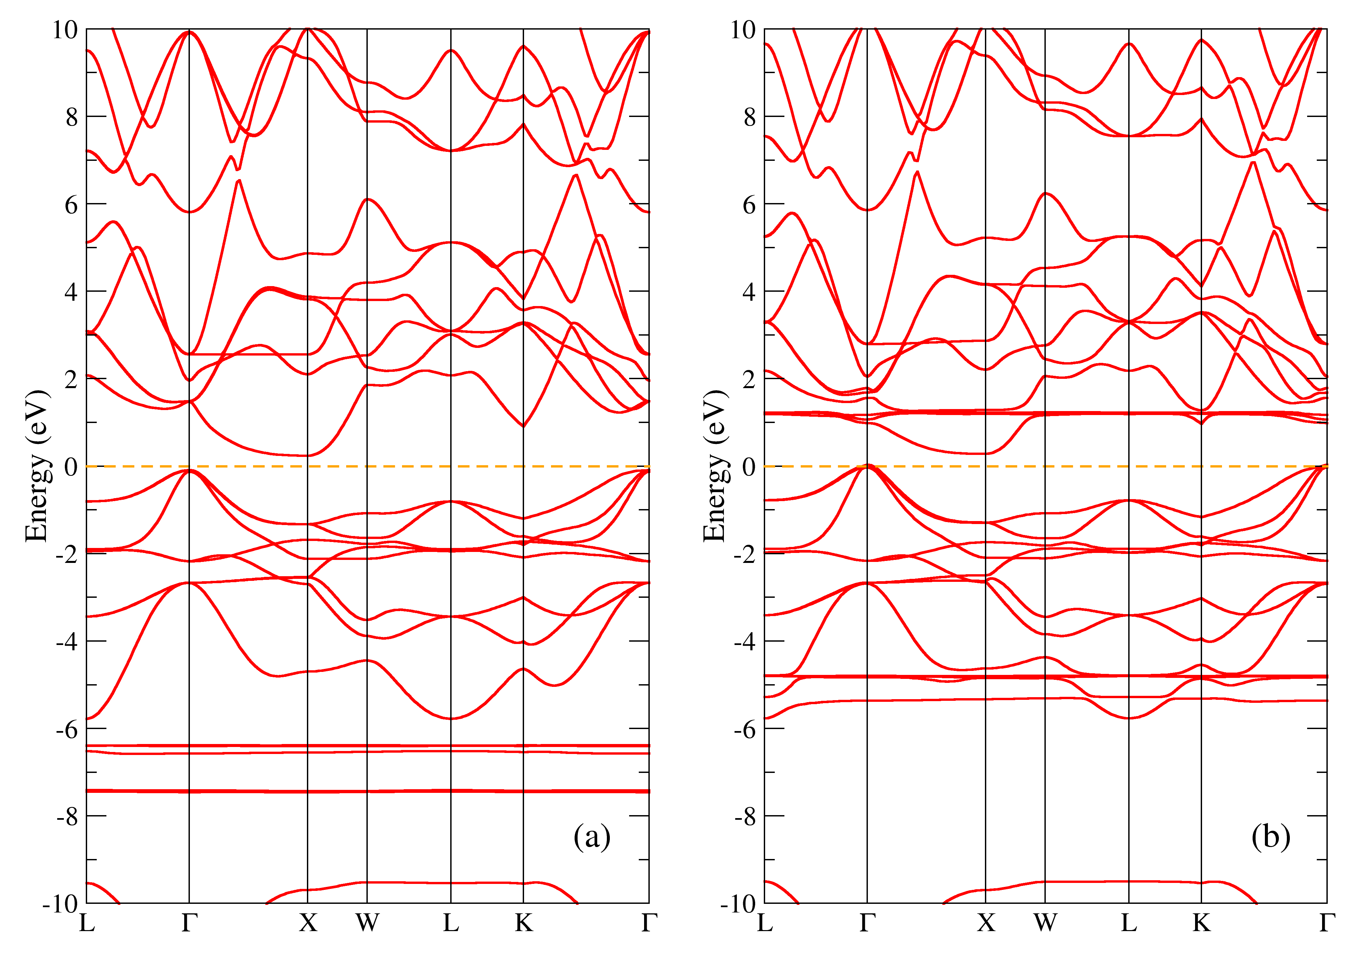
The band structure of the ErNiSb compound
$$E_{g}^{(a)}=0.33 eV$$
$$E_{g}^{(b)}=0.25 eV$$
Figure 3. Band structure of ErNiSb for the majority (a) and minority (b) spin projections.

Slide 6
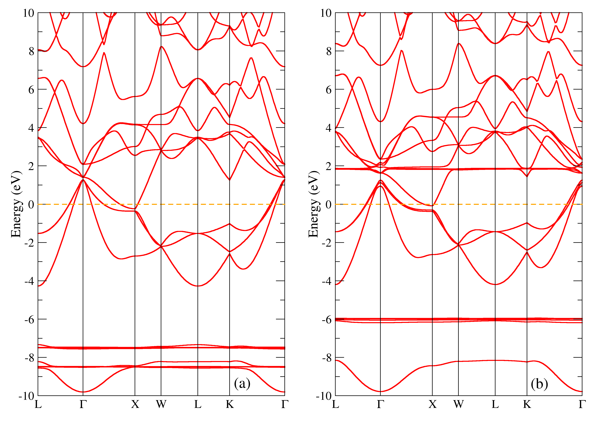
The band structure of the ErSb compound
Figure 4. Band structure of ErSb for the majority (a) and minority (b) spin projections.

Slide 7
Conclusions
Electronic structure of the compounds has been studied
We conclude that ErNiSb is a semiconductor with indirect energy gap of $↑$ 0.33 eV, $↓$ 0.25 eV
We conclude that ErNiSb is a semiconductor with indirect energy gap of ↑ 0.33 eV, ↓ 0.25 eV
ErSb is a semimetal with hole and electron pockets near Г and X points
We considered how the presence or absence of nickel in the structure affects band structure
Magnetic properties of the compounds are determined by those of erbium

Slide 8
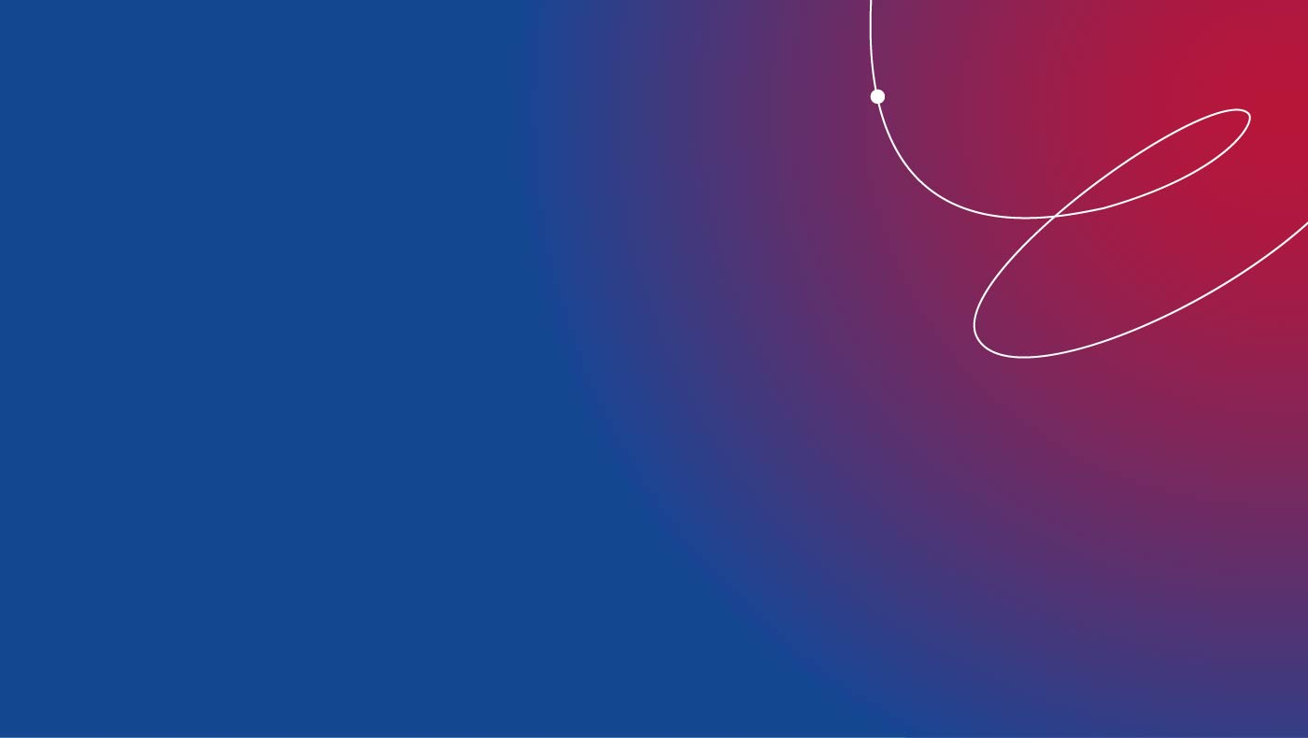
Thank you for your attention

