Slide 1
On the influence of different initial conditions on the soil temperature of Egypt using a regional climate model
Prepared by
Samy A. Anwar^{*,1}, Somayeh Hejabi²
¹Egyptian Meteorological Authority, Qobry EL-Kobba, Cairo, Egypt, P.O. Box 11784
²Department of Water Engineering, Faculty of Agriculture, Urmia University, Urmia, Iran

Slide 2
Motivation
Prediction of daily soil temperature profile (for few days in advance) or conducting a climatological study of the soil temperature profile is particularly important for daily agricultural activity or management of agricultural activity for a long-time scale.
Therefore, regional climate model (RCM) is considered an excellent tool for exploring the dynamics of the soil temperature profile over a hierarchy of time scales (ranging from daily to annual).
The present study examines the sensitivity of the simulated daily soil temperature profile of Egypt to different initial conditions (bare soil versus long-term spin-up file) using a regional climate model (RegCM4).

Slide 3
Abstract
Two eight-year simulations (2011-2018) were conducted to examine the sensitivity of the simulated soil temperature to different initial conditions using a regional climate model (RegCM4). The first simulation was initialized with an arbitrary initial condition (i.e., from bare soil) and it was referred to as RegCM4-S1; the second one was initialized with a long-term spin up file and it was designated as RegCM4-S2.
The two simulations were driven by ERA-Interim reanalysis and the output was compared with respect to in-situ observation.
The results showed that the RegCM4-S2 performs better than RegCM4-S1 in simulating the soil temperature profile; however the RegCM4 bias varies with time, depth and location. Moreover, the RegCM4-S2 shows a poor performance in simulating the soil temperature of deep depths but still outperforms the RegCM4-S1 with respect to in-situ observation.
Despite of the noted biases, the RegCM4-S2 can be used for simulating soil temperature of shallow depths. Regarding deep depths, the soil temperature parameterization needs to be revised and it is necessary to implement a numerical scheme to reduce the spin up time.

Slide 4
RegCM4 model description
In this study, the International Center for Theoretical Physics (ICTP) regional climate model (RegCM4; version 4.7.0; hereafter RegCM4; Giorgi et al. 2012) was used. RegCM4 is a limited area model and it is used for conducting long-term simulations in intercomparison projects. In addition, it was used in process studies (Qian et al. 2010) and future climate projections (Giorgi and Mearns 1999). Giorgi et al. (2012) reported that the RegCM4 model performance shows a remarkable improvement in comparison with previous versions: RegCM2.5 (Giorgi and Mearns 1999) and RegCM3 (Pal et al. 2007).
Also, RegCM4 includes a tropical band mode (RegT-Band; Coppola et al. 2012) to simulate the tropical climate processes (e.g., El Niño-Southern Oscillation; ENSO). Besides, it includes an interactive chemistry module, online gas-phase chemistry scheme (Shalaby et al. 2012). The radiation scheme is the third version of the Community Climate Model (CCM3; Kiehl et al. 1996) and includes representation of aerosols following (Solmon et al. 2006) and (Zakey et al. 2006). The RegCM4 model uses the boundary layer scheme of Holtslag et al. (1993). The Emanuel (Emanuel 1991) convection scheme is enabled over land and ocean.
Currently, the RegCM4 model is coupled with three land-surface models: Biosphere Atmosphere Transfer System (BATS; Dickinson et al. 1993), Community land model version 3.5 (CLM35; Oleson et al. 2008) and Community land model version 4.5 (CLM45; Oleson et al. 2013). It is important to highlight that the community land model version 5 (CLM5; Lawrence et al. 2019) has not been coupled to the RegCM4 till present day. Therefore, the CLM45 was used instead in this study.

Slide 5
Modifying the original CLM45 profile
To properly simulate the soil temperature profile of Egypt, modifications were inserted to the CLM45 model. The soil temperature of depth 2 cm (an example of shallow depth) is calculated as a function of soil temperature of depth 2.79 cm and soil temperature of depth 100 cm (an example of deep depth) is calculated as a function of soil temperature of depth 103.8 cm.
Spin up files of the National Center for Atmospheric Research (NCAR) don’t include the new depths (as in this study); however the inserted modifications enable the CLM45 land surface model to produce a restart file with the new depths (which are produced during the spin-up phase and required for initializing the actual simulation).

Slide 6
Experiment Design
In the present study, the model domain was customized with 30º latitude, 27º longitude, 40 grid points and 60 km grid horizontal resolution. The 60 km resolution was chosen to save the computational power for conducting the model simulations (particularly during the spin up phase). Caution was taken to ensure that Egypt boundaries lie within the selected domain. Figure 1 shows the domain dimension and topography. Two eight-year simulations were integrated from 01 January 2011 till 31 December 2018 and driven with the ERA-Interim 1.5º x 1.5º resolution grid spacing (EIN15; Dee et al. 2011) reanalysis as a lateral boundary condition. This time period was chosen for two reasons: (1) availability of the observed data and (2) EIN15 ends at year 2018.
It is important to highlight that version 4.7 of the RegCM4 doesn't support the ERA5 reanalysis (Hersbach et al. 2020) as a lateral boundary condition, therefore EIN15 was used instead. The first one was designated as RegCM4-S1 and the other one was referred to as RegCM4-S2. The RegCM4-S1 was initialized using arbitrary initial conditions (i.e., from bare soil); meanwhile the RegCM4-S2 was initialized using a long-term spin up file. The RegCM4-S2 simulation has two phases:
1. Spin-up phase: In this phase, the model was driven with the climatological mean of the EIN15 (EIXXX) to eliminate climate trend and inter-annual variability. To approach the equilibrium state (for shallow and deep depths), the model needs to cycle through the EIXXX 150 times.
2. Experiment phase: To initialize this phase, the last file from the spin up phase was interpolated on the first restart file (from the real simulation) using the interpinic. Interpinic is an executable program (provided by the offline CLM45 land surface model) and originally created for interpolating the CLM restart file from one resolution to another.

Slide 7
Observational Dataset
To evaluate the RegCM4 simulations, the soil temperature network of Egypt was used. The network comprises five stations (Asyut, Kharga, Giza, Tahrir and Malawi). For the purpose of the present study: Assyut, Kharga, Tahrir and Malawi stations were only used because they have no missed records.
Soil temperature of depths 2, 5, 10 and 20 cm are taken every 3 hours and then the daily average is calculated; meanwhile for depths 50, 100 and 200, soil temperature is recorded once per day. Besides, soil temperature records were taken in dry soil.
Because soil temperature data is available on daily basis, it is easy to examine the model ability in simulating the daily variability. The RegCM4 simulations were analyzed based on data availability in each station.

Slide 8
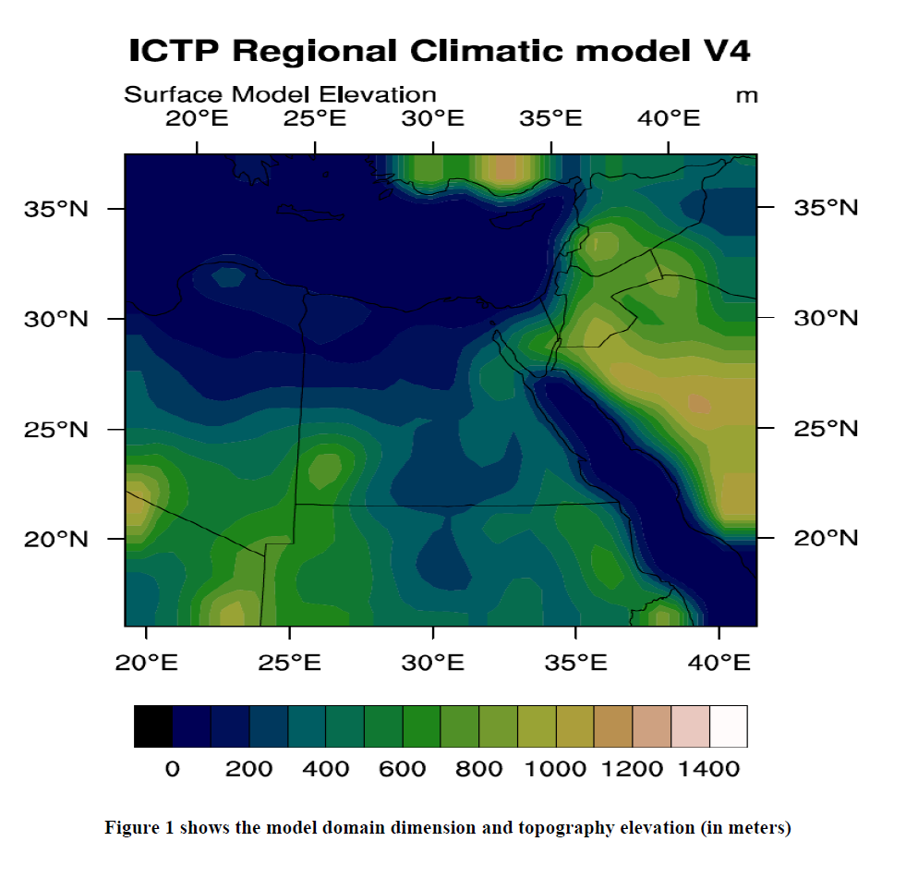

Slide 9
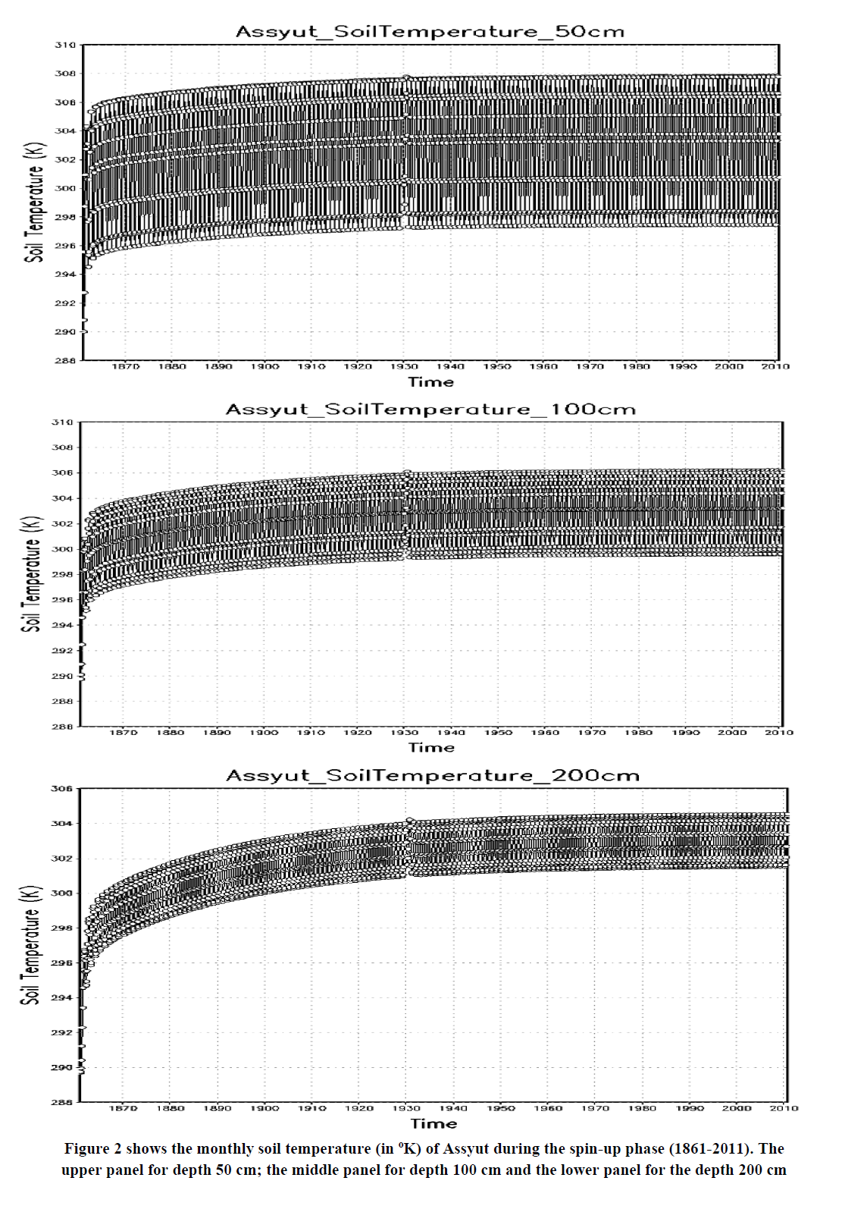

Slide 10
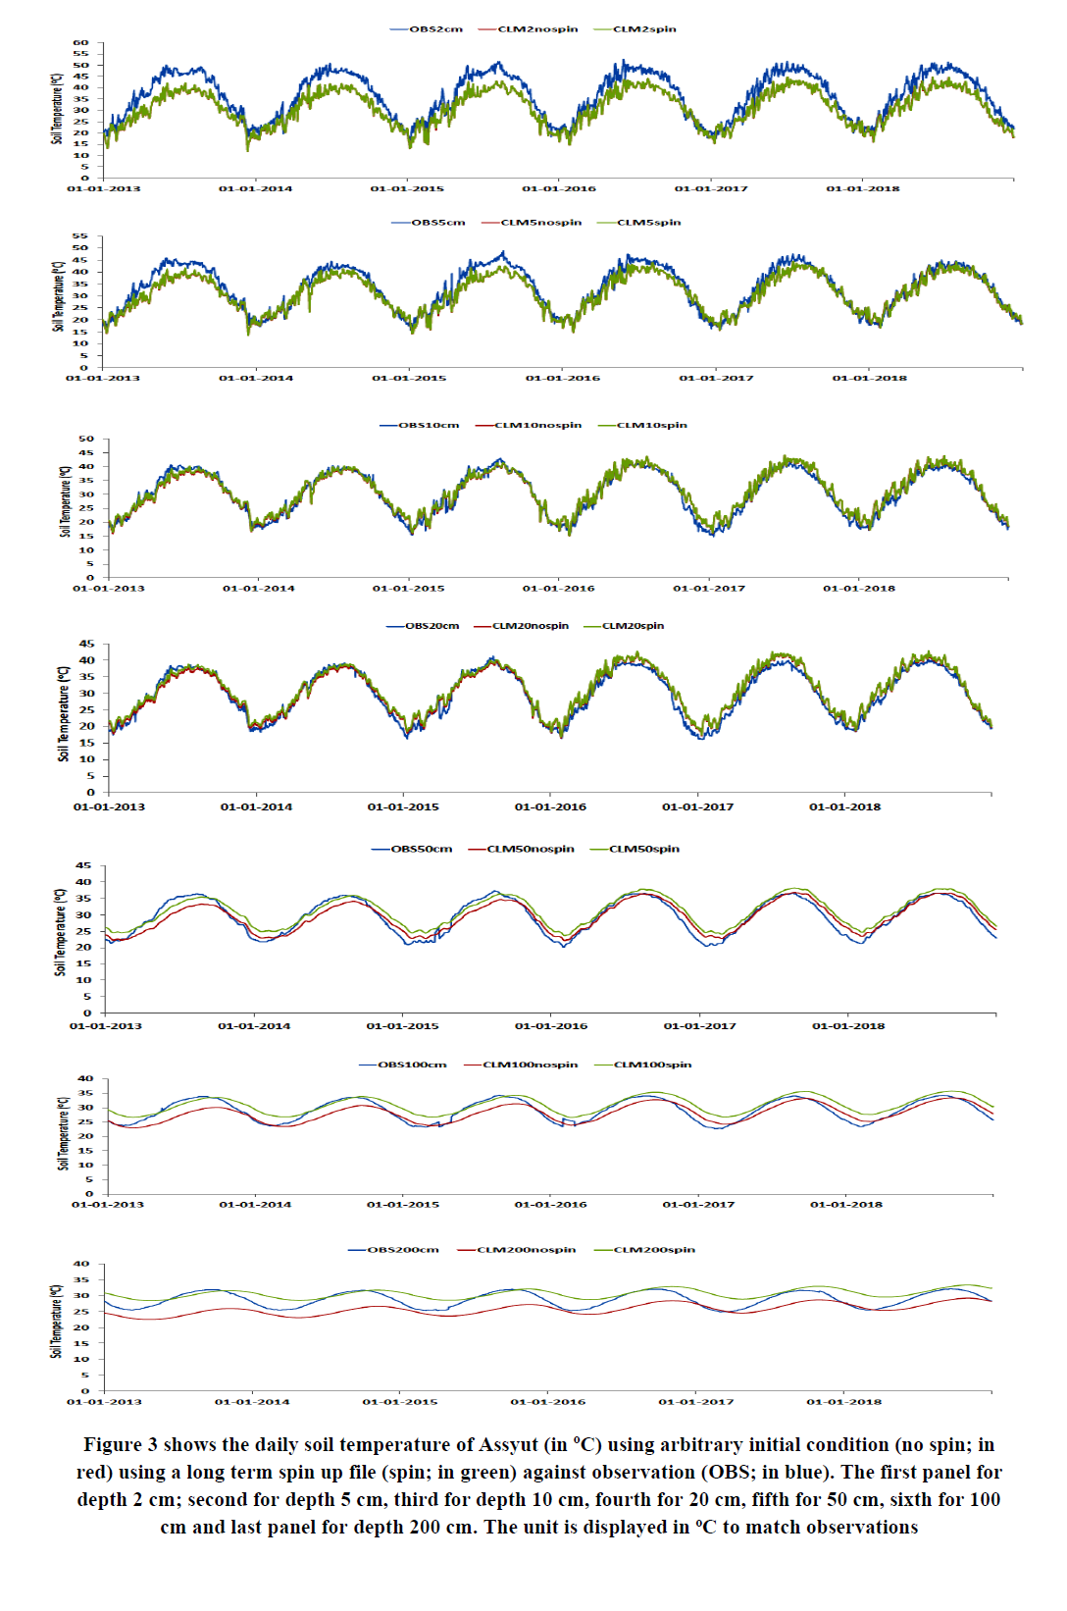

Slide 11
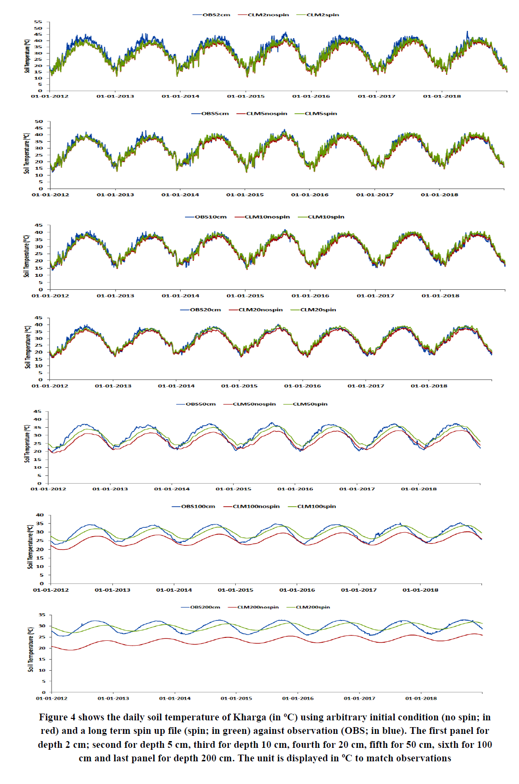

Slide 12
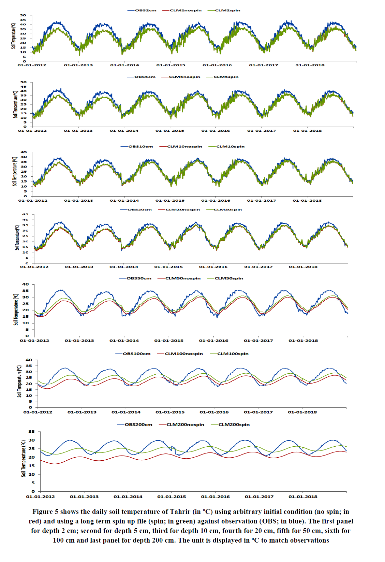

Slide 13
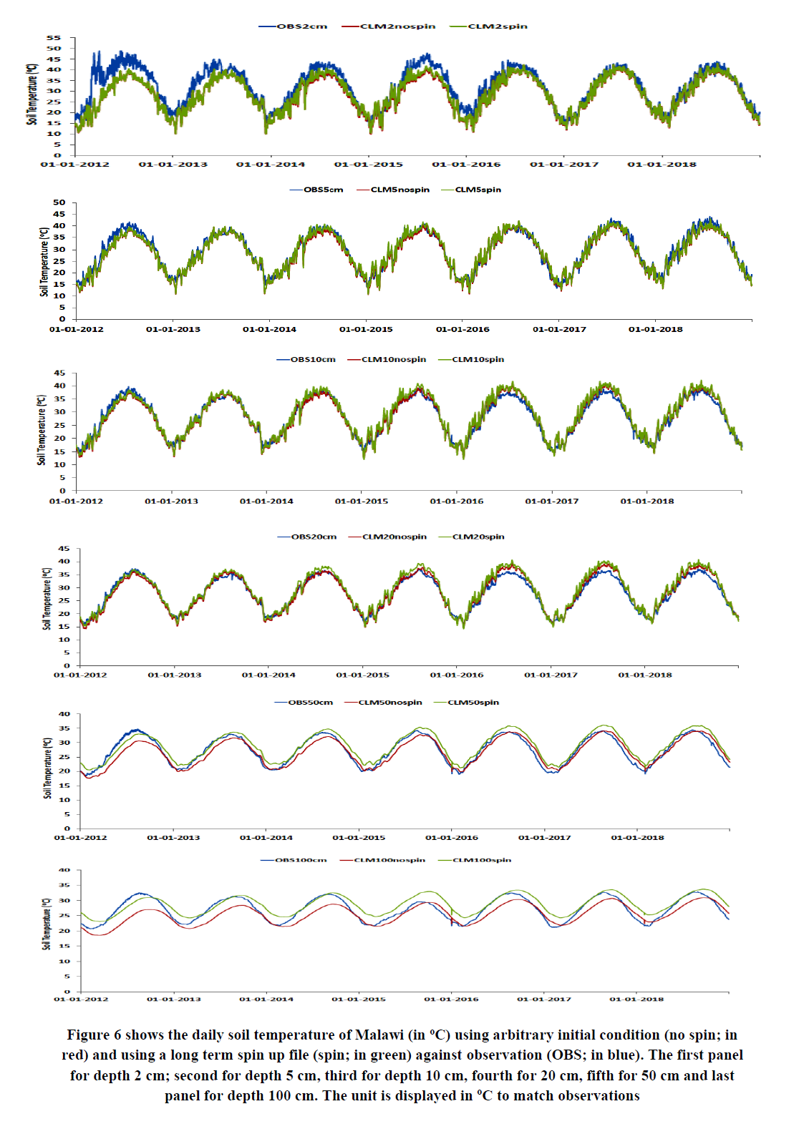

Slide 14
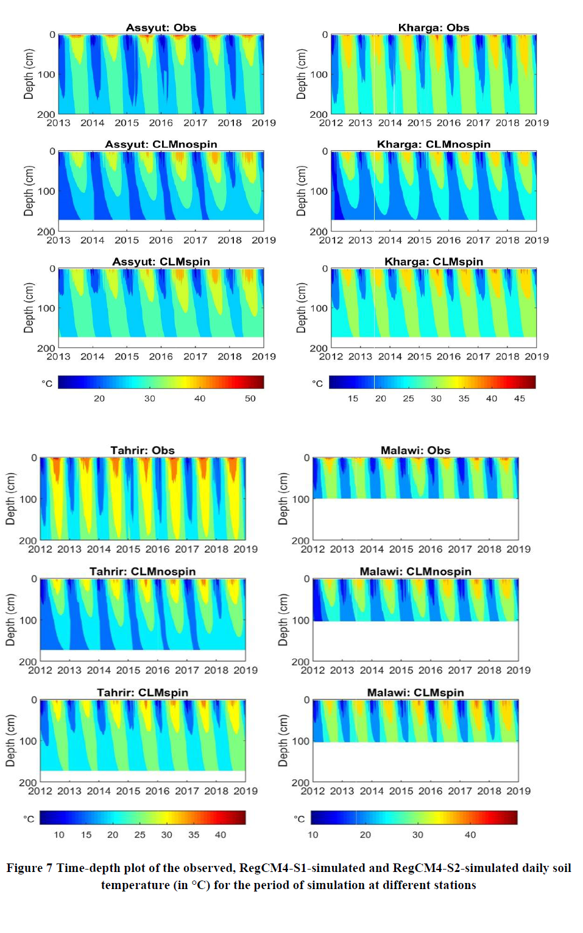

Slide 15
Discussion and Conclusion
Spinning up process is critically important to obtain a good initial condition for a real simulation particularly for arid/hyper arid regions for deep depths. Also, it improves the model capability for simulating the soil temperature profile more than when the arbitrary initial condition is used. Such good capability was indicated by a low model bias and the ability to capture the daily variability with respect to the observation. In addition, the present study provides a first insight in simulating the soil temperature at any particular depth over the region of interest using a regional climate model (RegCM4-CLM45). Despite of the noted biases, the RegCM4-S2 outperforms RegCM4-S1, therefore it can be recommended for predicting the daily soil temperature and conducting long-term simulations. To gain an improved performance of the RegCM4-S2, the following points need to be considered:
1. Incorporating a high-resolution soil map of Egypt in the global static dataset (to account for the local soil features); which considerably affects the heat transfer in soil from layer to another.
2. Implementing a numerical scheme to reduce the spin-up time of deep soil depths.
A future work will: 1) examine the influence of climate change on soil temperature profile by down-scaling the GCMs participated in the sixth phase of the Coupled Model Intercomparison Project (CMIP6; Eyring et al. 2016) using a high-resolution grid spacing (e.g., 10 km) and 2) couple the community land model version 5 (CLM5; Lawrence et al. 2019) with the RegCM4 and compare between the CLM45 and CLM5 in simulating the daily soil temperature profile with the in-situ observation.

