Slide 1
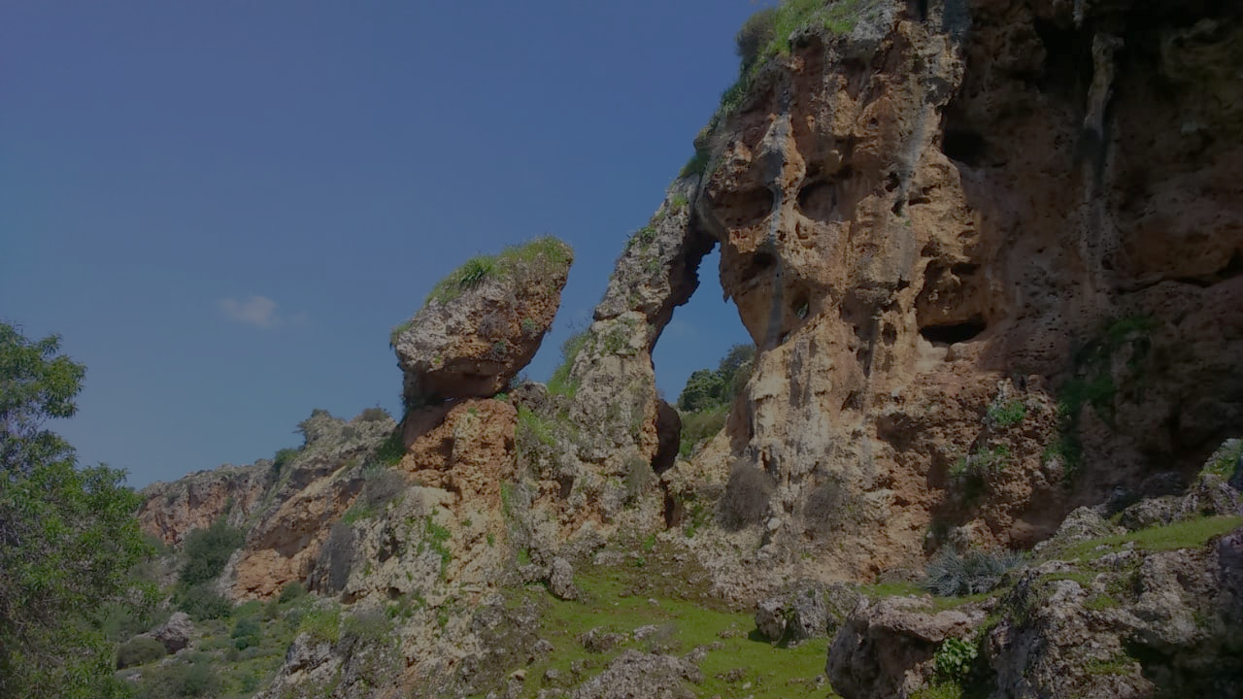
The 4th International Electronic Conference on Geosciences
The geosite of travertine waterfall of El ksiba (Morocco), a heritage to enhancement and preserve
AbdellAh AIT BARKA , Jamila Rais , Ahmed BARAKAT , Elhassan LOUZ , Samir NADEM
Notes:
Hi everyone. We present here the presetation about The geosite of travertine waterfall of El ksiba (Morocco), a heritage to enhancement and preserve.

Slide 2
The 4th International Electronic Conference on Geosciences
INTRODUCTION
The study area preserves a great number of karst geosites, such as ruiniform landscapes, caves and many remarkable reliefs such as cliffs and travertines.
This work concerns the quantitative evaluation of Travertines waterfall of El ksiba, and proposition of the strategies of valorization and protection.
The results reveal the high scientific (≃0.88) and aesthetic (≃0.88) values. The assessment also shows the high economic value (≃0.75) and cultral (≃0.81).

Slide 3
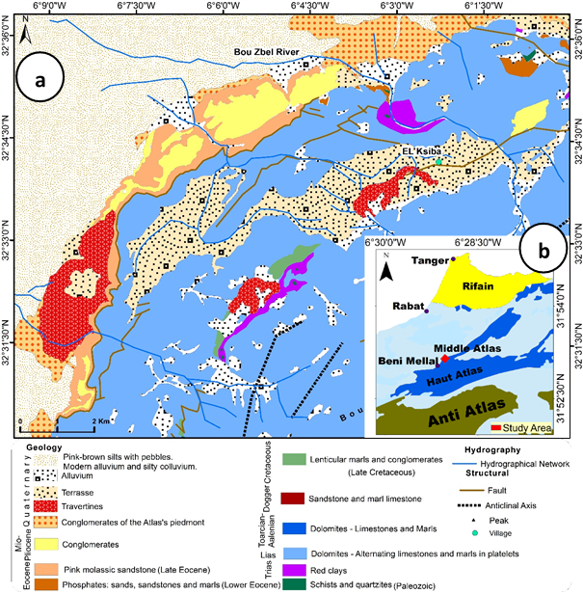
The 4th International Electronic Conference on Geosciences
Study Area
Figure 1. Geological map of study area
Travertines
Notes:
The travertines of El Ksiba forming cliffs with an extension of about 8 km and a variable height that can reach about thirty meters. They are developed on lacustrine limestones and conglomerates of Early Quaternary age.

Slide 4
The 4th International Electronic Conference on Geosciences
Materials and Methods
INPUT DATA
GEOLOGIQUAL MAP
GEOMORPHOLOGICAL MAP
FIELD SURVEY
DATA ANALYSIS
GEOSITES
(REYNARD et al. 2016)
Quantitative evaluation of the scientific and additionnal values
Qualitative evaluation about protection and managment issues
RESULTS
GEOSITES ASSESMENT AND STRATÉGIES OF PROTECTION
Figure 2. Research methodology fow chart
Notes:
This assessment we utilized the Reynard (2016) method. This approach took the scientific values and some additional values to identify geosites values.

Slide 5
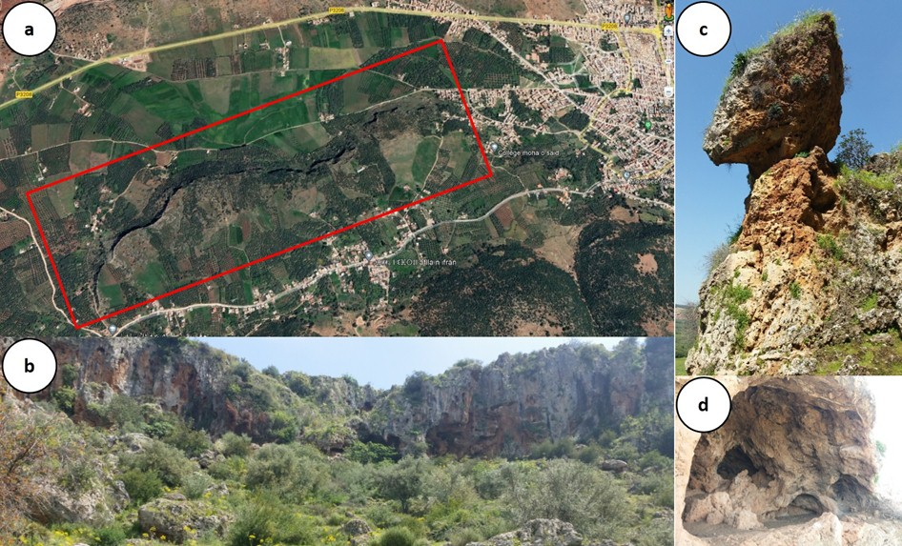
The 4th International Electronic Conference on Geosciences
RESULTS
Figure 3. Travertines of El ksiba: (a) area occupied by travertines (google earth image, october 20, 2022); (b) view on the travertines; (c) ruiniforms landscapes; (d) the Hyena Cave.
Notes:
as it shows in photo (a), the cascade type travertines occupy a large area. photo (b) presents a view from afar for these travertines. photo (c) shows a type of ruiniform landscape dominated in these travertines. photo (d) shows the Hyena Cave with great cultural significance

Slide 6
The 4th International Electronic Conference on Geosciences
RESULTS
Table 1. Quantitative assessment of the scientific and additional value of El ksiba’s Travertine.
Code | Name | Scientific value |  |  |  |  | Additional value
 |  | Int | Rep | Rar | Pal | Sc V | Ecol | Aes | Cul | Eco | Ad V
ELKhyd001 | the Hyena Cave | 1 | 0.75 | 1 | 0.75 | 0.88 | 0.75 | 0.75 | 0.75 | 0.75 | 0.75
ELKkar002 | Spring | 0.75 | 0.75 | 0.75 | 0.75 | 0.75 | 0.75 | 0.75 | 0.75 | 0.75 | 0.75
ELKhyd003 | Panoramic view | 1 | 1 | 0.75 | 1 | 0.94 | 1 | 1 | 1 | 0.75 | 0.94
ELKkar004 | ruiniforms landscapes | 0.75 | 1 | 1 | 1 | 0.94 | 0.75 | 1 | 0.75 | 0.75 | 0.812
Travertine Value |  | 0.75 | 0.88 | 0.75 | 0.63 | 0.88 | 0.81 | 0.88 | 0.81 | 0.75 | 0.81
Notes:
This table presents the Quantitative Evaluation of the scientific and complementary value of El Ksiba travertine. and in red color shows the scientific and additional values ​​of travertine

Slide 7
The 4th International Electronic Conference on Geosciences
CONCLUSION
The quantitative evaluation shows that the travertines of El ksiba have an important scientific value (0.88); it presents an open-air museum rich in paleontological, speleological and paleoclimatic data which helps us to reconstruct the old environment.
We proposed to popularize this geological phenomena by the Geoeducation.
Geotourism appears as the main component of the socio-economic development of the region, it aims to promote its geological and geomorphological wealth. It contributes to socio-economic development through the creation of new income-generating activities (ecological guest houses, traditional handicrafts, local natural products,...).
Notes:
The quantitative evaluation shows that the travertines of El ksiba have an important scientific value, culturel, economic, aescthétique important value

