Slide 1
Inventory and enhancement of geological heritage in the Ouzoud syncline (M'Goun UNESCO Geopark, Central High Altas, Morocco): first step for promoting geotourism and sustainable development
FACULTY OF SCIENCE AND TECHNOLOGY, UNIVERSITY SULTAN MOULAY SLIMANE
BENI MELLAL - MOROCCO
The 4th International Electronic Conference on Geosciences (IECG2022)
E. LOUZ, J.RAIS, A. BARAKAT, A. AIT BARKA, S. NADEM
Online event 1–15 Dec 2022

Slide 2
INTRODUCTION
The Béni Mellal-Khénifra region has an important geological heritage both by its richness and diversity.
These important geosites have become in recent years an attractive areas for tourists, especially foreigners.
a large part of this geological heritage is still unknown and under-exploited by managers.

Slide 3
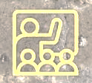
OBJECTIVES
Highlighting the geological heritage of Ouzoud syncline through an inventory supported by a quantitative assessment
Increase the local tourism attraction by enhancing the geotourism and educational potential

Slide 4
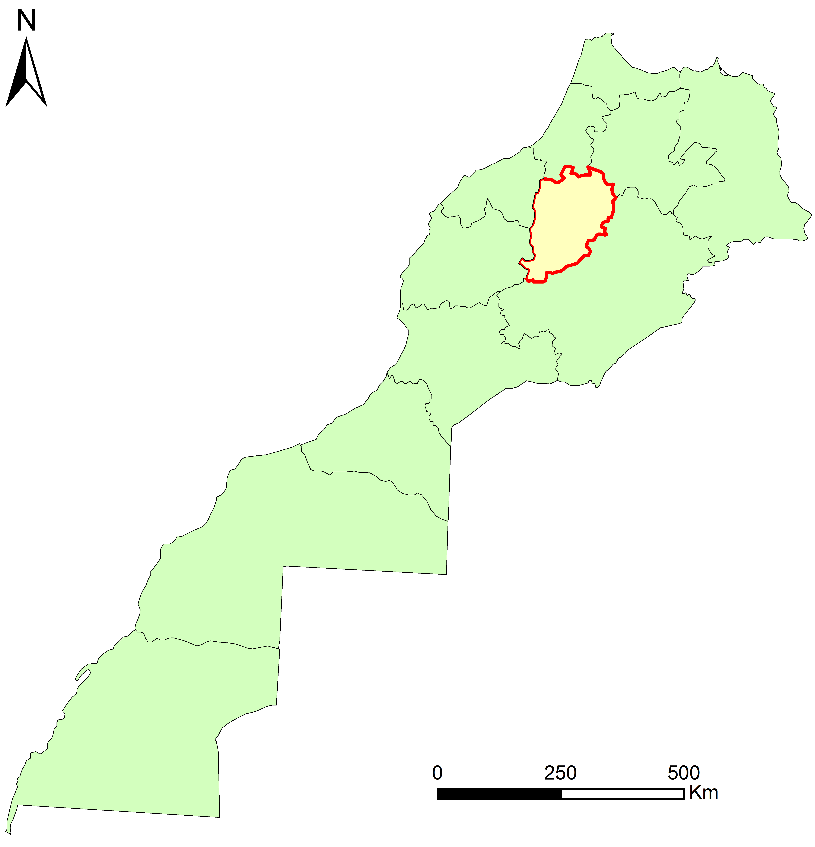
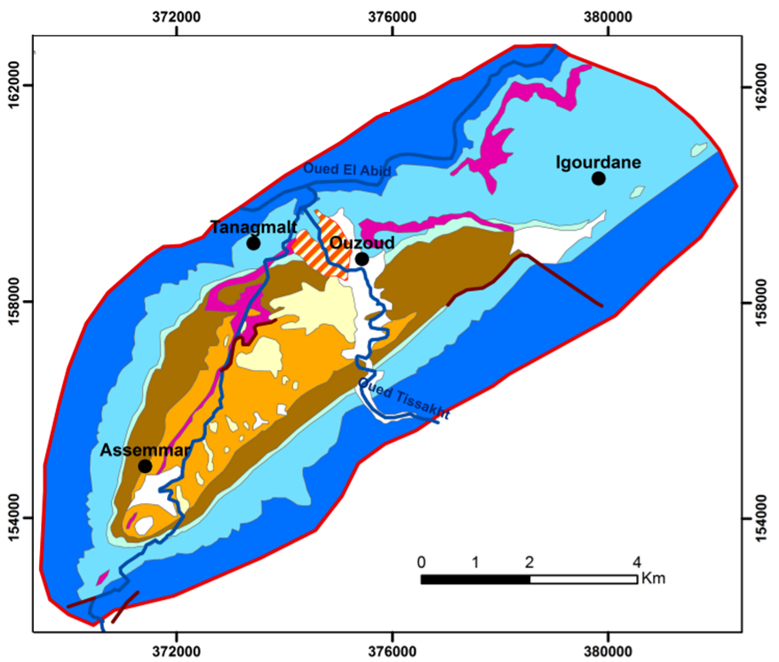
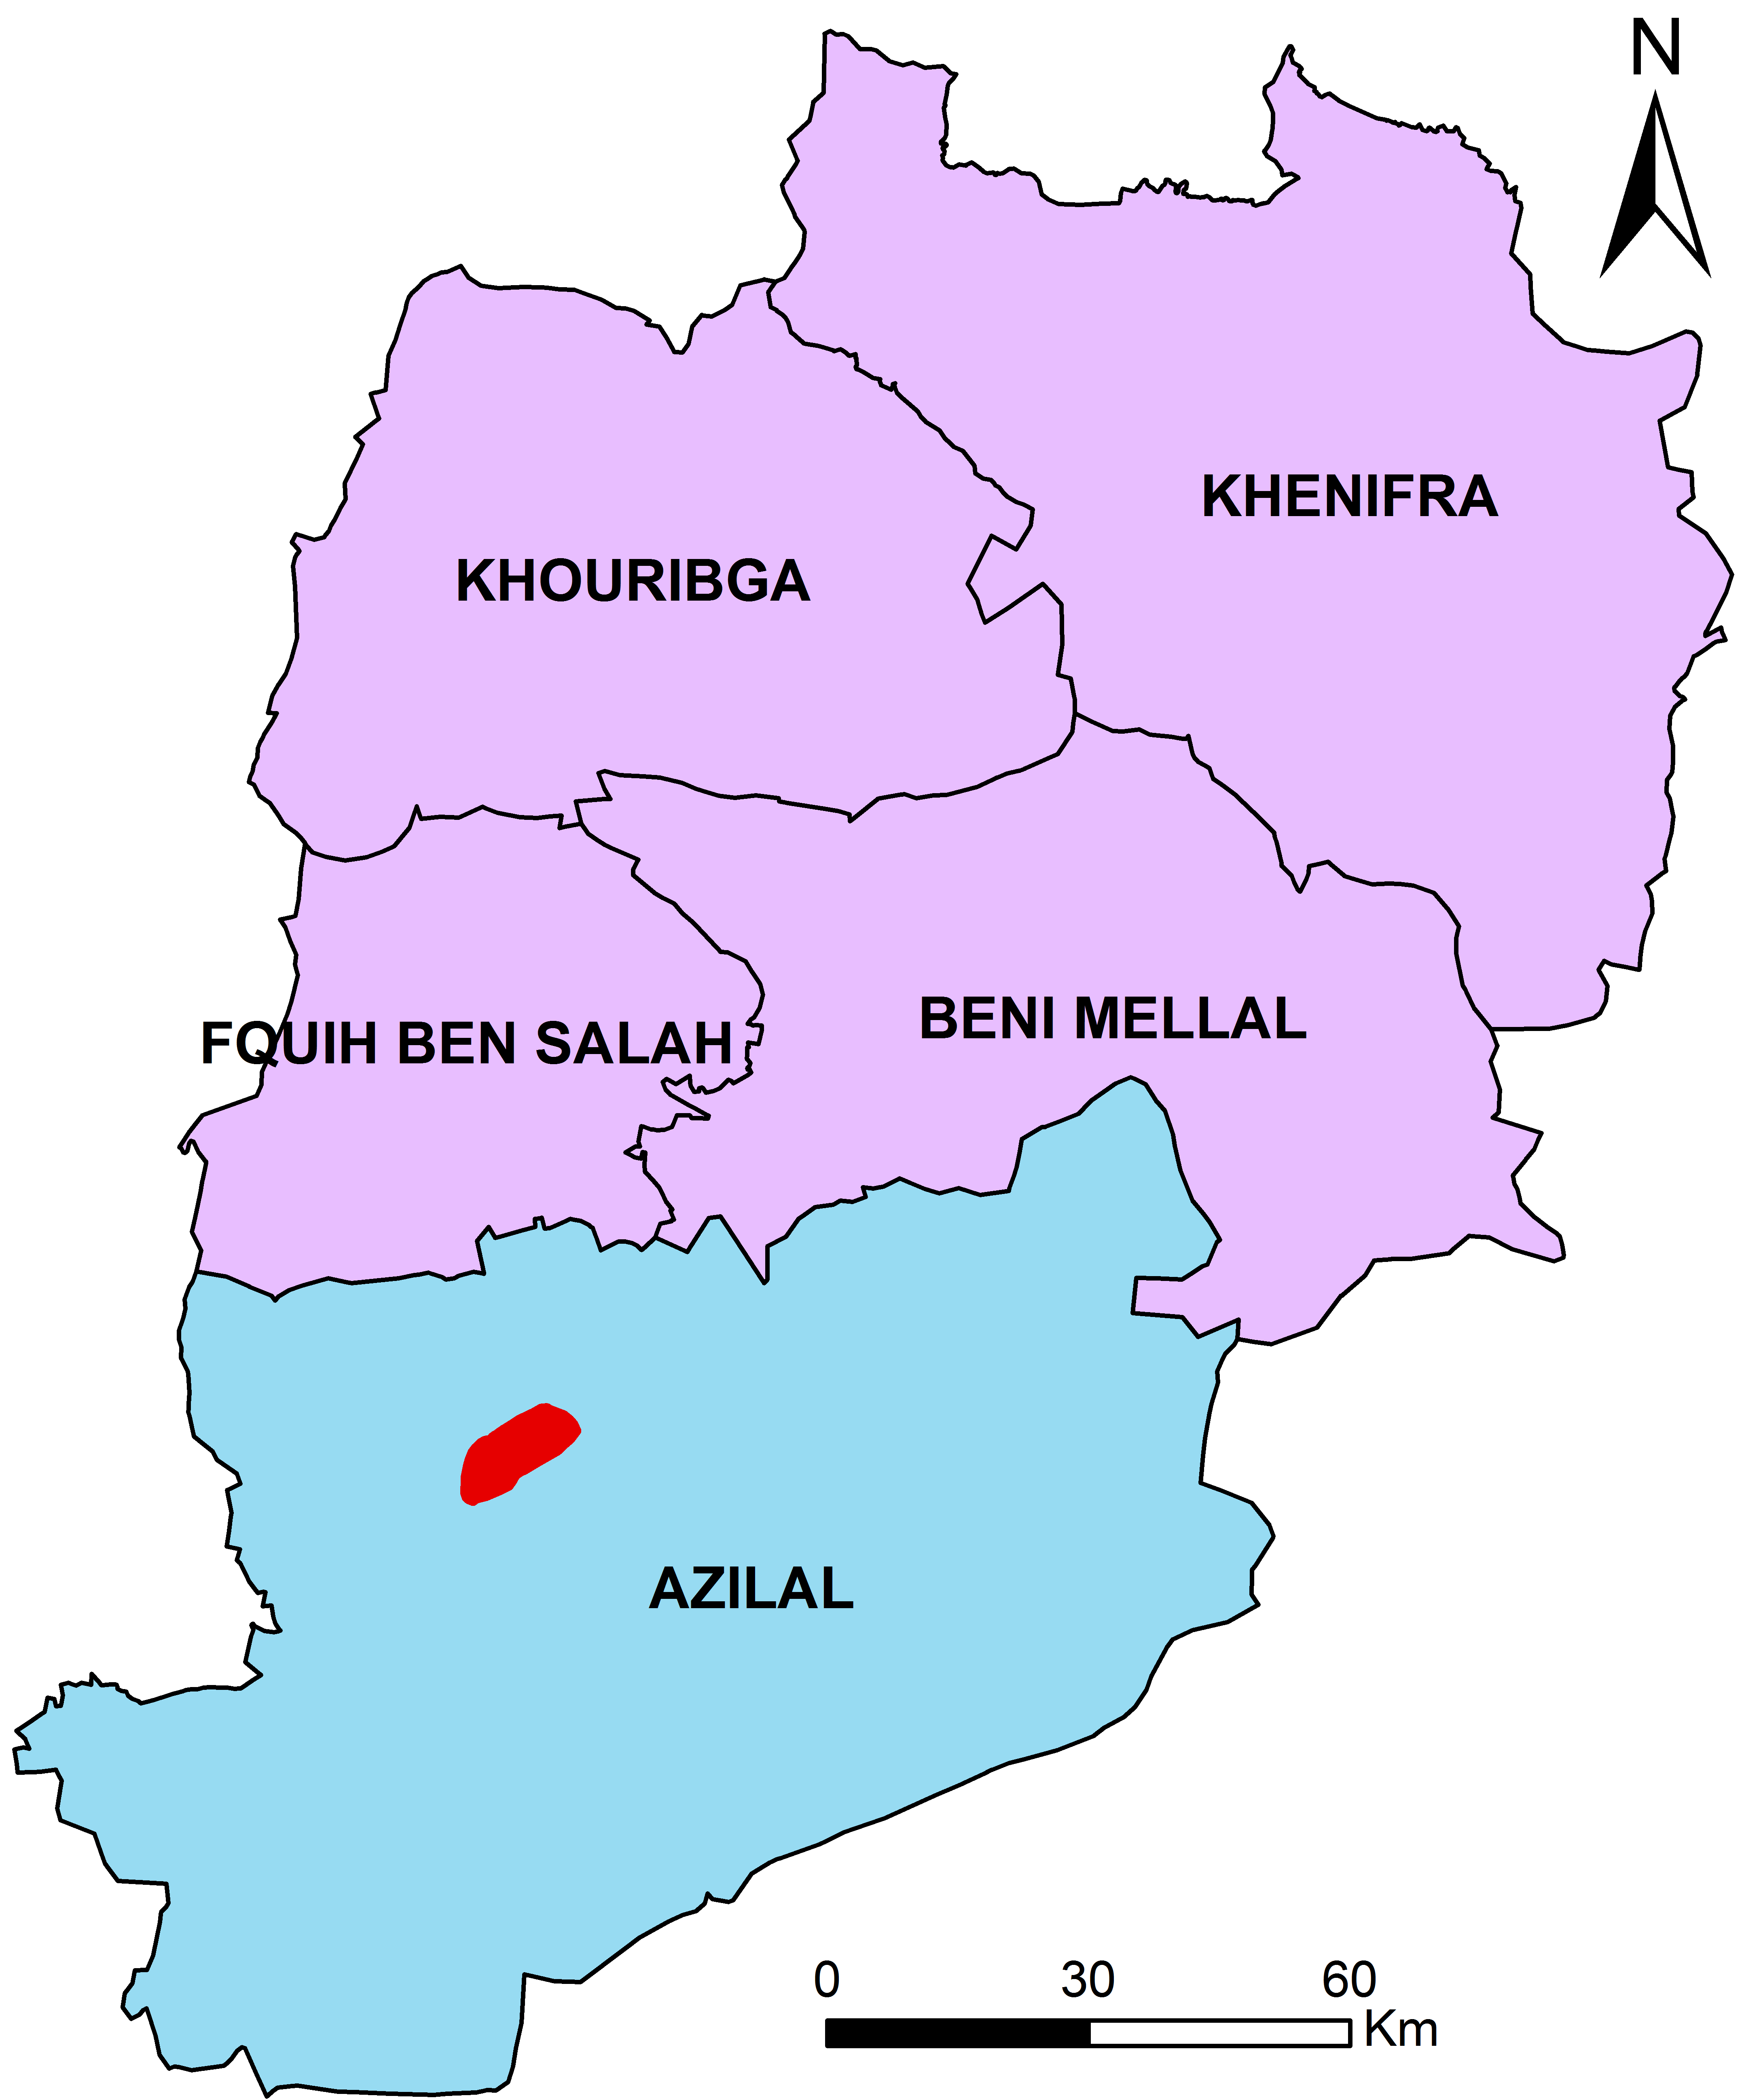
STUDY AREA
a
c
b
a) Geographical situation of Beni Mellal-Khenifra region in the centre of Morocco; b) Geographical situation of the study area in Beni Mellal-Khenifra region; c) Geological map of study area extracted from geological map of Afourer 1/100000 and Azilal 1/100000

Slide 5
METHODOLOGY
Identify all sites of geological interest
Collect and enter their characteristics in the form of technical sheets
Prioritize and validate sites with high heritage value
Assess their vulnerability with a view to proposing protective and promoting measures
In-depth bibliographic analysis
Geological literature review
Detailed description
and field investigation
GPS data
Taking photos
Consulting with experts
Quantitative assessment of
Scientific value
Additional value
Assessment of use and management characteristics
integrate these sites into territorial development as:
Touristic destination
Educational outings
According to Reynard (2016) methodology

Slide 6
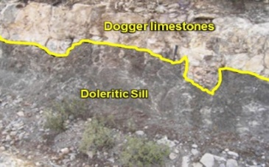
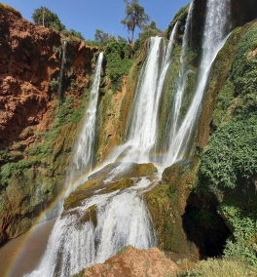
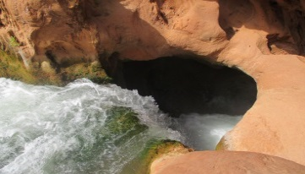
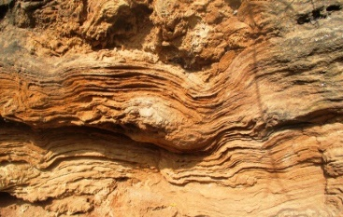
Results and discussion
It is a greenish dolerite layer of Lower Cretaceous age which intrudes the massifs limestones of the Dogger.
The most spectacular fall is about 110 m high at the bottom of a chasm covered with beautiful travertine concretions
1. The dolerite sill of Ouzoud
2. Ouzoud waterfalls
These concretions result from the precipitation of calcium carbonates dissolved in the river water
Tissakht watercourse descends quickly among limestone cliff covered with travertine. The rapid flow between these structures forms a turbulent eddy within the Giant's kettle
4. The estuary of Oued Tissakht
3. The Ouzoud travertines

Slide 7
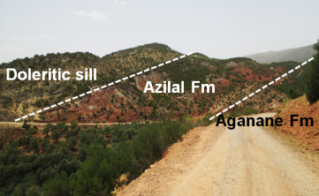
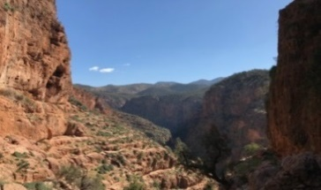
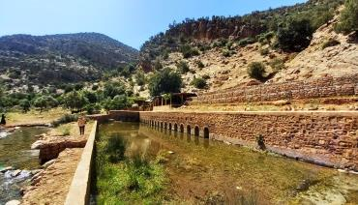
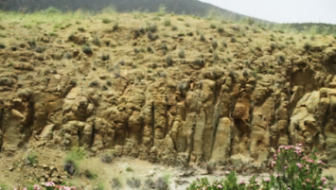
Results and discussion
It is an exceptional geomorphological forms carved out by the Oued El Abid river , forming a deep valley that exceeds 100 m.
it is a doleritic sill that cuts the reddish-brown marls of the Azilal Fm, leaving traces of contact metamorphism
6. Azilal Fm intruded by the Tanaghmelt sill
5. The Oued El Abid Gorges
associated with the upper part of the Iouaridène Fm, which corresponds to the second magmatic outpouring B2 of the Lower Cretaceous
Lias
Springs
there are 22 springs, which gush out through a complex karstic system formed by Liasic carbonates
8. Ouzoud springs
7. The basaltic flows of Ouzoud

Slide 8
Results and discussion
Quantitative assessment of scientific and additional value of inventoried geosites (According to Reynard et al. 2016)
Geosites |  | Scientific value |  |  |  |  | Additional value
Code | Name | Int | Rep | Rar | Pal | Sci Val | Eco Val | Aes Val | Cul val | Add Val
OUZmag001 | Doleritic sill of Ouzoud | 0.75 | 0.75 | 0.5 | 1 | 0.75 | 0.62 | 0.87 | 0.25 | 0.58
OUZhyd002 | Ouzoud waterfalls | 1 | 1 | 1 | 1 | 1 | 0.87 | 1 | 1 | 0.96
OUZkar003 | Ouzoud travertines | 1 | 1 | 0.5 | 1 | 0.87 | 0.87 | 1 | 0.75 | 0.87
OUZflu004 | Estuary of Oued Tissakht (Ouzoud caves) | 1 | 1 | 0.75 | 0.75 | 0.87 | 0.5 | 1 | 0.5 | 0.66
OUZgem005 | Oued El Abid Gorges | 1 | 1 | 0.75 | 0.5 | 0.81 | 0.5 | 1 | 0.5 | 0.66
OUZmag006 | Chocolate marl intruded by Tanaghmelt sill | 1 | 1 | 0.75 | 0.75 | 0.87 | 0.5 | 0.75 | 1 | 0.75
OUZmag007 | Basaltic flows of Ouzoud | 0.5 | 1 | 0.5 | 0.75 | 0.69 | 0.5 | 0.5 | 0.25 | 0.42
OUZkar008 | Karstic spring of Ouzoud | 0.75 | 1 | 0.75 | 0.5 | 0.75 | 0.87 | 0.75 | 0.75 | 0.79
Notes:
The quantitative assessment results revealed a high scientific value (average of 0.83) 46 (Table 2) for all selected geosites

Slide 9
Results and discussion
Quantitative assessment of use and management value (Reynard et al., 2016 ; Louz et al., 2022)
Geosites | Use and management values
 | Protection status | Eventual threats | Touristic infrastructure | Conditions of visit | Access road | Enhancement installation
Doleritic sill of Ouzoud | ** | *** | ** | **** | **** | Absent
Ouzoud waterfalls | **** | *** | **** | **** | **** | Present
Ouzoud travertines | *** | ** | **** | *** | *** | Absent
Estuary of Oued Tissakht (Ouzoud caves) | *** | ** | ** | ** | ** | Absent
Oued El Abid Gorges | ** | ** | ** | ** | ** | Absent
Chocolate marl intruded by Tanaghmelt sill | ** | ** | ** | *** | *** | Absent
Basaltic flows of Ouzoud | ** | **** | ** | *** | *** | Absent
Karstic spring of Ouzoud | *** | *** | *** | *** | *** | Present

Slide 10
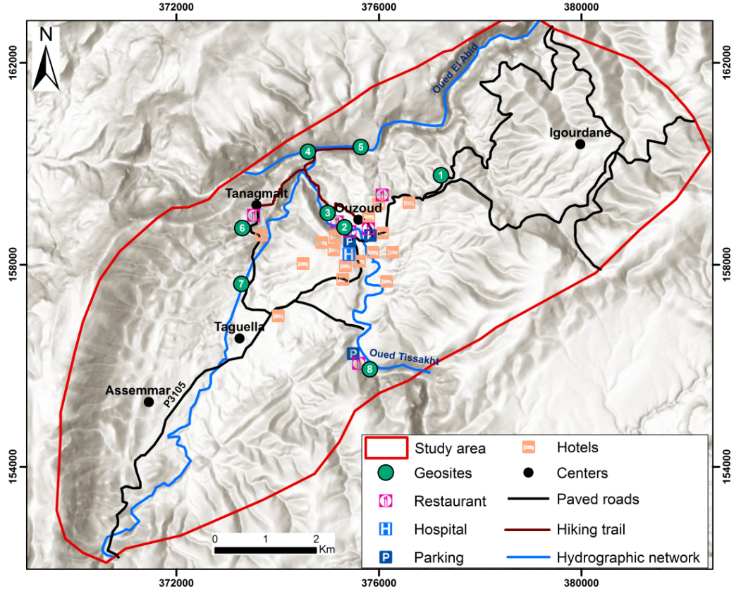
Results and discussion
A tourist circuit is proposed, starting with site 1 (Ouzoud dolerite sills) and passing respectively through sites 2, 3, 4, 5, 6, 7 to arrive at site 8 (Karstic springs of Ouzoud)

Slide 11
CONCLUSION
The results showed that the study area is dominated by geosites of high scientific and additional value suitable for scientific, tourist, and educational use;
Geotourism and geoeducation are vital tools that could be essential in protecting and enhancing national heritage;
The development of regional geotourism requires good management and the best decisions to attract more visitors while ensuring the sustainability and conservation of the interest sites;
Geoeducation aims to disseminate geosciences to the public to conserve geodiversity and ensure its sustainability for future generations.

Slide 12
Recommandations
Footpaths should be established to cover all sites in the syncline in order to reduce tourist concentration around the waterfalls and springs of Ouzoud;
Installation of interpretive panels that explain the potential of this area as a tourist and geoeducational destination;
The tourist infrastructure and offer should also be improved to attract different categories of tourists.

Slide 13
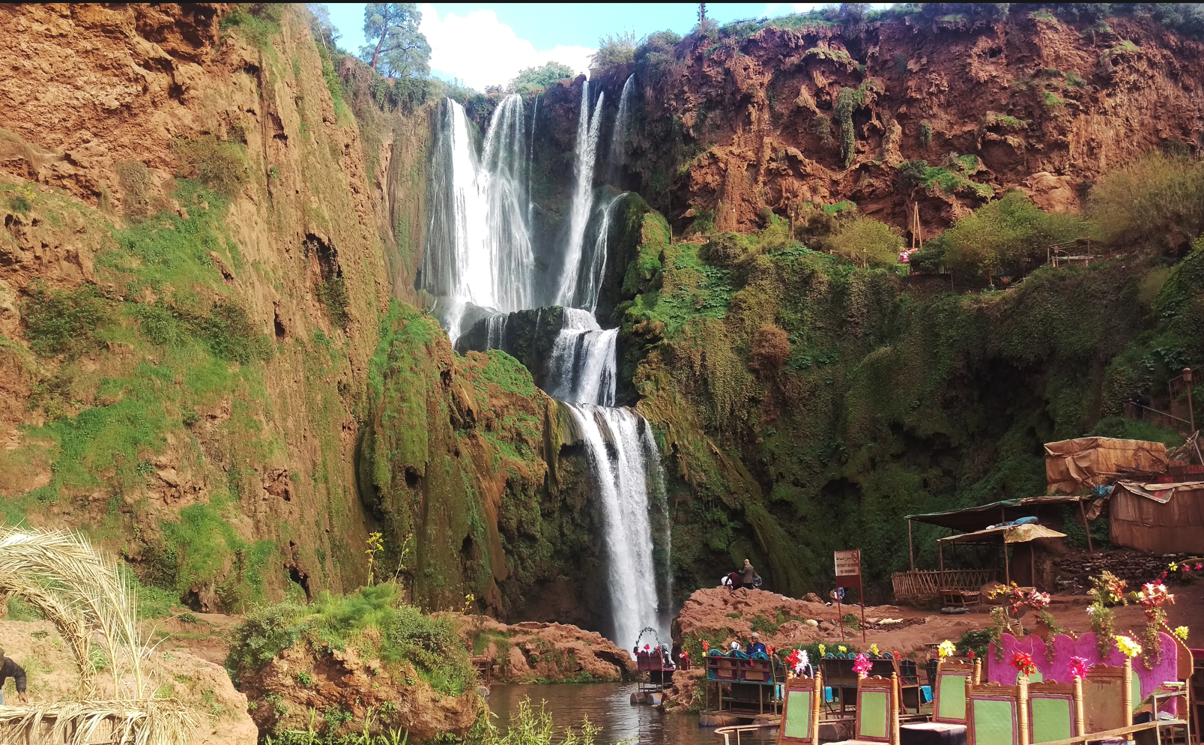
Thank you for your attention!

