Slide 1

ASEC 2022 The 3rd International Electronic Conference on Applied Sciences 01-15 Dec. 2022
Additive effects of lanthanide compound into CH₃NH₃PbI₃ perovskite layer on the photovoltaic properties and electronic structure
*A. Suzuki¹, K. Kishimoto¹, T. Oku¹,
M. Okita², S. Fukunishi², T. Tachikawa², and T. Hasegawa²
¹ The University of Shiga Prefecture, Shiga 522-8533, Japan
² Osaka Gas Chemicals Co., Ltd., Osaka 554-0051, Japan

Slide 2
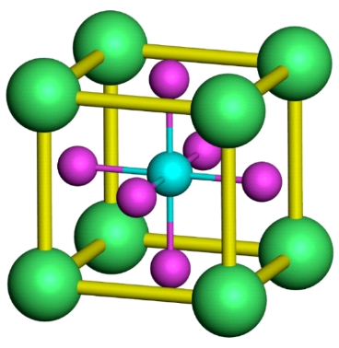
Introduction
Perovskite solar cell
Elements, Crystal structure
V_{oc} > 1.0 V Si, E_{g} ≈ 1.6 eV,
η ≈ Si, GaAs]
Conversion region (300 - 800 nm)
Simple process by spin coating
Easy to decompose,
Challenges for stability
2
+
Pb
I
-
CH
3
NH
3
+
(MA
+
)
Perovskite crystal
Perovskite solar cell
Energy diagram of solar cell
Lanthanoid compounds: Eu (II), Sm (III), Tb (III)
⇒ Stability of the photovoltaic performance
A. Suzuki, T. Oku, Jpn. J. Appl. Phys. 57 (2018) 02CE04-1-7.
A. Suzuki, M. Oe, T. Oku, J. Electron. Mater. 50 (2021) 1980.
A. Suzuki, T. Oku, Heliyon 4 (2018) e00755-1-22, A. Suzuki, T. Oku, Mater. Adv. 2 (2021) 2609-2616.
Wang et al., Science 363 (2019) 265–270.

Slide 3
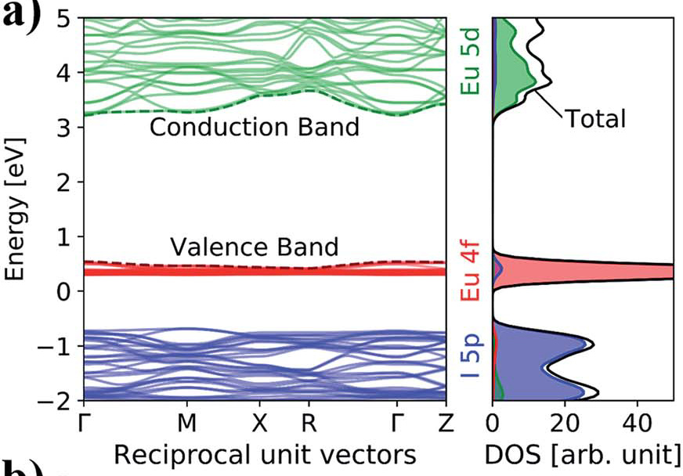
lanthanide (Ln) compound
4f-spin in Ln is less susceptible to the effect of crystal field
Eu³⁺: 4f-4f transition Red fluorescence
⇒Up/down conversion materials for solar cell
Eu²⁺: 4f⁶5d¹ transition wide fluorescence
Magnetism, high spin state (4f⁷ J = S = 7/2) (I = 5/2)
Incorporation of Eu suppressed the decomposition
⇒ Long-term of stability, Improved performance
Wang et al., Science 363, 265–270 (2019)
b)
Localization
Charge density of MAEuI₃ perovskite calculated by DFT+U
M. Pazoki, et. al. J. Mater. Chem. A, 5 (2017) 23131
Purpose: Electronic structures of lanthanide (Eu, Sm, Tb, Ce) incorporated perovskite crystal were calculated by first-principles calculation, and characterization of lanthanide compound incorporated CH(NH₂)₂PbI₃ (FAPbI₃) perovskite solar cell was performed for improving the photovoltaic performance.
Notes:
最近、希土類元素であるEuを導入したペロブスカイト太陽電池が作製され、その性能が報告されています。Euの酸化還元機構を利用してペロブスカイト層の分解が抑制され、長期安定性や性能向上が報告されています。
本研究の目的は、希土類元素である(Eu, Sm, Tb, Ce)を部分置換したペロブスカイト結晶の電子構造を第一原理計算により予測し、光起電力特性である短絡電流密度や変換効率の向上を検証することである。
Rare-earth-based compound with heavy-electron behavior have unique type of physical phenomena such as magnetic properties, fluorescence characteristics and superconductivity.
For example, the 4f electrons of europium are blocked by the closed shell structure of 5s-5p6.
The europium compound (EuIII) emits a sharp red fluorescence based on 4f-4f transition,
applying wavelength converter for solar cells.
The europium compound (EuII) had a wide area of fluorescence, electron correlation between d orbital and conductive carrier based on metal-ligand charge transfer in the coordination structure.
The heavy-electron behavior based on localized 4f orbital will be considered by the electronic structure and effective mass.

Slide 4
First-principle calculation

Slide 5
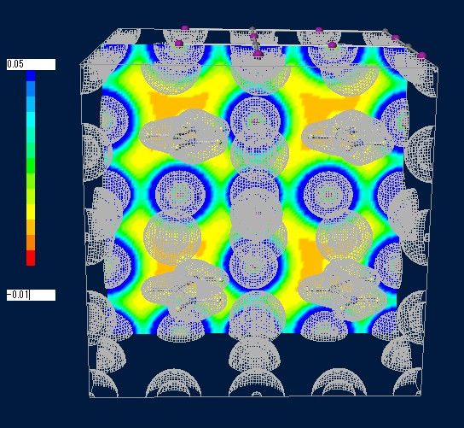
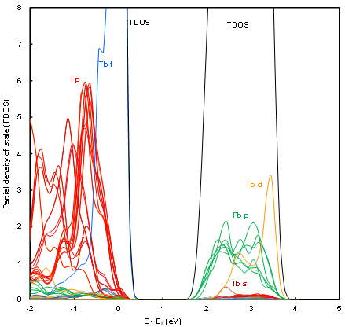
Electronic structure of FAPbTb(III)I₃
Electron density distribution
Band structure
Partial density of state (PDOS)
(a)
(b)
(c)
0.05
I
Total energy -4725 eV cell⁻¹
ΔE = -980 eV cell⁻¹
FA FA
I Tb I
I Pb I
E_{g} = 1.49 eV
-0.01
(a) Electronic density distribution, (b) band structure and (c) partial density of state (PDOS) of Tb(III)-doped FAPbI₃ perovskite crystals
PBE, k = 4 x 4 x 4, Cubic, a = 12.72 Å
Tb: 4f⁹ 5d 6s²
Notes:
FAPbTb(III)I3ペロブスカイト結晶の電子密度分布、バンド構造、部分状態密度を示します。
Tb, I原子の電子密度分布は高く、Tb – I結合間の相互作用は弱い。
価電子帯では局在化したTb 4f軌道が出現し、配位子I p軌道との相互作用は弱く、電荷移動は抑制され、
ホール移動、Jsc, ηは低下すると予想される。
伝導帯ではPb p軌道から離れたところにTb d軌道が出現し、電荷移動の影響は少ない。
バンドギャップは1.49 eVとなり、開放電圧はFAPbI3系と同様の結果が予想される。
全エネルギーはFAPbI3系よりも低下し、Tb(III)添加によりエネルギー的に安定性を示す。

Slide 6
Total energies of the doped-FAPbI₃ cluster and crystals.
Doped-cluster Total energy (eV cell⁻¹) Δ E ª (eV cell⁻¹)
FAPbI₃ -6513 0
Eu²⁺ -8918 -2405
Eu³⁺ -8915 -2402
Sm²⁺ -5417 1096
Tb³⁺ -5894 619
Eu²⁺, Cl⁻ -11971 -5458
Eu²⁺, Br⁻ -8931 -2418
Stability
Doped-crystal Total energy (eV cell⁻¹) Δ E ª (eV cell⁻¹)
FAPbI₃ -3745 0
Eu²⁺ -4582 -837
Eu³⁺ -3714 31
Sm²⁺ -3538 207
Stability
Tb³⁺ -4725 -980
Ce⁴⁺ -3500 245
Stability
ª △ E: difference between the total energy of the doped-FAPbI₃ and FAPbI₃ clusters and crystals
Notes:
Lanthanide—doped perovskite結晶の全エネルギーを表に示す。
Euを導入した系の全エネルギーは低下し、安定性を示した。
Total energies of Eu-doped cluster and crystals were decreased as compared with other cases,
yielding thermal stabilities of conversion efficiency.
Gd-doped crystal total energy

Slide 7
Results and Discussion
(a)
(b)
FAI 10%
+EuCl₂ 2%
FAI 10%,
EuCl₂ 2%
30 days
stability
FAI 20%
FAI 10%
+EuBr₂ 1%
FAI 10%
+EuBr₂ 2%
FAI 20%
+EuBr₂ 2%
J-V characteristics of the solar cells
Stabilities of conversion efficiency
Photovoltaic parameters of the perovskite solar cells with FAI and Eu.
Perovskite 190 ℃ | J_{sc} (mA cm⁻²) | V_{oc} (V) | FF | R_{s} (Ω cm²) | R_{sh} (Ω cm²) | η (%) | η_{ave} (%)
FAI 20% | 14.5 | 0.874 | 0.640 | 7.46 | 3950 | 8.13 | 7.40
FAI 10%+EuCl₂ 2% | 17.6 | 0.860 | 0.659 | 6.57 | 3960 | 9.94 | 8.30
FAI 10%+EuBr₂ 1% | 10.7 | 0.889 | 0.510 | 14.6 | 622 | 4.85 | 4.66
FAI 10%+EuBr₂ 2% | 9.40 | 0.883 | 0.563 | 11.5 | 1690 | 4.67 | 3.59
FAI 20%+EuBr₂ 2% | 8.90 | 0.875 | 0.594 | 12.3 | 4760 | 4.62 | 4.34
Notes:
Euを導入した系の電流-電圧特性と変換効率の経時変化を示す。
FAI 10%, EuCl2 2%導入によって短絡電流密度、極性因子、並列抵抗が改善し、変換効率が向上した。
変換効率は30日間維持し、安定性を示した。
Figures show J-V characteristics and stability of conversion efficiency for the perovskite solar cells.
The photovoltaic parameters of the perovskite solar cell are listed in Table.
Addition of 10% FAI and 2% EuCl2 improved the photovoltaic parameters such as shirt circuit current density and fill factor related to η.
Addition of FAI and EuCl2 maintained the stability of η for 30 days.

Slide 8
(a)
JV curve
(b)
Stability of η
Tb 210℃
Tb 190℃
Sm 210℃
Sm 190℃
decomposition
J-V characteristics of the solar cells.
Stabilities of conversion efficiency
FAI 20%
Sm, Tb 2%
Photovoltaic properties of perovskite solar cells
 | J_{sc} (mA cm⁻²) | V_{oc} (V) | FF | R_{s} (Ω cm²) | R_{sh} (Ω cm²) | η (%) | η_{ave} (%)
190℃ Sm | 7.76 | 0.885 | 0.195 | 100 | 118 | 1.34 | 1.20
210℃ Sm | 11.2 | 0.891 | 0.440 | 23.6 | 455 | 4.79 | 4.54
190℃ Tb | 10.6 | 0.870 | 0.564 | 11.8 | 421 | 5.19 | 5.17
210℃ Tb | 14.6 | 0.932 | 0.582 | 10.9 | 2030 | 7.93 | 7.23
Notes:
Sm, Tbを導入した系の電流-電圧特性と変換効率の経時変化を示す。
Sm, Tb導入系は熱処理温度210℃で短絡電流密度、極性因子、並列抵抗が改善し、変換効率が向上した。
しかし、変換効率は7日間で低下し、安定性を示さなかった。
J-V characteristics and stability of conversion efficiency for the added with Sm- and Tb-doped perovskite solar cells
are shown in Figures and table.
Incorporation of Tb into the perovskite layer improved the photovoltaic parameters of shirt circuit current density,
open circuit voltage, FF, series resistance, shunt resistance related to η. Stabilities of η were reduced for 1 week.

Slide 9
External quantum efficiency (EQE)
(a)
FAI 10%+EuCl₂ 2%
(b)
FAI 20%
FAI 20%
210℃ Tb
FAI 10%
+EuBr₂ 1%
190℃ Tb
FAI 10%
+EuBr₂ 2%
210℃ Sm
FAI 20%
+EuBr₂ 2%
190℃ Sm
EQE of the perovskite solar cells with (a) Eu, FA and (b) Sm or Tb.
FAI 10%, EuCl₂ 2% EQE Up, Tb, Sm 190℃→210℃ EQE increased

Slide 10
Conclusion
Electronic structure of lanthanide incorporate perovskite crystal was expected by first-principles calculation. The experimental investigation was performed.
Incorporation of Eu promoted the charge transfer, increasing J_{sc} related to η. Localization of d, f orbital of Sm, Tb, Ce near VB and CB suppressed the carrier diffusion, decreasing J_{sc} related to η.
The calculation prediction could be proved from the experiments.

