Slide 1
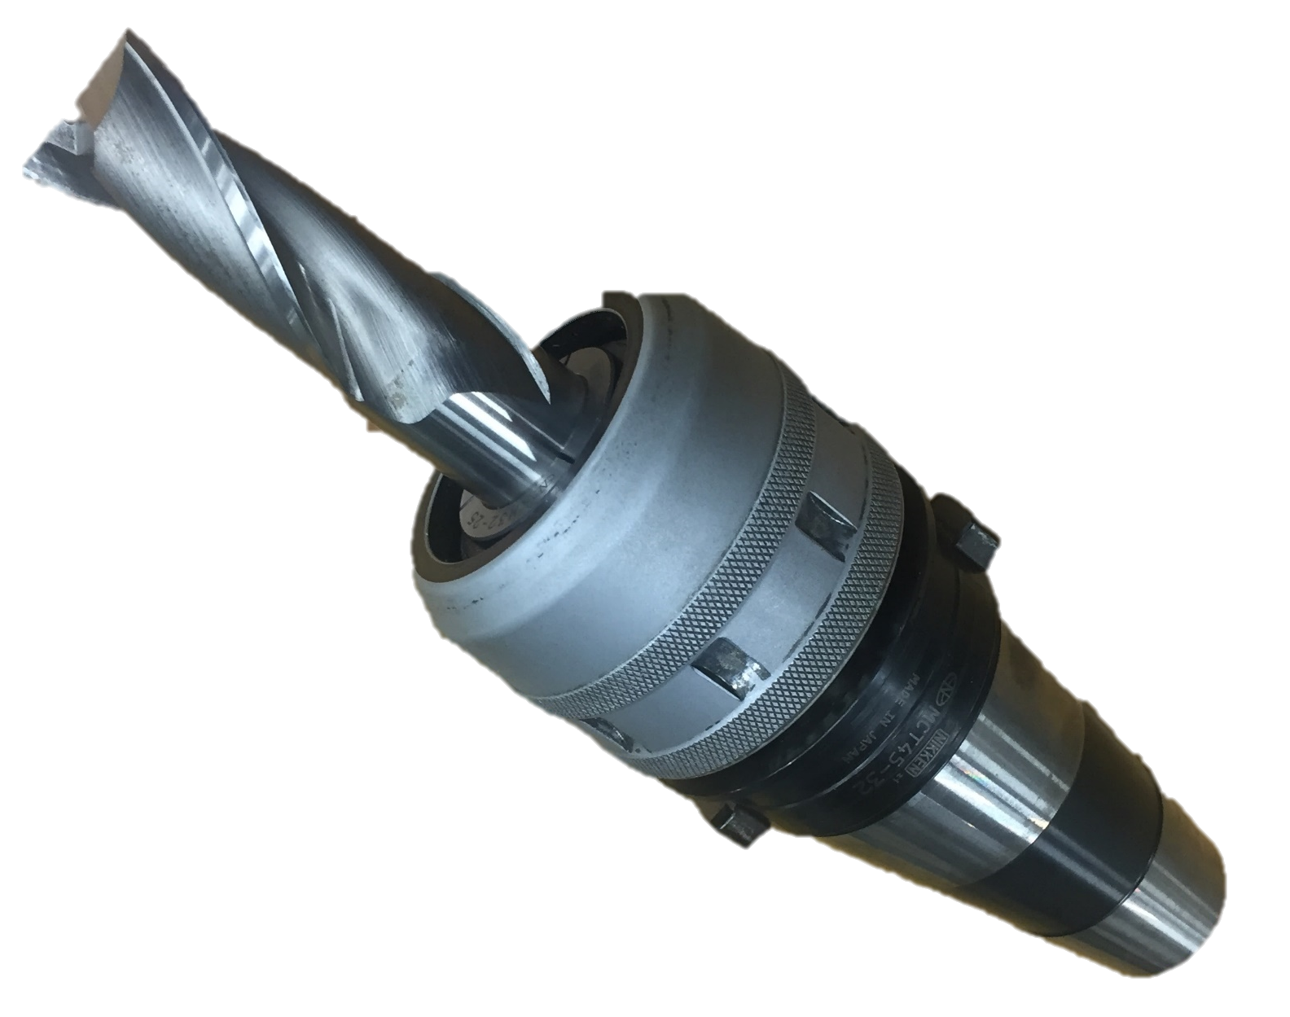
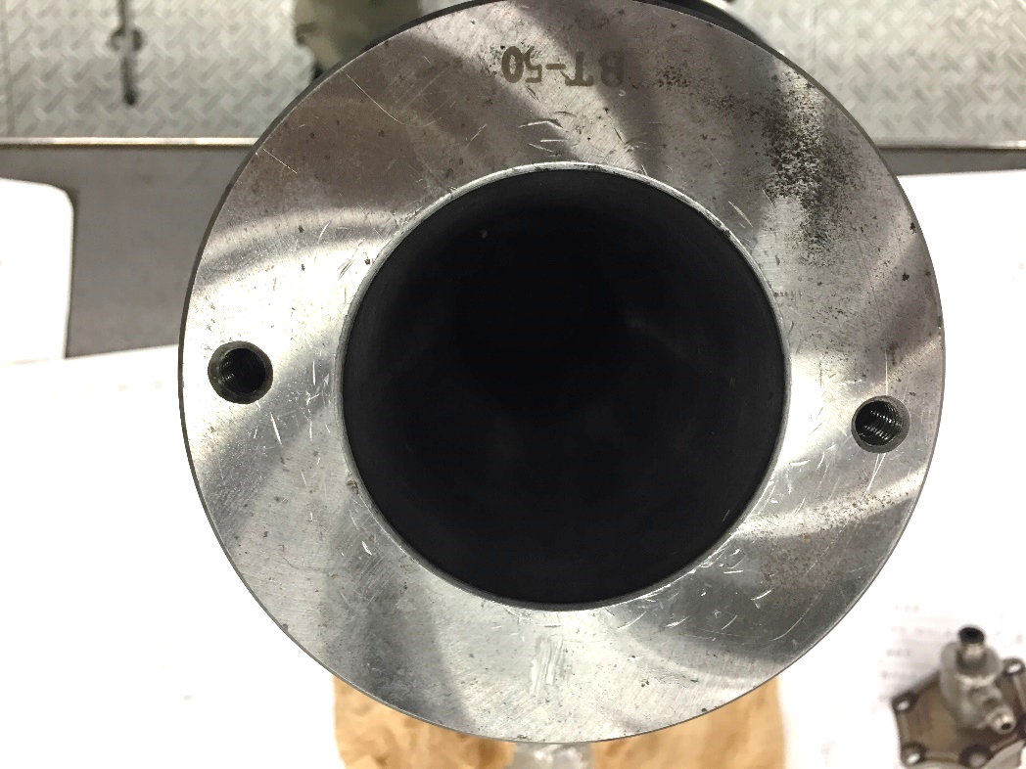
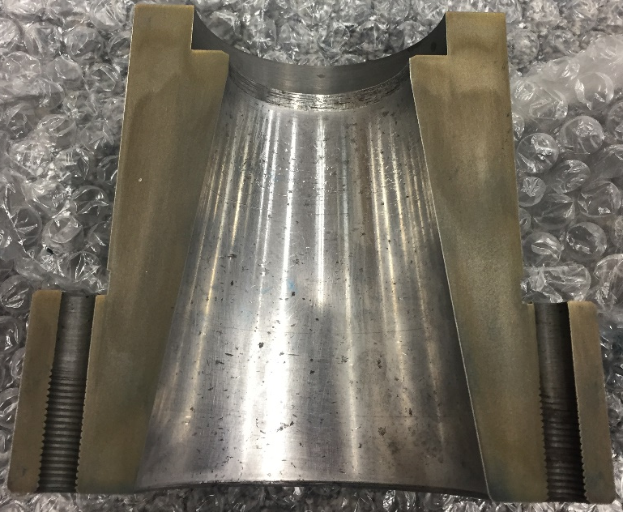
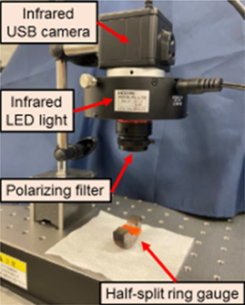
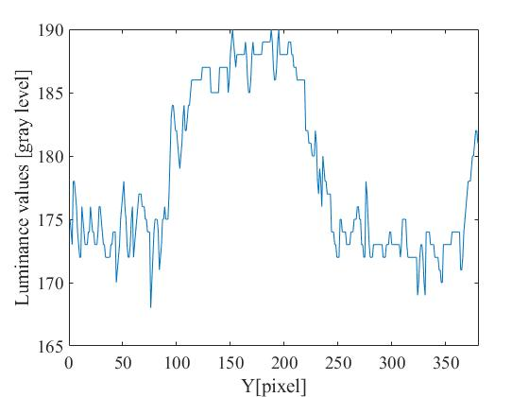
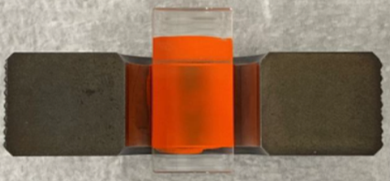
Wear amount measuring method using red lead paint
to innovate sensory inspection for female taper socket
of machine tools
Kaito FUJIYOSHI¹, Mikihiko MAWATARI¹, Ichiro YOSHIDA²
HOSEI University, Graduate School of Science and Engineering, Major in Mechanical Engineering
HOSEI University, Faculty of Science and Engineering, Department of Mechanical Engineering
Background
In the future, IoT and full automation will be essential.
Taper shank and tool
As regards the maintenance for female tapers of machine tools, sensory inspection has been standardized in both JIS and ISO standards. Therefore, highly skilled operators are required.
In order to promote automation and improve productivity by IoT, human workload needs to be reduced.
Female taper socket
Purpose
・Develop new measurement method that is less dependent on an operator's skill level.
・Achieve quantification, skillless and automation maintenance.
Method
Cross-sectional view of female taper
Ring gauge is used instead of the female taper .
The paint is applied onto the measurement surface.
The amount of wear is calculated.
photographed image with infrared camera.
Painted ring gauge.
Photograph of
imaging device.
Luminance values.
Decide the concentration of red lead paint necessary for accurately measuring the amount of wear.
Conclusion
The most suitable concentration of red lead paint for measuring
the amount of wear is that when ratio of red lead powder to oil is 1:1.
Correspondence: Ichiro Yoshida, HOSEI University, E-mail: yoshida.ichiro@hosei.ac.jp

