Slide 1

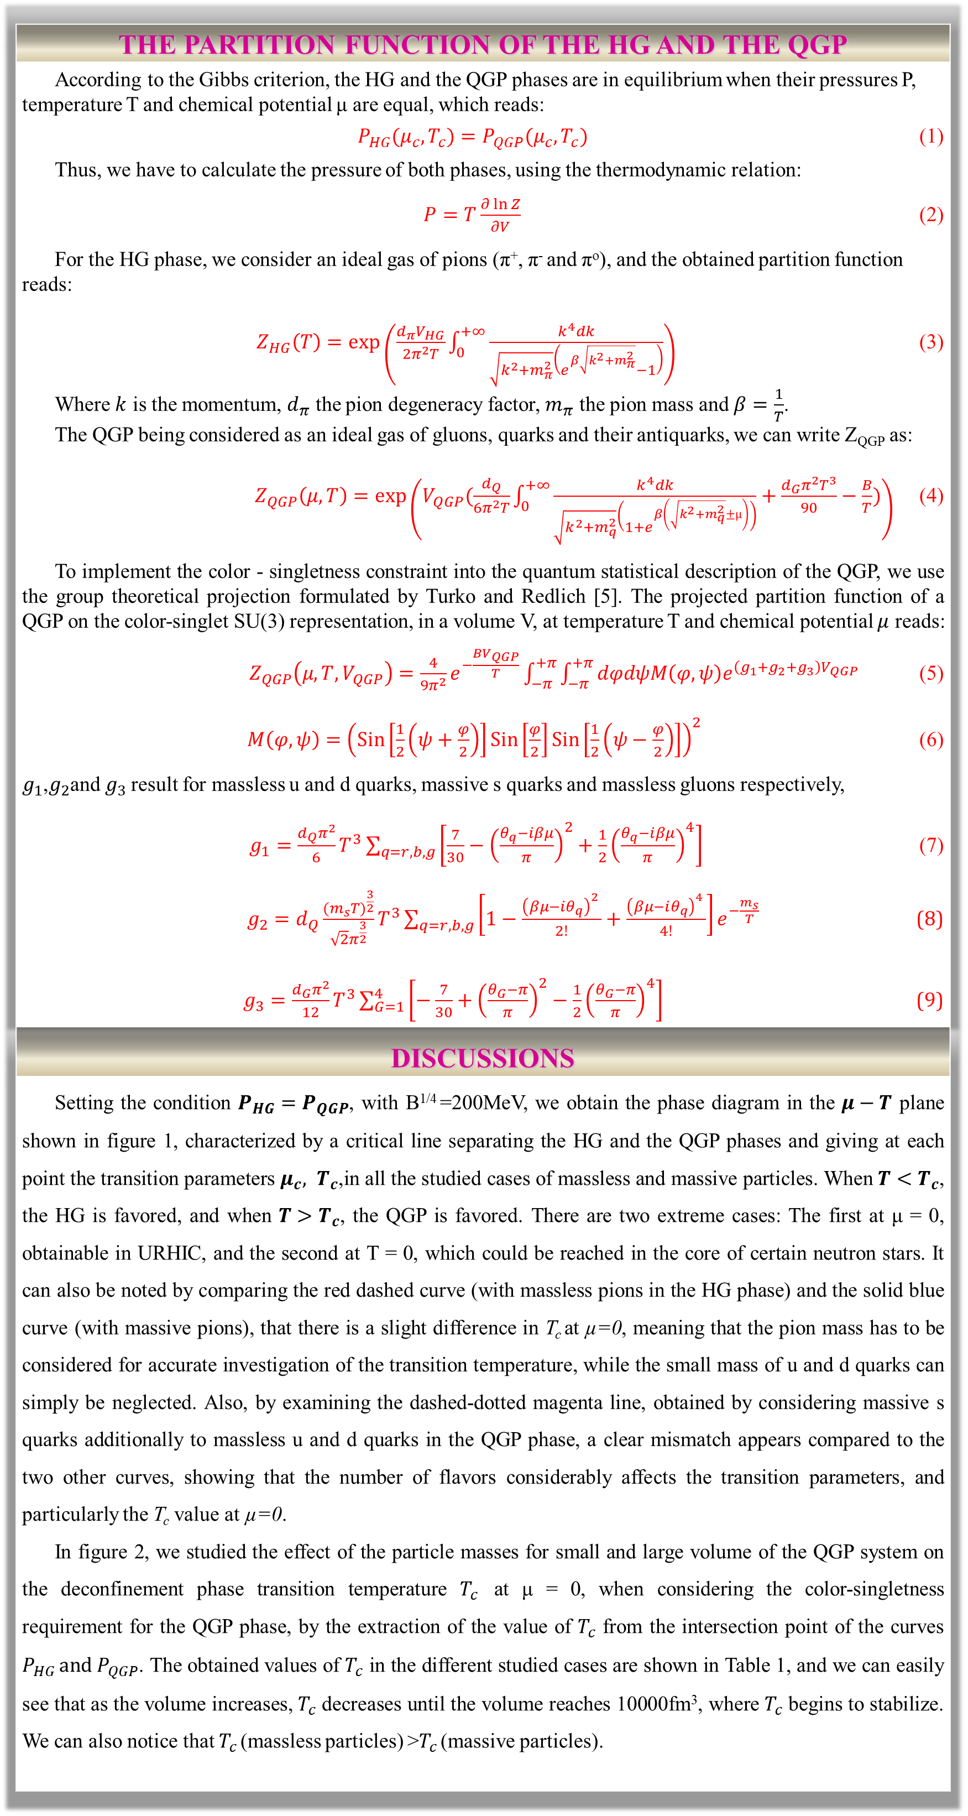
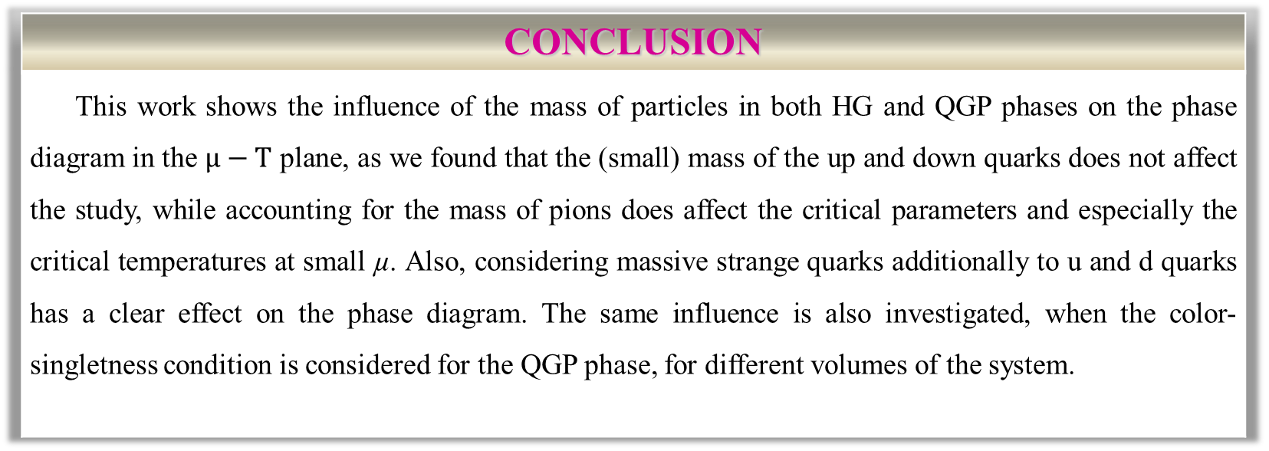
Thermodynamic Investigation of the QCD Phase Diagram with 2+1 Quark Flavors
Hayet Sahi and Amal Ait El Djoudi
Laboratoire de Physique des Particules et Physique Statistique
Ecole Normale Supérieure - Kouba, B.P. 92, 16050 , Vieux Kouba, Algiers, Algeria
Email: h.sahi@univ-boumerdes.dz; amal.aiteldjoudi@g.ens-kouba.dz
Abstract: This work deals with the deconfinement phase transition from a hadronic gas (HG) phase consisting of massive pions, to a quark-gluon plasma (QGP) phase consisting of gluons, massless up, down and massive strange quarks, in addition to their antiquarks. We study the variations of the pressure characterizing the HG and the QGP phases. For this latter, we calculate the partition function of the color-singlet QGP within the projection method, using a density of states containing the volume term only. We investigate the phase diagram of the strongly interacting matter, in the µ-T plane, in several cases: with massless pions in the HG phase then considering their masses, and with 2 massless quarks then when adding massive strange quarks in the QGP phase.
Key words : Deconfinement phase transition; phase diagram; First order phase transition.
FIGURES
INTRODUCTION
Quantum Chromodynamics (QCD) is the basic theory that describes the strong interactions, between the quarks and the gluons in the hadrons [1]. In the ordinary conditions, quarks and gluons are confined into hadrons. However, at high temperature and/or density, hadronic matter undergoes a phase transition: quarks and gluons become deconfined, i. e., free [2], in a new phase called the Quark-Gluon Plasma (QGP). To illustrate the phase transition from the HG phase to the QGP phase, we will investigate the phase diagram of the strongly interacting matter, in the µ-T plane, based on the Gibbs criterion setting the mechanical equilibrium between the two phases at the transition, with massless and massive particles in the two phases.
Figure1. (a) Phase diagram in the $μ−T$ plane, with B^{1/4} =200MeV, for both cases of massless pions (red dashed line) and massive pions (blue solid line) in the HG phase with massless u and d quarks in the QGP phase, with the third case of massive pions in the HG and massive strange quarks additionally to massless u and d quarks in the QGP (magenta dashed-dotted line). (b) Magnification of the phase diagram in the region of high temperatures and low and intermediate chemical potentials, for the same cases as in (a).
THE PARTITION FUNCTION OF THE HG AND THE QGP
According to the Gibbs criterion, the HG and the QGP phases are in equilibrium when their pressures P, temperature T and chemical potential μ are equal, which reads: $P_{HG}(μ_{c}, T_{c})=P_{QGP}(μ_{c}, T_{c})$ (1) Thus, we have to calculate the pressure of both phases, using the thermodynamic relation: $P=T\frac{∂\ln{Z}}{∂V}$ (2) For the HG phase, we consider an ideal gas of pions (π⁺, π⁻ and πº), and the obtained partition function reads: $Z_{HG}\left(T\right)=\exp\left(\frac{d_{π}V_{HG}}{2π^{2}T}\int_{0}^{+∞}{\frac{k^{4}dk}{\sqrt{k^{2}+m_{π}^{2}}\left(e^{β\sqrt{k^{2}+m_{π}^{2}}}−1\right)}}\right)$ (3) Where $k$ is the momentum, $d_{π}$ the pion degeneracy factor, $m_{π}$ the pion mass and $β=\frac{1}{T}$. The QGP being considered as an ideal gas of gluons, quarks and their antiquarks, we can write Z_{QGP} as: $Z_{QGP}\left(μ,T\right)=\exp\left(V_{QGP}(\frac{d_{Q}}{6π^{2}T}\int_{0}^{+∞}{\frac{k^{4}dk}{\sqrt{k^{2}+m_{q}^{2}}\left(1+e^{β\left(\sqrt{k^{2}+m_{q}^{2}}±µ\right)}\right)}}+\frac{d_{G}π^{2}T^{3}}{90}−\frac{B}{T})\right)$ (4) To implement the color - singletness constraint into the quantum statistical description of the QGP, we use the group theoretical projection formulated by Turko and Redlich [5]. The projected partition function of a QGP on the color-singlet SU(3) representation, in a volume V, at temperature T and chemical potential $μ$ reads: $Z_{QGP}\left(μ,T,V_{QGP}\right)=\frac{4}{9π^{2}}e^{−\frac{BV_{QGP}}{T}}\int_{−π}^{+π}{\int_{−π}^{+π}{dφdψM\left(φ,ψ\right)e^{\left(g_{1}+g_{2}+g_{3}\right)V_{QGP}} }}$(5) $M\left(φ,ψ\right)={\left(Sin\left[\frac{1}{2}\left(ψ+\frac{φ}{2}\right)\right]Sin\left[\frac{φ}{2}\right]Sin\left[\frac{1}{2}\left(ψ−\frac{φ}{2}\right)\right]\right)}^{2}$ (6) $g_{1}$,$g_{2}$and $g_{3}$result for massless u and d quarks, massive s quarks and massless gluons respectively, $g_{1}=\frac{d_{Q}π^{2}}{6}T^{3}\sum_{q=r, b,g}{\left[\frac{7}{30}−{\left(\frac{θ_{q}−iβμ}{π}\right)}^{2}+\frac{1}{2}{\left(\frac{θ_{q}−iβμ}{π}\right)}^{4}\right]}$ (7) $g_{2}=d_{Q}\frac{{(m_{s}T)}^{\frac{3}{2}}}{{\sqrt{2}π}^{\frac{3}{2}}}T^{3}\sum_{q=r, b,g}{\left[1−\frac{{\left(βμ−iθ_{q}\right)}^{2} }{2!}+\frac{{\left(βμ−iθ_{q}\right)}^{4} }{4!}\right]}e^{−\frac{m_{s}}{T}}$ (8) $g_{3}=\frac{d_{G}π^{2}}{12}T^{3}\sum_{G=1}^{4}{\left[−\frac{7}{30}+{\left(\frac{θ_{G}−π}{π}\right)}^{2}−\frac{1}{2}{\left(\frac{θ_{G}−π}{π}\right)}^{4}\right]}$ (9)
DISCUSSIONS
Setting the condition $P_{HG}=P_{QGP}$, with B^{1/4} =200MeV, we obtain the phase diagram in the $μ−T$ plane shown in figure 1, characterized by a critical line separating the HG and the QGP phases and giving at each point the transition parameters $μ_{c}, T_{c}$,in all the studied cases of massless and massive particles. When $T<T_{c}$, the HG is favored, and when $T>T_{c}$, the QGP is favored. There are two extreme cases: The first at μ = 0, obtainable in URHIC, and the second at T = 0, which could be reached in the core of certain neutron stars. It can also be noted by comparing the red dashed curve (with massless pions in the HG phase) and the solid blue curve (with massive pions), that there is a slight difference in T_{c} at µ=0, meaning that the pion mass has to be considered for accurate investigation of the transition temperature, while the small mass of u and d quarks can simply be neglected. Also, by examining the dashed-dotted magenta line, obtained by considering massive s quarks additionally to massless u and d quarks in the QGP phase, a clear mismatch appears compared to the two other curves, showing that the number of flavors considerably affects the transition parameters, and particularly the T_{c} value at µ=0. In figure 2, we studied the effect of the particle masses for small and large volume of the QGP system on the deconfinement phase transition temperature $T_{c}$ at μ = 0, when considering the color-singletness requirement for the QGP phase, by the extraction of the value of $T_{c}$ from the intersection point of the curves $P_{HG }and P_{QGP}$. The obtained values of $T_{c}$ in the different studied cases are shown in Table 1, and we can easily see that as the volume increases, $T_{c}$ decreases until the volume reaches 10000fm³, where $T_{c}$ begins to stabilize. We can also notice that $T_{c }$(massless particles) >$T_{c }$(massive particles).
Figure 2. Variations of the pressure of the HG and of the color-singlet QGP with temperature at μ = 0, for B^{1/4} =200 MeV, for massless and massive particles in both phases.
V (fm³) | 200 | 1000 | 10000
T_{C} (MeV) for Massless pions (HG) and Massless u, d quarks (QGP) | 144.507 | 143.947 | 143.941
T_{C} (MeV) for Massive pions (HG) and Massless u, d quarks (QGP) | 143.859 | 143.305 | 143.299
T_{C} (MeV) for Massless pions (HG) and Massless u, d and massive s quarks (QGP) | 141.828 | 141.291 | 141.285
T_{C} (MeV) for Massive pions (HG) and Massless u, d and massive s quarks (QGP) | 141.216 | 140.685 | 140,679
Table 1. The critical temperature T_{C} for different volumes, within a color-singlet QGP.
CONCLUSION
This work shows the influence of the mass of particles in both HG and QGP phases on the phase diagram in the $μ−T$ plane, as we found that the (small) mass of the up and down quarks does not affect the study, while accounting for the mass of pions does affect the critical parameters and especially the critical temperatures at small µ. Also, considering massive strange quarks additionally to u and d quarks has a clear effect on the phase diagram. The same influence is also investigated, when the color-singletness condition is considered for the QGP phase, for different volumes of the system.
REFERENCES
References
1. F. Akram, Basics of Quantum Chromodynamics, 5th School on LHC Physics, NCP Islamabad (August 2016).
2. S. Ramadas, QGP in Quark Stars, PhD thesis, University of Calicut, India (April 2014).
3. R. Pasechnik and M. Šumbera, arXiv: 1611.01533v3 [hep-ph].
4. L. Apolinário, J. G. Milhano, G. P. Salamand and C. A. Salgado, Physical Review Letters 120 (2018) 232301.
5. K. Redlich and L. Turko, Z. Phys. C5 (1980) 201; L. Turko, Phys. Lett. B 104 (1981) 153.

