Slide 1
A Solution for “Unexpected black holes”
Raghav Narasimha P¹
Della Vincent¹
Arun Kenath¹
C. Sivaram²
¹ Christ (Deemed to be University Department of Physics and Electronics, Christ (Deemed to be University), Bengaluru, 560029, Karnataka, India.
² Indian Institute of Astrophysics, Bengaluru, 560034, Karnataka, India
(raghav.p@phy.christuniversity.in, dellavincent06@gmail.com, kenath.arun@christuniversity.in, sivaram@iiap.res.in)

Slide 2
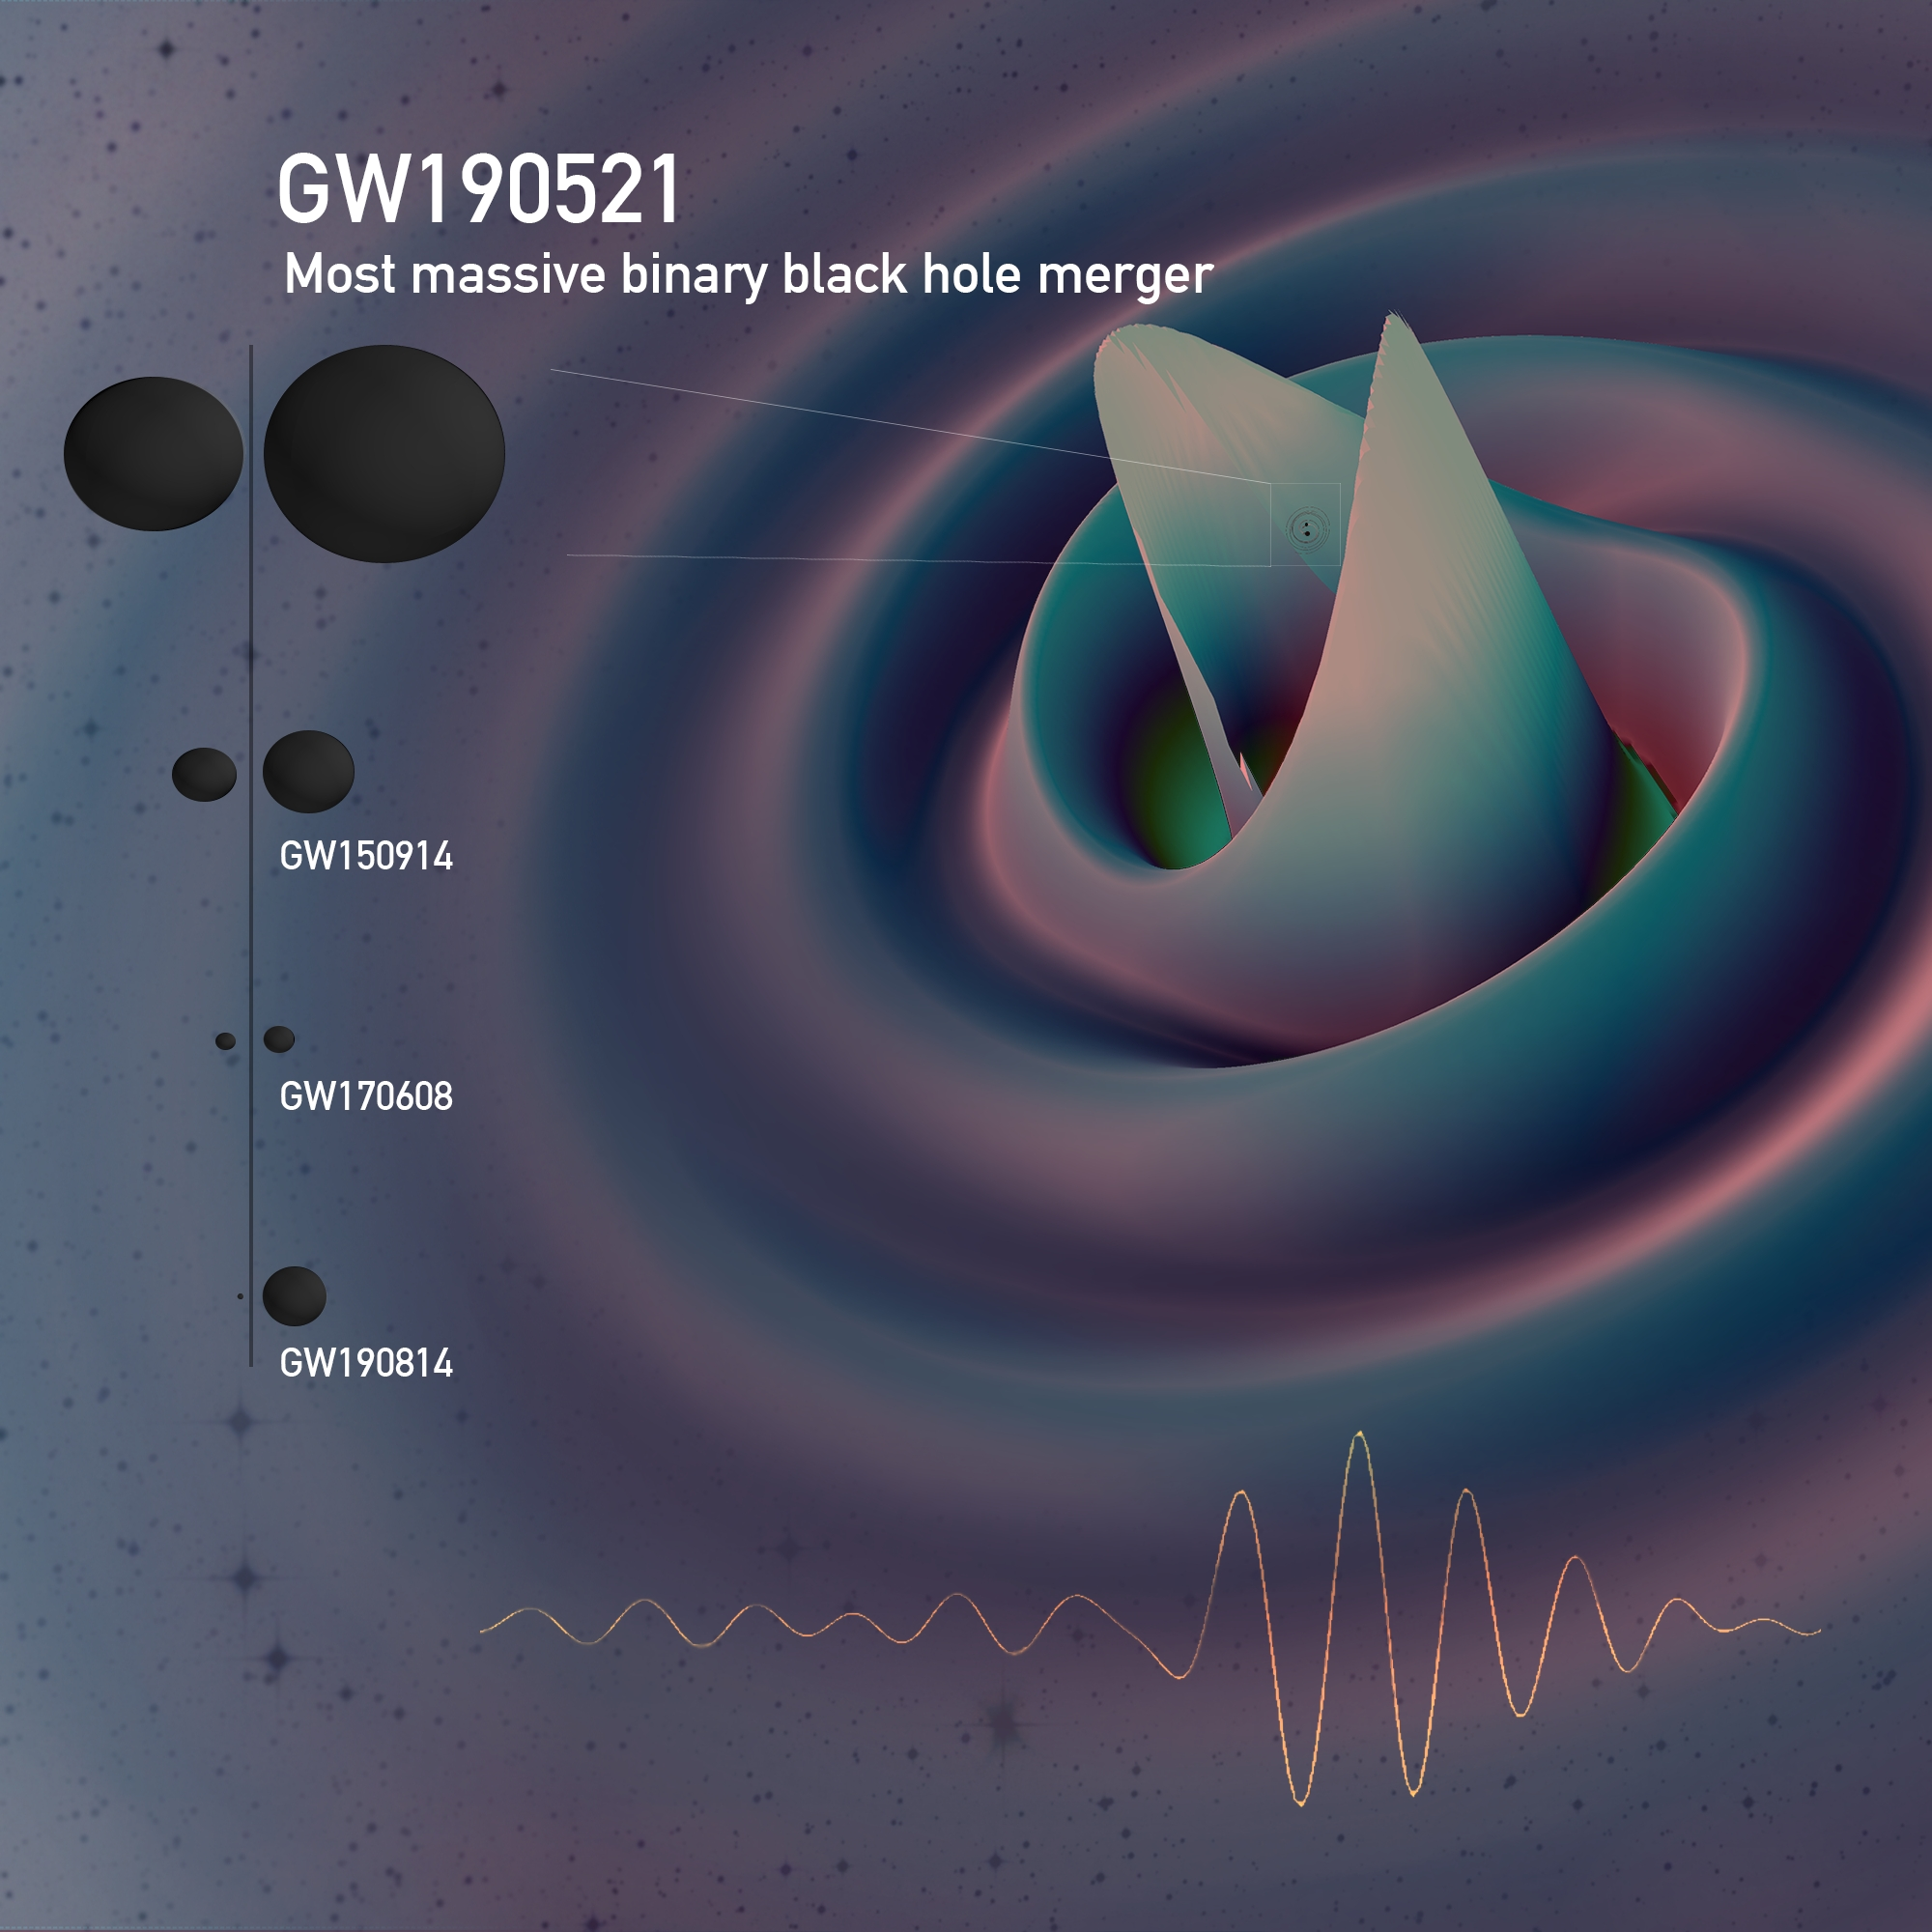
GW190521
On 21st May 2019, LIGO and Virgo interferometer observed the largest binary black hole merger to date (Abbott et al., 2020).
The merger involved two black holes with masses of 85 M⊙ and 66 M⊙.
The mass of the remnant black hole is about 142 M⊙
One of the primary black holes (85M⊙) in the merger lies within the PISN mass gap.
PROBLEM: The black hole with 85 M⊙ is theoretically not expected to exist due to pair instability processes.
(Image credit: Ferguson et al.)

Slide 3
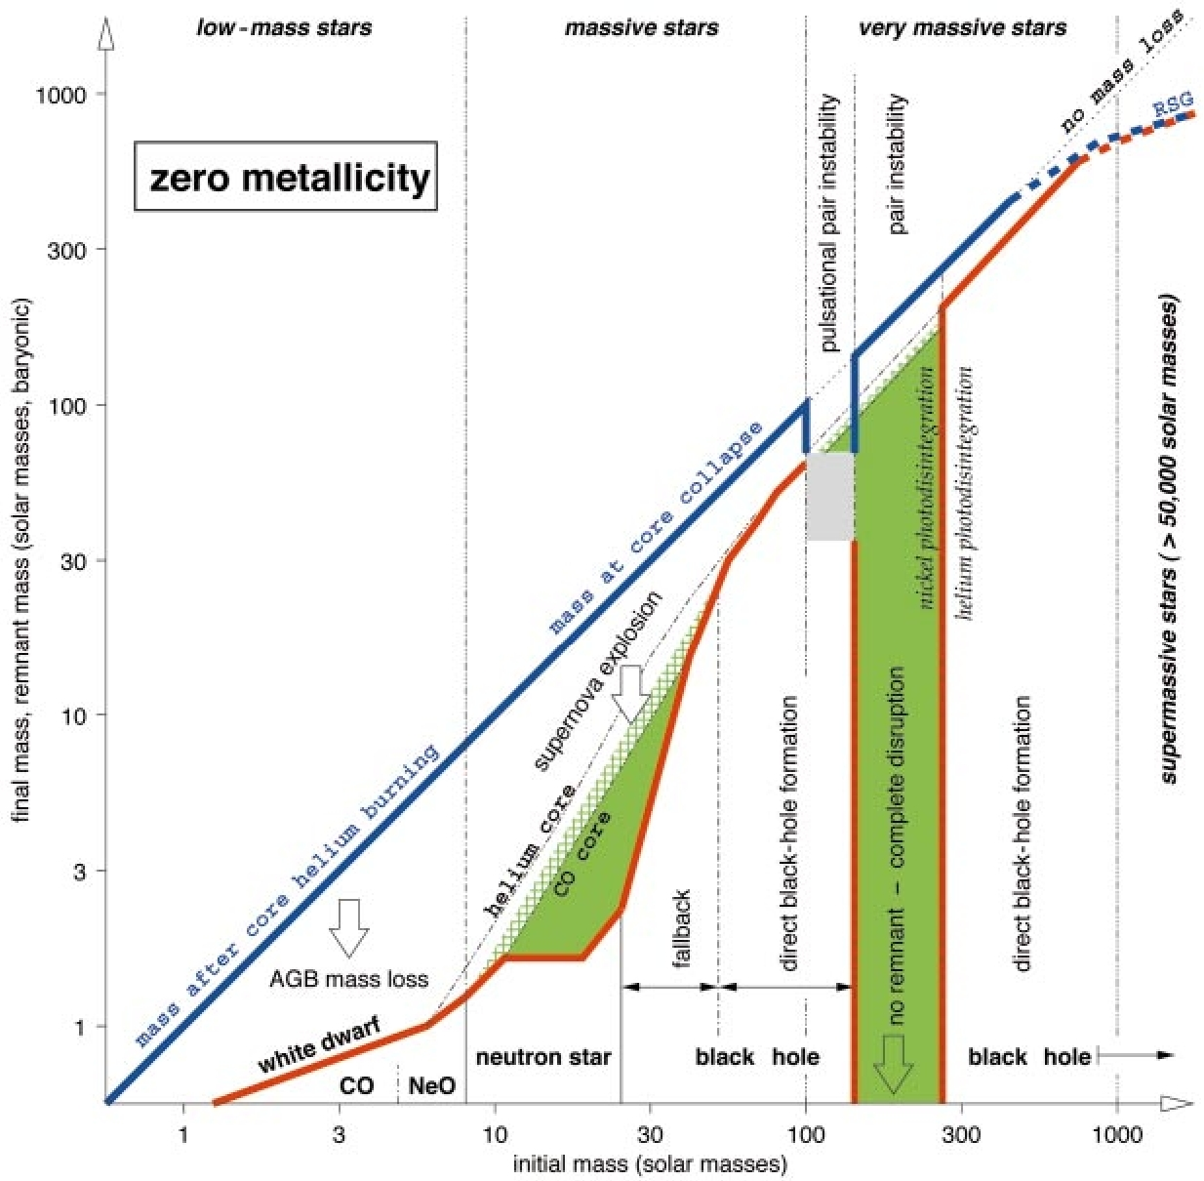
Pair-Instability Supernova (PISN)
Depending upon the mass, stars take different trajectories from their Main Sequence (MS) period into their end.
When Carbon-Oxygen (CO) core reaches a mass ranging between 60 M⊙ to 130 M⊙, at sufficient temperature and density, electron-positron pair starts to form (D. Branch et al., 2017).
Once explosive oxygen burning takes place, the dynamical instability leads the CO core to explode with no compact remnant left behind.
Hence, no black holes are expected to form in the mass range of 60 M⊙ to 130 M⊙ creating a mass gap in the black hole birth function.
(Woosley et al., 2002)

Slide 4
What’s the solution?!
(Image credit: LIGO)

Slide 5
A possible solution
Dark Matter (DM) is non-baryonic matter which is five times more abundant than baryonic matter in the universe.
Presence of DM admixed with baryonic matter in the stellar objects can affect their structure and evolution (Arun Kenath et al., 2018; Arun Kenath et al., 2019; Sandeep et al., 2020; Clea et al., 2020).
From hydrostatic equilibrium relation, (Kippenhahn, 2013)
$$T_{c}∝\frac{M}{R}$$
To analyze how dark matter admixture alters the progenitor, we take the ratio of mass in presence of DM particles to the mass in absence of DM particles which is given as:
$$\frac{M_{DM}}{M_{0}}=\frac{fm_{DM}+\left(100−f\right)m_{B}}{100m_{B}}$$

Slide 6
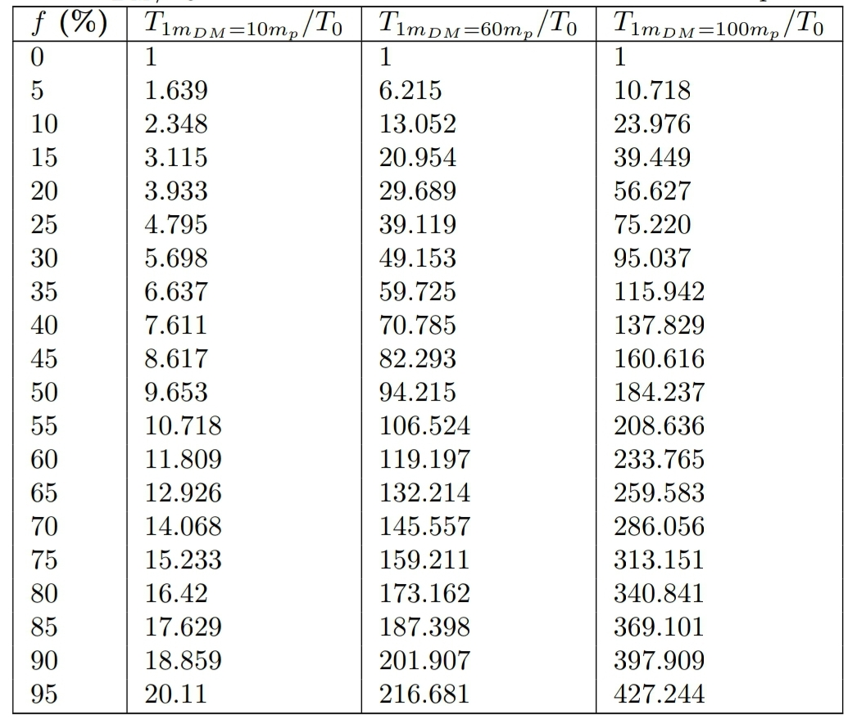
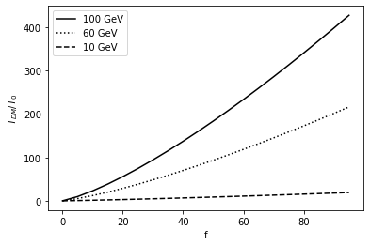
Effect of DM on Temperature
$$\frac{T_{DM}}{T_{0}}={\left(\frac{M_{DM }}{M_{0}}\right)}^{1.3}$$

Slide 7
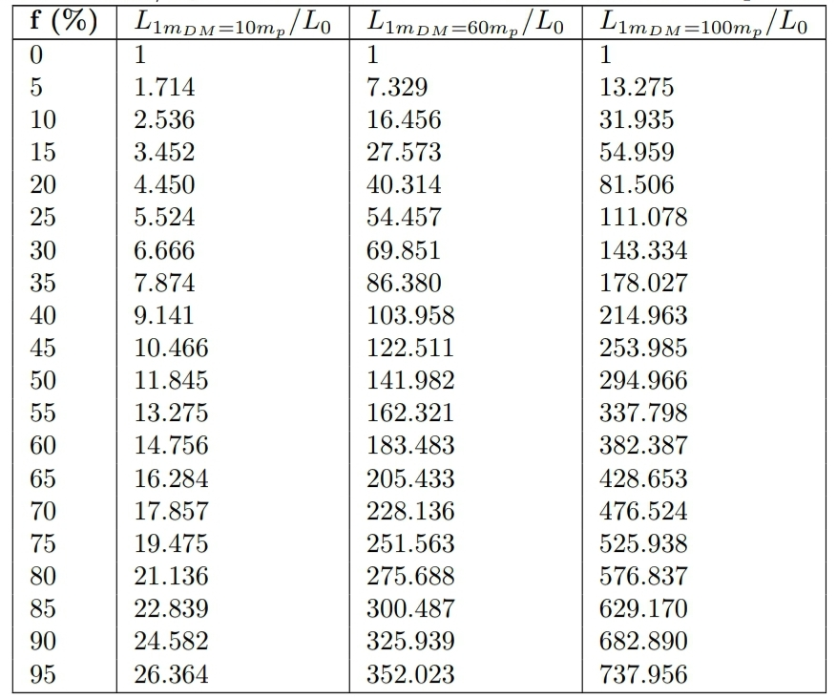
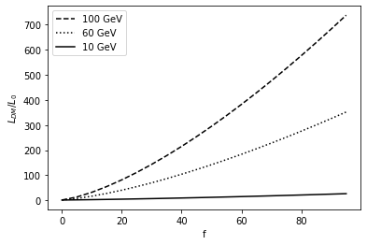
Effect of DM on Luminosity
$$\frac{L_{DM}}{L_{0}}={\left(\frac{M_{DM }}{M_{0}}\right)}^{1.45}$$

Slide 8
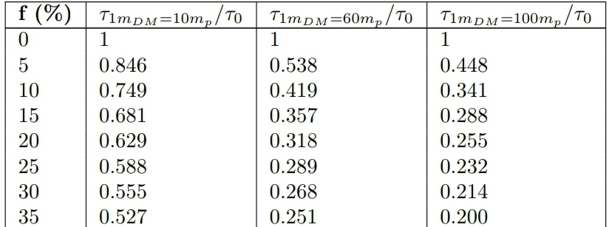
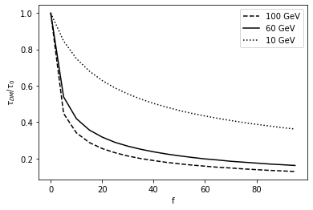
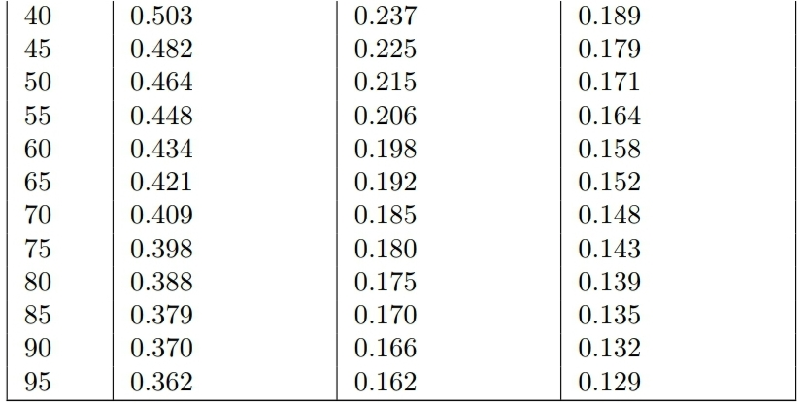
Effect of DM on Lifetime
$$\frac{τ_{DM}}{τ_{0}}={\left(\frac{M_{DM }}{M_{0}}\right)}^{−0.45}$$

Slide 9
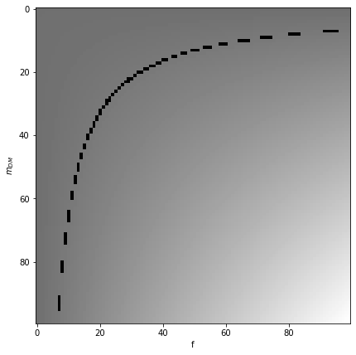
Conclusion
When the core mass rise in the presence of DM, the luminosity and temperature also rise.
The enhanced luminosity and temperature cause the lifetime of the PISN progenitor to drop to around half.
Admixture model is used extensively.
10% of DM particles with 50 GeV mass is sufficient.
Overcome explosive oxygen burning phase.
With black hole as a remnant in pair-instability mass gap.
(DM fraction versus DM mass for a change in temperature by a factor of 10)

Slide 10
References
Clea Sunny, Arun Kenath, C Sivaram et al., Phys. Dark Univ. 30, 100727, (2020).
D. Branch and J. C. Wheeler, Supernova Explosions, (2017).
Arun Kenath, S.B. Gudennavar, A. Prasad, and C. Sivaram. Advances in Space Research, 61(1):567–570 (2018).
Arun Kenath, S. B. Gudennavar, A. Prasad, and C. Sivaram. Astrophysics and Space Science, 364(2) (2019).
R. Abbott et al. (LIGO Scientific Collaboration and Virgo Collaboration), Phys. Rev. Lett. 125, 101102 (2020).
Rudolf Kippenhahn et al. Stellar Structure and Evolution, (2013).
S. E. Woosley, A. Heger, and T. A. Weaver, Rev. Mod. Phys. 74, 1015 (2002).
S. Sandeep Kumar, Arun Kenath, C. Sivaram, Phys. Dark Univ. 28, 100507 (2020).

