Slide 1


Reconstruction, Analysis and Constraints of
Cosmological Scalar Field φCDM Models
OLGA AVSAJANISHVILI
E.Kharadze Georgian National Astrophysical Observatory
Based on the paper: Olga Avsajanishvili, Yiwen Huang, Lado Samushia, Tina Kahniashvili,
“The observational constraints on the flat φCDM models”, Eur. Phys. J. C78, 09, 773; 2018; arXiv:1711.11465
The presentation is supported in part by the Rustaveli National Science Foundation of Georgia under Grant FR-19-8306
The 2nd International Electronic Conference on Universe
February 16 - March 2 2023

Slide 2
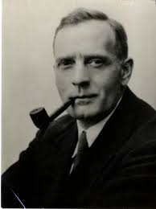
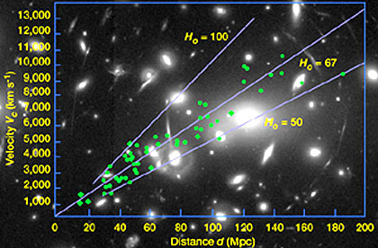
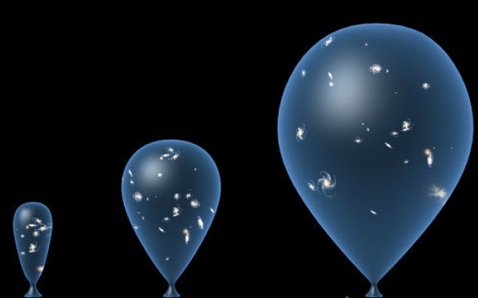
Hubble law
- Hubble constant
= 67.4 km s⁻¹Mpc⁻¹

Slide 3
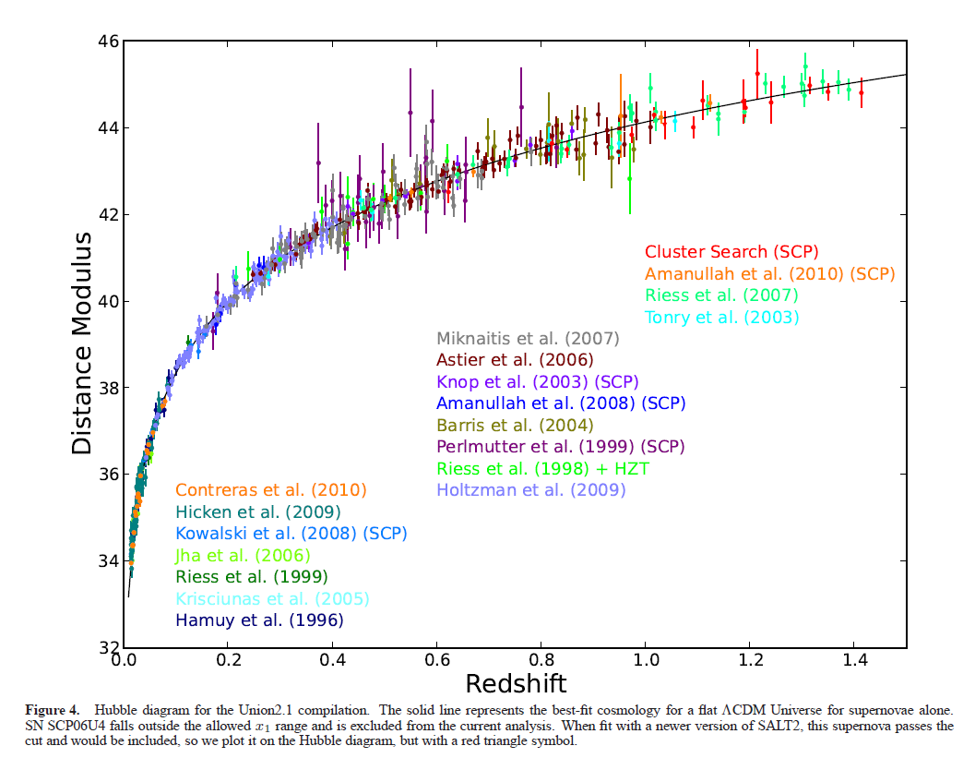
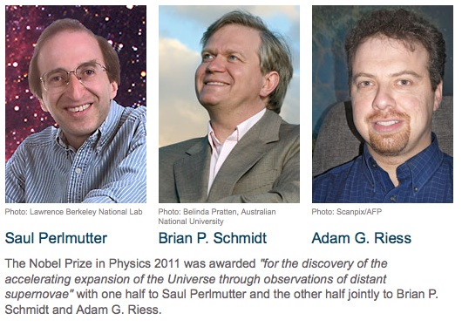
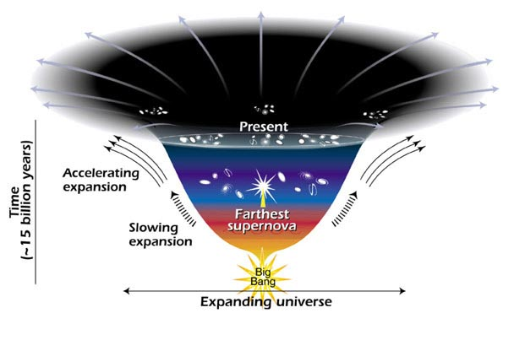
Accelerated expansion of the Universe
Nobel Prize in Physics 2011
Supernovae data
Suzuki et al. 2012
Dark Energy?
Modified Gravity?

Slide 4
Dark energy models
Cosmological constant, Λ
Scalar field (quintessence and phantom) models
K-essence models
Holographic dark energy models
Barotropic fluid or Chaplygin gas models
Coupled dark matter (neutrino)-dark energy models

Slide 5

Cosmological constant
  Λ → “concordance” ΛCDM model
ΛCDM model provides the best fit for cosmological observations
ΛCDM model is based on GTR for description of gravity in the Universe on large scales
ΛCDM model has:
- fine tuning problem
- coincidence problem

Slide 6



Dynamical scalar field φCDM models
  The equation of state parameter
  ΛCDM model φCDM models

Slide 7

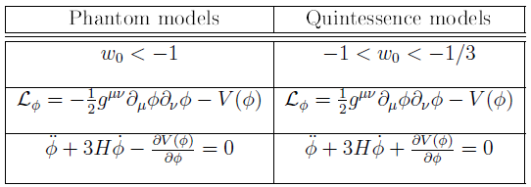
Phantom and quintessence φCDM models

Slide 8

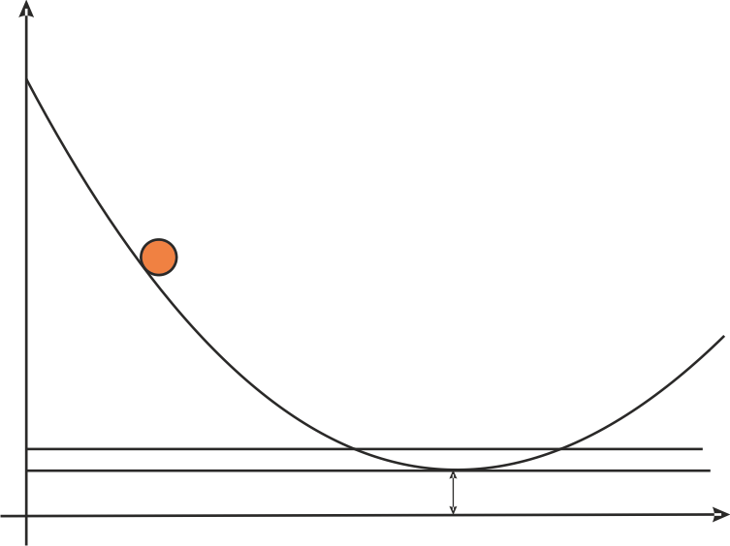


Quintessence
Spatially uniform dynamical scalar field
Slowly rolls down to the minimum of its almost flat potential
This model avoids the fine tuning problem of the ΛCDM model
Plays a role of the time-dependent cosmological constant

Slide 9
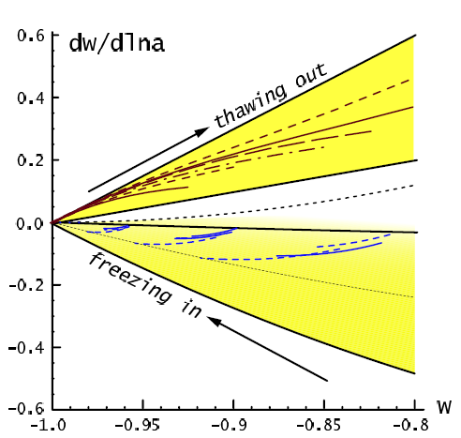
Subdivision of the quintessence models:
the thawing models for which the evolution of the scalar field is fast compared to the Hubble expansion.
- underdamped
the tracking (freezing) models
for which the evolution is slow compared to the Hubble expansion:
- overdamped
R.Caldwell & E.Linder, Phys. Rev. Lett. 95, 141301 (2005)

Slide 10
Chevallier-Polarsky-Linder (CPL) parameterization
M.Chevallier & D.Polarski, Int. J. Mod. Phys. D 10, 213 (2001)

Slide 11
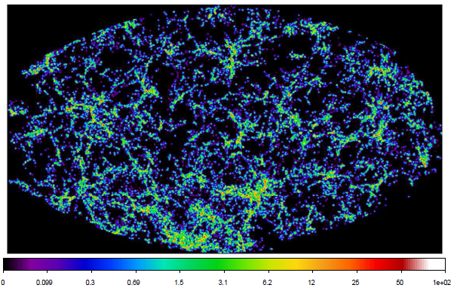
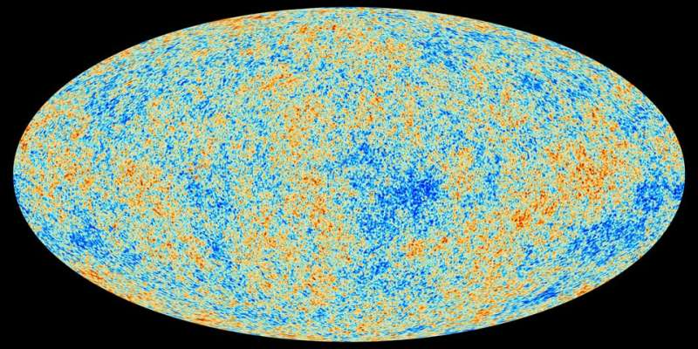
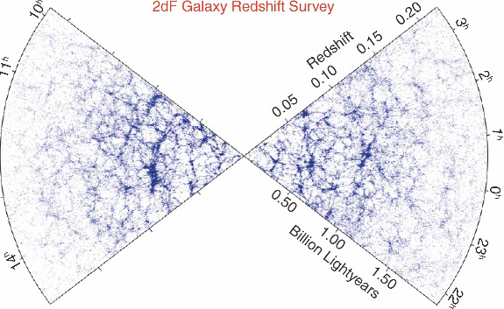
What is the influence of the dark energy model on the evolution of large-scale structures?
CMB map from Planck space experiment
Cosmic Web (SDSS)

Slide 12


Influence of the φCDM model on the formation of the large-scale structure in the universe
The growth rate
The linear perturbation equation
The linear growth factor
The matter density fluctuations

Slide 13
Fractional matter density
Growth rate function
Fitting formula
L.M.Wang & P.J. Steinhardt, Astrophys. J. 508, 483 (1998)
Erick Linder, Phys. Rev. D 72, 043529 (2005)

Slide 14
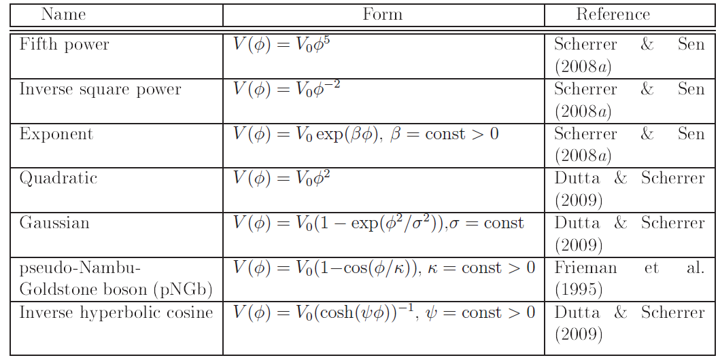
Phantom Potentials

Slide 15
Quintessence Potentials

Slide 16
Phantom φCDM model
The first Friedmann’s equation
The scalar field equation
The energy density of the scalar field
The pressure of the scalar field
The equation of state parameter
We consider the flat universe

Slide 17
Quintessence φCDM model
The first Friedmann’s equation
The scalar field equation
The energy density of the scalar field
The pressure of the scalar field
The equation of state parameter
We consider the flat universe

Slide 18
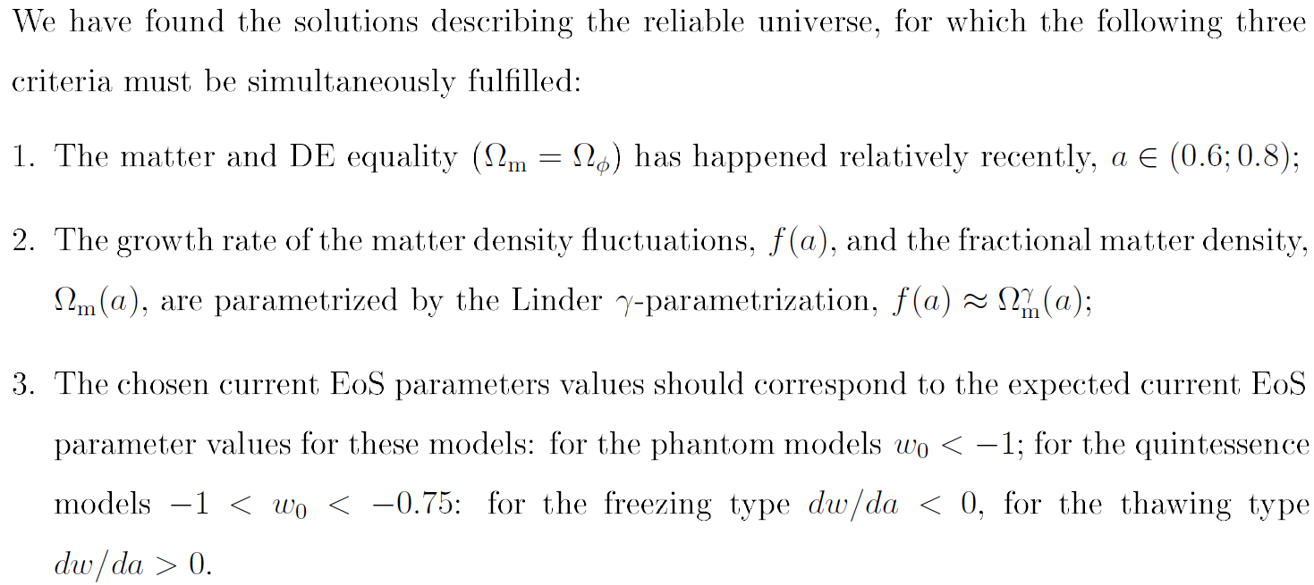
Criteria for Selection of Solutions

Slide 19
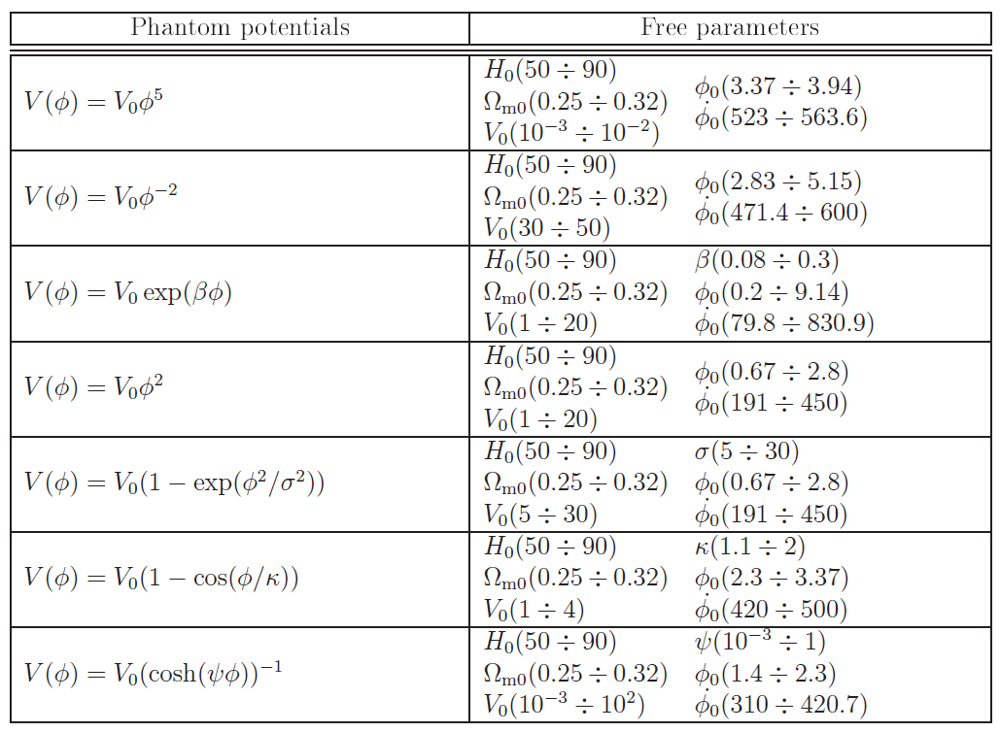
Model Parameters and Initial Conditions for Phantom Potentials

Slide 20
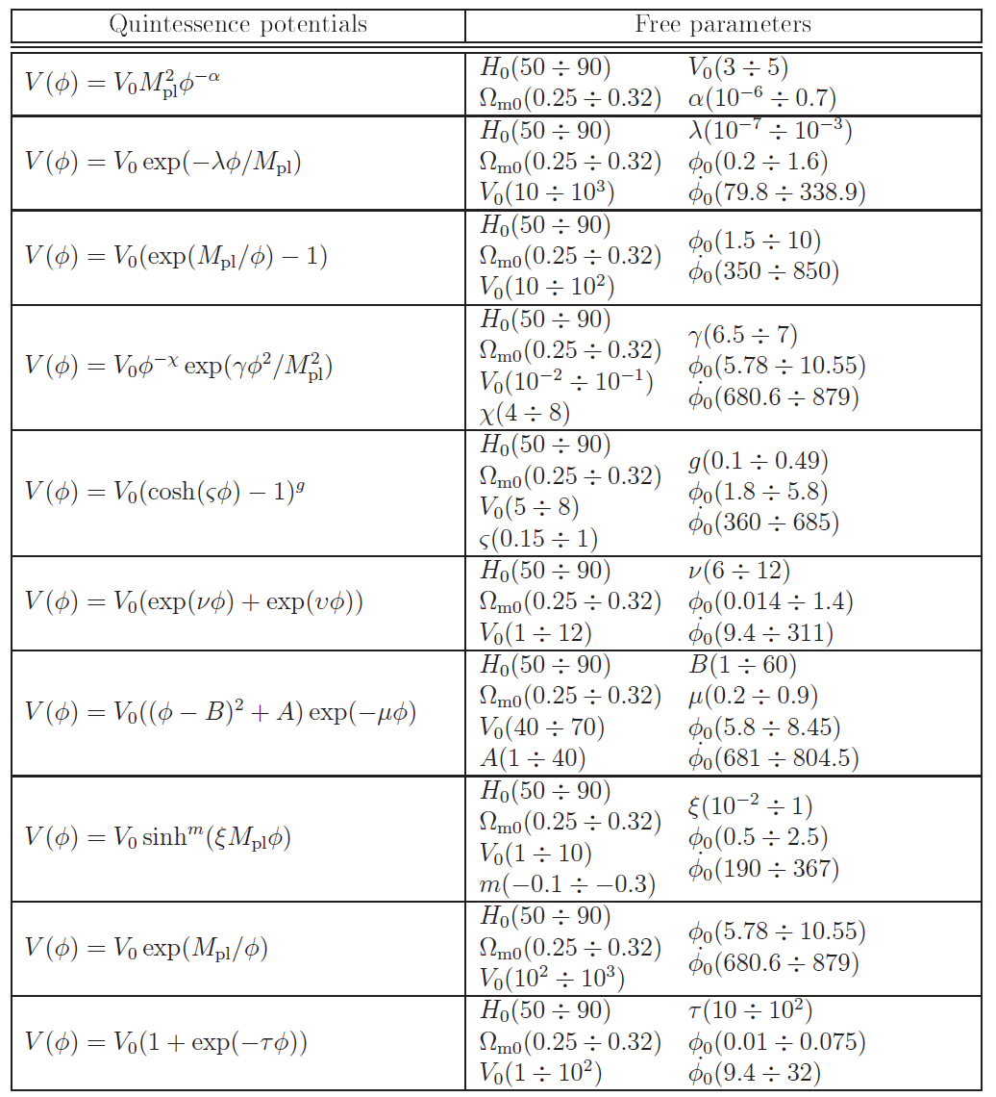
Model Parameters and Initial Conditions for Quintessence Potentials

Slide 21



MCMC Analysis
The normalized Hubble parameter:
The angular diameter distance:
The range of the redshift values,
The variances correspond to the predicted values for DESI data
The combination of the growth rate of the matter density fluctuations
and the matter power spectrum amplitude, :

Slide 22
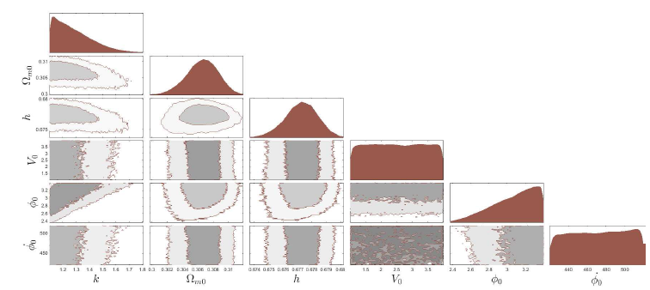
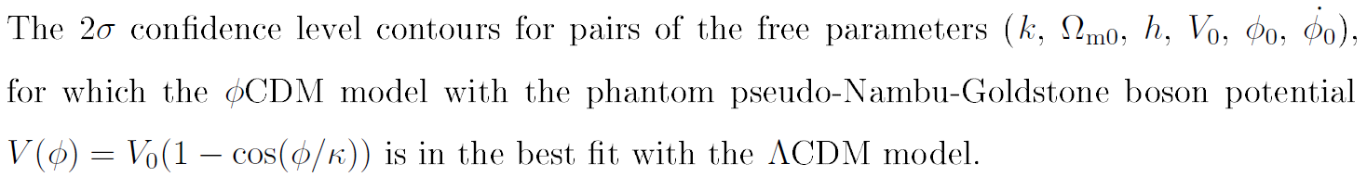
MCMC Results

Slide 23
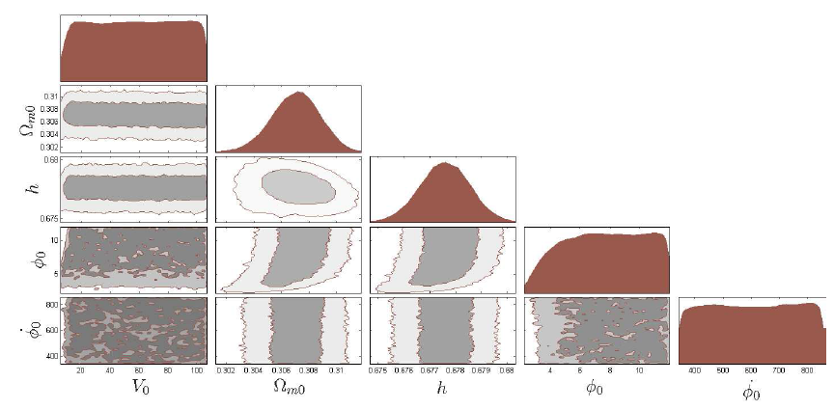
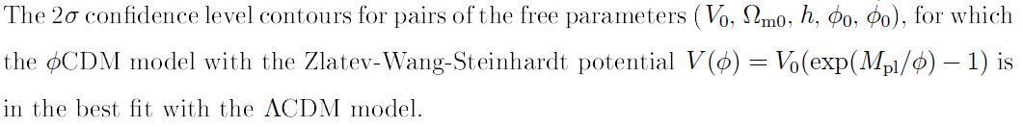
MCMC Results

Slide 24
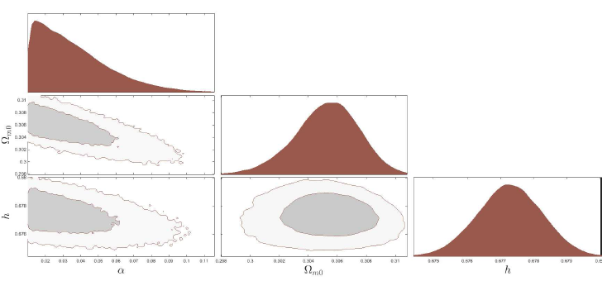
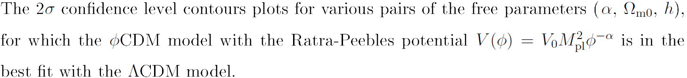
MCMC Results

Slide 25
MCMC analysis with upcoming DESI data

Slide 26






Bayesian Statistics
Akaike information criterion
Schwarz information criterion
Bayes evidence

Slide 27
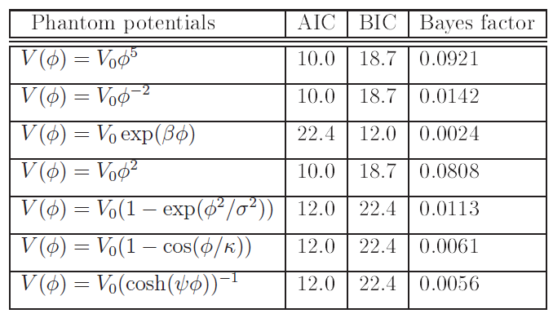
Bayesian Statistics for the Phantom Potentials

Slide 28
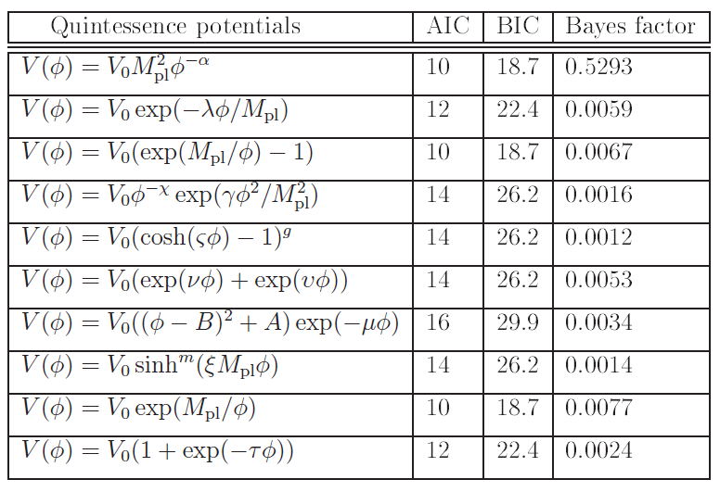
Bayesian Statistics for the Quintessence Potentials

Slide 29
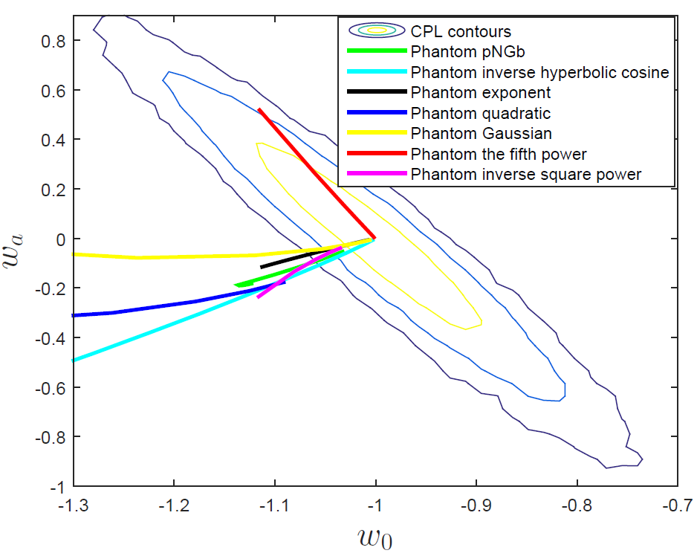
Phantom φCDM Models in the CPL Phase Space

Slide 30
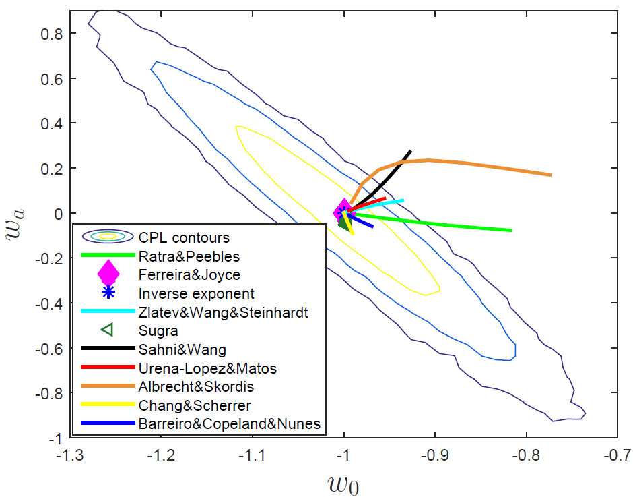
Quintessence φCDM Models in the CPL Phase Space

Slide 31
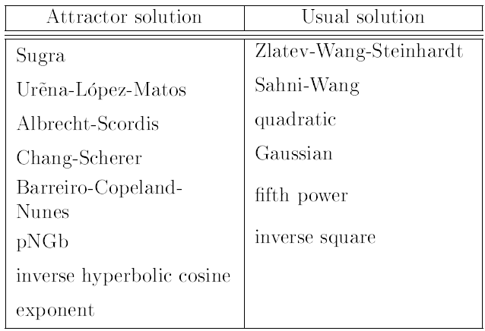
Subclasses of the Potentials

Slide 32
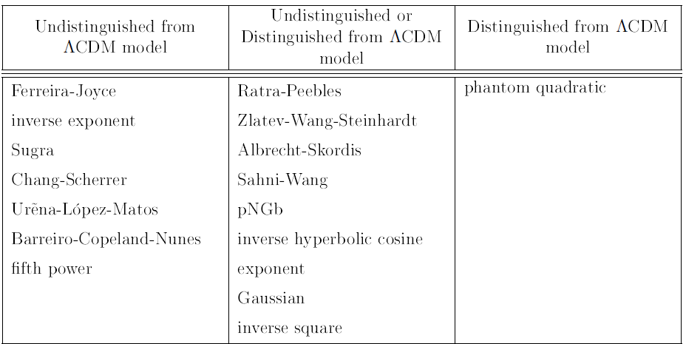
Subclasses of the Potentials

Slide 33
Conclusion
1) We reconstructed quintessence and phantom scalar field φCDM models using the phenomenological method developed by us.
2) Using the Bayesian statistical analysis, we could not uniquely identify the preferable φCDM models compared to the fiducial ΛCDM model based on the predicted DESI data, and the ΛCDM model is a true model.
Mapping φCDM models in the phase space of the CPL-ΛCDM contours, we could identify the subclasses of these models, which:
i) have the attractor and usual solutions,
ii) can be distinguished from the ΛCDM model,
iii) cannot be distinguished from the ΛCDM model,
iv) can be either distinguished or undistinguished from the ΛCDM model at present epoch.

Slide 34
Thank You for Your Kind Attention!

