Slide 1
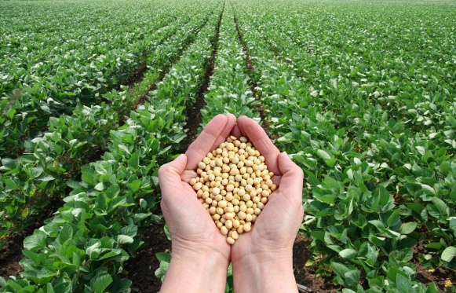
HPLC screening of phytoestrogens from soybeans in conjunction with chemometric data analysis: a tool for selecting the best raw materials for producing dietary supplements for menopausal health
Edward MUNTEAN^{1, 2, *}, Camelia URDA², Raluca REZI²
¹University of Agricultural Sciences and Veterinary Medicine Cluj Napoca, Romania
²Research & Development Station for Agriculture, Turda, Romania
*Presenting author e-mail: edimuntean@yahoo.com

Slide 2
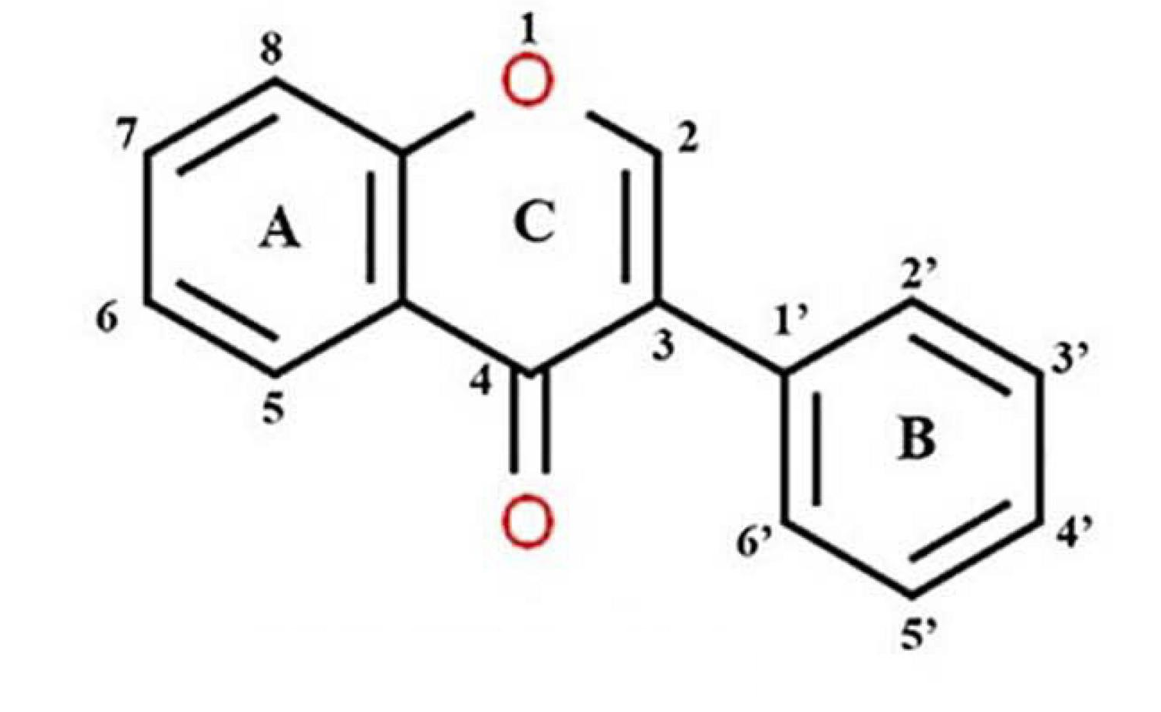
Introduction
Soybeans are extensively cultivated crops with multiple applications, such as human consumption, livestock feed, biofuel production, and the fabrication of various chemicals.
They boast a substantial amount of proteins, as well as ample amounts of fiber, vitamins, and minerals, all of these making soybeans a nutritious option [Hartman et al., 2011; Medic et al., 2014; Rizo and Baroni, 2018].
As a result of their nutritional profile and health advantages, there is growing interest in breeding soybeans with enhanced protein, fatty acid and isoflavone content.

Slide 3
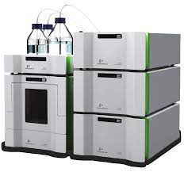
Introduction (cont.)
Soybeans are a leading source of isoflavones - phytoestrogens with numerous health benefits, particularly for women's health, being increasingly used in the production of dietary supplements over the last decades [He and Chen, 2013; Pabich and Materska, 2019; Poluzzi et al., 2014; Wang et al., 2018].
High performance liquid chromatography (HPLC) is currently the preferred method for separating components in mixtures; it is a highly modern, efficient, and versatile technique that is widely used to separate, identify, and quantify analytes, as well as to obtain the chemical profile or fingerprint of a diverse range of analytes from biological samples, hence being used in this context.

Slide 4
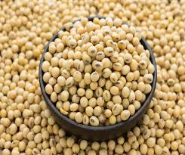
Research objective
To develop a synergistic approach of HPLC and chemometric techniques, allowing for a swift and convenient evaluation of the isoflavone content in soybean seeds from diverse genotypes, with the aim of selecting the optimal raw materials for the production of dietary supplements for menopausal health.

Slide 5
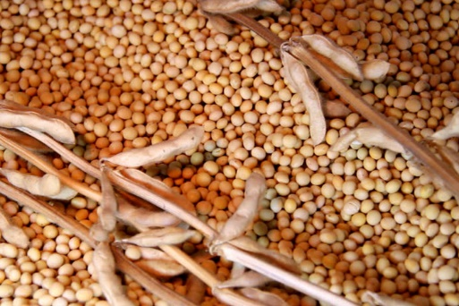
Material and methods
Plant material:
soybean seeds originating from 20 genotypes were harvested at maturity from the Research & Development Station for Agriculture, Turda - Romania.
Sample preparation:
~ 100 g seeds were milled, then ~ 1g from the resulted flour was weighed, defatted using 10 mL of hexane, then the extraction of isoflavones was accomplished with 20 mL ethanol (50%) on a magnetic stirrer (350 rpm, 60⁰C, 2 hours); the resulted suspensions were vacuum-filtered, brought to the volume of 25 mL with 50% ethanol, filtrated through 0,47 mm membrane filters then subjected to HPLC analysis.

Slide 6
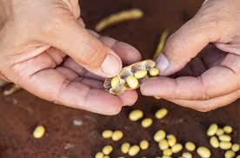
Material and methods (cont.)
HPLC analysis
Chromatographic analysis was accomplished using a Flexar system (Perkin Elmer) consisting of two UHPLC pumps, a solvent degasser, an autosampler, a column oven, and a UV-VIS detector.
Baseline separations were accomplished for daidzin, glycitin, genistin, daidzein, genistein and glycitein using a Kinetex column and gradient elution with acetonitrile and water, both with 0.1% H₃PO₄, in a total run time less than 8 minutes; the flowrate was 1 mL/ min and the injection volume of 5 μL.
Quantifications were based on the external standard method.
Data analysis
Chromatographic data analysis was accomplished using Chromera (Perkin Elmer) and LCSolution (Shimadzu). Autoscaled preprocessed chromatographic data were further subjected to principal component analysis (PCA) and cluster analysis using Matlab (MathWorks Inc., USA).

Slide 7
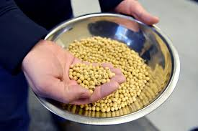
Results
The HPLC analysis of soybeans genotype revealed distinct fingerprints of isoflavones, which were influenced by genetic factors; figure 1 shows a representative isoflavone pattern for a genotype having daidzin, glycitin and genistein as major isoflavones.
Figure 1. Representative HPLC chromatogram of isoflavones from a soybean genotype containing high amounts of isoflavones. Peak ID’s: 1-daidzin, 2-glycitin, 3-genistin, 4-daidzein, 5-glycitein

Slide 8
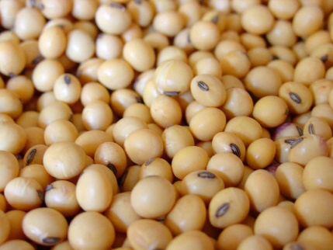
Results
The brief descriptive statistics of the obtained data is presented in table 1, revealing that daidzin and genistin are the major isoflavones from the studied genotypes; in 15% from the analyzed samples, daidzein and genistein were not detected.
Table 1. Concentration ranges for isoflavones in the studied genotypes [mg/ 1000 g]
 | Daidzin | Glycitin | Genistin | Daidzein | Glycitein | Genistein | Total
Min. | 308.76 | 27.73 | 349.57 | 0.00 | 4.23 | 0.00 | 829.20
Max. | 777.98 | 84.76 | 935.96 | 14.38 | 28.39 | 16.85 | 1732.59
Average | 567.48 | 62.93 | 596.40 | 7.29 | 15.17 | 8.59 | 1257.86

Slide 9
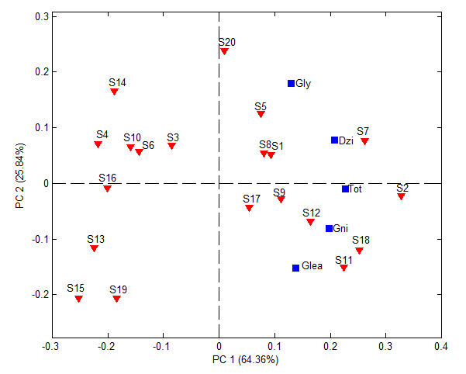
Results
PCA was accomplished on the experimental dataset using five variables (concentrations of glycitin, daidzin, genistin, glycitein and total isoflavones'), leading to a model in which the first two principal components explained 90.19% variance.
The biplot from figure 2 emphasizes the soybeans genotypes with the highest:
- total content of isoflavones (S2, S7, S18)
- content of glycitin (S20)
- content of daidzin (S7)
- content of genistin (S11)
as well as genotypes with similar isoflavone composition (S8-S1, S10-S6).
Hence, the biplot diagram can be a useful tool in assisting decision-making for using a certain genotype as raw material for the production of food supplements designed for menopausal health.
Figure 2. Biplot diagram obtained from the principal component analysis; here, the concentration of glycitin – Gly/ daidzin – Dzi/ genistin – Gni/ glicitein – Glea/ total isoflavones - Tot

Slide 10
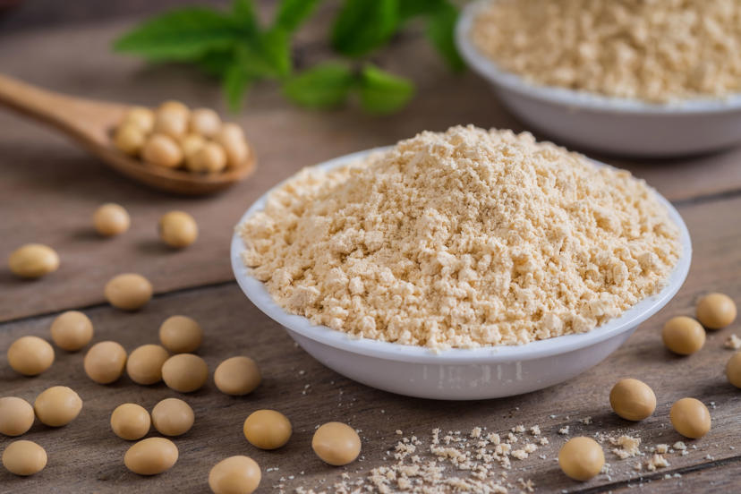
Conclusions
The developed HPLC method proved to be fast (under 8 minutes run-time for the separation of the targeted isoflavones), sensitive, reproductible, accurate and suitable for the analysis of soybean seeds.
The obtained results extended the current knowledge, providing the content of isoflavones in the studied genotypes.
The reported values can support future nutrition studies involving isoflavones from plant sources, as well as their use in different functional products.
Overall, the proposed approach can be considered an efficient tool for both quality control assessment purposes and for assisting breeding programs targeted at developing new genotypes with the desired isoflavones’ profile.

Slide 11
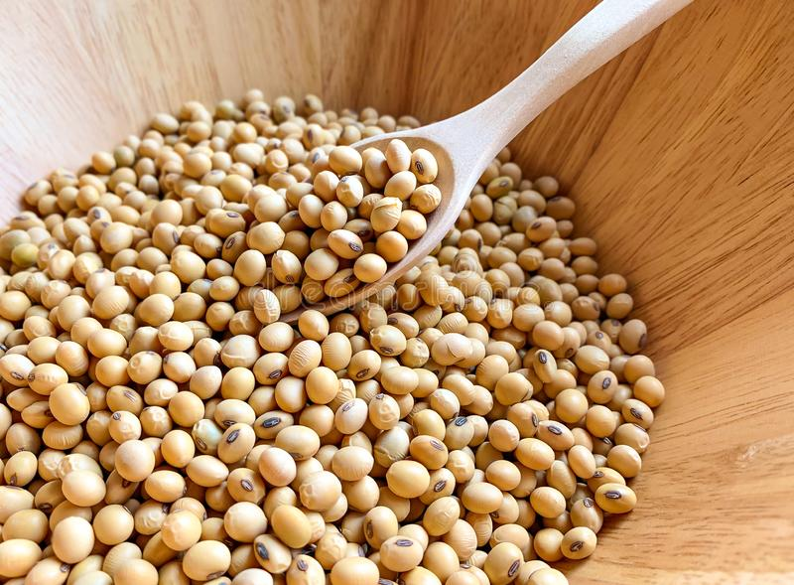
References
Hartman, G. L., West, E. D., & Herman, T. K. (2011). Crops that feed the World 2. Soybean—worldwide production, use, and constraints caused by pathogens and pests. Food Security, 3, 5-17.
He, F. J., & Chen, J. Q. (2013). Consumption of soybean, soy foods, soy isoflavones and breast cancer incidence: Differences between Chinese women and women in Western countries and possible mechanisms. Food science and human wellness, 2(3-4), 146-161.
Medic, J., Atkinson, C., & Hurburgh, C. R. (2014). Current knowledge in soybean composition. Journal of the American oil chemists' society, 91, 363-384.
Pabich M., Materska M. (2019). Biological effect of soy isoflavones in the prevention of civilization diseases. Nutrients, 11(7), 1660.
Poluzzi, E., Piccinni, C., Raschi, E., Rampa, A., Recanatini, M., & De Ponti, F. (2014). Phytoestrogens in postmenopause: the state of the art from a chemical, pharmacological and regulatory perspective. Current medicinal chemistry, 21(4), 417-436.
Rizzo, G., & Baroni, L. (2018). Soy, soy foods and their role in vegetarian diets. Nutrients, 10(1), 43.
Wang Y., Liu L., Ji F., Jiang J., Yu Y., Sheng S., Li H. (2018). Soybean (Glycine max) prevents the progression of breast cancer cells by downregulating the level of histone demethylase JMJD5. Journal of cancer research and therapeutics, 14(10), 609.

