Slide 1


Modulatory action of Combretum paniculatum Vent ethanolic extract on oxidoinflammatory anomalies in experimental animals
* Chukwuma, Ifeoma F., Nworah, Florence N. and Apeh, Victor O.
Presented by:
Chukwuma, Ifeoma Felicia (Ph.D)
Department of Biochemistry, University of Nigeria, Nsukka, Nigeria.
*Corresponding author: Email: chukwuma.ifeoma@unn.edu.ng; +2347064614452.

Slide 2
INTRODUCTION
Inflammation is the response of the body tissue to an injuries stimuli.
However, unregulated inflammatory response leads to uncontrolled mobilization of pro-inflammatory mediators which initiate tissue damage by generating excessive reactive oxygen and nitrogen species.
The radical species overwhelm the reducing capacity of endogenous antioxidant leading to oxidative stress.
In clinical settings, several drugs are used to modulate inflammation and oxidative stress

Slide 3
Natural products as treatment option for inflammation and oxidative mediated diseases
The interest in natural products is due to their:
High safety profile.
Biocompatibility.
Accessibility.
Therapeutic efficacy.
Low cost.
Multi-targeted approach.

Slide 4
Combretum paniculatum
Combretum paniculatum (Combretaceae) also called forest frame, is a tropical African endemic plant.
It is extensively used in ethno medicine for the treatment of chronic dysentery, analgesic, diarrhea, enlarged spleen and liver.
The pharmacological potency of the leaves includes antiulcer, anti-diarrhea, antioxidant, strong anti-viral and anti-cancer activity (Peter et al., 2020).
So, this study was designed to investigate the modulatory action of Combretum paniculatum Vent ethanolic extract on oxidoinflammatory anomalies in experimental animals

Slide 5
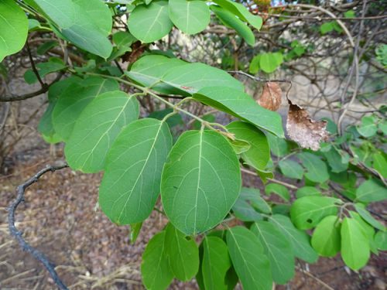
Figure 3: Picture of Combretum paniculatum leaves

Slide 6
MATERIALS AND METHODS
Collection and identification of plant materials
The plant material, C. paniculatum leaves (Figure 1) was collected around University of Nigeria Nsukka community and identified by a taxonomist Mr. Alfred Ozioko (reference number INTERCEDD/1909).
Extraction and fractionation
The pulverized dried leaves (2 kg) were extracted with 80 % ethanol (5 L) for 48 h to get C. paniculatum ethanolic extract (CPEE) used for the study.
Acute toxicity studies
The lethal dose of EECP was evaluated in two phases with the Lorke’s (1983) method.
Phytochemical screening
This was investigated using the experimental procedure of Harbone (1998); Trease, and Evans (1989).

Slide 7
STATISTICAL ANALYSIS
Statistical evaluation of data was performed using GraphPad Prism software version 6.5 (GraphPad Software, Inc., San Diego, CA, USA) and results obtained presented as mean ± SD. Data were considered statistically significant when *p < 0.05, **p < 0.001, and ***p < 0.001.

Slide 8
RESULTS
&
DISCUSSION

Slide 9
Table 1: Median lethal dose and Acute toxicity study (LD₅₀) of CPEE
Phases | Doses of EFCPL (mg/kg) | Mortality
Phase 1 | 10 | nil
 | 100 | nil
 | 1000 | nil
Phase 2 | 1600 | nil
 | 2900 | nil
 | 5000 | nil
n= 3

Slide 10
Table 2: Quantitative phytochemical compositions of CPEE
S/N | Phytochemicals | Amounts (mg/100 g)
1 | Phenols | 2711.02 ± 60.66
2 | Tannins | 21.12 ± 0.41
3 | Flavonoids | 49.00 ± 6.74
4 | Alkaloids | 605.83 ± 10.10
5 | Steroids | 0.64 ± 0.06
6 | Terpenoids | 12.17 ± 0.55
7 | Reducing sugar | 57.03 ± 0.12
8 | Glycosides | 2.59 ± 0.82
Results are expressed in Means ± SD (n = 3)

Slide 11
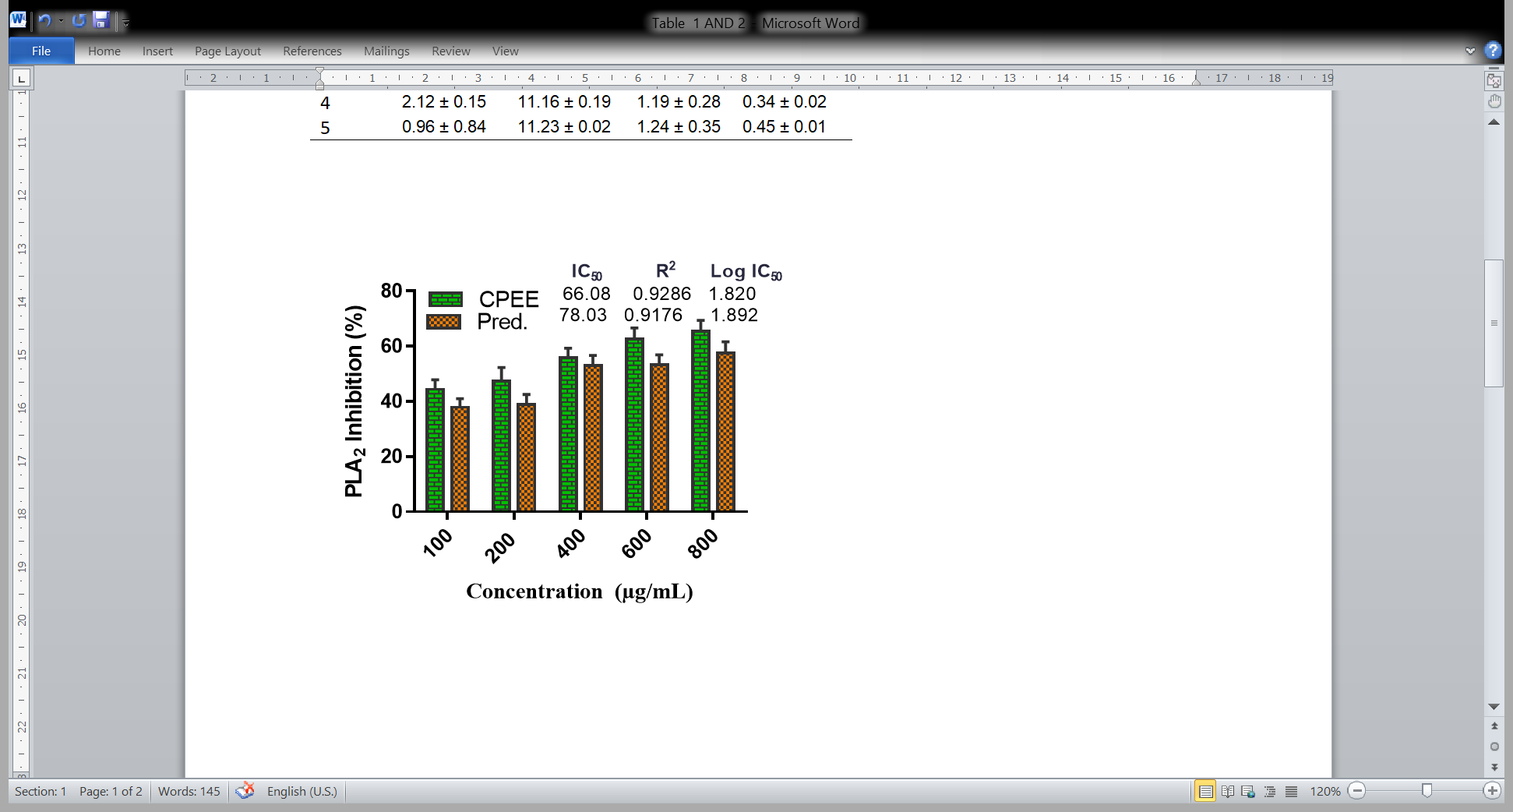
Figure 2: Effect of CPEE on PLA2 activity.
The values are presented as the mean ± S.D. (n = 5)..

Slide 12
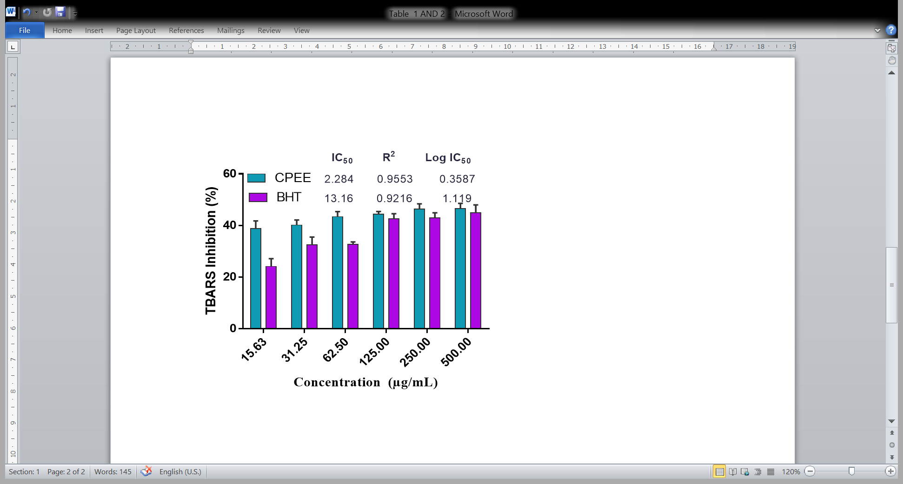
Figure 3: Effect of CPEE on in vitro lipid peroxidation
The values are presented as the mean ± S.D. (n = 5).

Slide 13
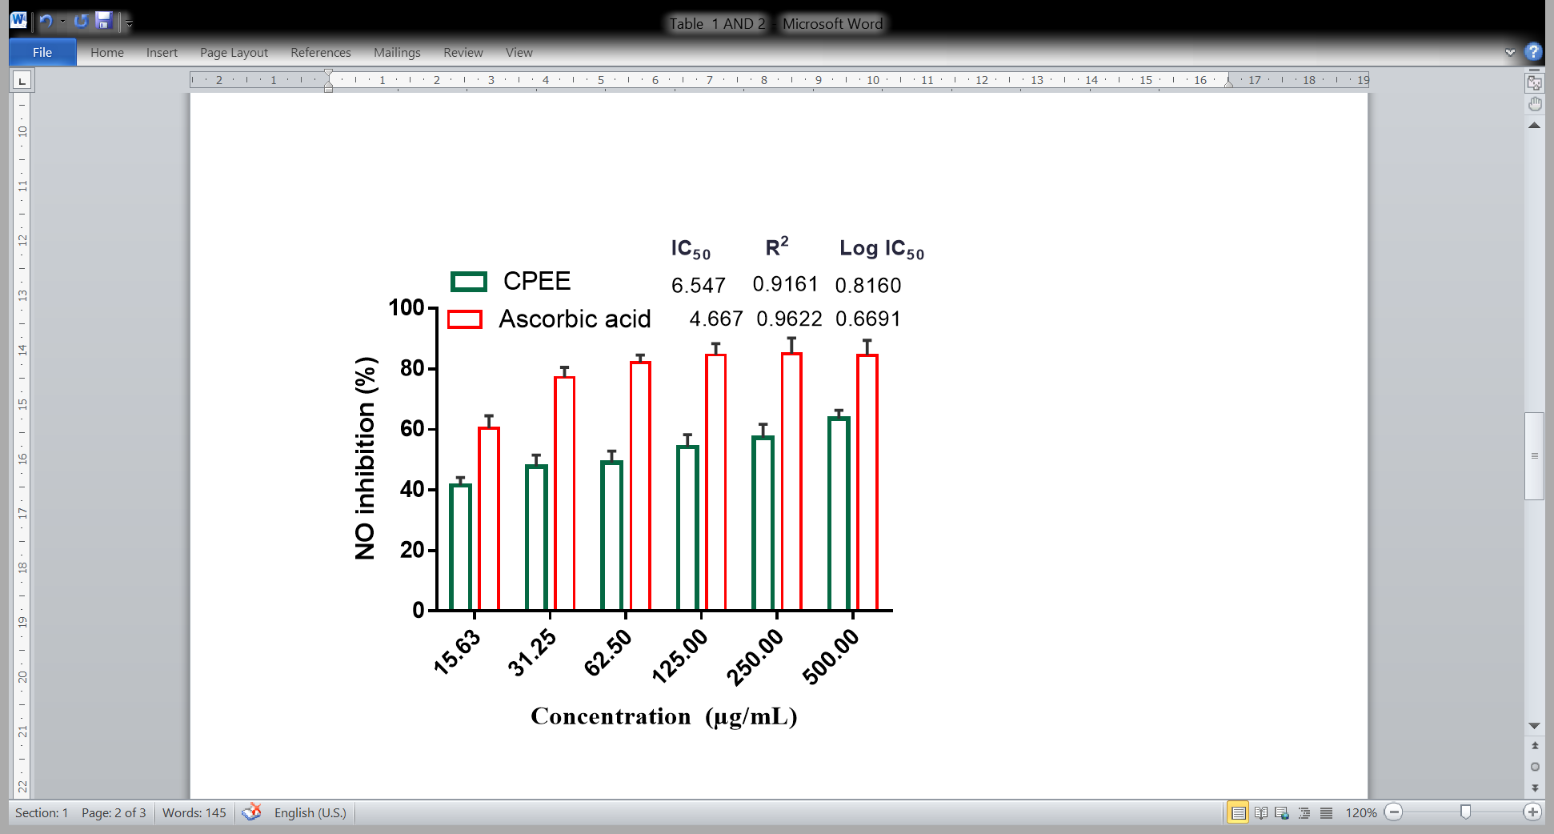
Figure 4: Effect of CPEE on nitric oxide scavenging activities
The values are presented as the mean ± S.D. (n = 5).

Slide 14
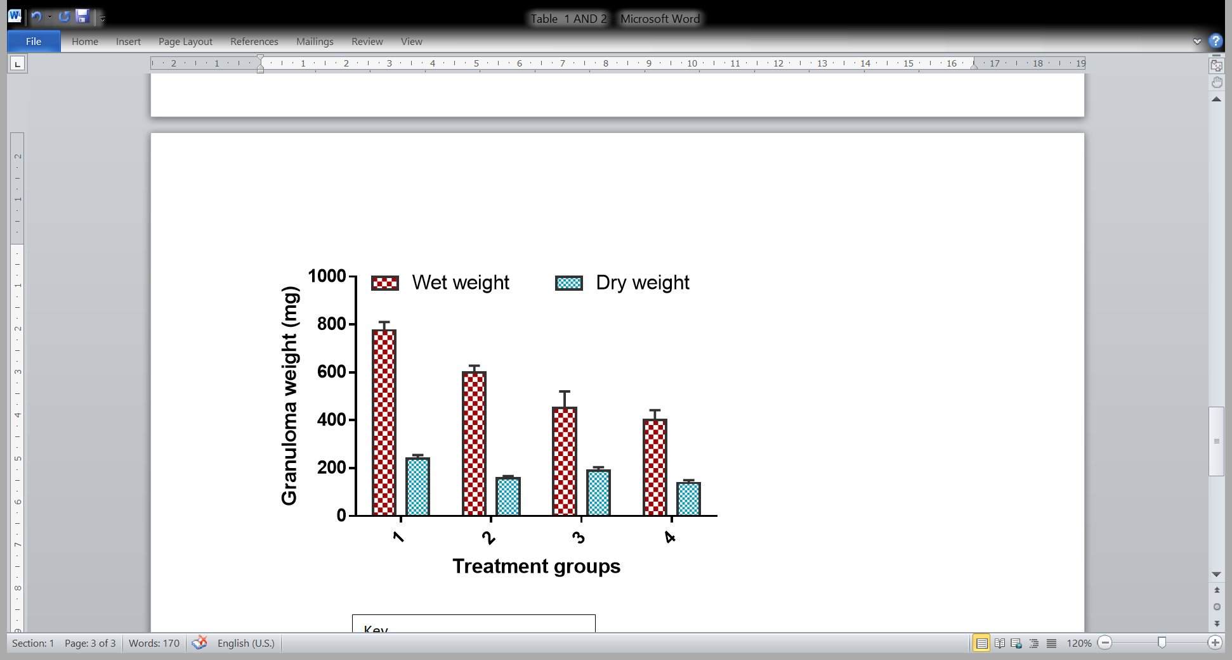
Figure 5: Effect of CPEE on wet and dry granuloma tissue weight
The values are presented as the mean ± S.D. (n = 5).

Slide 15
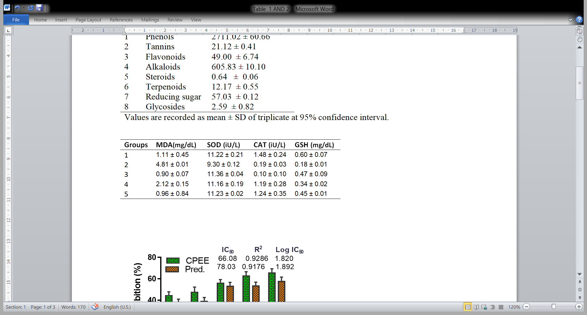
Table 3: Effect of CPEE on lipid peroxidation and antioxidant markers
The values are presented as the mean ± S.D. (n = 5).

Slide 16
CONCLUSION
These findings from this study show that CPEE ameliorated chronic inflammatory-induced oxidative stress in the experimental animals.
This pharmaceutical action could be attributed to the rich phytoconstituents identified in the extract including polyphenols known to mitigate oxidative damage by scavenging radicals via hydrogen/ electron donation from their multiple phenolic rings.
Thus, the leaves of C. paniculatum could be employed as an effective remedy for developing antioxidant and anti-inflammatory drugs.

Slide 17
Selected references
Peter IE, Aroh CM, Shere UG, Ani NI, Adaka IC, Asogwa FK, Isiogugu ON, Abonyi CU, Onwuka AM. (2020). Pharmacological Actions of Methanol Leaf Extract of Combretum paniculatum. Trop J Nat Prod Res. 4(7):3- 9.
Harborne JB. Phytochemicals Methods: A Guide to Modern Technique of Plant Analysis. 2nd Edition. Chapman and Hall; 1998.
Trease GE, Evans W. Pharmacognosy. 11th editi. Macmillan Publishers; 1989.
Lorke D. Determination of acute toxicity. Arch Toxicol. 1983; 53:275-287.

Slide 18
THANK YOU
FOR
LISTENING

