Slide 1
Identification of Potential Protein Biomarkers in a Depressed Chinese Malaysian University Student using Liquid Chromatography-tandem Mass Spectrometry
Yap Sin Yee
Universiti Tunku Abdul Rahman, MAlaysia

Slide 2
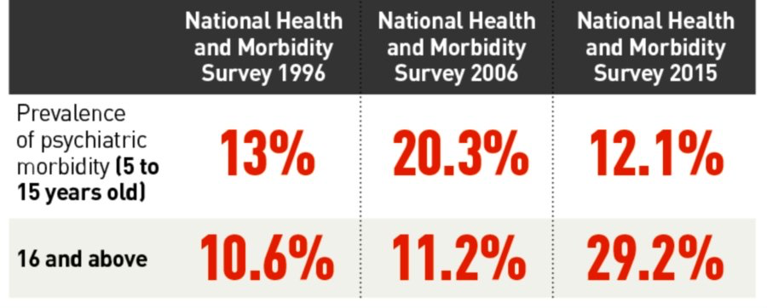
Depression in Malaysia
Mental disorder is one of the biggest health issues affecting Malaysians.
Image source: Suicide on the rise among Malaysian youth: New Straits Times (online)
Mukhtar & Oei, 2011; Institute for Public Health (IPH), 1996; IPH, 2008; IPH, 2015

Slide 3
Depression in Malaysia
National Health and Morbidity Survey 2019 reported that nearly half a million of Malaysian adults suffered from depression.
A 2020 study reported that 42.3% of Malaysian adults had depression.
Another nationwide survey among general population has showed an alarming prevalent rate of depression (59.2%) during the COVID-19 pandemic.
The prevalence of depression was apparently increasing.
IPH, 2020; Chua, 2020; Perveen et al, 2020; Wong et al, 2021

Slide 4
Depression among university students
Depression often develops at a young age and is often recurring.
18-29 year olds are three times more likely to be depressed than people of 60 year olds and above.
University students are experiencing a stressful period:
Academic stress
Financial problems
Concern for their future
Makes them more vulnerable to depression.
American Psychiatric Association, 2013; Yeoh et al, 2017

Slide 5
Depression among university students in Malaysia

Slide 6
Diagnosis and treatment of depression
To date, the etiology of depression is not fully understood yet.
There is no clinical laboratory tests available for the diagnosis of depression due to its complex nature.
Currently, the diagnosis and treatment of depression is superior to symptom-based.

Slide 7
Diagnosis and treatment of depression
Screening:
Questionnaires
Diagnosis:
Patients’ descriptions of symptoms
Diagnostic criteria (DSM-5 & ICD-11)
Patients’ management:
Refer to psychiatric services
There is a need for a convenient and effective way to detect depression:
Biomarker
Clinical behavior observations
Admit to the psychiatric ward
American Psychiatric Association, 2013

Slide 8
Biomarker
Biomarker is any measurable indicator of the state of a body.
A biomarker can be a gene or a group of genes, proteins or other biomolecules.
Bodily fluids like blood, urine, and cerebral spinal fluid are one of the easily accessible sources of psychiatric biomarkers.
Biomarker Definitions Working Group, 2001; García-Gutiérrez et al, 2020

Slide 9
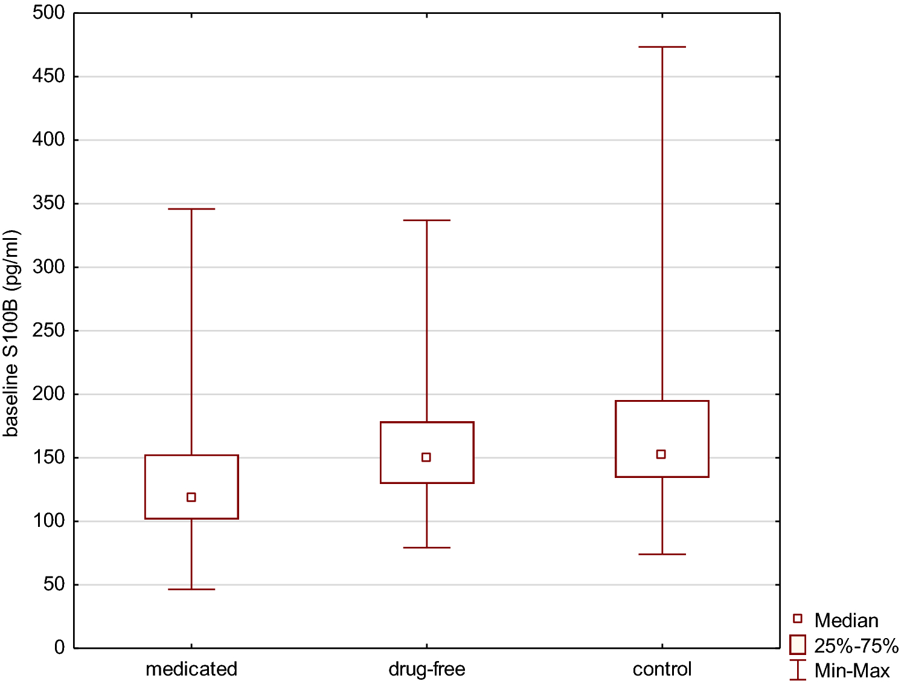
Protein markers of depression
Serum S100B were found to be lower in medicated youth patients, compared with those who were drug-free, and healthy controls.
Rajewska-Rager et al, 2021

Slide 10
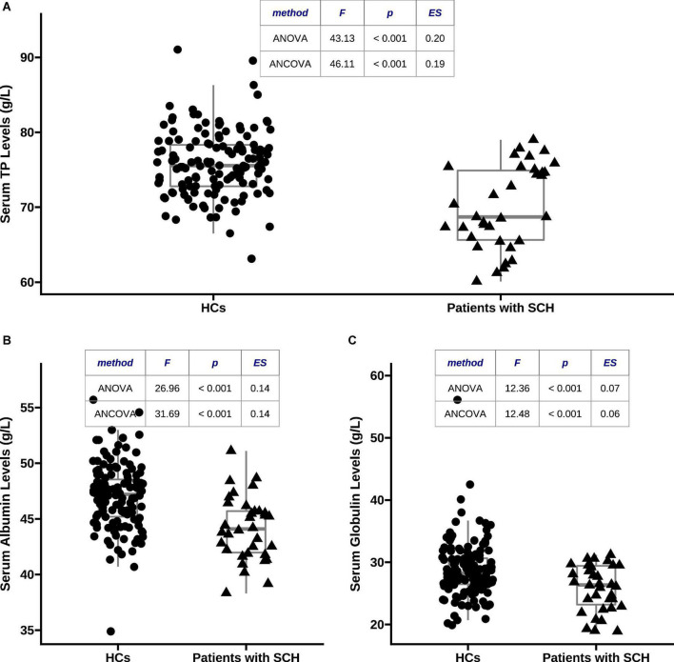
Protein markers of depression
Decreased serum total proteins, albumin, and globulin were found associated with depressive severity in schizophrenia.
Yin et al, 2022

Slide 11
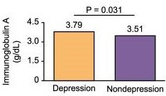
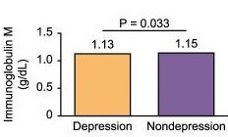
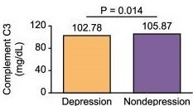
Protein markers of depression
Chinese older adults with depression had higher levels of immunoglobulin A and lower levels immunoglobulin M and complement C3 than the group without depression.
Sun et al, 2022

Slide 12
Our results
^{Note} Other proteins: ceruloplasmin, albumin and luminal proteins

Slide 13
Our results
Globulins were most commonly detected, followed by globins, apolipoproteins, glycoproteins, inhibitory proteins, complement proteins, binding protein and other proteins such as ceruloplasmin, albumin and luminal proteins.
^{Note} Other proteins: ceruloplasmin, albumin and luminal proteins

Slide 14
Our results
Majority of the identified proteins have functions related to:
Inflammation
Lipids transport

Slide 15
Inflammation
When we are sick:
Our immune system creates an inflammatory response so that we can heal.
When inflammatory cytokines in body reach a certain threshold, our brain will initiate its own inflammatory response:
The macrophages will pump out more cytokines that attack both invaders and healthy tissues.
Kany et al, 2019

Slide 16
Via neurotransmitter systems
Cytokines can also alter the neurotransmitter systems involved in the development of depression.
Meta-analysis in 2019 demonstrated alterations of cytokines levels in patients with antidepressant outcomes.
Liu et al, 2020

Slide 17
Via neurotransmitter systems
C-reactive protein (CRP) is an inflammation protein marker that increases during infection.
Meta-analysis consists of 30 studies with 11 813 participants showed that presence of low-grade inflammation and elevated CRP levels were found in depressed patients.
Higher CRP levels was associated with depressive symptoms from Netherlands Study of Depression and Anxiety (NESDA) and UK Biobank cohorts.
Osimo et al, 2019; Milaneschi et al, 2021

Slide 18
Neurotransmitter systems
Monoamines neurotransmitters like dopamine, norepinephrine, and serotonin are primarily associated with the development of depression.
Increased dopamine signalling and lower levels of depressive symptoms among Asian, however, contradictory result was found among Caucasian samples.
Reduction of depression-like behavior was found in rat models with significantly increased norepinephrine levels.
Shao & Zhu, 2020; Avinun et al, 2020; Du et al, 2020

Slide 19
Neurotransmitter systems
Neurotransmitters like glutamate and GABA are also related to depression:
Patients with first episode depression had significantly decreased glutamate and increased GABA levels compared to healthy controls.
These neurotransmitters are also associated with inflammation:
Depressed adolescents found higher levels of pro-inflammatory cytokines associated with higher levels of glutamate.
Hybrid molecules targeted GABA-A and serotonin 5-HT6 receptors showed anti-inflammatory and antidepressant activity in recent in vivo studies.
Draganov et al, 2020; Ho et al, 2021; Marcinkowska et al, 2023

Slide 20
Serum lipids and depression
Serum lipids may be linked to depression via alteration of serotonin metabolism.
Cholesterol has crucial role in brain development and in neuron-to-neuron signaling.
Patients with a major depressive episode show increased levels of LDL cholesterol.
LDL cholesterol can reduce availability of serotonin and increase depression risk by directly impair the function of the serotonin 1A receptor in the brain.
Gliozzi et al, 2021; Wagner et al, 2019; Han, 2022

Slide 21
Serotonin and depression
A recent study found rapid response to selective serotonin reuptake inhibitors (SSRIs) in post-COVID depressed patients:
Suggests that SSRIs could be an effective depression treatment option for the neuroinflammation triggered by SARS-CoV-2.
However, there is a recent review opposes the idea that serotonin cause depression:
Found no consistent evidence showing association between serotonin and depression.
Mazza et al, 2022; Moncrieff et al, 2022

Slide 22
In short
Most protein markers identified in this study were related to inflammation and lipid transport.
Biomarkers can be used to distinguish between depressed and healthy groups.
Can also enhance our current diagnosis method and allowing individualized treatment.

Slide 23
In short
Future studies:
With healthy controls are much needed to further confirm the role of these biomarkers in depression.
Could look into the relationship between these inflammation markers and dietary patterns, so that we can modify our food intake for early prevention of depression.

Slide 24
References
Mukhtar, F.; Oei, T.P.S. A Review on Assessment and Treatment for Depression in Malaysia. Depression Research and Treatment 2011, 2011, e123642, doi:10.1155/2011/123642.
Institute for Public Health (IPH). The Second National Health and Morbidity Survey (NHMS 1996): Psychiatric Morbidity; 1996, http://iku.moh.gov.my/images/IKU/Document/REPORT/1996/PsyhiatricMorbidity.pdf
Institute for Public Health (IPH). The Third National Health and Morbidity Survey (NHMS 2006): Psychiatric Morbidity; 2008, http://iku.moh.gov.my/images/IKU/Document/REPORT/2012/PsyhiatricMorbidity.pdf
Institute for Public Health (IPH). National Health and Morbidity Survey 2015 (NHMS 2015): Vol. II: Non-Communicable Diseases, Risk Factors & Other Health Problems; 2015, https://www.moh.gov.my/moh/resources/nhmsreport2015vol2.pdf
Institute for Public Health (IPH). National Health and Morbidity Survey (NHMS 2019): Non-Communicable Diseases, Healthcare Demand, and Health Literacy; 2020, https://iku.moh.gov.my/images/IKU/Document/REPORT/NHMS2019/Infographic_Booklet_NHMS_2019-English.pdf
Chua, S.N. The Economic Cost of Mental Disorders in Malaysia. Lancet Psychiatry 2020, 7, e23, doi:10.1016/S2215-0366(20)30091-2.
Perveen, A.; Hamzah, H.; Ramlee, F.; Othman, A.; Minhad, M. Mental Health and Coping Response among Malaysian Adults during COVID-19 Pandemic Movement Control Order. Journal of Critical Reviews 2020, 7, 2020.
Wong, L.P.; Alias, H.; Fuzi, A.A.M.; Omar, I.S.; Nor, A.M.; Tan, M.P.; Baranovich, D.L.; Saari, C.Z.; Hamzah, S.H.; Cheong, K.W.; et al. Escalating Progression of Mental Health Disorders during the COVID-19 Pandemic: Evidence from a Nationwide Survey. PLOS ONE 2021, 16, e0248916, doi:10.1371/journal.pone.0248916.
American Psychiatric Association Diagnostic and Statistical Manual of Mental Disorders; Fifth Edition.; American Psychiatric Association, 2013; ISBN 978-0-89042-555-8.
Yeoh, S.H.; Tam, C.L.; Wong, C.P.; Bonn, G. Examining Depressive Symptoms and Their Predictors in Malaysia: Stress, Locus of Control, and Occupation. Front Psychol 2017, 8, 1411, doi:10.3389/fpsyg.2017.01411.
Islam, Md.A.; Low, W.Y.; Tong, W.T.; Choo, C.W.Y.; Abdullah, A. Factors Associated with Depression among University Students in Malaysia: A Cross-Sectional Study | KnE Life Sciences. The 2nd International Meeting of Public Health 2016 (IMOPH) 2018, 415–427, doi:10.18502/kls.v4i4.2302.
Yap, S.Y.; Foo, C.N.; Lim, Y.M.; Ng, F.L.; Mohd-Sidik, S.; Tang, P.Y.; Najar Singh, J.K.; Pheh, K.-S. Traditional Chinese Medicine Body Constitutions and Psychological Determinants of Depression among University Students in Malaysia: A Pilot Study. Int J Environ Res Public Health 2021, 18, doi:10.3390/ijerph18105366.
Fata Nahas, A.R.M.; Elkalmi, R.M.; Al-Shami, A.M.; Elsayed, T.M. Prevalence of Depression Among Health Sciences Students: Findings From a Public University in Malaysia. J Pharm Bioallied Sci 2019, 11, 170–175, doi:10.4103/jpbs.JPBS_263_18.

Slide 25
References
Hamzah, N.S.A.; Farid, N.D.N.; Yahya, A.; Chin, C.; Su, T.T.; Rampal, S.R.L.; Dahlui, M. Correction to: The Prevalence and Associated Factors of Depression, Anxiety and Stress of First Year Undergraduate Students in a Public Higher Learning Institution in Malaysia. Journal of Child & Family Studies 2019, 28, 3582–3582.
Talwar, P.; Othman, M.; Othman, A.E.A.; Mustaffa, M.S.; Mughal, Y.H. Socio-Demographic Determinants and Prevalence of Depression, Anxiety, and Stress among Malaysian University Students. Journal of the Indian Academy of Applied Psychology 2017, 43, 296–304.
Teh, C.K.; Ngo, C.W.; Zulkifli, R.A. binti; Vellasamy, R.; Suresh, K. Depression, Anxiety and Stress among Undergraduate Students: A Cross Sectional Study. Open Journal of Epidemiology 2015, 05, 260, doi:10.4236/ojepi.2015.54030.
Shamsuddin, K.; Fadzil, F.; Ismail, W.S.W.; Shah, S.A.; Omar, K.; Muhammad, N.A.; Jaffar, A.; Ismail, A.; Mahadevan, R. Correlates of Depression, Anxiety and Stress among Malaysian University Students. Asian J Psychiatr 2013, 6, 318–323, doi:10.1016/j.ajp.2013.01.014.
Gan, W.Y.; Nasir, M.; Mohd Shariff, Z.; Abu Saad, H. Disordered Eating Behaviors, Depression, Anxiety and Stress among Malaysian University Students. College Student Journal 2011, 45, 296.
García-Gutiérrez, M.S.; Navarrete, F.; Sala, F.; Gasparyan, A.; Austrich-Olivares, A.; Manzanares, J. Biomarkers in Psychiatry: Concept, Definition, Types and Relevance to the Clinical Reality. Front Psychiatry 2020, 11, 432, doi:10.3389/fpsyt.2020.00432.
Rajewska-Rager, A.; Dmitrzak-Weglarz, M.; Kapelski, P.; Lepczynska, N.; Pawlak, J.; Twarowska-Hauser, J.; Skibinska, M. Longitudinal Assessment of S100B Serum Levels and Clinical Factors in Youth Patients with Mood Disorders. Sci Rep 2021, 11, 11973, doi:10.1038/s41598-021-91577-6.
Yin, X.; Cai, Y.; Zhu, Z.; Zhai, C.; Li, J.; Ji, C.; Chen, P.; Wang, J.; Wu, Y.; Chan, R.; et al. Associations of Decreased Serum Total Protein, Albumin, and Globulin with Depressive Severity of Schizophrenia. Frontiers in Psychiatry 2022, 13, 957671, doi:10.3389/fpsyt.2022.957671.
Sun, Z.; Lin, J.; Zhang, Y.; Yao, Y.; Huang, Z.; Zhao, Y.; Zhang, P.; Fu, S. Association between Immunoglobulin A and Depression in Chinese Older Adults: Findings from a Cross-Sectional Study. Immun Ageing 2022, 19, 21, doi:10.1186/s12979-022-00283-y.
Kany, S.; Vollrath, J.T.; Relja, B. Cytokines in Inflammatory Disease. Int J Mol Sci 2019, 20, 6008, doi:10.3390/ijms20236008.
Liu, J.J.; Wei, Y.B.; Strawbridge, R.; Bao, Y.; Chang, S.; Shi, L.; Que, J.; Gadad, B.S.; Trivedi, M.H.; Kelsoe, J.R.; et al. Peripheral Cytokine Levels and Response to Antidepressant Treatment in Depression: A Systematic Review and Meta-Analysis. Mol Psychiatry 2020, 25, 339–350, doi:10.1038/s41380-019-0474-5.
Osimo, E.F.; Baxter, L.J.; Lewis, G.; Jones, P.B.; Khandaker, G.M. Prevalence of Low-Grade Inflammation in Depression: A Systematic Review and Meta-Analysis of CRP Levels. Psychological Medicine 2019, 49, 1958–1970, doi:10.1017/S0033291719001454.

Slide 26
References
Milaneschi, Y.; Kappelmann, N.; Ye, Z.; Lamers, F.; Moser, S.; Jones, P.B.; Burgess, S.; Penninx, B.W.J.H.; Khandaker, G.M. Association of Inflammation with Depression and Anxiety: Evidence for Symptom-Specificity and Potential Causality from UK Biobank and NESDA Cohorts. Mol Psychiatry 2021, 26, 7393–7402, doi:10.1038/s41380-021-01188-w.
Shao, X.; Zhu, G. Associations Among Monoamine Neurotransmitter Pathways, Personality Traits, and Major Depressive Disorder. Frontiers in Psychiatry 2020, 11.
Avinun, R.; Nevo, A.; Radtke, S.R.; Brigidi, B.D.; Hariri, A.R. Divergence of an Association between Depressive Symptoms and a Dopamine Polygenic Score in Caucasians and Asians. Eur Arch Psychiatry Clin Neurosci 2020, 270, 229–235, doi:10.1007/s00406-019-01040-x.
Du, X.; Yin, M.; Yuan, L.; Zhang, G.; Fan, Y.; Li, Z.; Yuan, N.; Lv, X.; Zhao, X.; Zou, S.; et al. Reduction of Depression-like Behavior in Rat Model Induced by ShRNA Targeting Norepinephrine Transporter in Locus Coeruleus. Transl Psychiatry 2020, 10, 1–11, doi:10.1038/s41398-020-0808-8.
Draganov, M.; Vives-Gilabert, Y.; de Diego-Adeliño, J.; Vicent-Gil, M.; Puigdemont, D.; Portella, M.J. Glutamatergic and GABA-Ergic Abnormalities in First-Episode Depression. A 1-Year Follow-up 1H-MR Spectroscopic Study. Journal of Affective Disorders 2020, 266, 572–577, doi:10.1016/j.jad.2020.01.138.
Ho, T.C.; Teresi, G.I.; Segarra, J.R.; Ojha, A.; Walker, J.C.; Gu, M.; Spielman, D.M.; Sacchet, M.D.; Jiang, F.; Rosenberg-Hasson, Y.; et al. Higher Levels of Pro-Inflammatory Cytokines Are Associated With Higher Levels of Glutamate in the Anterior Cingulate Cortex in Depressed Adolescents. Frontiers in Psychiatry 2021, 12.
Marcinkowska, M.; Mordyl, B.; Fajkis-Zajaczkowska, N.; Siwek, A.; Karcz, T.; Gawalska, A.; Bucki, A.; Żmudzki, P.; Partyka, A.; Jastrzębska-Więsek, M.; et al. Hybrid Molecules Combining GABA-A and Serotonin 5-HT6 Receptors Activity Designed to Tackle Neuroinflammation Associated with Depression. European Journal of Medicinal Chemistry 2023, 247, 115071, doi:10.1016/j.ejmech.2022.115071.
Gliozzi, M.; Musolino, V.; Bosco, F.; Scicchitano, M.; Scarano, F.; Nucera, S.; Zito, M.C.; Ruga, S.; Carresi, C.; Macrì, R.; et al. Cholesterol Homeostasis: Researching a Dialogue between the Brain and Peripheral Tissues. Pharmacological Research 2021, 163, 105215, doi:10.1016/j.phrs.2020.105215.
Wagner, C.J.; Musenbichler, C.; Böhm, L.; Färber, K.; Fischer, A.-I.; von Nippold, F.; Winkelmann, M.; Richter-Schmidinger, T.; Mühle, C.; Kornhuber, J.; et al. LDL Cholesterol Relates to Depression, Its Severity, and the Prospective Course. Progress in Neuro-Psychopharmacology and Biological Psychiatry 2019, 92, 405–411, doi:10.1016/j.pnpbp.2019.01.010.
Han, A.L. Association between Lipid Ratio and Depression: A Cross-Sectional Study. Sci Rep 2022, 12, 6190, doi:10.1038/s41598-022-10350-5.
Mazza, M.G.; Zanardi, R.; Palladini, M.; Rovere-Querini, P.; Benedetti, F. Rapid Response to Selective Serotonin Reuptake Inhibitors in Post-COVID Depression. European Neuropsychopharmacology 2022, 54, 1–6, doi:10.1016/j.euroneuro.2021.09.009.
Moncrieff, J.; Cooper, R.E.; Stockmann, T.; Amendola, S.; Hengartner, M.P.; Horowitz, M.A. The Serotonin Theory of Depression: A Systematic Umbrella Review of the Evidence. Mol Psychiatry 2022, 1–14, doi:10.1038/s41380-022-01661-0.

