Slide 1
Evaluation of the coagulation dysfunction in Multiple Sclerosis from the perspective of IgG antibodies against thrombus-related components and genetic polymorphisms
Maria Hadjiagapiou
Neuroimmunology Department, CING
The Cyprus Institute of Neurology and Genetics

Slide 2
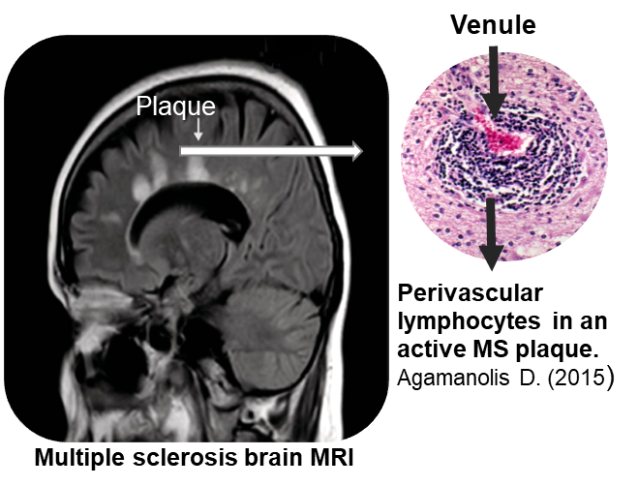
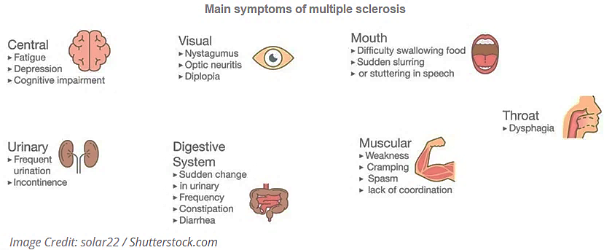
Multiple Sclerosis - Overview
An idiopathic autoimmune inflammatory disease of the central nervous system (CNS) presenting a relapsing or progressive course
Leading cause of no traumatic neurological disability in young adults
Characterized by disseminated lesions or “plaques” within the CNS due to inflammation and demyelination
Immensely variable symptomatology, including impaired vision, decreased sensation, paresthesia, ataxia, motor weakness and imbalance

Slide 3
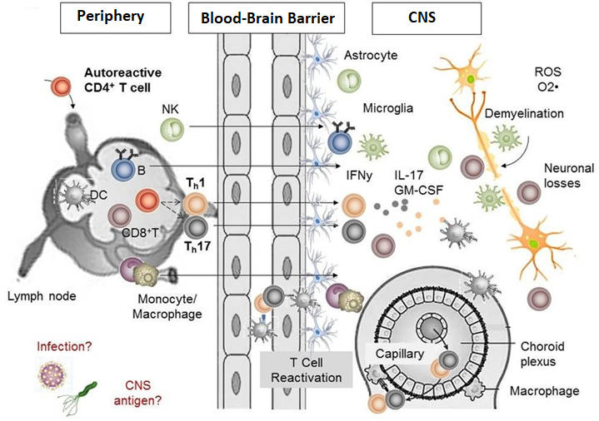
Multiple Sclerosis - Pathology
Activated lymphocytes and innate immune cells in the periphery gain entry into the CNS crossing the blood-brain barrier
In the presence of myelin antigens
immune cells are re-activated in situ along
with CNS resident cells like microglia and
astrocytes
Pro-inflammatory cytokines
promote inflammation and myelin
damage along with increased barrier
permeability and chemotaxis of
peripheral immune cells
Image Credit: C. Dendrou et al., Nature 2015

Slide 4
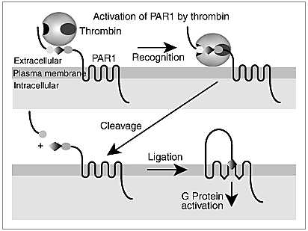
Coagulation-Inflammation interplay in Multiple Sclerosis
Thrombin and fibrin(ogen)
Modify the microglia motility towards pre-demyelinated areas
Act as chemoattractant for the immune cells
Induce the release of pro-inflammatory cytokines
Contribute in the axonal damage and neurodegeneration
Enhance the blood-brain
barrier disruption
Images Credit: S.Cooghlin, JTH 2005
Thrombin's proinflammatory effects are mediated by the protease-activated receptors (PARs).

Slide 5
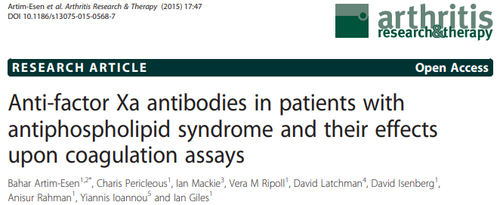
Antibodies against coagulation components in autoimmune diseases
Interfere with negative feedback regulation of thrombin in circulation, contributing to thrombosis.
Suppress the inactivation of the target coagulant serine proteases by antithrombin.
Inhibit the enzyme activities of the target proteases in fibrinolysis.
Promote thrombin-mediated activation of the complement C3 and C5.

Slide 6
Antibodies against coagulation components seem to play a pivotal role in overlapping diseases with Multiple Sclerosis, contributing to the coagulation-inflammation circuit.
Rationale of the study
Detection and characterization of IgG antibodies against coagulation components in patients with MS.
Assessing the IgG levels based on patients clinical profile.
Evaluation of the expression levels of pro-inflammatory mediators produced in vitro after the cell exposure to IgG antibodies studied.
Goal and Aims

Slide 7
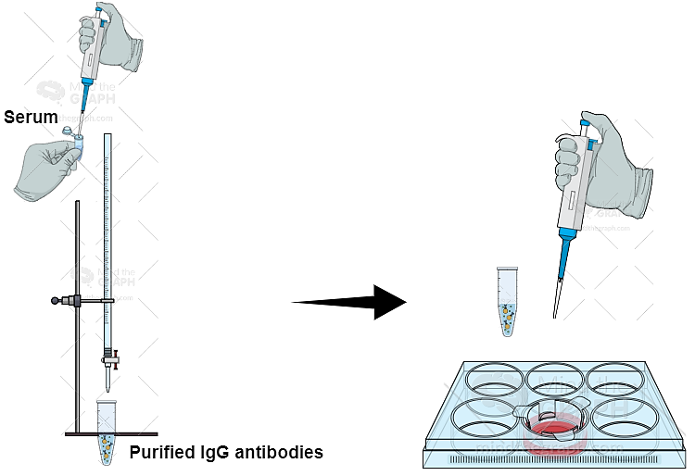
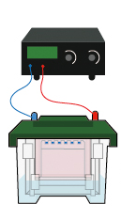
Methodology
Step 2
Step 1
Screening for IgG antibodies against factor(F)VIIa, thrombin, prothrombin, FXa, FXII, plasmin, and protein C (PC).
Sera from patients with MS (n=167) and healthy controls (n=40) were analyzed using the enzyme-linked immunosorbent assay.
Antibody purification by affinity chromatography and endotoxin removal from purified IgG fractions
In vitro and ex vivo exposure of human astrocytes (U87 cell line and primary cells) in 100μg/ml IgG fractions
Purified IgG samples were isolated from 15 MS patients positive for IgG tested, 8 MS negative patients, and 14 HCs.
Immunoblotting
Evaluation and quantification of the expression levels of thrombin receptor-1 (PAR-1) and phosphorylated ERK1/2 kinases
Step 3

Slide 8
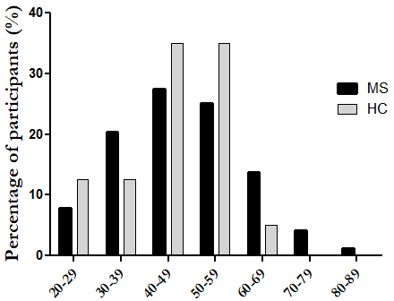
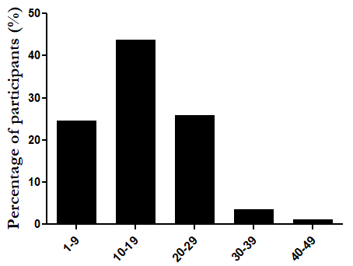
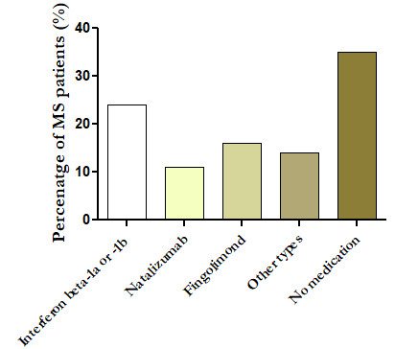
Demographics and clinical data of study participants
Results
Sex
MS group HC group
Age
Disease courses
Disease duration
n=110 n=57 n=21 n=19
Distribution among patients
Distribution among participants
EDSS score
MS severity score
Medication
Mild: 0-3.0
Moderate: 3.5-5.5
Severe: 6.0-9.5
Benign: 0-1.99
Moderate: 2.0-6.99 Severe: 7.0-10

Slide 9
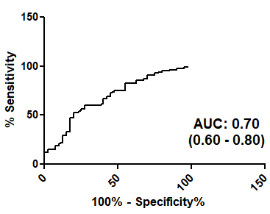
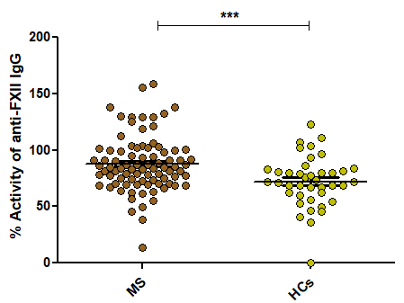
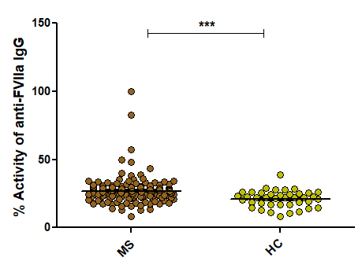
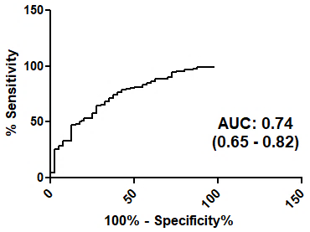
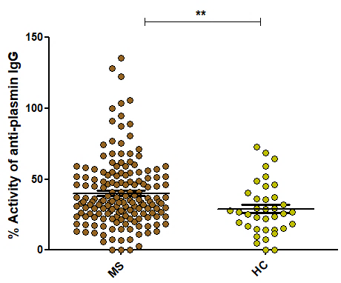
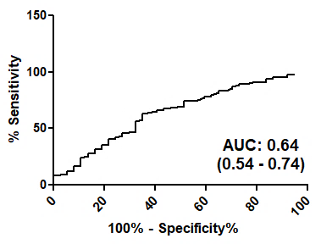
Antibodies to coagulation components are implicated in MS
Results
I. IgG antibody presence in MS patients and controls
Higher activity levels of anti-FVIIa, anti-FXII and anti-plasmin IgG antibodies in patients compared to controls.
The presence of such factors can discriminate patients with MS from healthy controls (AUC: 0.64 – 0.74).
Adapted from: M.S. Hadjiagapiou et al., MSRD 2022

Slide 10
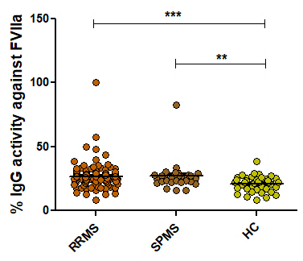
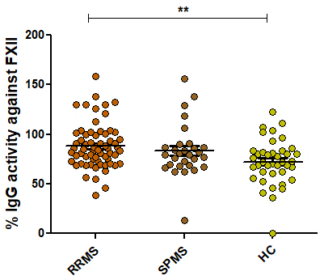
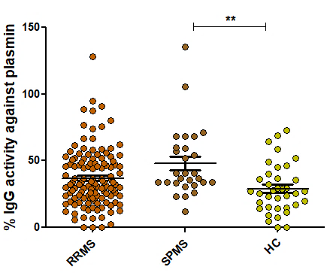
Antibodies to coagulation components are implicated in MS
Results
II. IgG antibody presence and disease courses
Both RRMS and SPMS patients showed significantly higher activity to FVIIa in comparison to controls.
RRMS patients displayed significantly increased levels of anti-FXII IgG antibodies compared to controls.
SPMS patients exhibited a greater index of activity against plasmin that significantly differed from controls.
Adapted from: M.S. Hadjiagapiou et al., MSRD 2022

Slide 11
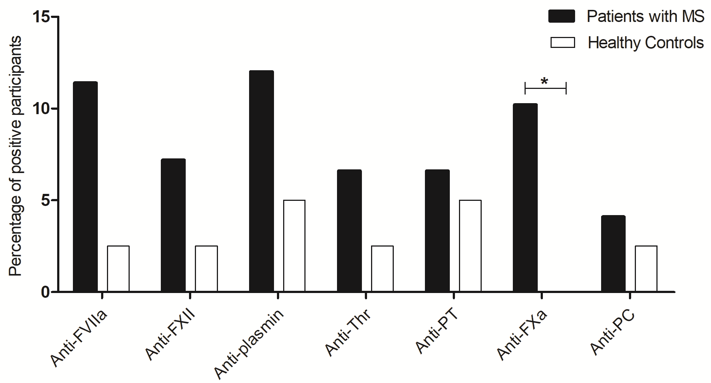
IgG seropositivity in patients with MS
Results
I.
Distribution of IgG antibody positivity between MS patients and HCs
II.
IgG positivity between MS patients and HCs
MS patients
Healthy controls
Increased seropositivity for almost all the antibodies studied. Significant difference was revealed between patients and controls for the anti-FXa IgG antibodies (p<0.05).
Increased proportion of patients with MS tested positive for IgG antibodies (n=72, 43%) compared to healthy controls (n=8, 20%, p<0.001).

Slide 12
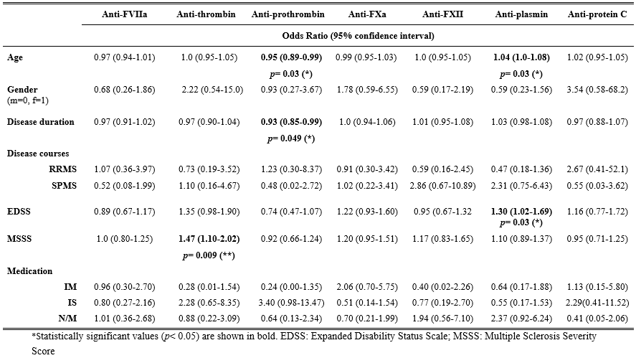
Results
Association between the IgG antibodies and the clinical outcomes of MS
Correlations between IgG antibodies and demographic or clinical features of MS
Antibodies against thrombin increase 47% the possibility of disease worsening.
Anti-prothrombin IgG were less likely to be associated with the age and disease duration of MS patients.
Patients with antibodies against plasmin had a 30% increased possibility of showing advanced disability.
Activity against plasmin was also associated with age, indicating that as the patient gets older, there is a strong possibility these antibodies to be detected.
Adapted from: M.S. Hadjiagapiou et al., MSRD 2022

Slide 13
Results
In vitro optimization of astrocytic activation by IgG antibodies
Astrocytes are activated by thrombin at least 2 hours after thrombin exposure (Rajput et al., Glial 2020).
Higher relative expression of PAR-1 after 4 hours of exposure to stimuli compared to 1 hour (Ishida et al., J. Neuropathol. Exp. Neurol. 2006).
In the current study
Four hours of activation with thrombin (5U/ml) or pooled sample containing antibodies of interest significantly affect PAR-1 expression levels.

Slide 14
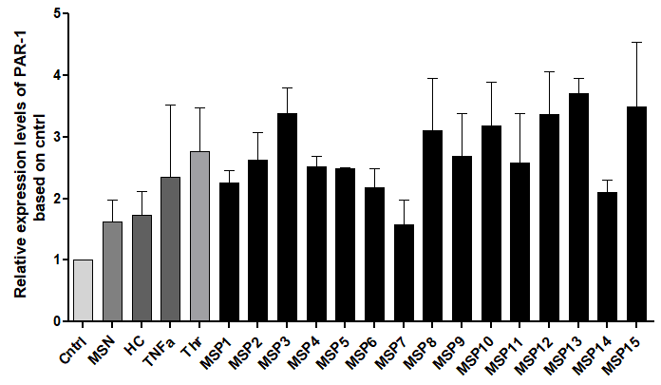
PAR-1 expression upon stimulation of U87 astrocytes with purified IgG antibodies against coagulation components
Results
66 kDa
37 kDa
66 kDa
37 kDa
Increased relative expression levels of PAR-1 upon astrocytic stimulation with purified IgG (MSP 1-15) compared to control.
The highest relative expression levels observed after stimulation with anti-thrombin IgG antibodies (MSP-13).
Astrocytes treated with samples derived from negative MS patients or HCs did not show any important fold changes
MSP: IgG fractions from positive MS patients; MSN: negative MS patients; HCs: healthy controls; TNF-a: positive control; Thrombin: positive control; Cntrl: unstimulated cells (negative control)

Slide 15
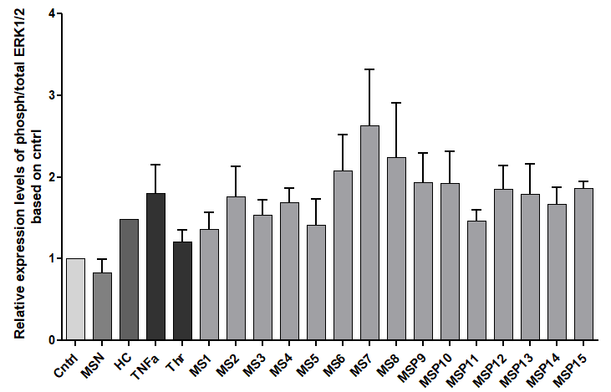
Activated ERK1/2 expression upon stimulation of U87 astrocytes with purified IgG antibodies against coagulation components
Results
Up to 2.5-fold increased relative expression levels of activated ERK1/2 upon stimulation with purified IgG antibodies.
The highest levels obtained following stimulation with samples with seropositivity for more than one antibodies (MSP6, MSP7, and MSP8).
MSP: IgG fractions from positive MS patients; MSN: negative MS patients; HCs: healthy controls; TNF-a: positive control; Thrombin: positive control; Cntrl: unstimulated cells (negative control)

Slide 16
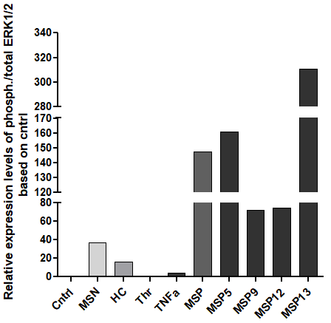
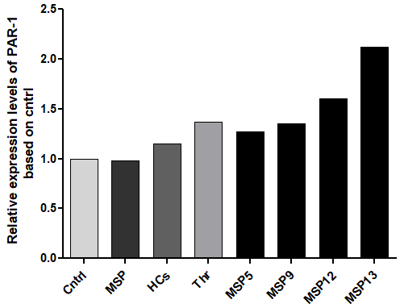
Ex vivo analysis of the role of IgG antibodies against coagulant components
Results
I. PAR-1 expression upon activation of primary human astrocytes
II. Activation of ERK1/2 upon stimulation of primary human astrocytes
Upregulation of PAR-1, especially upon stimulation with anti-thrombin IgG (MSP-13).
Upregulation of activated ERK1 and ERK2 kinases due to the presence of antibodies against coagulant components.
Cntrl: unstimulated cells (negative control); MSP: Stimulated cells with IgG fractions from positive MS patients; HCs: stimulated cells with healthy controls samples; Thrombin: stimulated cells with thrombin (positive control)
Cntrl: unstimulated cells (negative control); MSP: IgG fractions from positive MS patients; MSN: negative MS patients; HCs: healthy controls; TNF-a: positive inflammatory control; Thrombin: positive coagulant control

Slide 17
SUMMARIZING
IgG antibodies against coagulation components are associated with inflammatory diseases.
Our research has documented the presence of IgG antibodies against serine proteases of the coagulation cascade in a high proportion of patients diagnosed with Multiple Sclerosis.
The presence of antibodies - especially to thrombin - can promote the activation of pro-inflammatory pathways, contributing to disease progression.
The antibodies from MS patients can stimulate the expression of the thrombin PAR-1 receptor, a key player in thrombin's pro-inflammatory mechanisms, and are involved in pro-inflammatory pathways, such as activating ERK1/2 kinases.
IgG antibodies against coagulation antigens can be potential biomarkers in disease monitoring and prognosis, and they prove to be valuable tools for establishing new therapeutic strategies.

