Slide 1
Digital polarization holography: challenges and opportunities
Rakesh Kumar Singh
Home | Optics Lab | Information photonics and optical metrology | Varanasi
Department of Physics, Indian Institute of Technology (Banaras Hindu University), Varanasi, Uttar Pradesh, 221005, India
krakeshsingh.phy@iitbhu.ac.in
krakeshsingh@gmail.com
International conference on: Holography meets Advanced manufacturing, University of Tartu, Estonia: 20-22 Feb 2023

Slide 2

Outline
Background
Optical Imaging
Digital Holography
Recording and reconstruction of wavefront
Polarization holography
Jones matrix imaging
Randomness assisted imaging
Speckle illumination polarization holography
Stokes holography
Holography with higher order Stokes correlations
Conclusion

Slide 3
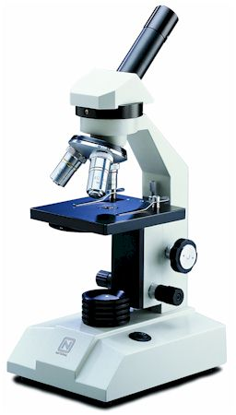
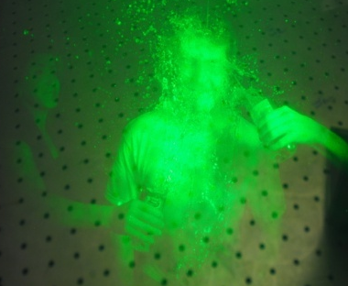
Optical Imaging
Replica at imaging plane
Microscopy: improvement in resolution possible by tailored illumination
Holography: Provides 3D complex field reconstruction
Optical imaging through randomness
2f
2f
Imaging lens

Slide 4
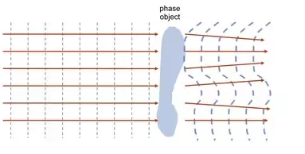
Phase objects
Transparent specimen
Do not absorb or scatter light
Instead produces a phase change of light
Notes:
Specimens that alter the intensity of transmitted light are termed amplitude specimens are can be observed in the microscope as a consequence of their ability to absorb or otherwise affect the light intensity, which is proportional to the square of the light wave amplitude. In contrast, transparent specimens that do not absorb light, but instead, produce a phase change of light passing through are termed phase specimens. These specimens are invisible or very difficult to image because the human eye is insensitive to changes in the relative phase shifts of visible light waves. Phase changes are primarily due to differences in thickness and refractive index between the specimen and its surrounding medium. A typical example is living tissue culture cells, which appear almost transparent under brightfield illumination.

Slide 5
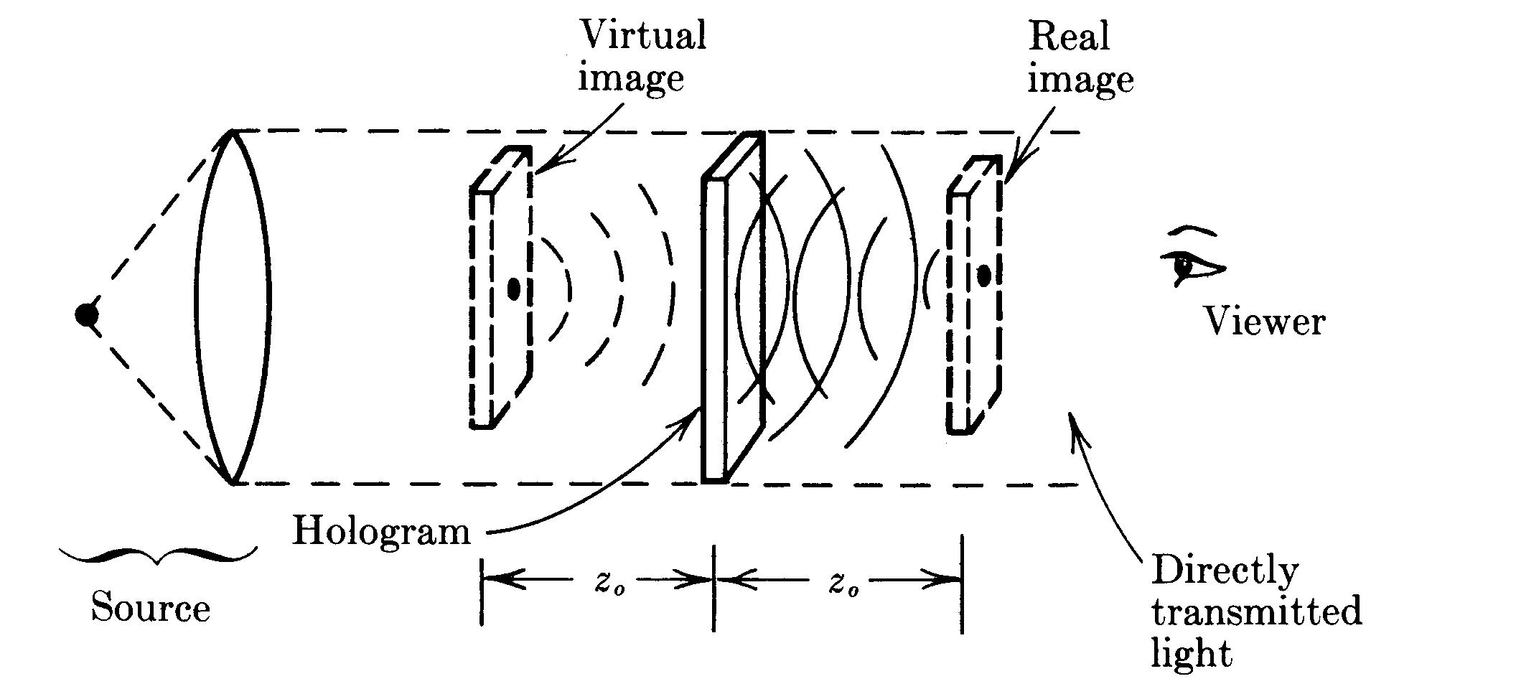
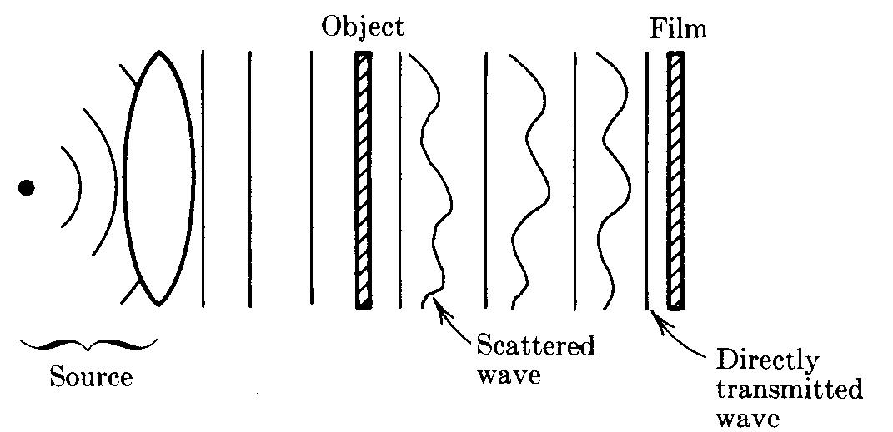
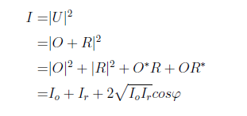
Holography
Gabor’s Holography: In line Holography
Off-axis Holography
Object
Pseudo
Image
J. Goodman, Fourier Optics

Slide 6
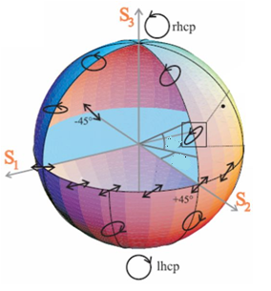
Polarization
Polarization ellipse representation
y’
y
x’
b
x
O
a
Poincare representation

Slide 7
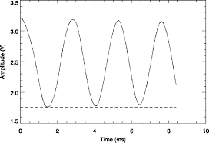
Significance of polarization
P
Interference effect:
Fully coherent case: V=1
Q₁
Fully incoherent case: V=0
Q₂
coherent light sources makes high visibility fringe
M. Born and E. Wolf, Principle of Optics

Slide 8
Generalized Interferometry
P
Intensity modulation
Polarization modulation
Q₁
Q₂
In general four kind of polarization modulation takes place
Only one (first one) in conventional holography
T. Setala, J. Tervo, and A. Friberg, Opt. Lett 31 (2006) 2208

Slide 9
Polarization Measurement
Rotating retarder
Linear polarizer
Technique based on multiple images
Detector
Ref. E. Collet, Chapter 6,Polarized Light
Stokes intensity formula
Technique based on single shot
K. Oka and T. Kaneko, Opt. Express 11,1510 (2003)

Slide 10
Polarization Digital holographic microscope
Opt. Lett. 41 (2016) 906

Slide 11
Angular & Polarization multiplexing
Opt. Lett. 41 (2016) 906

Slide 12
Imaged orthogonally polarized components
Biological cells
Liquid crystal droplets

Slide 13
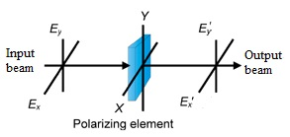
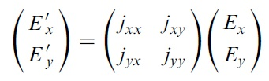
Light matter interaction: Jones matrix
Jones matrix formalism

Slide 14
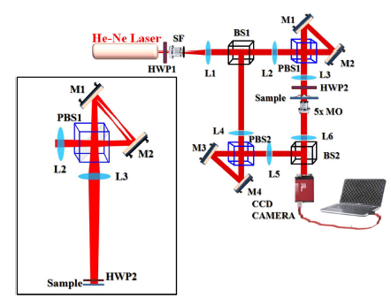
Jones matrix microscopy from a single shot measurment
Opt. Lett. 42 (2017) 5194

Slide 15
Jones matrix microscopy: multiplexed hologram
Opt. Lett. 42 (2017) 5194

Slide 16
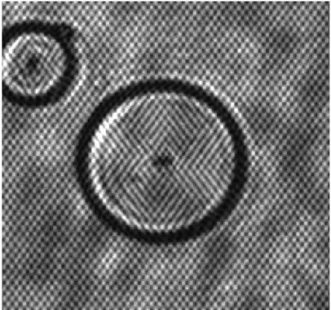
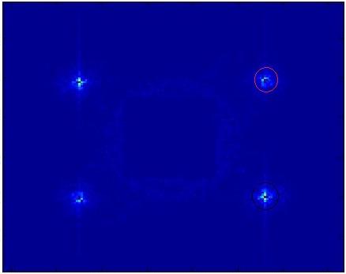
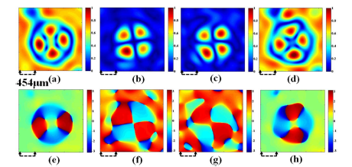
Recovered Jones matrix elements
FFT
Jxx
Jxy
Jyx
Jyy
Opt. Lett. 42 (2017) 5194

Slide 17
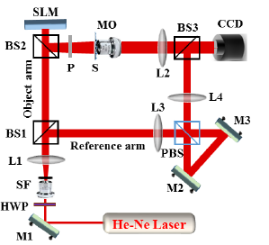
Speckle field digital polarization holography
Optics Letter 44 (2019) 5711

Slide 18
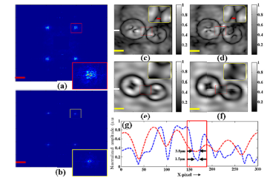
Enhanced resolution
MO=5X & 0.1NA
Optics Letter 44 (2019) 5711

Slide 19
Reconstruction of polarization holograms
Polarization imaging with correlations
Stokes Holography, Opt. Lett. 39 (2012) 966
Phase shifting holography with HBT method- Opt. Letter 45 (2020) 212; Opt. Express 28 (2020) 8145
HBT with polarized light: Opt. Express 26 (2018) 10801
Holography with higher order Stokes correlations, Phys. Rev. A 106 (2022) 013508

Slide 20
Holography with Stokes correlations

Slide 21
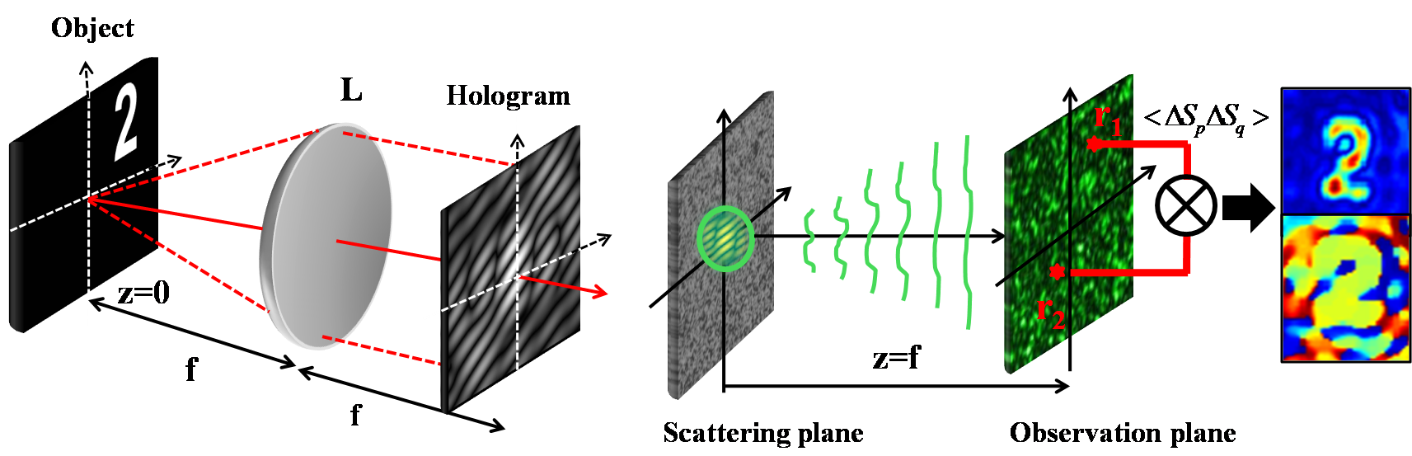
Holography with higher order Stokes correlations
Recording of Hologram
Reconstruction of Hologram
Phys. Rev. A 106 (2022) 013508

Slide 22
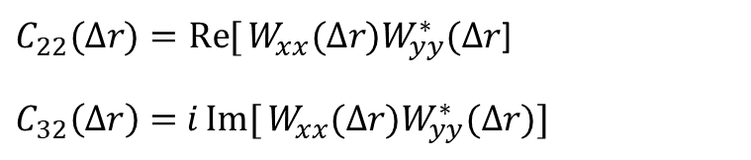
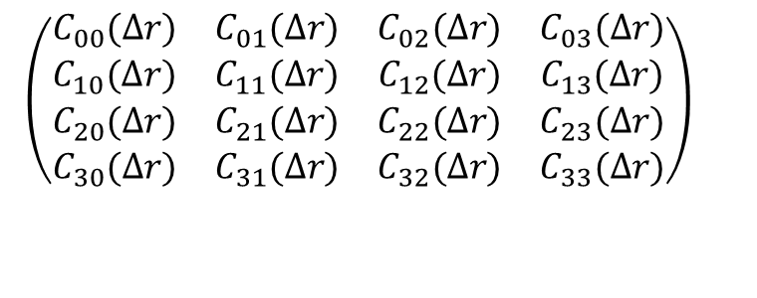
Holography with Stokes correlation
The correlation between SPs fluctuations is
$$\left(\begin{matrix}C_{00}(Δr) & C_{01}(Δr) & C_{02}(Δr) & C_{03}(Δr) \\ C_{10}(Δr) & C_{11}(Δr) & C_{12}(Δr) & C_{13}(Δr) \\ C_{20}(Δr) & C_{21}(Δr) & C_{22}(Δr) & C_{23}(Δr) \\ C_{30}(Δr) & C_{31}(Δr) & C_{32}(Δr) & C_{33}(Δr)\end{matrix}\right)$$
Using un-polarized source: W_{xy}(∆r) W_{yx}*(∆r)=0
$C_{22}(Δr)=\operatorname{Re}{[}W_{xx}(Δr)W_{yy}^{∗}(Δr$]
$C_{32}\left(∆r\right)=$ $i\operatorname{Im}{[}W_{xx}(Δr)W_{yy}^{∗}(Δr)]$
$$C(Δr)=C_{22}(Δr)+iC_{32}\left(∆r\right)$$
Phys. Rev. A 106 (2022) 013508

Slide 23
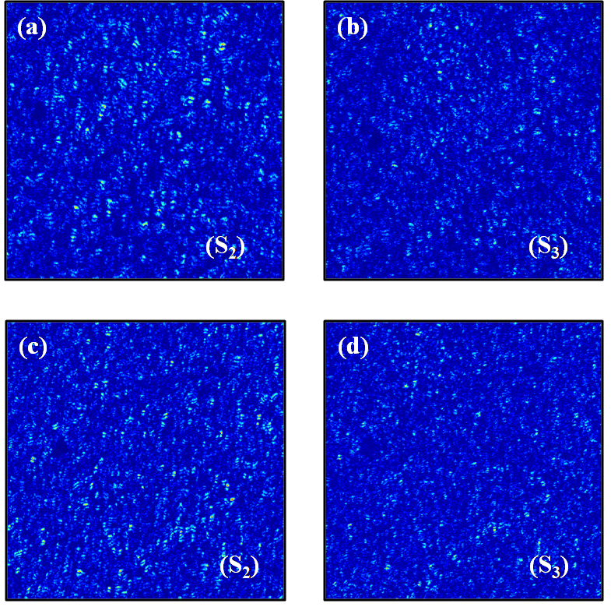
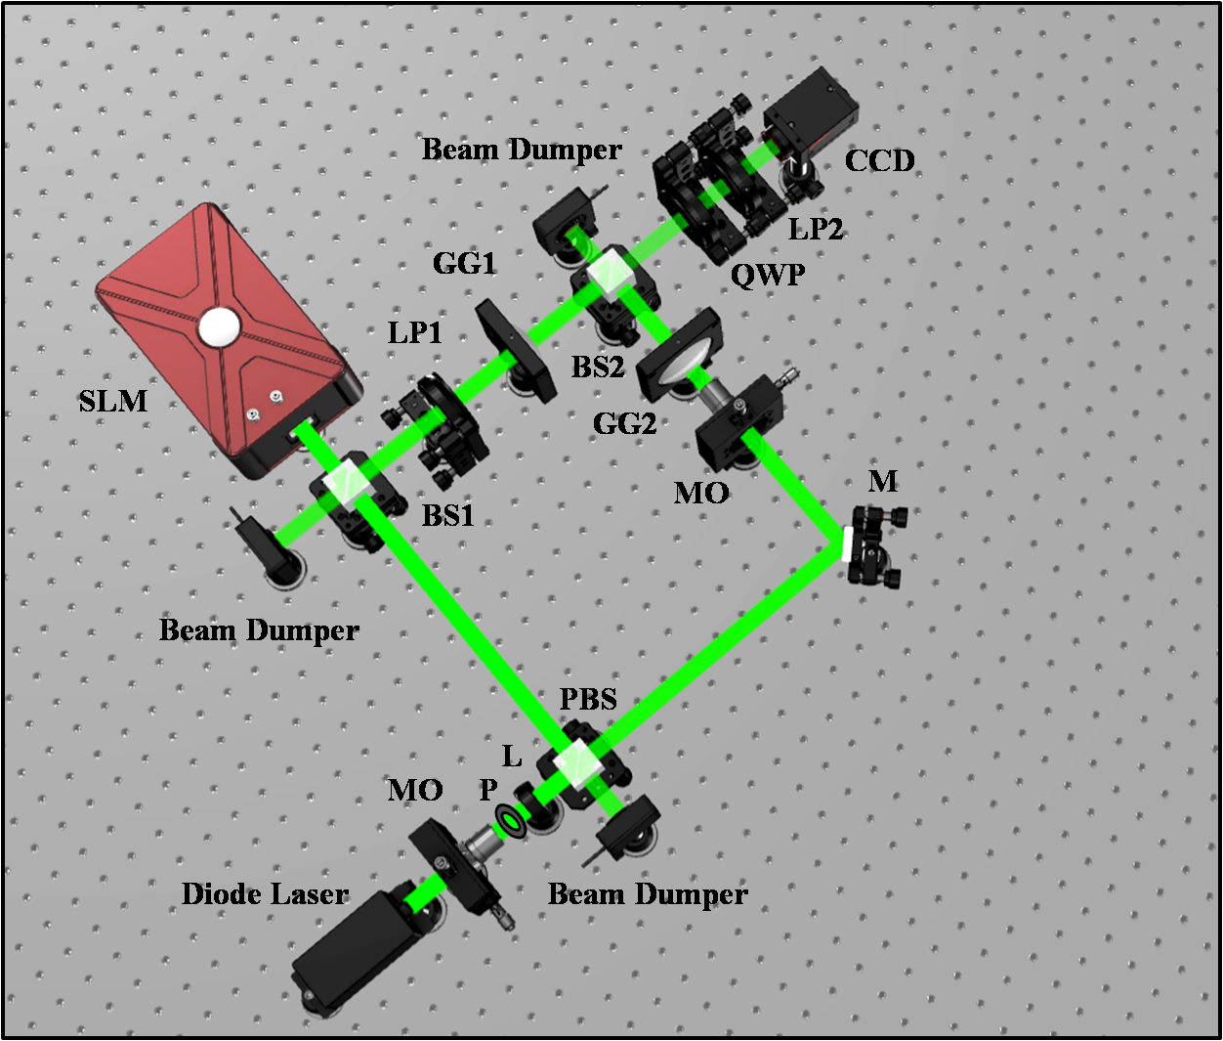
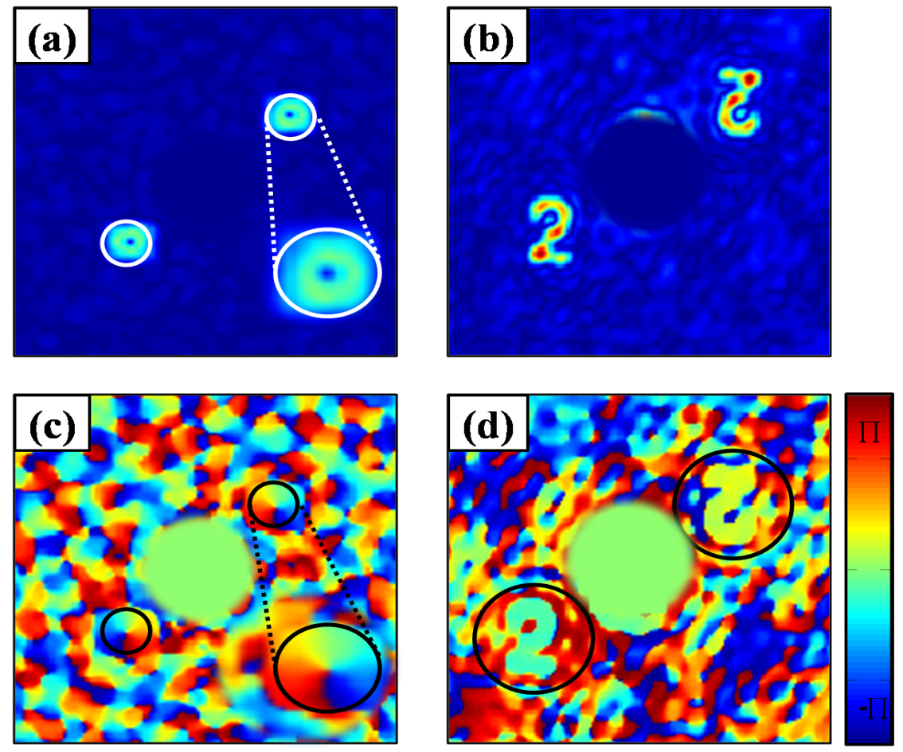
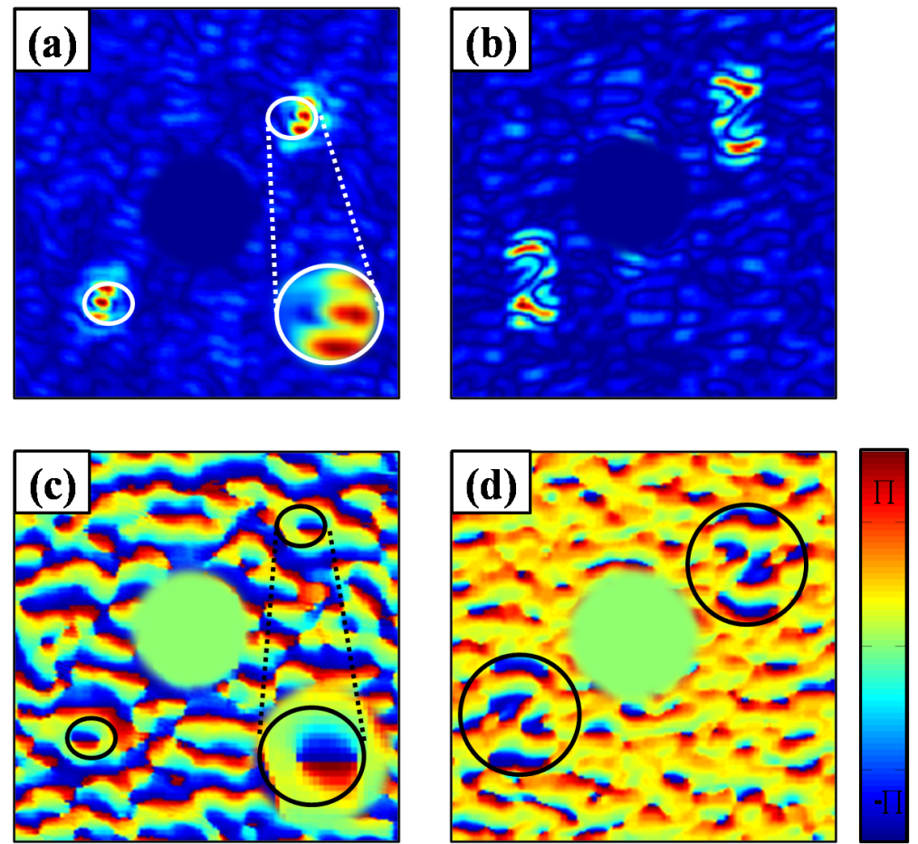
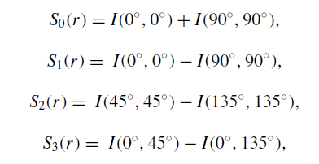
Holography with Stokes correlation
Amplitude
Phase
Experimental measured Stokes parameters :(a)-(b) for l=1, (c)-(d) for number 2
Simulation Results
Experimental Results
Phys. Rev. A 106 (2022) 013508

Slide 24
Conclusion:
Polarization digital holography (PDH) is discussed and described in the context of recovery and reconstruction of the complete wavefront
Few experimental designs of the PDH are discussed
A possible extension of the digital holography with random light is also discussed

Slide 25


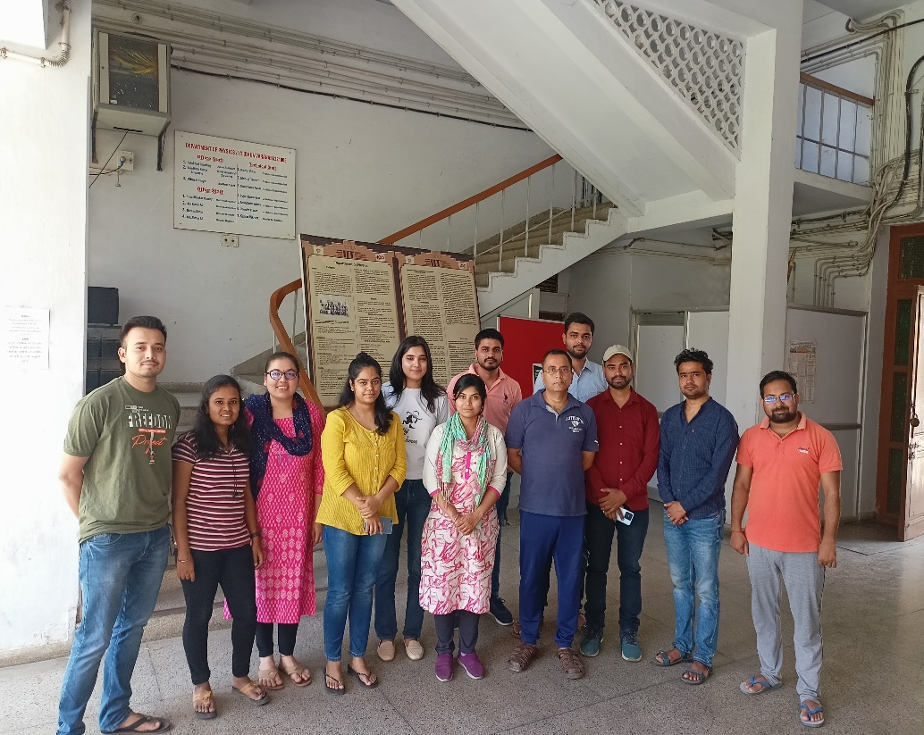


Acknowledgement
CORE/2019/000026
BT/PR35557/MED/707/2019
080(0092)/2020/EMR-II
58/14/0/2021-BRNS/37092
Dr. Vinu R V & Dr. Darshika Singh, IIST-Trivandrum
Former master students: Niraj Soni, Atul Somukuwar, Annie Varghese, Sreelal M,

Slide 26


