Slide 1
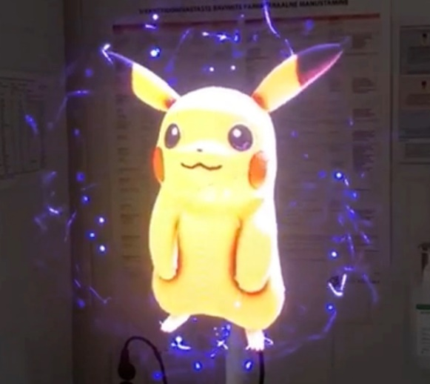
Holographic technology as a new pain-reducing solution for Children
Anneli Kolk MD, PhD (1 ; 2); Alina Rostsinskaja MD (1 ; 2); Marianne Saard PhD (3)
Faculty of Medicine, University of Tartu
Tartu University Hospital Children’s Clinic, Department of Pediatrics and Neurology, Tartu, Estonia
Institute of Clinical Medicine, Faculty of Medicine, University of Tartu, Tartu, Estonia
Holography Meets Advanced ManufacturingUM
Management of medical fear and procedural pain is a challenging and complex mission in pediatric patients. In recent years treatment of pain has made new strides. Holographic technology provides an innovative distraction approach. To our knowledge, holograms have not been used as distractions in hospital settings before.
The aim of the study was to deliver holographic characters as a new digital pain and stress reducing tool which could be used more widely in medicine.
Methods
The study was performed between March 2020 to April 2021 at the University of Tartu Children’s Hospital. 62 children aged 10 months to 11 years (mean age 5.31 yrs; SD=2.63) underwent painful needle-related procedures, such as intravenous cannulation and blood tests. We examined the structure of hospital fear via questionnaires from parents and the Children’s pain scores, assessed by nurses with FLACC scale before and after viewing holograms during procedures. For children over 7 years, Visual analog scale (VAS) modified for fear was used. During the procedures 33 different playful holographic characters with HYPERVSN 3D device were presented. The animations were accompanied by sounds and music, holograms were shown for 3-10 minutes depending on the length of the procedure/examination.
Results
We found that the use of holographic techniques (HT) in the procedure room was effective: before viewing the holograms 64% of children presented moderate discomfort, 7% severe, 22% mild, and 7% none by FLACC scale. Assessment after viewing holograms showed a remarkable positive effect: 50% of children had no signs of distress at all, 43% had mild discomfort, 7% moderate and no children with severe pain were reported. In addition children demonstrated increased comfort and cooperation during procedures. The HT was effective for children in all age groups, including smaller children aged 10-13 months. The medical procedures like measuring blood pressure and Botox therapy were easier to be conducted using the holographic method. In addition, parents reported on the calming effect of holograms on themselves, which shows that holograms also reduce stress in adults.
Conclusions: Holograms are the new tool to prepare and guide patients during a potentially painful or uncomfortable medical intervention. We believe that looking at holograms, in addition to distraction, may improve patient’s emotional state and perception of control over pain. We encourage technical staff to create and develop new 3D solutions based on holographic technology to improve healthcare services.
The study was supported by the Estonian Research Council grant PRG789.

