Slide 1
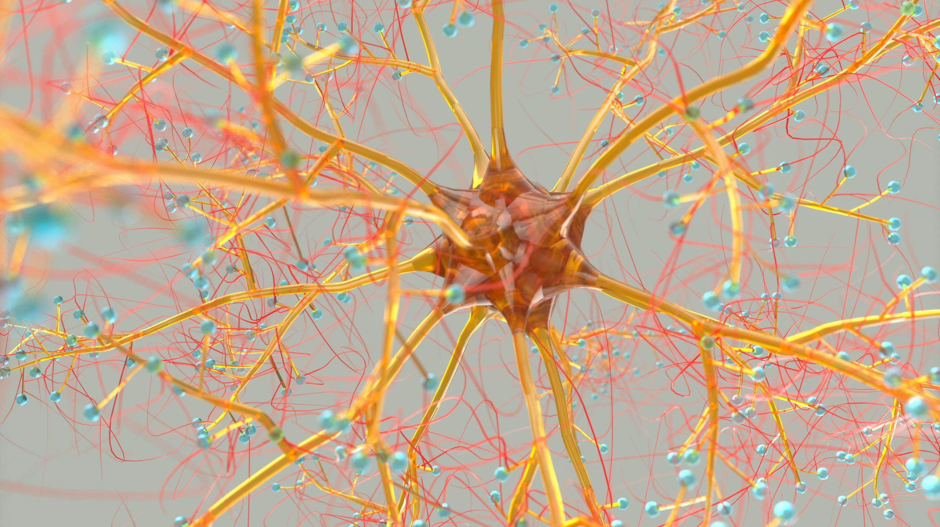
Relationship between BDNF-positive number of nerve fibers and pain in intervertebral disc degeneration
Marcin Gadzieliński^{a,b}, Dorian Gładysz^{a,b}, Marcin Gralewski^{a,b}, Rafał Staszkiewicz^{a,b}, Dawid Sobański^{b,c}, Paweł Wojciech Bogdał^{b}, Beniamin Oskar Grabarek^{a,b}
ª Department of Neurosurgery, 5th Military Clinical Hospital with the SP ZOZ Polyclinic in Krakow, 30-901 Krakow, Poland
^{b} Department of Histology, Cytophysiology and Embryology, Faculty of Medicine in Zabrze, Academy of Silesia, 40-055 Katowice, Poland
^{c} Department of Neurosurgery, Szpital sw. Rafala, 30-693 Kraków, Poland

Slide 2
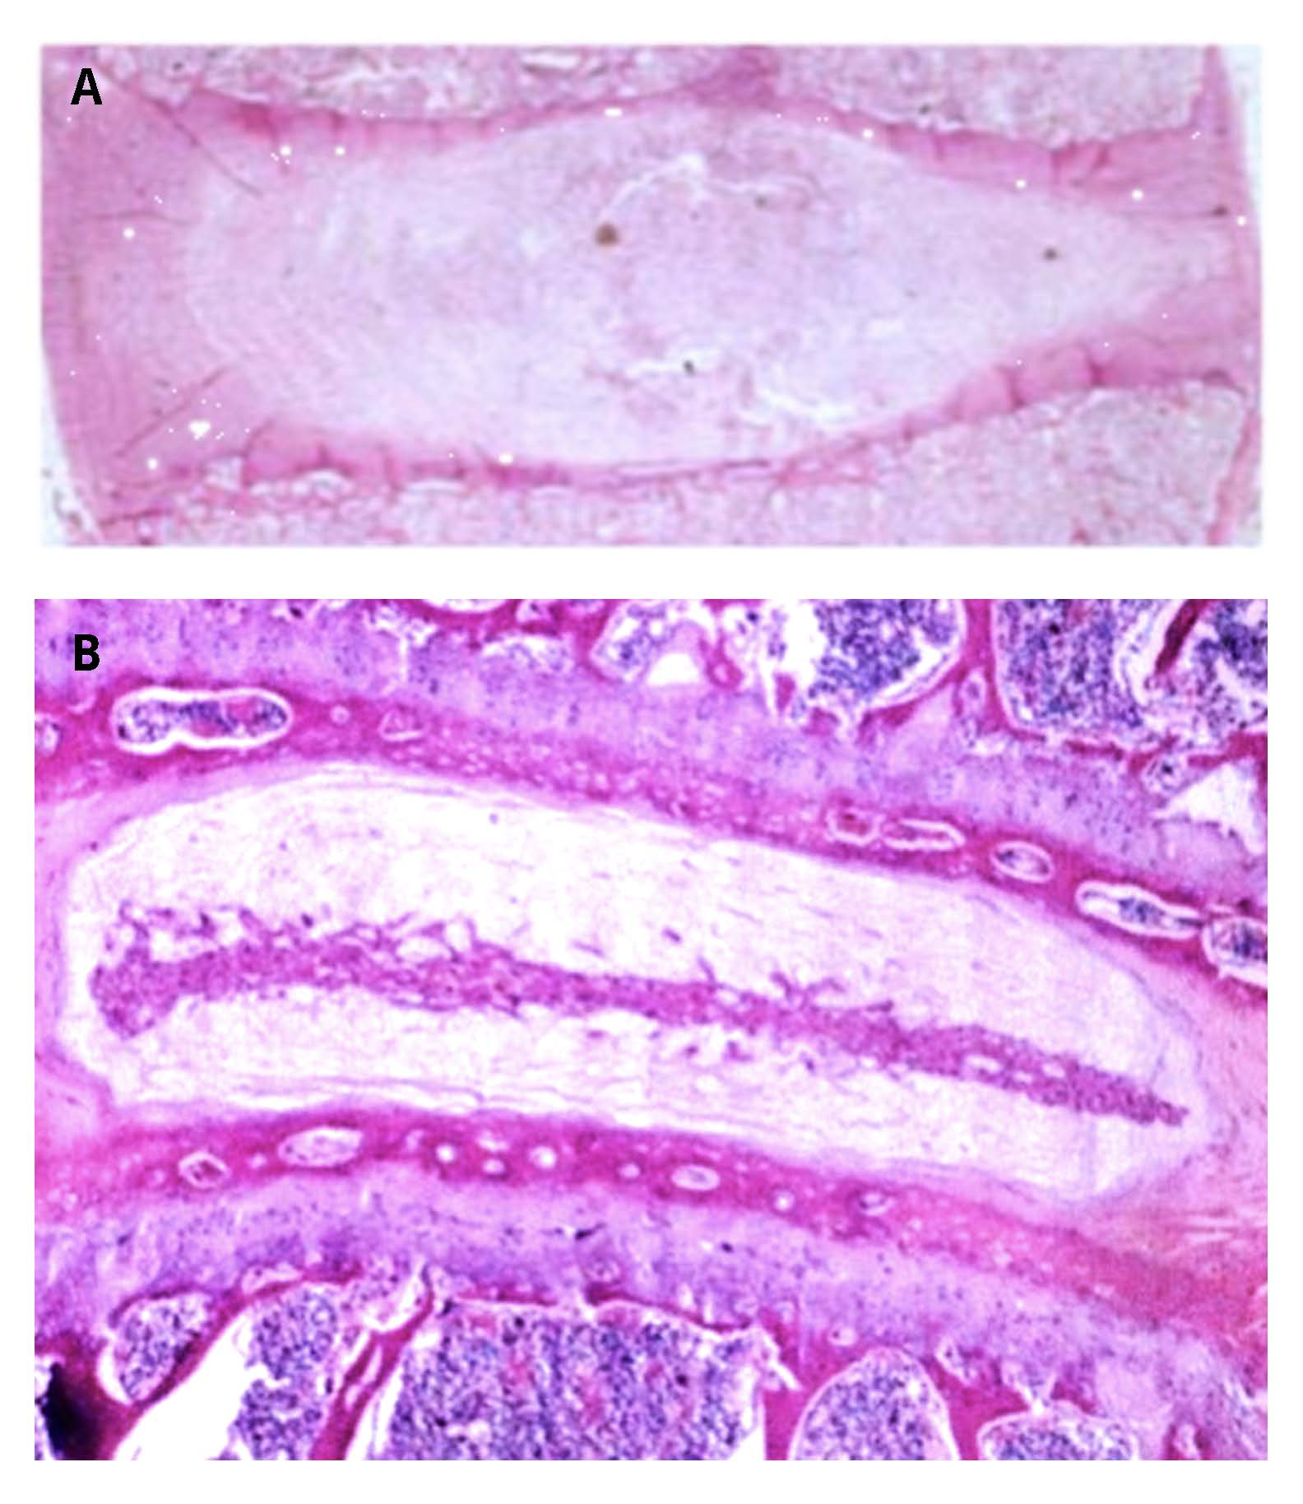
Introduction
In the etiology of pain of discogenic origin, attention is paid to the role of neurotrophic factors, such as brain-derived neurotrophic factor (BDNF). Considering the potential role of BDNF in the etiology of pain during IVDD, this study aimed to assess changes in the number of BDNF-positive nerve fibers and levels of BDNF in the IVDD of the lumbosacral spine in comparison to IVDs of the control group (cadavers).
Figure 2. Results of H&E staining of intervertebral disc in control group and experimental group (×50) [own picture].
A, healthy intervertebral disc; B, degeneration intervertebral disc

Slide 3
Material and methods
The study group comprised 113 patients with IVDD of the lumbosacral spine. The control group consisted of 81 people (cadavers). We performed hematoxylin-eosin staining to assess IVD structures (degeneration), and immunohistochemistry to determine the number of BDNF-positive nerve fibers. In immunofluorescent staining, we used a primary rabbit anti-BDNF antibody (Novus Biologicals, Centennial, CO, USA; catalog number NB100-98682; dilution 1:200). H&E staining of IVDs obtained from the control group was carried out to assess whether features of IVD degeneration were present in the present samples, which allowed them to be classified as controls.

Slide 4
Results

Slide 5
Conclusion
We did not find that the number of BDNF-positive nerves differed significantly according to the degree of perceived pain (p = 0.359; one-way ANOVA test). The lowest number of nerve fibers was found in the group of patients reporting a perceived pain level of 6, and the highest at a level of 10.
The results indicate an increasing trend in both the number of nerve fibers and the concentration of BDNF with the progress of the degeneration process in IVDD, but only to a certain stage, at which it seems that the intercellular matrix still allows biochemical processes to take place.

Slide 6
1. Francisco V, Pino J, González-Gay MÁ, et al. A new immunometabolic perspective of intervertebral disc degeneration. Nat Rev Rheumatol. 2022;18(1):47-60. doi:10.1038/s41584-021-00713-z
2. Ekşi MŞ, Orhun Ö, Yaşar AH, et al. At what speed does spinal degeneration gear up?: Aging Paradigm in patients with Low Back Pain. Clinical Neurology and Neurosurgery. 2022;215:107187. doi:10.1016/j.clineuro.2022.107187
3. Cyril D, Giugni A, Bangar SS, et al. Elastic Fibers in the Intervertebral Disc: From Form to Function and toward Regeneration. International Journal of Molecular Sciences. 2022;23(16):8931. doi:10.3390/ijms23168931
4. Morel L, Domingues O, Zimmer J, Michel T. Revisiting the Role of Neurotrophic Factors in Inflammation. Cells. 2020;9(4):865. doi:10.3390/cells9040865
de León A, Gibon J, Barker PA. NGF-dependent and BDNF-dependent DRG sensory neurons deploy distinct degenerative signaling mechanisms. eneuro. 2021;8(1).
5. Colucci-D’Amato L, Speranza L, Volpicelli F. Neurotrophic factor BDNF, physiological functions and therapeutic potential in depression, neurodegeneration and brain cancer. International journal of molecular sciences. 2020;21(20):7777.
6. Freemont AJ, Watkins A, Le Maitre C, et al. Nerve growth factor expression and innervation of the painful intervertebral disc. The Journal of pathology. 2002;197(3):286-292.

