Slide 1

Advanced Imaging Methods Using Coded Aperture Digital Holography
Joseph Rosen
School of Electrical and Computer Engineering,
Ben-Gurion University of the Negev, Beer-Sheva, ISRAEL
Holography meets Advanced Manufacturing
February 2023
Ben-Gurion University of the Negev
School of Electrical & Computer Engineering

Slide 2
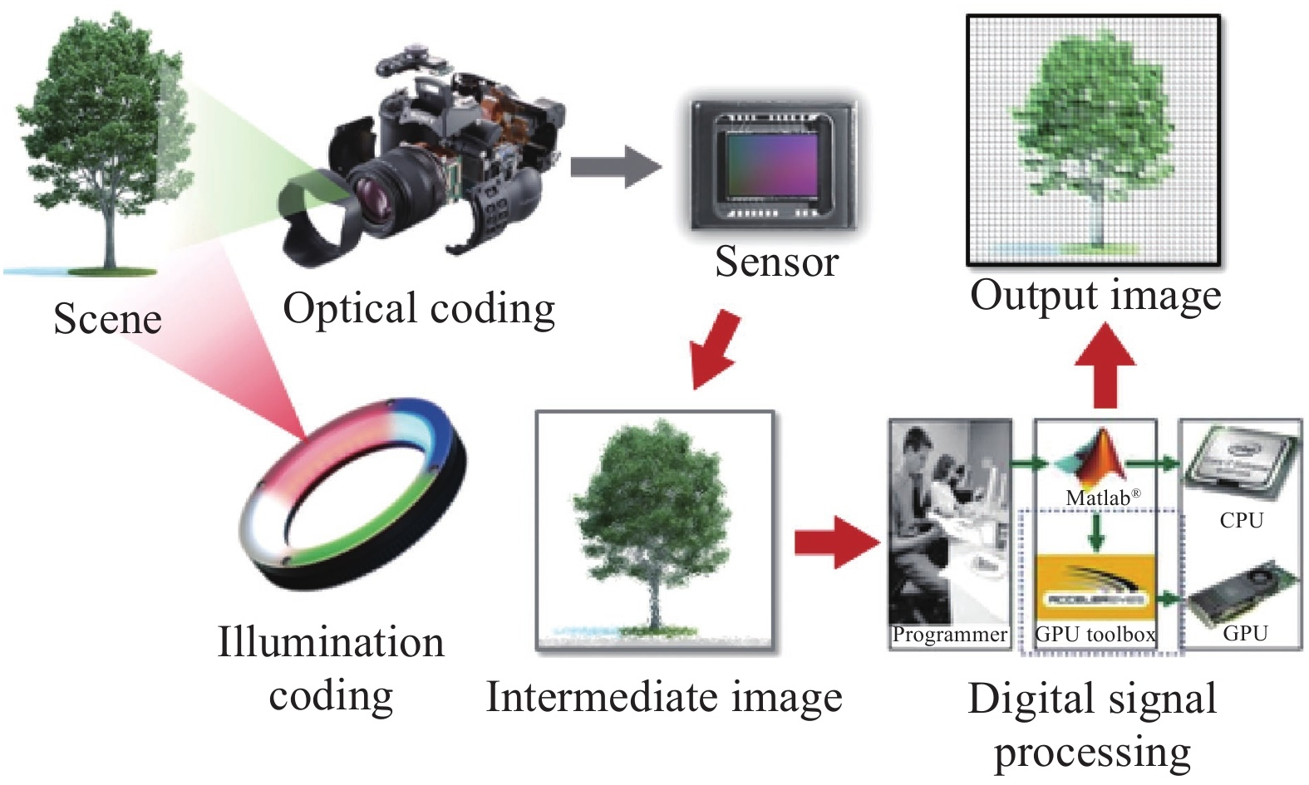
Introduction
Coded Aperture Digital Holography is part of Computational Imaging
The advanced model of computational imaging
Ben-Gurion University of the Negev
School of Electrical & Computer Engineering

Slide 3
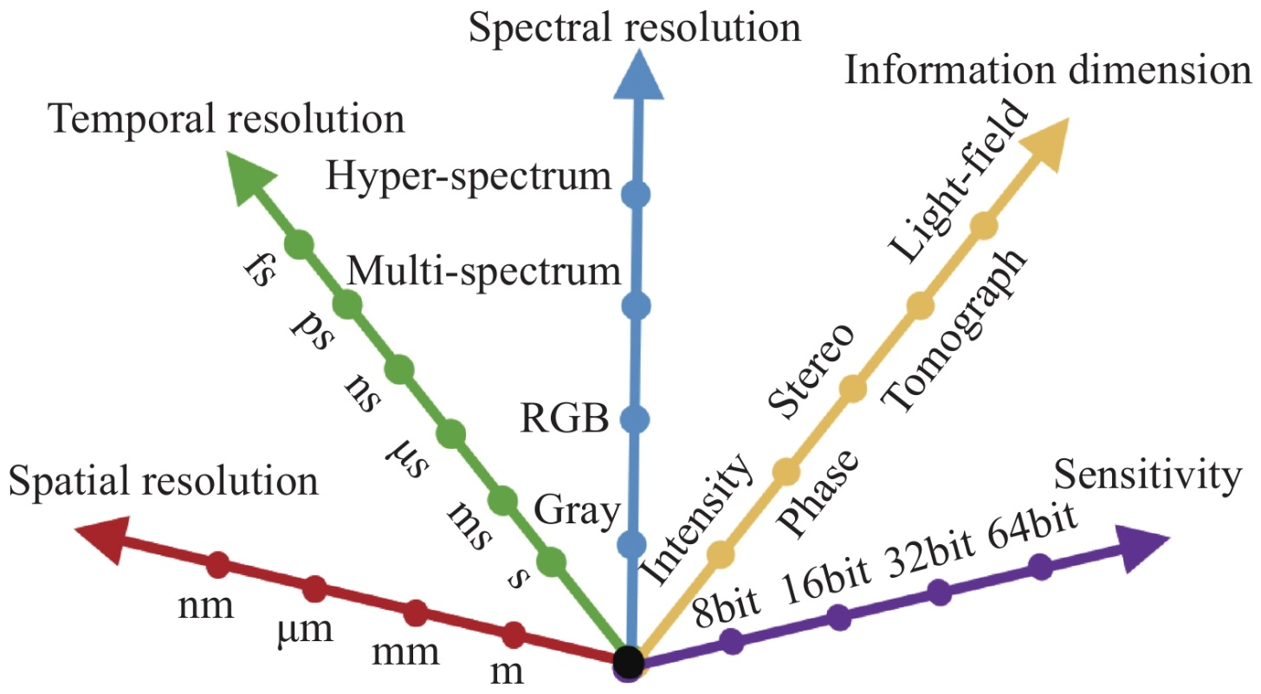
Computational Imaging
Goals for the development of optical imaging technology
y
3D Imaging
10⁻¹⁵
2D
The last two figures are adapted from: Chao Zuo, Qian Chen. Computational optical imaging: An overview[J]. Infrared and Laser Engineering, 2022, 51(2): 20220110 (in Chinese)
10⁻⁹
Ben-Gurion University of the Negev
School of Electrical & Computer Engineering

Slide 4
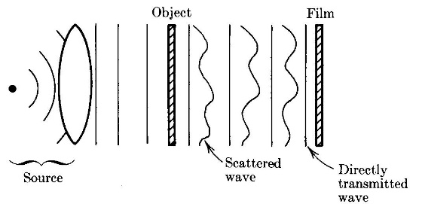
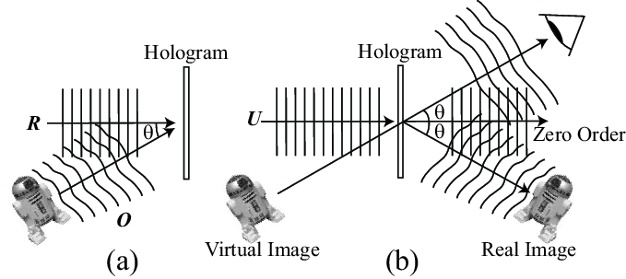
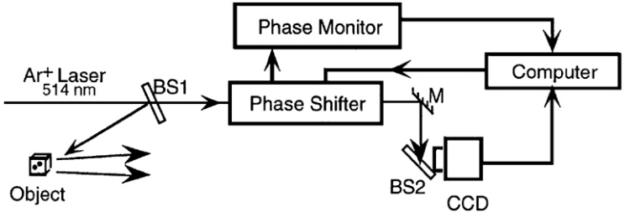
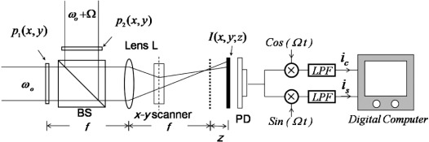
Historical Introduction of Holography for Imaging
Coherent Light
Incoherent Light
Gabor Hologram (1948)
Leith-Upatnieks
Off-Axis Hologram (1962)
Optical Hologram
Vander Lugt, Fourier Hologram (1964)
Stroke-Restrick Self-Interference Holograms (1965)
Digital Hologram
Goodman-Lawrence, Off-Axis Digital Hologram (1967)
Optical Scanning Hologram (T.C. Poon, 1985)
Yamaguchi-Zhang, On-Axis Digital Hologram (1997)
Multiple View Projection Hologram (2001)
Fresnel Incoherent Correlation Holography (FINCH 2007)
Fresnel Incoherent Correlation Holography (FINCH 2007)
Ben-Gurion University of the Negev
School of Electrical & Computer Engineering

Slide 5
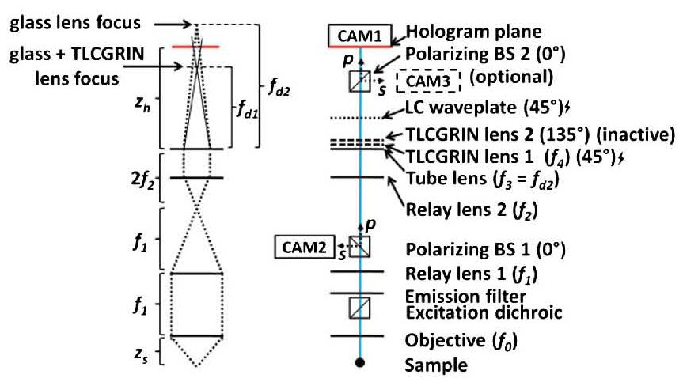
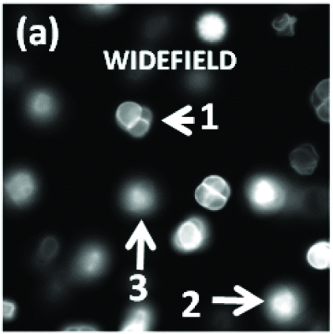
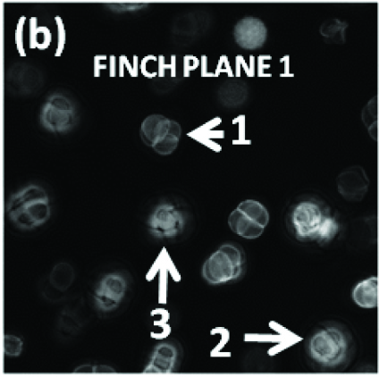
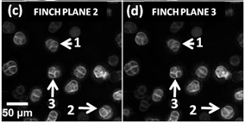
FINCH Fluorescence Microscope (2013)
Ben-Gurion University of the Negev
School of Electrical & Computer Engineering

Slide 6
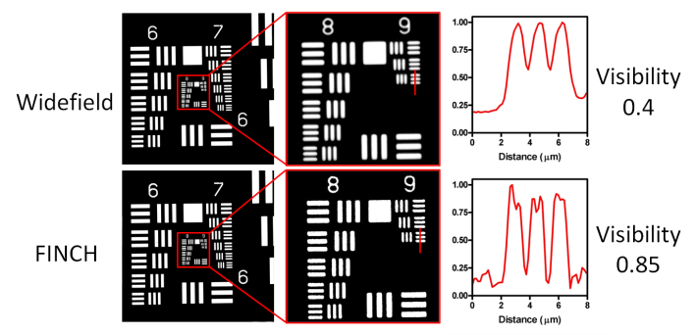
FINCH fluorescence microscope
G. Brooker, N. Siegel, J. Rosen, N. Hashimoto, M. Kurihara, and A. Tanabe, Optics Letters 38, 5264–5267 (2013).
(a) Widefield and (b)–(d) reconstructed FINCH images of pollen grains captured using a 20× (0.75 NA) objective, showing the ability of FINCH to refocus at depths that were out of focus under widefield conditions.
Ben-Gurion University of the Negev
School of Electrical & Computer Engineering

Slide 7
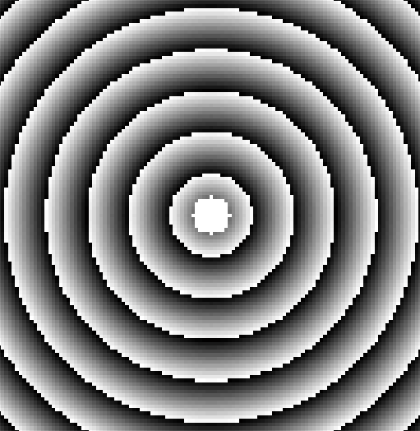
FINCH fluorescence microscope
Goal: Achieve optical
sectioning in FINCH.
  ‘Phase pinhole’:
Added cost: target scanning.
(a)
(b)
2
phase clear
pinhole aperture
R. Kelner, B. Katz, and J. Rosen, "Optical sectioning using a digital Fresnel incoherent-holography-based confocal imaging system," Optica 1, 70-74 (2014).
Schematics of FINCH recorders: (a) a dual lens FINCH system; (b) a confocal FINCH system. L_{o}, objective lens; L_{c}, converging lens; SLM₁ and SLM₂, spatial light modulators; P₁ and P₂, polarizers; CCD, charge-coupled device.
Ben-Gurion University of the Negev
School of Electrical & Computer Engineering

Slide 8
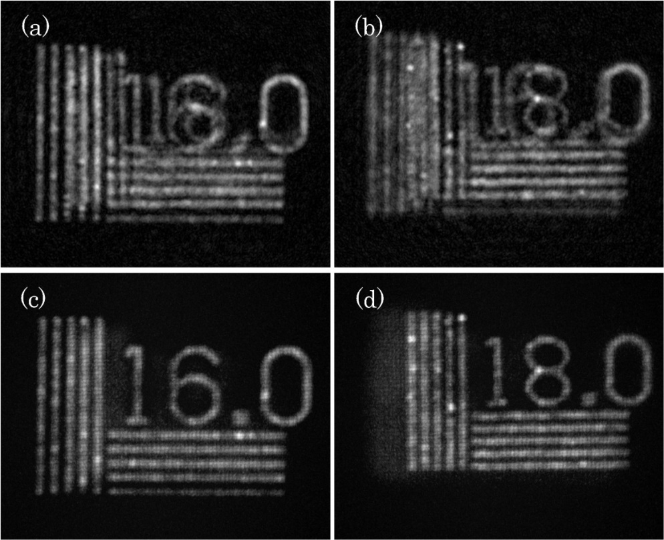
Confocal Fresnel Incoherent Correlation Holography
Results (wide-field illumination)
FINCH
FINCH
Optical-sectioning-FINCH
Optical-sectioning-FINCH
(a) FINCH reconstruction of a 16.0 cycles/mm resolution chart located 30cm away from the objective lens, with the 18.0 cycles/mm resolution chart at 31cm; (b) FINCH reconstruction of a 18.0 cycles/mm resolution chart located 30cm away from the objective lens, with the 16.0 cycles/mm resolution chart at 29cm; (c) and (d) are the optical-sectioning-FINCH equivalents of (a) and (b), respectively.
R. Kelner, B. Katz, and J. Rosen, "Optical sectioning using a digital Fresnel incoherent-holography-based confocal imaging system," Optica 1, 70-74 (2014).
Ben-Gurion University of the Negev
School of Electrical & Computer Engineering

Slide 9
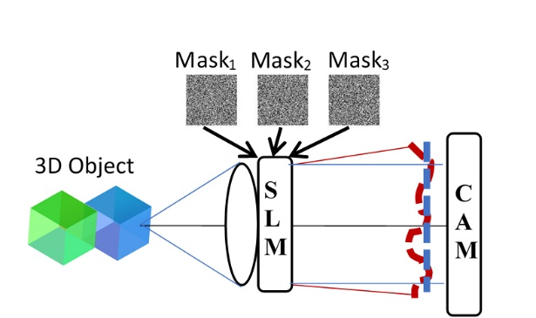
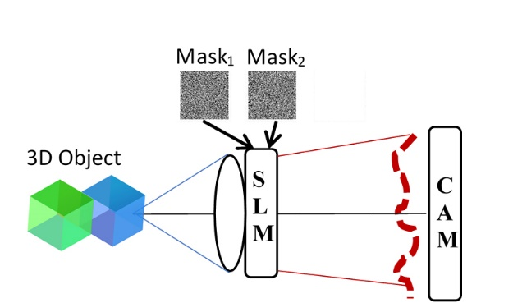
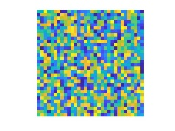
I-COACH (2017)
A. Vijayakumar, Y. Kashter, R. Kelner, and J. Rosen, "Coded aperture correlation holography–a new type of incoherent digital holograms," Opt. Express 24, 12430-12441 (2016).
A. Vijayakumar and J. Rosen, “Interferenceless coded aperture correlation holography–a new technique for recording incoherent digital holograms without two-wave interference,” Opt. Express 25(12) 13883-13896 (2017).
Optical Mask
The hologram is recorded without two beam interference
Interferenceless Coded Aperture Correlation Holography I-COACH
Ben-Gurion University of the Negev
School of Electrical & Computer Engineering

Slide 10
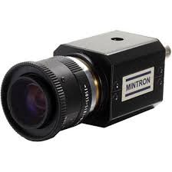
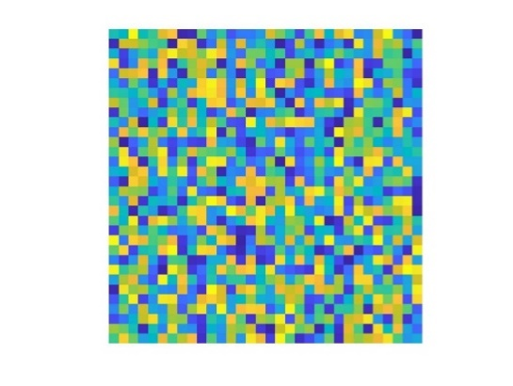
3D-I-COACH
1. System Calibration
A. Vijayakumar and J. Rosen, "Interferenceless coded aperture correlation holography- a new technique for recording incoherent digital holograms without two-wave interference," Optics Express 25, 13883-13896 (2017).
SLM
4
3
2
1
Point-Response Library
Ben-Gurion University of the Negev
School of Electrical & Computer Engineering

Slide 11
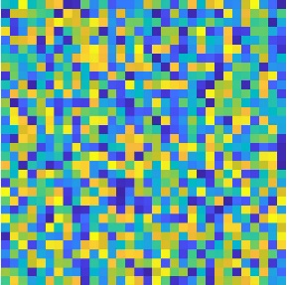
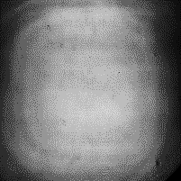
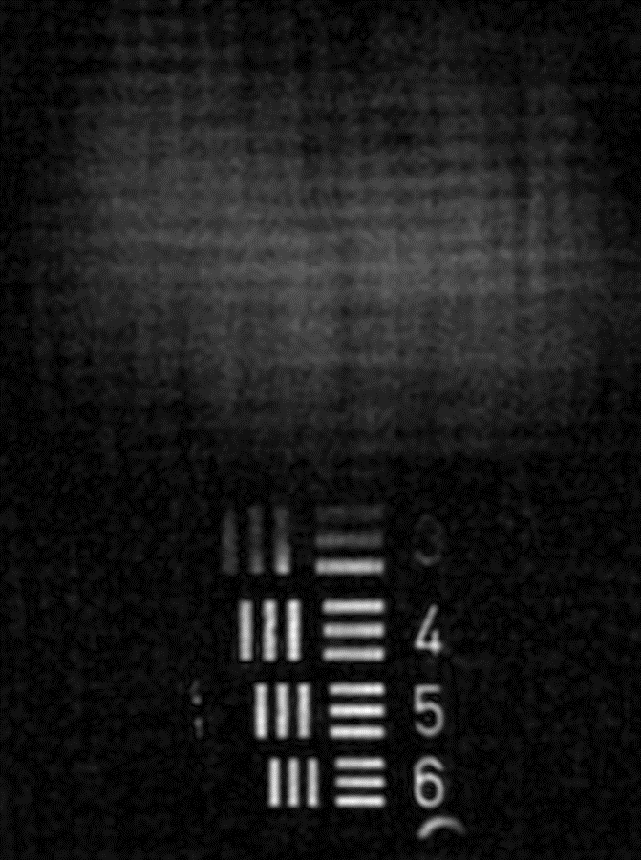
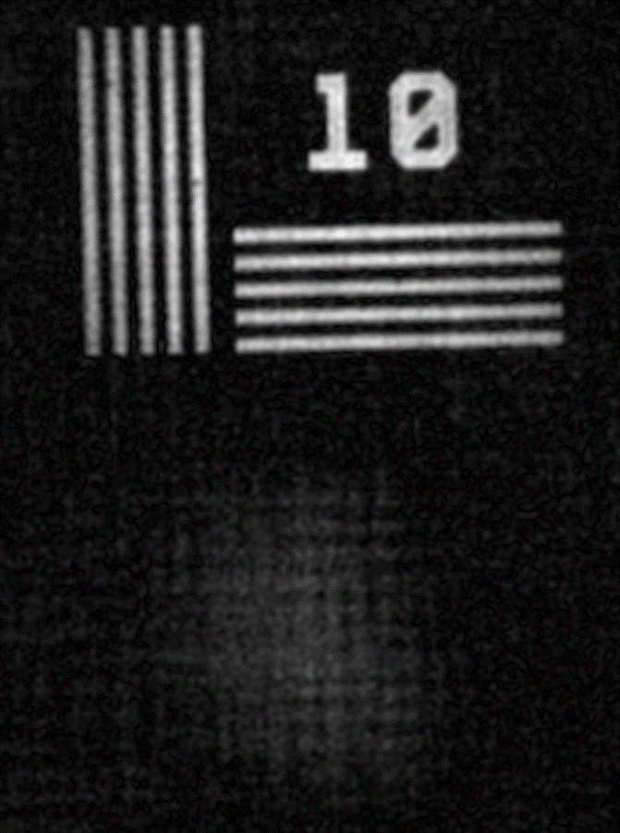
3D-I-COACH
2. Recording hologram of 3D object
Object hologram
SLM
Multi-Plane Object
Ben-Gurion University of the Negev
School of Electrical & Computer Engineering

Slide 12
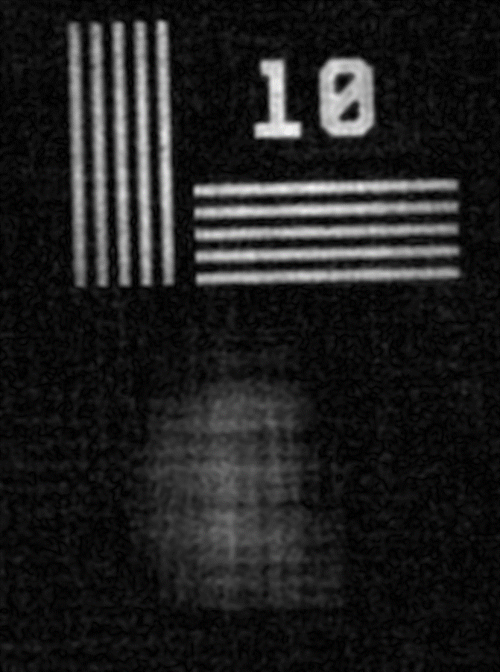
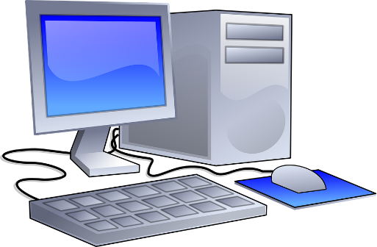
3D-I-COACH
3. Image Reconstruction
Object hologram
Point-Response Library
1
=
CORRELATION
2
3
4
Ben-Gurion University of the Negev
School of Electrical & Computer Engineering

Slide 13
Nonlinear image Reconstruction
O=Object h=Impulse Response
I=Image ϴ=Correlation
h’=Reconstructing Function
I=Oϴh
Linear Reconstruction: I=Oϴh’
Optimal Reconstruction: hϴh’=δ
In Fourier Plane: H·H’*=|H|exp(iΦ_{H})·|H|^{r}exp(-iΦ_{H})=|H|^{r+1}
Optimal Reconstruction: |H|^{r+1} =Constant
r=-1→ Inverse Filter
Instead, Nonlinear Reconstruction:
|H|ºexp(iΦ_{H})·|H|^{r}exp(-iΦ_{H}) =|H|^{o+r}
Where o and r are chosen as the parameters that minimize some cost function
Nonlinear Reconstruction of the Object:
I=FT⁻¹{|O|ºexp(iΦ_{O})·|H|^{r}exp(-iΦ_{H})}
M.R. Rai, A. Vijayakumar, and J. Rosen, "Non-linear adaptive three-dimensional imaging with interferenceless coded aperture correlation holography (I-COACH)," Opt. Express 26, 18143-18154 (2018).
Ben-Gurion University of the Negev
School of Electrical & Computer Engineering

Slide 14



    CAFIR - Coded Aperture with FINCH Intensity Responses
Algorithm result without SLM
FINCH
(b)
(a)
Quadratic Phase Masks
COACH
Coded Phase Mask
z₁
z₂
Lens L_{o}
Lens L_{o}
f_{o}
z_{h}
Digital Camera
f_{o}
z_{h}
Digital Camera
Coded Phase Mask
Coded Phase Mask
z₁
z₂
I-COACH
CAFIR
(c)
(d)
Lens L_{o}
Lens L_{o}
f_{o}
z_{h}
Digital Camera
f_{o}
z_{h}
Digital Camera
A. Bulbul, N. Hai, and J. Rosen, "Coded aperture correlation holography (COACH) with a superior lateral resolution of FINCH and axial resolution of conventional direct imaging systems," Opt. Express 29, 42106-42118 (2021).
Ben-Gurion University of the Negev
School of Electrical & Computer Engineering

Slide 15
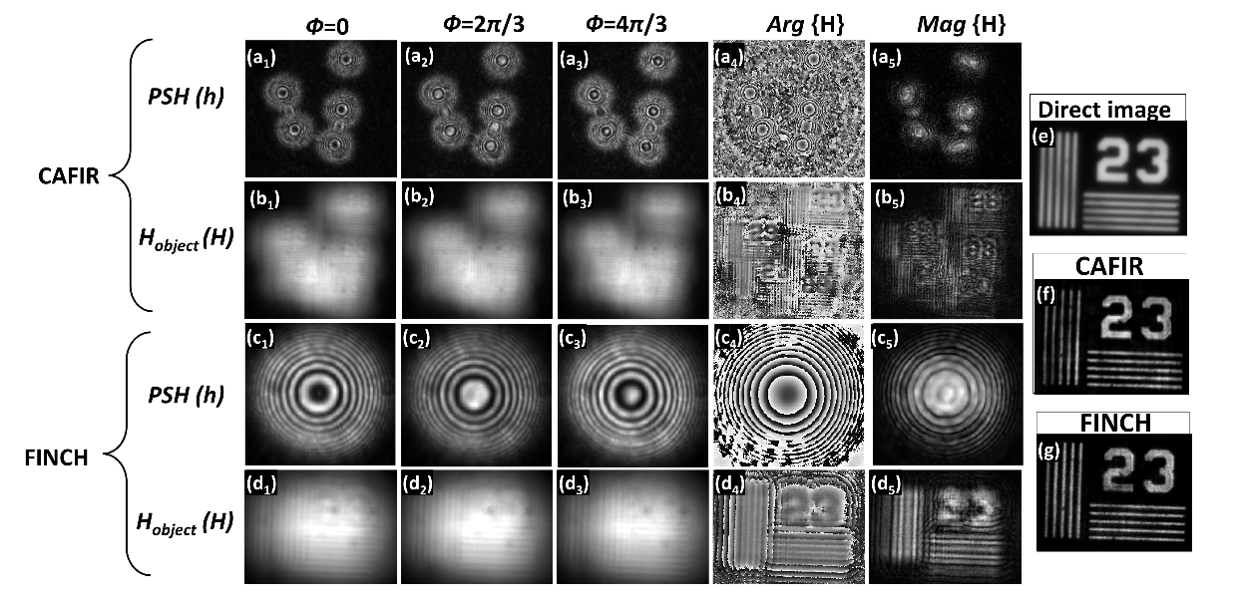
Coded Aperture with FINCH Intensity Responses (CAFIR)
(a₁-a₃), (b₁-b₃) and (c₁-c₃), (d₁-d₃) recorded intensity for point-object (h) and object (H) respectively with Ф= 0, 2π/3 and 4π/3 (a₄, a₅); (b₄, b₅) and (c₄, c₅), (d₄, d₅) phase and magnitude of superimposed PSH and object holograms for CAFIR and FINCH, respectively. (e) Direct imaging, (f) POF reconstructed image for CAFIR (g) FINCH reconstructed image.
Ben-Gurion University of the Negev
Department of Electrical & Computer Engineering
15

Slide 16
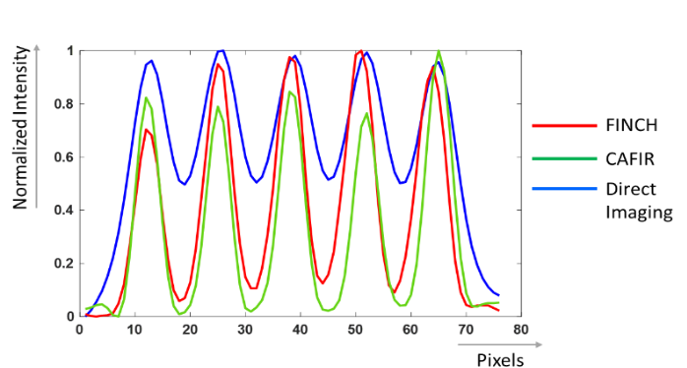
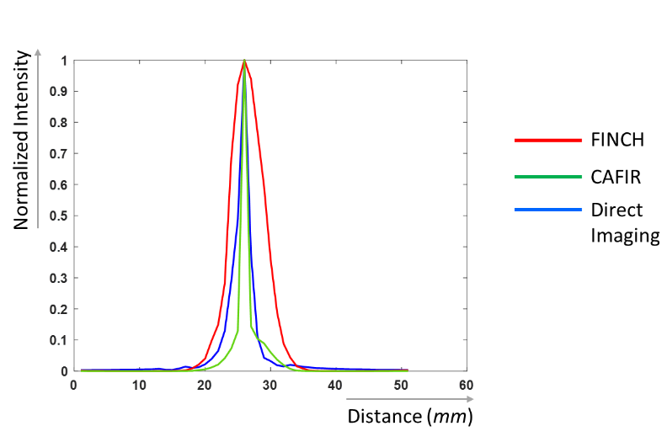
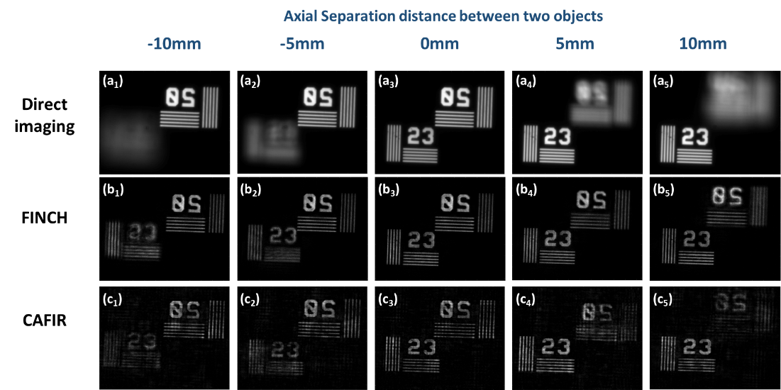
Coded Aperture with FINCH Intensity Responses (CAFIR)
Average cross-sections of gratings of direct image and reconstructed images with FINCH and CAFIR with f₁=32 cm
Axial distance of pinhole from f₀ in mm.
Direct image and reconstructed images with FINCH and CAFIR with f₁=32 cm at different axial distances from f₀ varying between 10 to -10 mm with 5 mm intervals.
Ben-Gurion University of the Negev
Department of Electrical & Computer Engineering
16

Slide 17
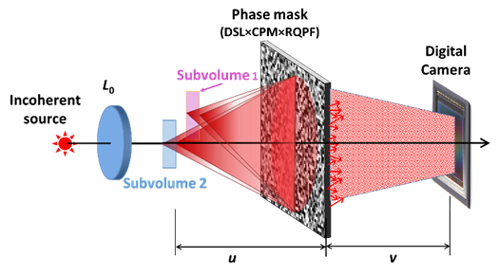
Depth of Field Engineering-incoherent imaging
Goal: imaging objects positioned at different sub-volumes of the object space, and only in these sub-volumes.
M. Rai and J. Rosen, "Depth-of-field engineering in coded aperture imaging," Opt. Express 29, 1634-1648 (2021).
Ben-Gurion University of the Negev
School of Electrical & Computer Engineering

Slide 18
Depth of Field Engineering
Phase mask displayed on the SLM for each sub-volume is the product of 3 phase masks:
Diffractive Spherical Lens (DSL) – defines the axial location of the sub-volume.
Radial Quartic Phase Function (RQPF) – defines the axial length of the sub-volume or the DOF.
Coded Phase Mask (CPM)– Responsible to the point response on the camera plane in the form of sparse, randomly distributed, dots.
Ben-Gurion University of the Negev
School of Electrical & Computer Engineering

Slide 19
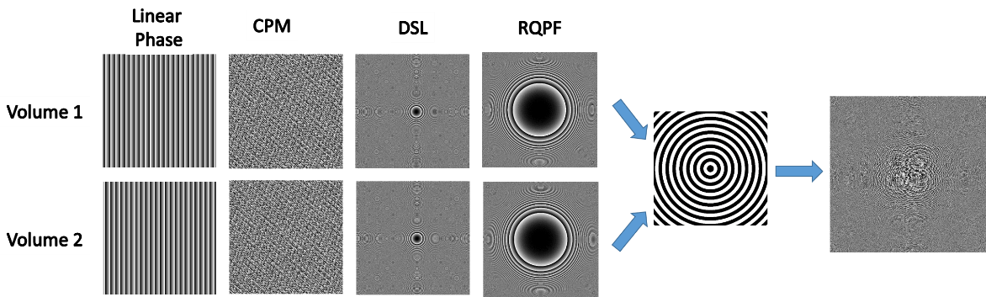
Depth of Field Engineering
Multiplexing process of two sets of phase masks for multi-volume imaging.
Ben-Gurion University of the Negev
School of Electrical & Computer Engineering

Slide 20
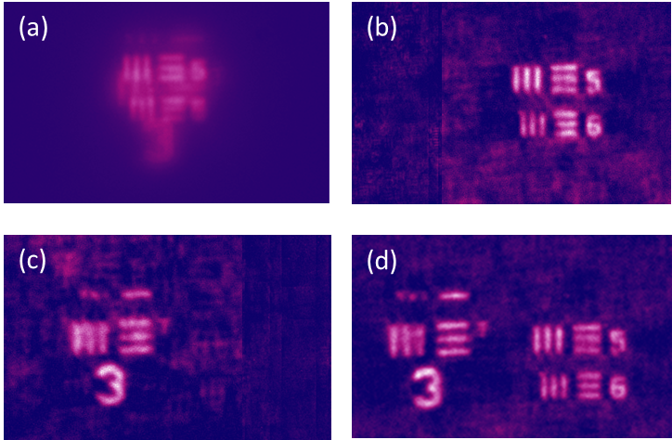
Depth of Field Engineering
Direct images with an overlap between the objects because they are placed on the same sightline.
Reconstructed image with PSH of subvolume 1
Reconstructed image with PSH of subvolume 2
Reconstructed image when the same CPM was used for both subvolumes.
Ben-Gurion University of the Negev
School of Electrical & Computer Engineering

Slide 21
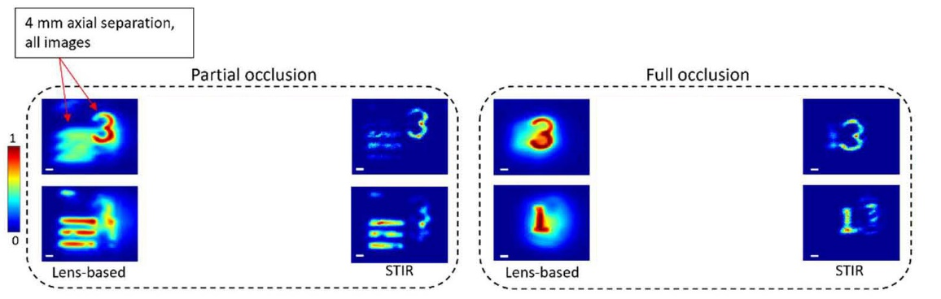
STIR - Sectioning by Tilted Intensity Rods
N. Hai, and J. Rosen, “Single Viewpoint Tomography Using Point Spread Functions of Tilted Pseudo-Nondiffracting Beams in Interferenceless Coded Aperture Correlation Holography with Nonlinear Reconstruction,” SSRN 4216569
Regular Lens-Based Imaging system
System with Multiple Phase Masks
Lens L₁
Lens L₂
Lens L₁
z₁
z₂
z₁
z₂
System with Phase Mask
Point Spread Function
Imaging of 2 points Positioned along the Z Axis
Lens L₁
Lens L₁
Image Sensor
3
1
ϴ
Image Sensor Plane
_{d}
z₁
z₂
z₁
z₂
Ben-Gurion University of the Negev
Department of Electrical & Computer Engineering
Notes:
Your solution
Please describe your solution
Elaborate on the parts that are relevant to your improvement
e.g., if the main advantage of your invention is the use of low temperatures, please emphasize this aspect
Please describe what was done in your lab during the past year and at what stage is the research these days
e.g., did you perform in vitro or in vivo experiments, built a prototype, ran simulations

Slide 22
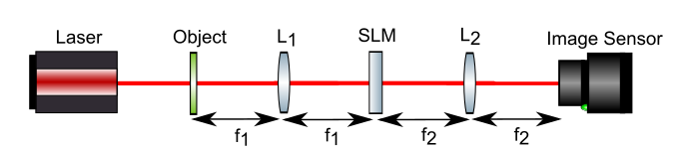
  Quantitative Phase Imaging
Goal: Quantitative Phase imaging of coherently illuminated objects
M
M
θ
BS
BS
N. Hai, and J. Rosen, “Coded aperture correlation holographic microscope for single-shot quantitative phase and amplitude imaging with extended field of view,” Opt. Express 28(19), 27372-27386 (2020).
Ben-Gurion University of the Negev
School of Electrical & Computer Engineering

Slide 23
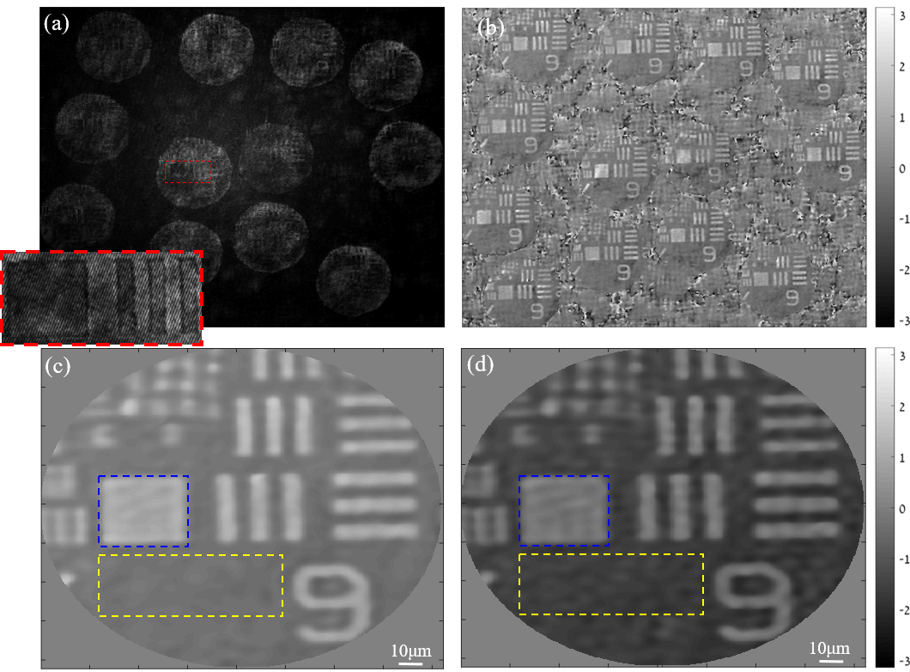
  Quantitative Phase Microscopy
  using Coherent Sparse COACH
Off-axis hologram recorded using Coherent Sparse COACH containing image replications
The phase of its filtered signal after phase background subtraction.
Quantitative phase imaging of USAF pure phase resolution chart using Coherent Sparse COACH
Quantitative phase imaging of USAF pure phase resolution chart using standard open aperture holography
 | Open aperture | CS-COACH
Phase element MSE (blue dashed square) | 1.97e-3 | 1.92e-3
Substrate MSE (yellow dashed square) | 10.86e-4 | 7.06e-4
Phase element height [nm] | 273 | 267
Ben-Gurion University of the Negev
School of Electrical & Computer Engineering

Slide 24
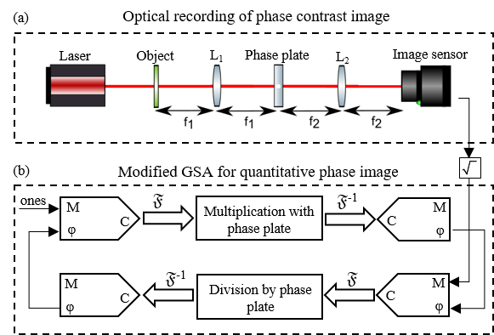
  Quantitative Phase Imaging
Goal: Quantitative Phase imaging by a single shot on-axis system
Optical configuration used to record a phase contrast image of pure phase objects
Modified GSA, based on the optical system, to reconstruct the quantitative phase values at the object plane.
Ben-Gurion University of the Negev
School of Electrical & Computer Engineering

Slide 25
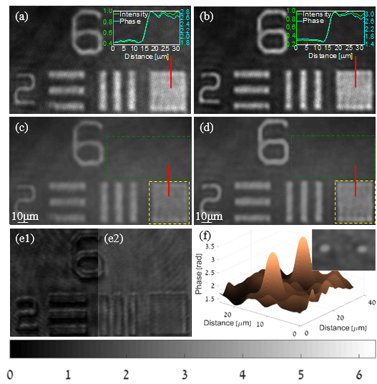
  Quantitative Phase Imaging
phase plot of the 6 μm diameter Polystyrene microspheres reconstructed in a similar method
150 nm
250 nm
Phase-contrast images of phase targets captured by the camera
Quantitative phase images obtained from the modified GSA output after initialization with the corresponding phase contrast images
(e1) Intensity image captured by the camera without the phase contrast operation and (e2) the corresponding phase reconstruction by using the modified GSA.
Phase plot of the 6 μm diameter Polystyrene microspheres reconstructed in a similar method
Ben-Gurion University of the Negev
School of Electrical & Computer Engineering

Slide 26
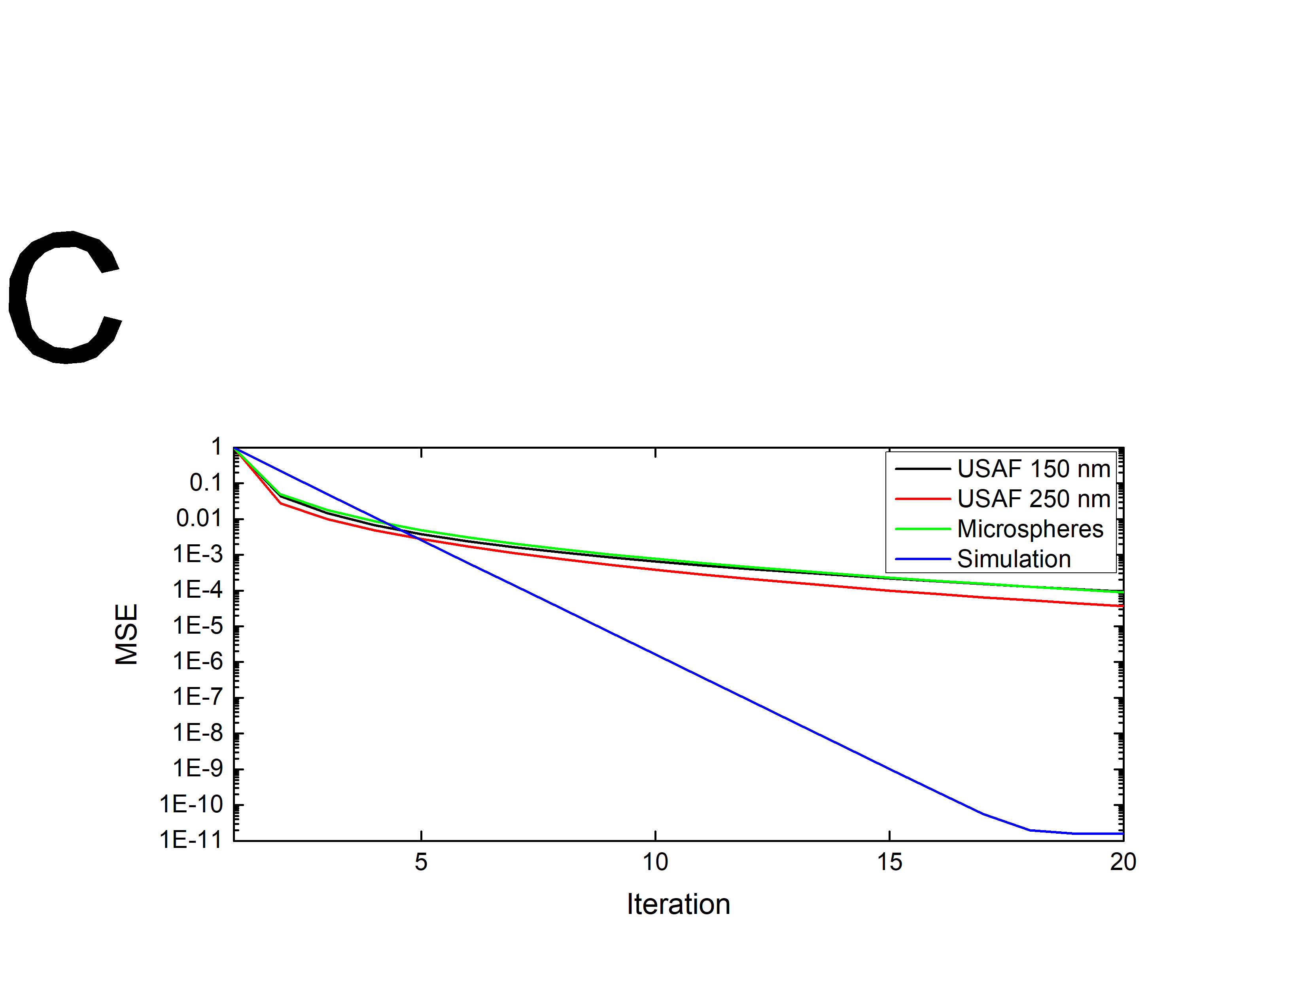
  Quantitative Phase Imaging
Quantitative analysis
Phase object | Phase contrast-based phase retrieval |  | Holography
USAF 1951 phase target (150 nm) | 161 nm |  | 170 nm
USAF 1951 phase target (250 nm) | 244 nm |  | 267 nm
Polystyrene microspheres (6 μm diameter) | 6.04 μm |  | 5.78 μm
Convergence plots of the recovered phase distribution from the modified GSA. Normalized (to the initial MSE) mean square error (MSE) in log scale as a function of the iteration number in linear scale, for the three examined objects and a simulated object shows that convergence to MSE<10⁻³ is achieved within a maximum of 10 iterations.
N. Hai, and J. Rosen, “Phase contrast-based phase retrieval: a bridge between qualitative phase contrast and quantitative phase imaging by phase retrieval algorithms,” Opt. Lett. 45(20), 5812-5815 (2020).
Ben-Gurion University of the Negev
School of Electrical & Computer Engineering

Slide 27
Conclusions and Challenges
Inventions can sometimes be nothing more than a new and unexpected combination of well-known and unrelated ideas. Therefore, it is essential to read about other close or far studies and to stay open-minded to as many as possible influences from others.
Incoherent imaging with synthetic aperture imaging should be explored further. Instead of working with a baseline interferometer, a method based on local detection should be studied.
Better methods should be explored in the areas of image sectioning, tomography, and imaging through a scattering medium.
Ben-Gurion University of the Negev
School of Electrical & Computer Engineering

Slide 28

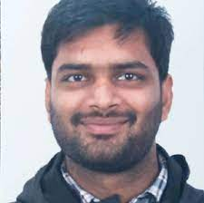
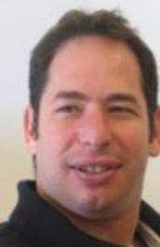
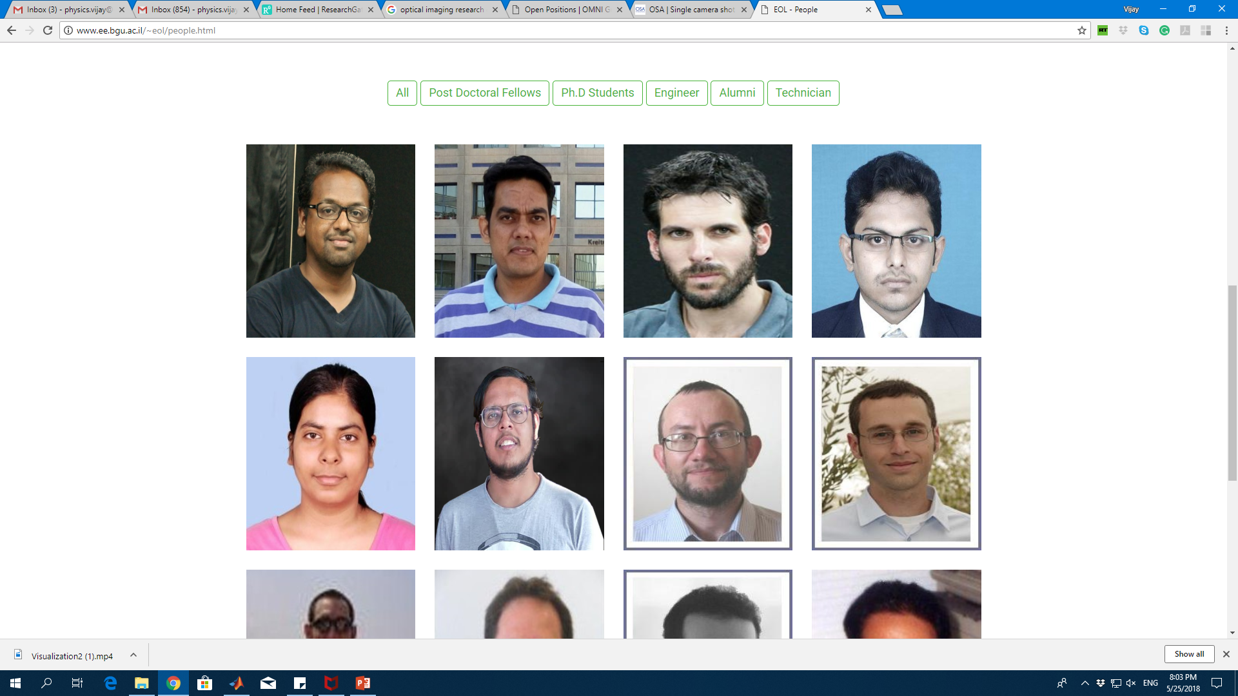
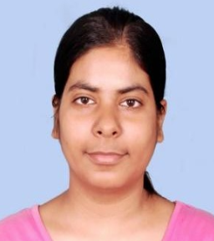
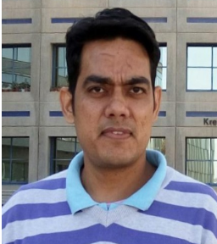
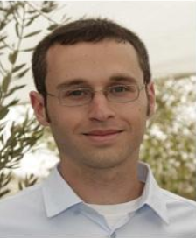




Acknowledgment
Thank you for your attention
Prof. Vijayakumar Anand PostDoc
Prof. Ravi Kumar
PostDoc
Dr. Barak Katz
PhD Student
Dr. Mani R. Rai
PhD Student
Dr. Angika Bulbul
PhD Student
Dr. Saswata Mukherjee
PhD Student
Dr. Manoj Kumar
PostDoc
Dr. Roy Kelner
PhD Student
Dr. Yuval Kashter
PhD Student
Jawahar Desai
PhD Student
Nitin Dubey
PhD Student
Dr. Nathaniel Hai
PhD Student
Ben-Gurion University of the Negev
School of Electrical & Computer Engineering

Slide 29
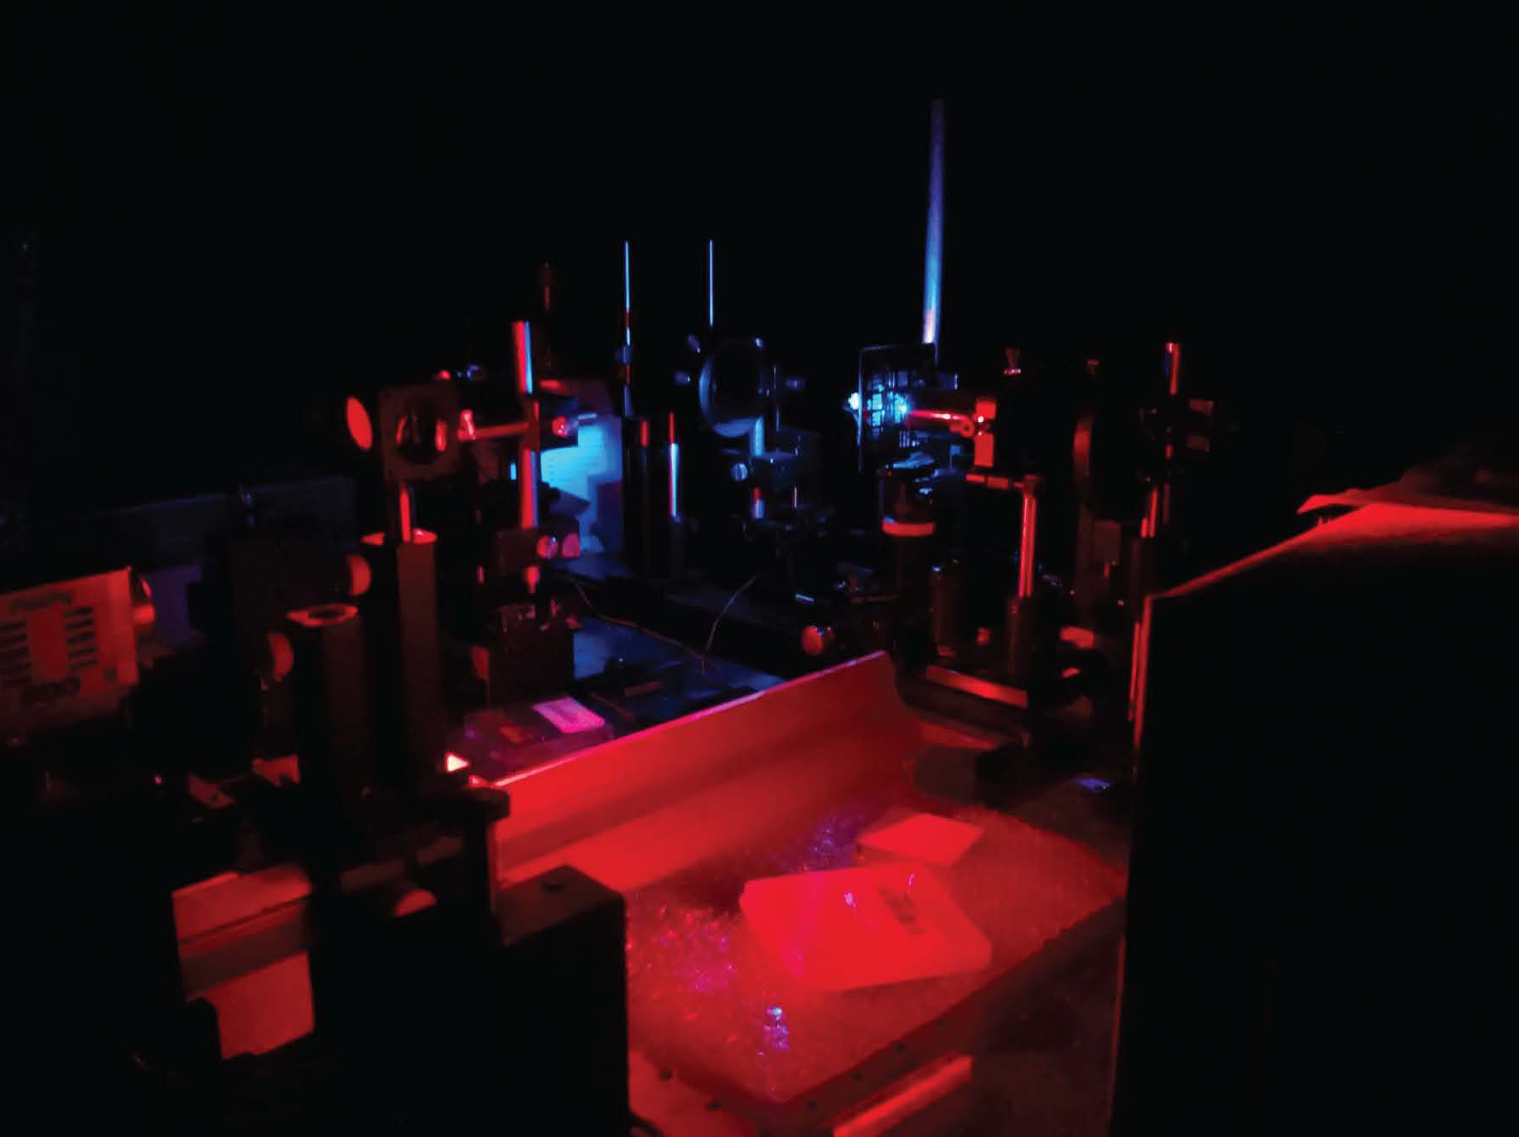
Thank you for your attention
Questions/comments are welcome.
Ben-Gurion University of the Negev
School of Electrical & Computer Engineering

