Slide 1
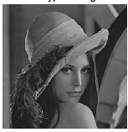
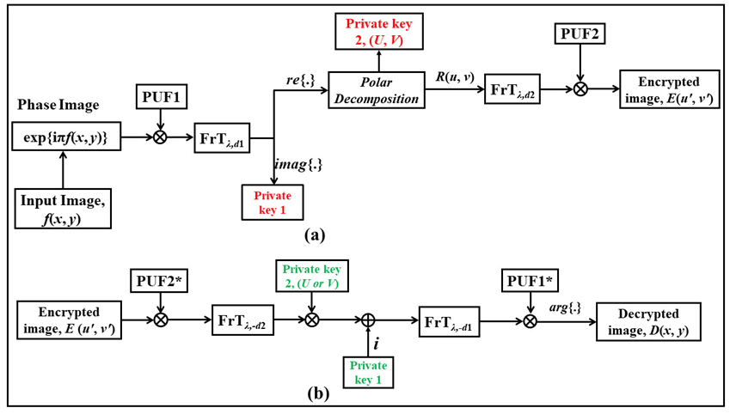
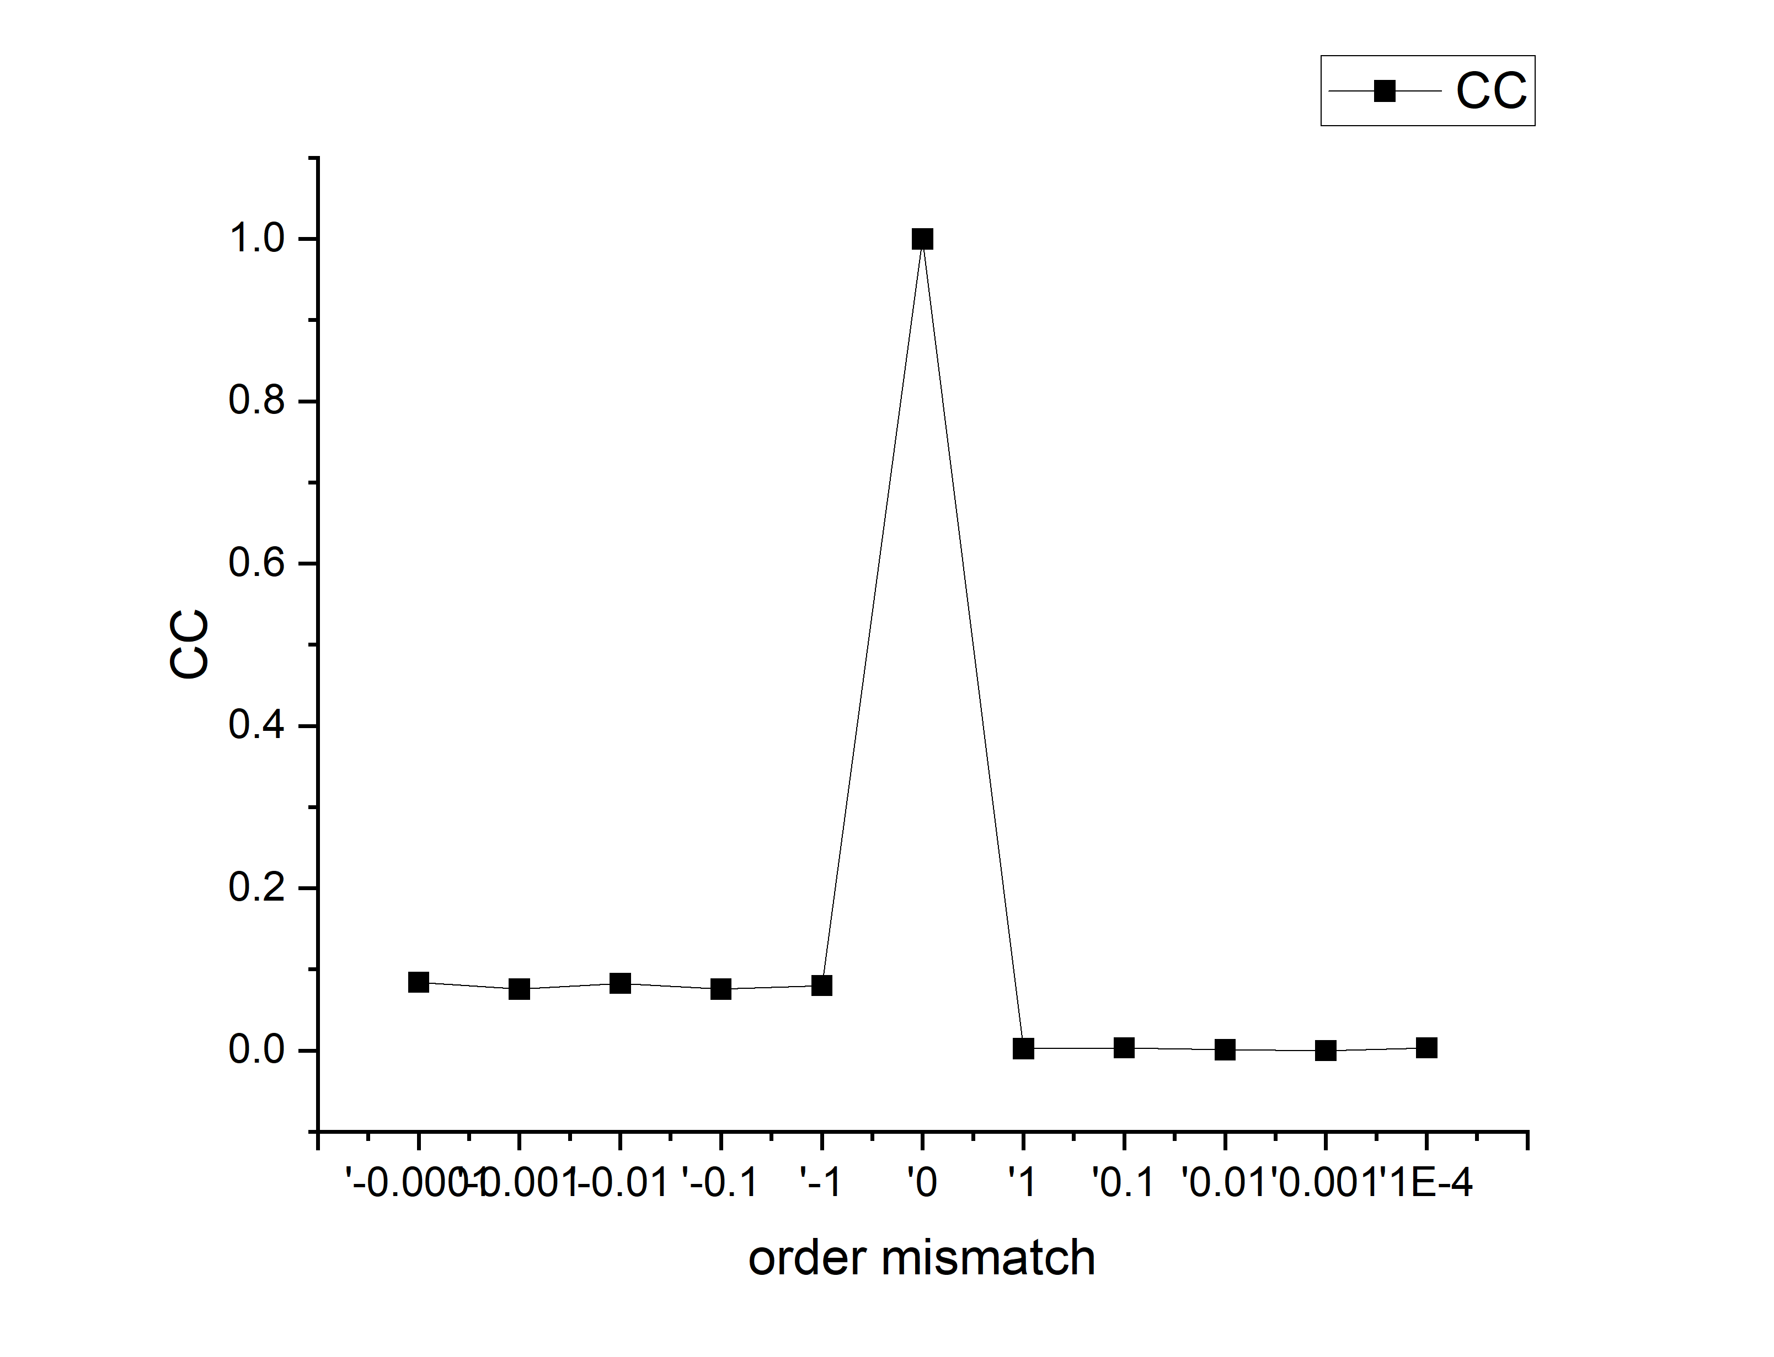
An asymmetric optical cryptosystem using physically unclonable functions in the Fresnel domain
Vinny Cris ${\text{M}}^{a}$,*, Shashi Prabhaka${\text{r}}^{b}$, Harsh Vardha${\text{n}}^{a}$, Ravi Kuma${\text{r}}^{a}$, Salla Gangi Redd${\text{y}}^{a}$, Saksh${\text{i}}^{c}$ , RP Sing${\text{h}}^{b}$
a Department of Physics, SRM University - AP, Andhra Pradesh - 522502, India
b Physical Research Laboratory, Navrang Pura, Ahmedabad-380009, India
c Ben-Gurion University of the Negev, P. O. Box 653, Beer-Sheva 8410501, Israel
Objectives
Theory
To design a new asymmetric optical cryptosystem using PUFs
To enable multiuser capability using polar decomposition method..
To study the key sensitivity and robustness of the proposed method.
Real part
Private key 2 (U,V)
PUF2
E(u’,v’)
$A\left(x,y\right)=(exp⁡(iπf\left(x,y\right))∗PUF1)$
$A′\left(x,y\right)=ℑ_{λ}^{d_{1}}[A\left(x,y\right)]$
$PD\left\{real\left\{A′\left(x,y\right)\right\}\right\}= \left[\begin{matrix}R & U & V\end{matrix}\right]$
$B\left(x′′,y′′\right)=ℑ_{λ}^{d_{1}}[R\left(x′,y′\right)]$
$E\left(x",y"\right)=\left(B\left(x^{′},y^{′}\right)∗PUF2\right)$
λ
f(x,y)
PUF1
Polar Decomposition
R(u,v)
$$d_{1}$$
Imaginary part: private key 1
$$d_{2}$$
Fig.1. encryption process
Proposed Technique
Conclusions
In conclusion, a new asymmetric optical cryptosystem with multiuser capabilities is proposed using polar decomposition in Fresnel domain.
The method has a large set of keys which include the Fresnel propagation parameters, two variable PUFs, and three private keys generated during the encryption process.
The PUFs used as security keys are difficult to replicate which improves the robustness against various attacks.
The sensitivity of all the keys is also verified.
The work is a subject of our ongoing research and will be presented in detail in the near future.
Fig.3. Flowchart explaining the (a) encryption and (b) decryption process.
References
Results
Refregier, P.; Javidi, B. Optical Image Encryption Based on Input Plane and Fourier Plane Random Encoding. Optics Letters 1995, 20, 767-769.
Nischal, K.N. Optical Cryptosystems; IOP Publishing Ltd: Bristol, UK, 2020; pp 2-1-2-18.
Javidi, B. et.al, Roadmap on Optical Security, Journal of Optics 2016, 18:083001.
Kumar, R.; Quan, C. Asymmetric multi-user optical cryptosystem based on polar decomposition and Shearlet transform, Optics and Lasers in Engineering 2022, 120, 118-126; https://doi.org/10.1016/j.optlaseng.2019.03.024
Vantiha, P.; Manupati, B.; Muniraj, I,; Anamalamudi, S.; Reddy, S. G.; Singh, R. P. Augmenting Data Security: Physical Unclonable Functions for linear canonical transform based cryptography, Applied Phys B 2022, 183; https://doi.org/10.1007/s00340-022-07901-z
(i)
Fig.3. (c) PUF of OV(m=2) (d) encrypted image (e) decrypted image with all the correct parameters (f) decrypted image with deviation in Fresnel distance d1=2 mm (g) deviation in Fresnel distance d2 = 2mm (h) using wrong PUF of OV(m =3) with corresponding CC values. (i) CC plot for deviation in fractional order OV- PUF

