Slide 1
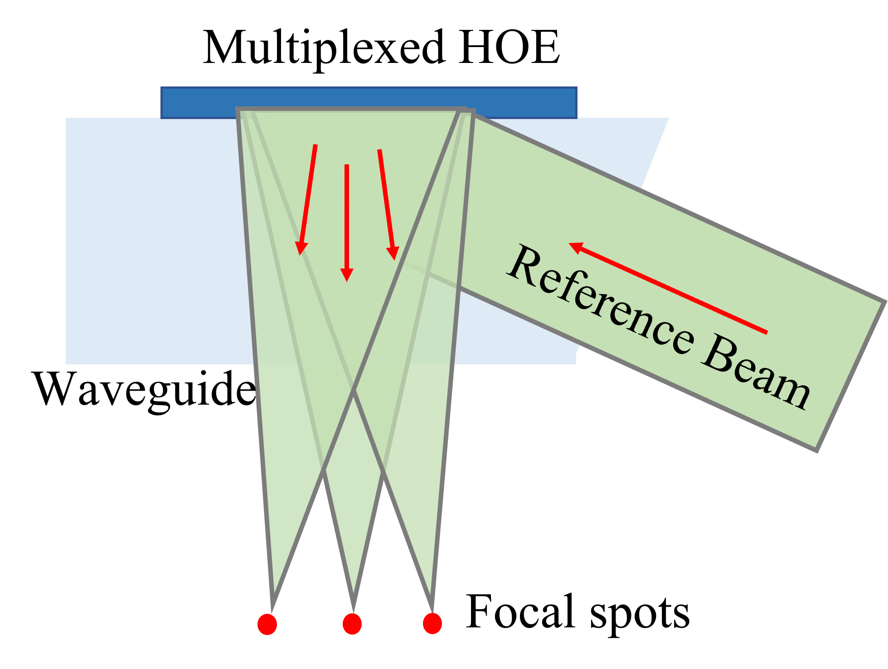
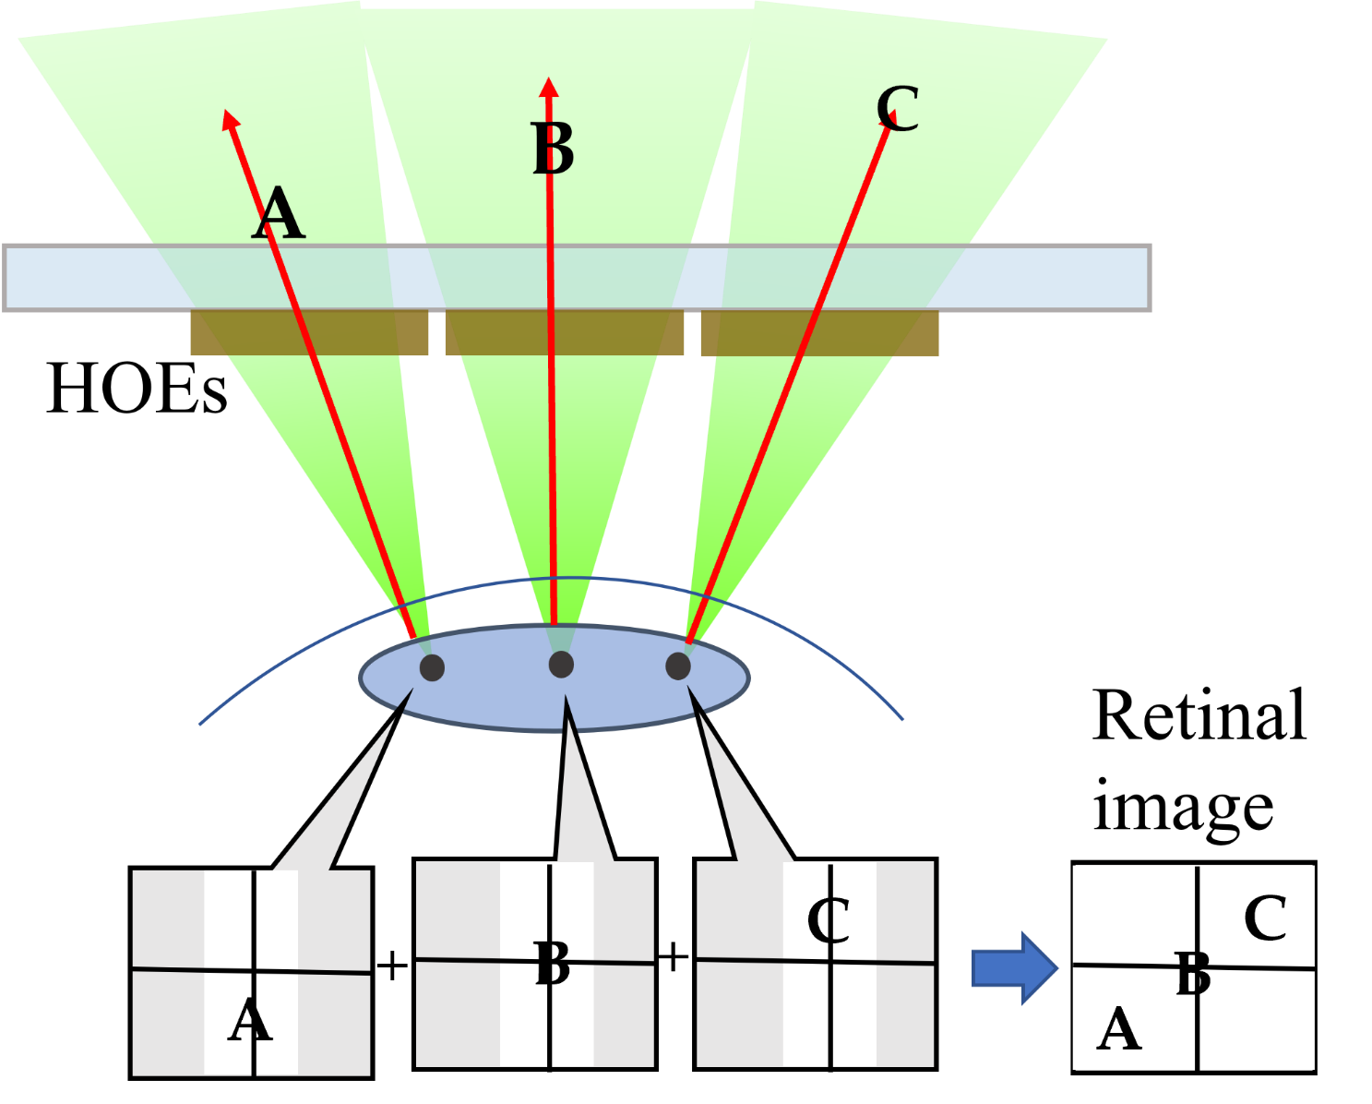
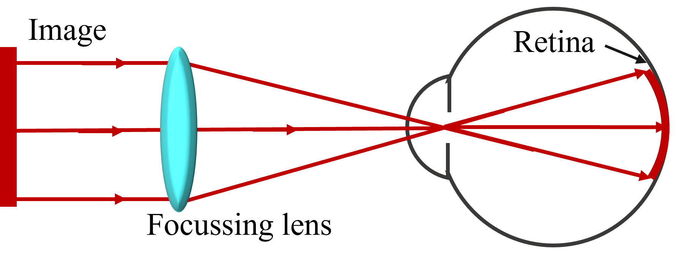
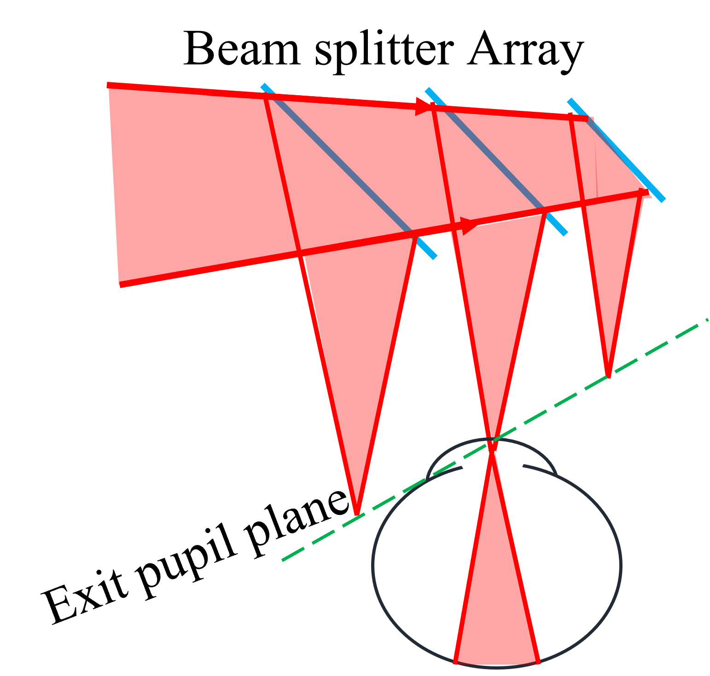
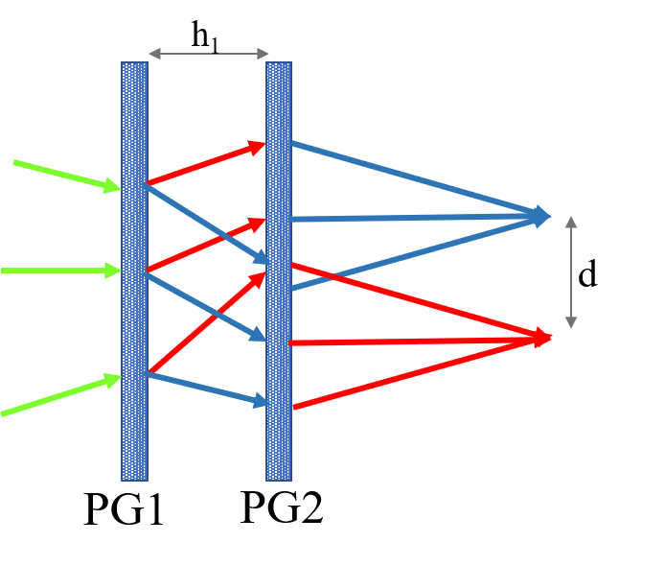
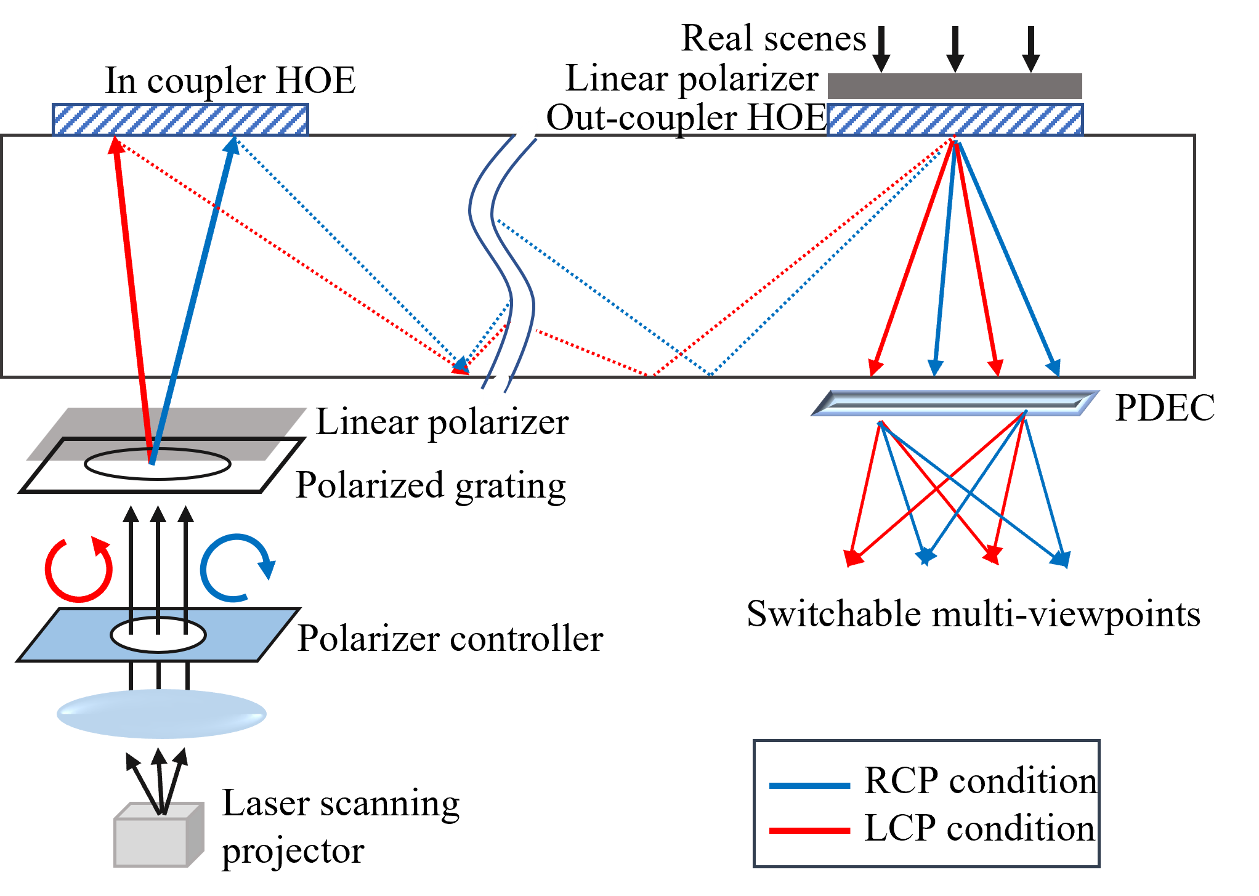
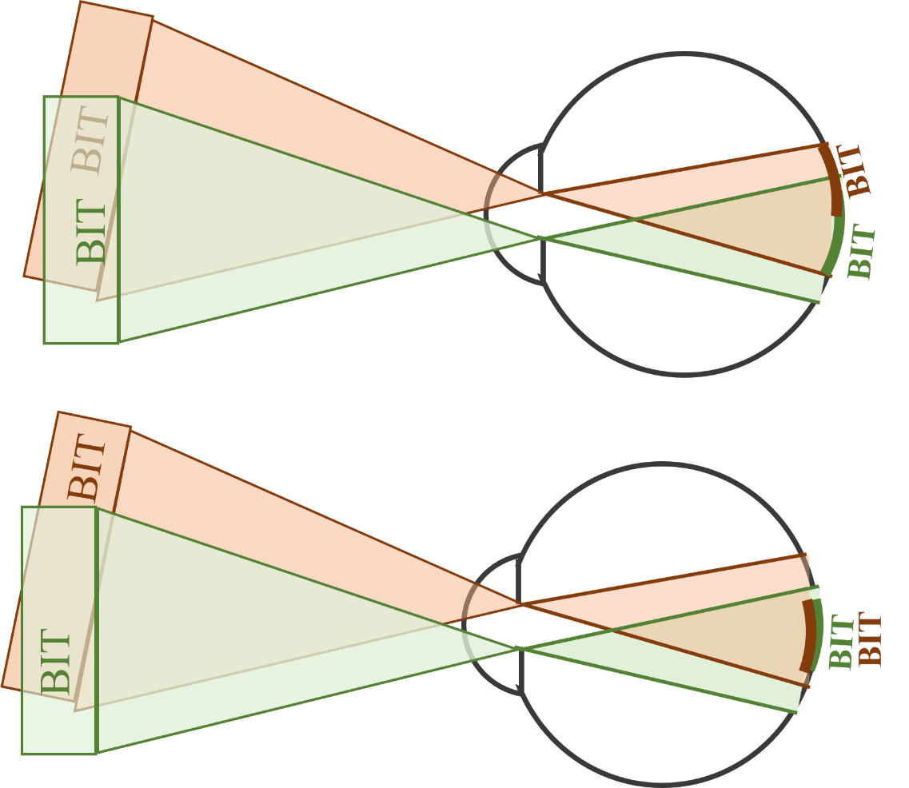
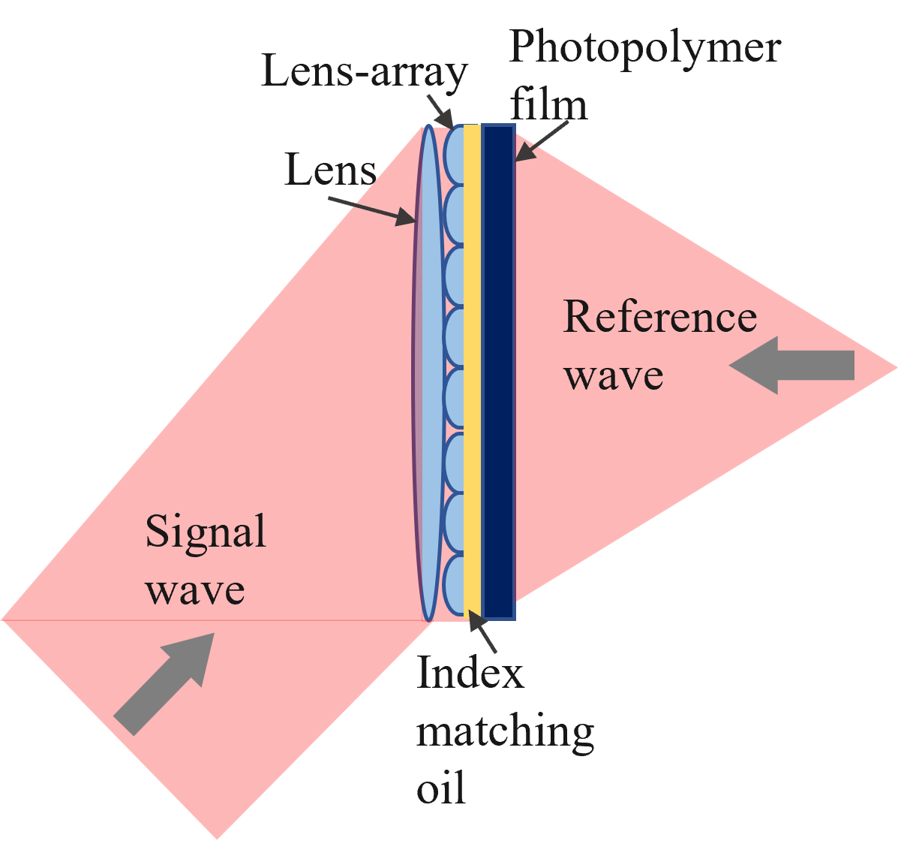
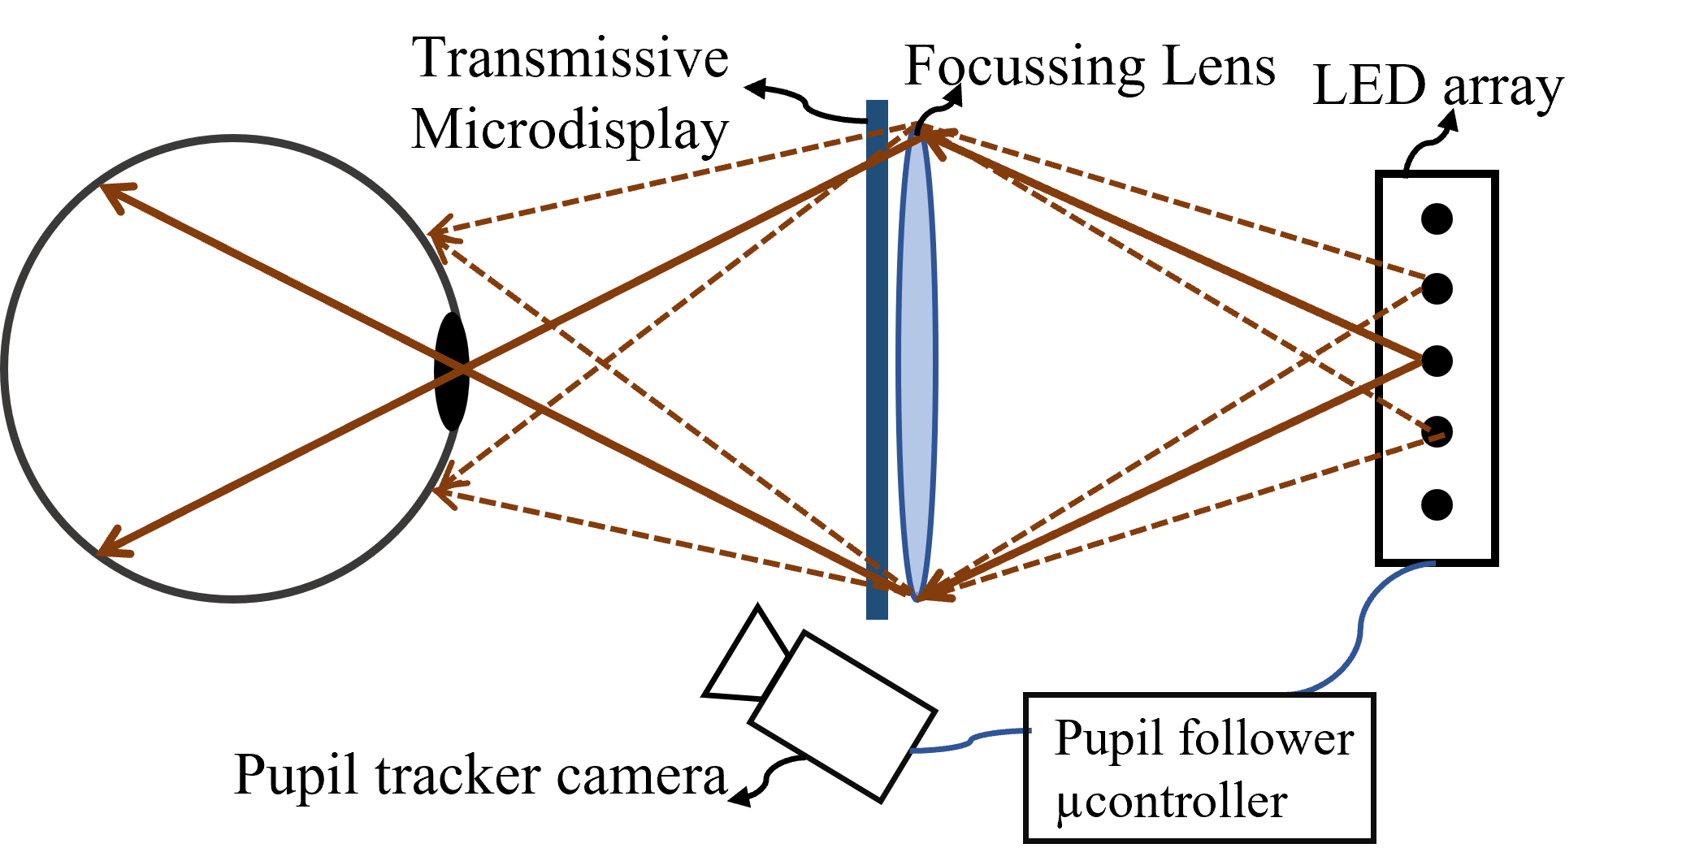
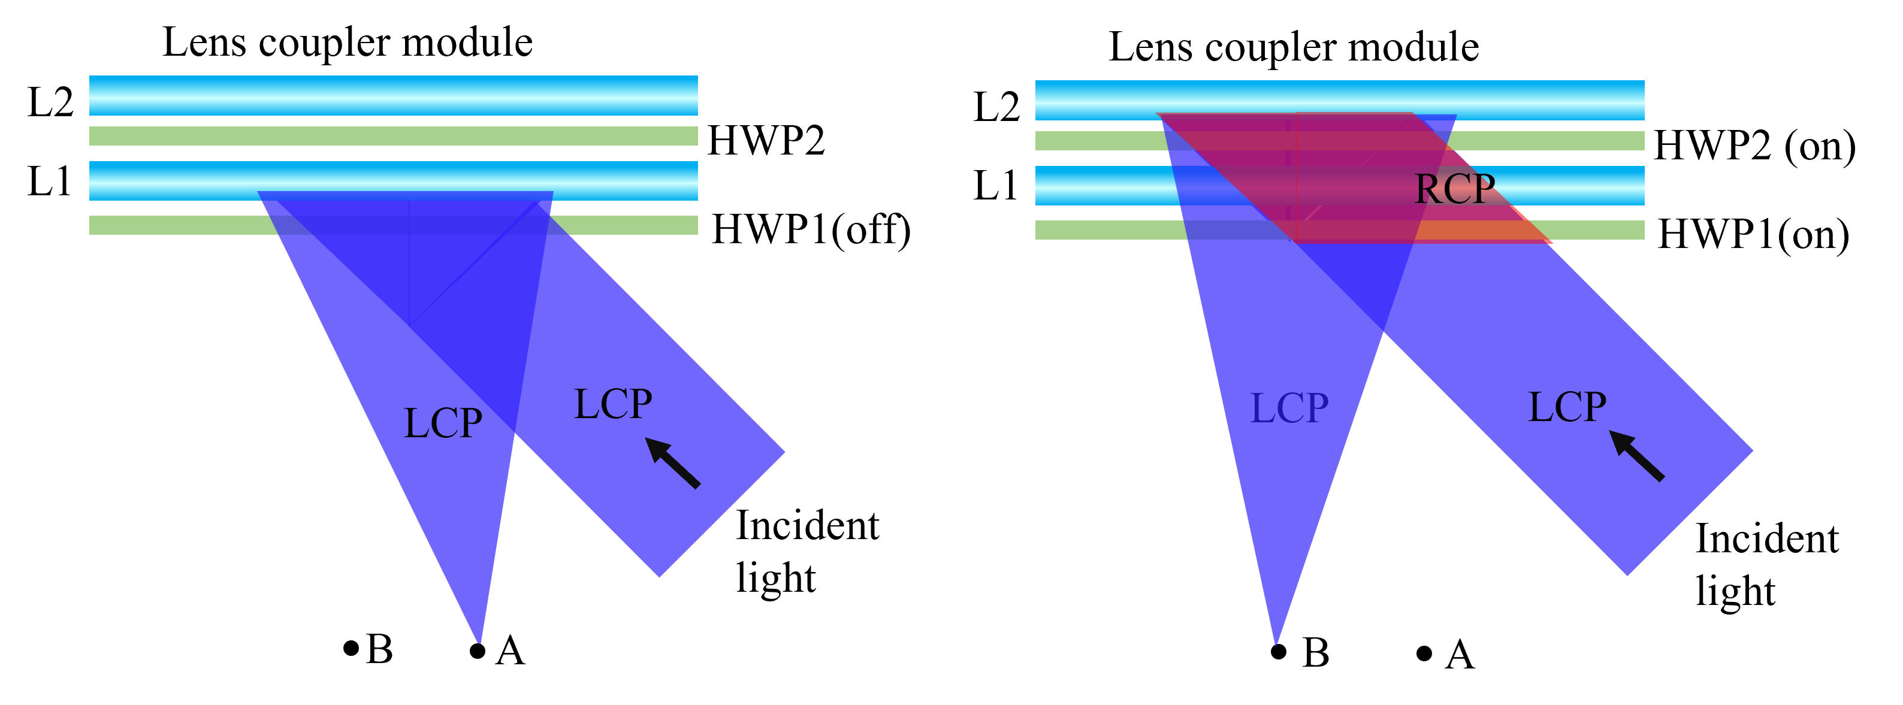
Techniques to expand the exit pupil of Maxwellian display: A review
Rajveer Kaur^{1,2}, Raj Kumar^{1,2,*}
1 CSIR-Central Scientific Instruments Organisation, Sector 30C, Chandigarh 160030, India
2 Academy of Scientific and Innovative Research (AcSIR), Ghaziabad 201002, India
*Email: raj.optics@csio.res.in
Abstract
The near-eye display (NED) devices are required to provide visual instructions in the fields of education, navigation, military operations, construction, healthcare, etc. The issues with conventional NEDs are the vergence-accommodation conflict (VAC) and form factor. The Maxwellian display alleviates the VAC in NEDs by providing always-focused images to the viewer. The main limitation of the Maxwellian display has a limited exit pupil size. Due to misalignment of the device or eyeball rotation, the user may miss the eye box, and the image will become lost. To mitigate this limitation, exit pupil expansion can be obtained either statically or dynamically. This paper reviews the various techniques employed to expand the exit pupil. The review includes the principle, advantages, and drawbacks of various techniques for expanding the exit pupil of the Maxwellian display.
The Maxwellian display is based on the Maxwellian view, which directly projects images onto the retina by focusing the light rays on the eye pupil instead of providing the proper focus cues and the main limitation is eye box size is limited to the size of the eye pupil
(a)
Fig. 1. Schematic diagram of conventional Maxwellian display.
Abstract
Eye box expansion of the Maxwellian displays can be done by generating multiple view-points. An angular multiplexing, spatial multiplexing and polarization multiplexing are used in Maxwellian displays to expand the eye box.
Introduction
(b)
(c)
Fig. 2. Static eye box expansion techniques: (a) using multiplexed HOE; (b) Beam splitter array; (c) Multiple HOEs
Static
Static eye box replication give fixed intervals between the viewpoints, which must be tunable to the variation in eye pupil size among the users. Using the polarization grating, multiplexed HOEs, and polarization-dependent eyepiece lens, the tunable viewpoints can be generated.
Tunable
Techniques
Dynamic
(c)
Conclusion
(b)
The dynamic eye box is achieved using backlight modulation, and cholesteric liquid crystal holographic lens (CLCHL) and a switchable polarization converter
References
(a)
Westheimer, G. The Maxwellian view. Vision Res. 1966, 6, 669–682.
Kim, S. B., & Park, J. H. Optical see-through Maxwellian near-to-eye display with an enlarged eyebox. Opt. Lett. 2018, 43, 767-770.
Shrestha, P.K., Pryn, M.J., Jia, J., Chen, J.S., Fructuoso, H.N., Boev, A., Zhang, Q. & Chu, D. Accommodation-free head mounted display with comfortable 3D perception and an enlarged eye-box. Research 2019.
Jo, Y., Yoo, C., Bang, K., Lee, B., & Lee, B. Eye-box extended retinal projection type near-eye display with multiple independent viewpoints. Appl. Opt. 2021, 60, A268-A276.
Park, J. H., & Kim, S. B. Optical see-through holographic near-eye-display with eyebox steering and depth of field control. Opt. Express 2018, 26, 27076-27088.
Shi, X., Liu, J., Zhang, Z., Zhao, Z., & Zhang, S. Extending eyebox with tunable viewpoints for see-through near-eye display. Opt. Express 2021, 29, 11613-11626.
Zhang, S., Zhang, Z., & Liu, J. Adjustable and continuous eyebox replication for a holographic Maxwellian near-eye display. Opt. Lett. 2022, 47, 445-448.
Yoo, C., Chae, M., Moon, S., & Lee, B. Retinal projection type lightguide-based near-eye display with switchable viewpoints. Opt. Express 2020, 28, 3116-3135.
Jang, C., Bang, K., Li, G., & Lee, B. Holographic near-eye display with expanded eye-box. ACM Trans. Graph. 2018, 37,1-14.
Hedili, M. K., Soner, B., Ulusoy, E., & Urey, H. Light-efficient augmented reality display with steerable eyebox. Opt. Express 2019, 27, 12572-12581.
Xiong, J., Li, Y., Li, K., & Wu, S. T. Aberration-free pupil steerable Maxwellian display for augmented reality with cholesteric liquid crystal holographic lenses. Opt. Lett. 2021, 46, 1760-1763.
Fig. 3. Tunable eye box expansion techniques: (a) Using polarization multiplexing; (b) Pre compensation for continuous eye box;
(c) Polarization dependent HOEs.
(a)
By incorporating pupil-tracking, exit-pupil steering can be done to mitigate the limitation of conventional Maxwellian displays
(b)
Acknowledgements
Author thank CSIR, India for providing financial support under project number MLP2014 to carry out this research work. R. Kaur thank CSIR, India for providing fellowship to carry out this research work.
Conclusion
This paper reviewed the state-of-the-art Maxwellian display design, focusing on two comfort features, including form factor and large eye box. We have introduced the conventional Maxwellian display & its principle and then discussed the multiplexing techniques to expand the exit pupil. The techniques for enlarging the exit pupil of Maxwellian displays, such as spatial & angular multiplexing of HOEs, polarization multiplexing, backlight modulation, and materials, are reviewed. Our paper discusses the relative merits & demerits of the methods along with potential solutions in achieving AR displays’ goals.
(c)
Fig. 4. Dynamic eye box expansion techniques: (a) Using pupil shifting HOE; (b) Backlight modulation using LED array; (c) Using Cholesteric liquid crystal holographic material.

