Slide 1
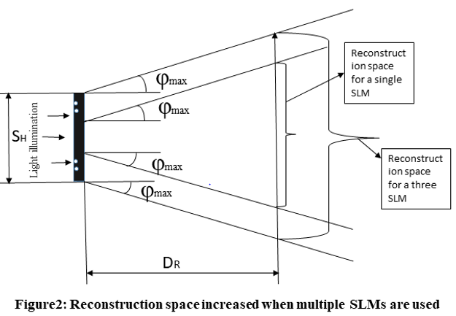
Field of view enhancement of dynamic holographic displays using algorithms, devices, and systems: A review
Monika Rani, Narmada Joshi, Bhargab Das, Raj Kumar*
CSIR-Central Scientific Instruments Organization, Sector 30C, Chandigarh, 160030, India
Email: raj.optics@csio.res.in
Abstract
Holography is a prominent 3D display approach as it offers a realistic 3D display without the need for special glasses. The core of dynamic holographic displays is spatial light modulator (SLM) technology. However, owing to the limited resolution and large pixel size of SLMs, holographic displays suffer from certain bottlenecks such as limited field of view (FOV) and narrow viewing angle. To develop a holographic display at the commercial level, it is crucial to solve these problems. A variety of probable solutions to these challenges may be found in the literature. In this review, we discuss the essence of these approaches.
Holographic Displays: Technical challenges and solutions
Holographic Display
The real-time computation of complex holographic patterns with huge information capacities for multi-color, wide-angle.
large-image Systems.
modulators (SLM) are one of the widely used.
In holographic displays, the computer generated holograms are calculated from 3D objects and they are reconstructed using spatial light modulators
Technical challenges
Field of View (FOV)
Space Bandwidth Product (SBP) of the hologram
The display quality
are all constrained by the size and pixel pitch of commercially available SLMs. From the literature survey, computer generated hologram (CGH) algorithms, number/configuration of display systems, and the optical devices are identified as the three most promising candidates for the above purpose.
Section III: Devices
The optical devices used in the optical configurations also have a significant contribution in enhancement of FOV
However, the spatial frequency and physical size of the CGH affect its information capacity
Section II: Systems
SLMs are used in holographic displays to replicate wave fronts of an object.FOV reconstructed images is relatively constrained because small size of available SLM.To display the calculated digital holograms, spatial light
Section I: Algorithms
One of the most important aspects of holographic displays is CGH generation.
The main objective of these algorithms is:-
The development of such devices are helpful in realization of holographic displays with wide FOV.
Conclusions
This paper reviews the current state-of-the-art of the FOV expansion for the holographic displays. CGH generation algorithms, configuration of display systems, and the optical devices are identified as the three most promising candidates for the above purpose. The combination of different primitive methods into an optimized algorithm is a good solution to enhance the FOV.
References
[1]. Geng, J. Three-dimensional display technologies. Adv Opt Photon 2013, 5, 456–535..
[2] Liangcai, C.; Wang, Z.; Zhang, H.; Jin, G.; Gu,C. Volume holographic printing using unconventional angular multiplexing for three-dimensional display. Appl Opt 2016, 55, 6046-6051..
[3] R. Leutz and A. Suzuki, Nonimaging Fresnel lenses: design and performance of solar concentrators vol. 83: Springer Science & Business Media, 2001.
[4] Xinhui, D.; Liu, J.; Shi, X.; Zhang, Z.; Xiao, J. Full-color see-through near-eye holographic display with 80 field of view and an expanded eye-box. Opt Exp 2020, 28, 31316-31329.

