Slide 1
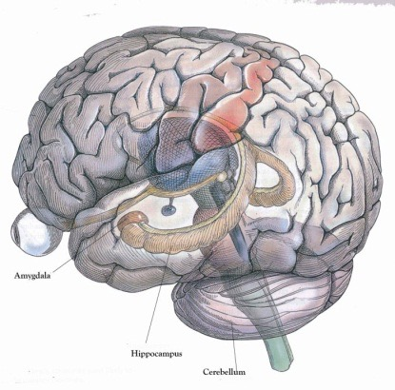
The nuclear tau as an early molecular marker of Alzheimer’s disease
Francesca Bruno¹, Valentina Sturiale¹, Desiree Brancato¹, Laura Gil² , Isabel M. Olazabal², Fernando Pinedo³, Ana B. Rebolledo², Salvatore Saccone¹, Concetta Federico¹
¹Dept. Biological, Geological and Environmental Sciences, University of Catania, Italy;
²Department of Genetics, Medical School, University ‘‘Alfonso X el Sabio”, Madrid, Spain
³Hospital Universitario Fundación Alcorcón, Department of Pathology, Alcorcon, Spain
Neuronal Cell Cycle re-entry
Hippocampus
Role of the altered cell cycle in neurodegenerative diseases such as Alzheimer’s Diseases (1)
Neuronal cell cycle re-entry does not result in cell division, but it is associated to increased susceptibility to cell death (1)
(1) Walton et al., Sci. Rep. 9:4594, 2019.

Slide 2
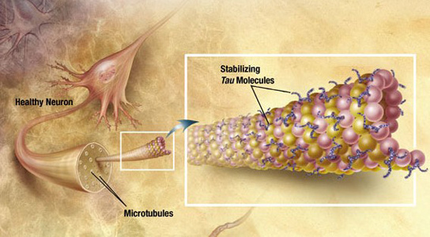
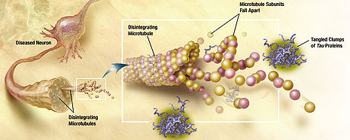
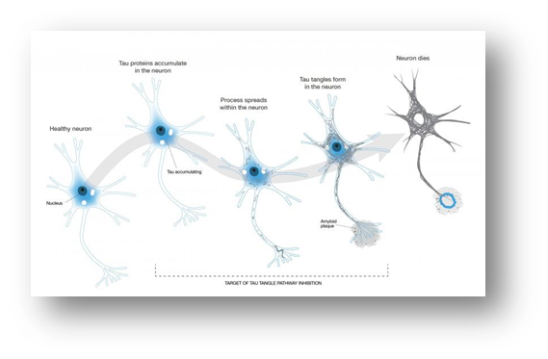
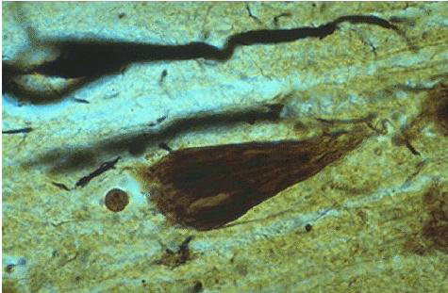
The nuclear tau as an early molecular marker of Alzheimer’s disease
Normal tau
Hyperphosphorylated tau
Destabilization of microtubules
Neuronal death
TAU aggregation
Neurofibrillary Tangles (NFT)

Slide 3
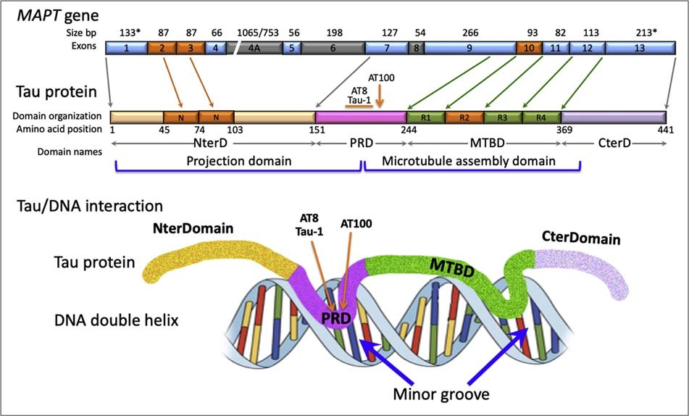
The nuclear tau as an early molecular marker of Alzheimer’s disease
MAPT gene structure and tau protein domains
Federico et al., In: Factors affecting nuerological aging: Genetics, neurology, behavior, and diet. Elsevier Inc., 2019.

Slide 4
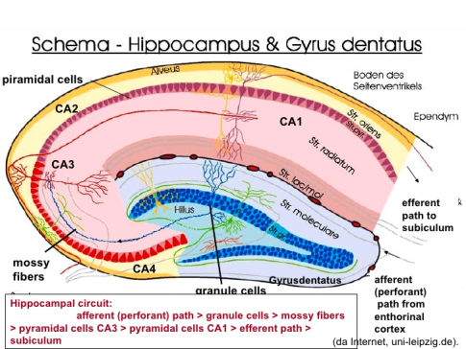
The nuclear tau as an early molecular marker of Alzheimer’s disease
AT100 epitope
Specific nuclear tau epitope, progressively increases in the nuclei of neuronal cells during aging
Young (20-40 y) Adult (40-60 y) Senile (> 60 y) ADI ADIV
Gil et al., Brain Res. 1677:129–137, 2017.

Slide 5
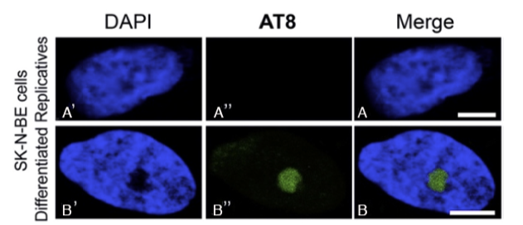
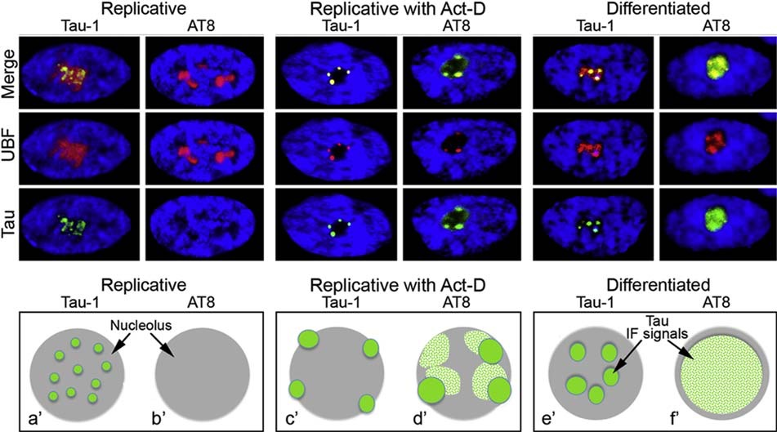
The nuclear tau as an early molecular marker of Alzheimer’s disease
AT8 epitope
Specific nuclear phosphorylated tau epitope, that appears to be related with neuronal differentiation
In a neuroblastoma cell line, we shown that the AT8 epitope is undetected in replicative cells, and appears in the nucleolus of neuronal differentiated cells (3).
AT8 appears in the nucleolus when the transcriptional activity is blocked (Act-D exposed cells) or largely reduced (differentiated cells) (3).
Federico et al., Gene 664:1-11, 2018.

Slide 6
The nuclear tau as an early molecular marker of Alzheimer’s disease
Phosphorylated AT8 epitope in the human neurons from the CA1 region
AT8+
The percentage of neurons with nucleolar AT8:
increases from foetal to young brain
decreases from young to senile brain
is low at the start of AD (AD-I)
AT8+
AT8 −
AT8 −
AT8 −
AT8 −
AT8 −
AT8+
AT8 −
AT8 −
AT8 −
AT8 −
***
AT8 −
***
***
AT8 −
***
AT8+
AT8 −
AT8+

Slide 7
The nuclear tau as an early molecular marker of Alzheimer’s disease
The results showed that the AT8 epitope disappears in senile neurons respect to cells from younger subjects, indicating a possible role of AT8 in the ectopic activation of the cell cycle in differentiated cells.
These data improve the knowledge on the role of nuclear tau in the neuronal differentiation and cell degeneration in AD, involving the presence/absence of AT8 in the nucleolus of neurons related to a re-entering in the cell cycle.
The molecular mechanisms related to the start of AD are not yet clear, so their understanding is very relevant if we consider the social impact of this disease in the human populations.

