Slide 1
PRESENTATION [ECB 2023] The 2nd International Electronic Conference on Biomedicines
Potential Therapeutic Target in Pancreatic Ductal Adenocarcinoma
Prof. Dr. AK Taha
MBCHB, MMED, MD/PHD
Auckland, New Zealand

Slide 2
Short Biography: Prof. Dr. AK Taha / MBCHB, MMED, MD/PHD Auckland, New Zealand.
More than 23 years’ experience in healthcare service and medical education overseas.
certificate of New Zealand International Qualification Assessment (IQA)
Chosen for Who’s Who in Medicine and Healthcare 2009/2010.
Overseas full practicing certificate to practice and teach medicine
Career
Honorary Professor and External Advisor from New Zealand, Widad University College, Malaysia
Associate Professor and High-end Foreign Expert, College of Basic Medicine & Clinical Medical College & Affiliated Hospital of Chengdu University, Chengdu University, China.
Research
Have published more than 50 research papers in SCI Journals and written a book on diabetes.

Slide 3
The Emergence of TRP Channels Interactome as a Potential Therapeutic Target in Pancreatic Ductal Adenocarcinoma

Slide 4
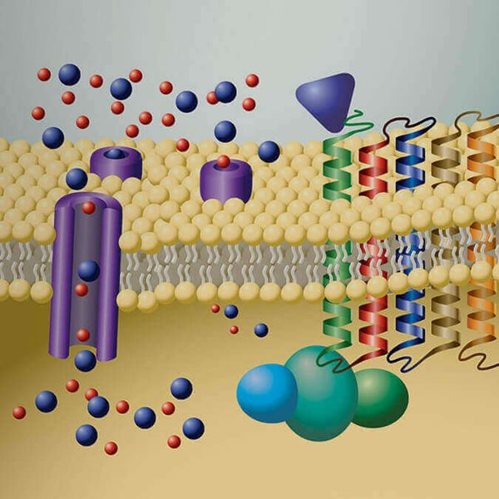
Transient Receptor Potential (TRP)
TRP channels are all sixth-order transmembrane proteins, with both N-terminus and C-terminus in the cell, and the fifth and sixth transmembrane domains together form non-selective cationic pore.
TRP (transient receptor potential) ion channels are a class of channel proteins that are widely distributed in the peripheral and central nervous systems.

Slide 5
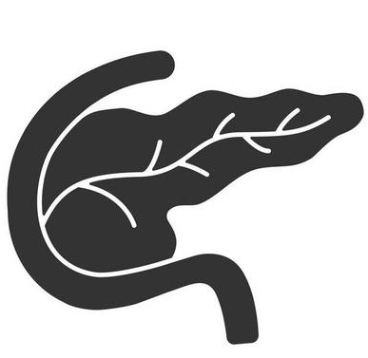
Channels are cellular sensors
for a variety of physical and chemical stimuli.
respiratory airways
cardiovascular system
eyes
nervous system
bladder
pancreas
skin
colon

Slide 6
TRP channels with their nine subfamilies are classified by sequence similarity, resulting in this superfamily's tremendous physiological functional diversity. Because TRP channels also play essential roles in cellular signaling and allow the host cell to respond to benign or detrimental environmental changes.
Understanding how each TRP channel responds to its unique forms of activation energy is critical and crucial as its impairment may lead to several diseases, especially carcinogenesis.

Slide 7
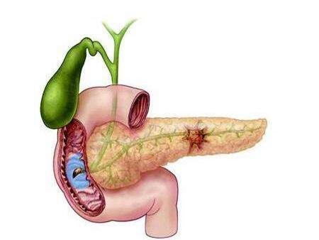
pancreatic cancer
deadly types
without effective treatment
increasing in prevalence

Slide 8
The early stage of pancreatic cancer is difficult to diagnose, which is why it has a very low survival rate.
Moreover, the development of effective treatment methods for pancreatic cancer has been hindered by the lack of understanding of the pathogenesis, which is partly due to the difficulty in studying human tissue samples

Slide 9
Scientific research on this topic has witnessed steady development in the past few years in understanding the molecular mechanisms that underlie TRP channel disturbance.
TRP channels have been reported to be associated with several cancers.

Slide 10
The focus is on the exploration of the pathogenesis of pancreatic cancer and its related pathways. In particular, TRPV1 has been linked to the promotion of pancreatic cancer cell proliferation and migration.
Several studies have shown that TRP channels are frequently overexpressed in pancreatic cancer cells and their expression levels correlate with poor prognosis and increased tumor growth

Slide 11
Introduction
Pancreatic cancer is considered one of the deadliest cancers, with a five-year survival rate of only 9% [1]. The early stage of pancreatic cancer is difficult to diagnose and treat, which is why it has a very low survival rate. The 5-year survival rate for this type of cancer is only about 20% [2]. Early detection and treatment are key, as the disease is often not diagnosed until it has spread to other parts of the body. Despite advances in medical treatments, the prognosis for pancreatic cancer remains poor, making research and efforts to improve early detection and treatment crucial [1-3].

Slide 12
As such, developing new treatment options is crucial to improve patient outcomes. TRP channels are a family of nonselective cation channels that mediate a variety of physiological functions in many different cell types. These channels have recently been identified as critical regulators of pancreatic cancer cell proliferation, invasion, and metastasis [4-7]. Targeting TRP channels represents an exciting new strategy for inhibiting pancreatic cancer cell growth and survival. This review summarizes current knowledge of the role of TRP channels in pancreatic ductal carcinoma to identify potential therapeutic interventions.

Slide 13
Pancreatic Ductal Adenocarcinoma (PDAC)
Pancreatic Ductal Adenocarcinoma (PDAC) is a malignant epithelial tumor that originates from the ductal cells of the pancreas. It is the most common type of pancreatic cancer and has a poor prognosis with a 5-year survival rate of less than 10% [8]. PDAC is a complex disease that arises from a series of genetic and epigenetic changes leading to the development of cancer cells. These changes may include mutations in key oncogenes such as KRAS, TP53, and SMAD4 and loss of tumor suppressor genes such as CDKN2A. In addition, chronic inflammation, oxidative stress, and other environmental factors have been implicated in the development of PDAC [8-10].

Slide 14
Diagnosis of PDAC is challenging due to the lack of specific symptoms in the early stages of the disease. Symptoms such as abdominal pain, weight loss, jaundice, and fatigue are often non-specific and may not be present until the disease has progressed [9-11]. Imaging techniques such as computed tomography (CT) and magnetic resonance imaging (MRI) can be used to visualize the pancreas and detect any abnormal growths, while endoscopic ultrasound (EUS) and biopsy can confirm the diagnosis [8-11].
Treatment of PDAC is multi-disciplinary and depends on the stage of the disease. Surgery is the preferred treatment for early-stage PDAC, with the goal of complete removal of the tumor [8,9]. Chemotherapy and radiation therapy are used for locally advanced and metastatic diseases to shrink the tumor and prevent growth. Novel therapies such as immunotherapy and targeted therapy are currently being investigated to improve outcomes for patients with PDAC [8-11]. Even though PDAC is a complex and aggressive cancer with a poor prognosis. Advances in our understanding of the genetic and epigenetic changes underlying PDAC have led to the development of new therapies, but there is still much work to be done to improve outcomes for patients with this disease.

Slide 15
Nevertheless, recent studies have shown that the expression and function of certain transient receptor potential (TRP) channels, such as TRPV1 and TRPM8, are upregulated in PDAC cells, promoting cell growth and survival [11-13]. Targeting these TRP channels with specific inhibitors has been shown to induce apoptosis and inhibit cell proliferation in PDAC cells, suggesting a potential therapeutic benefit for patients with this disease [12,13]. However, it is important to note that this is a relatively new area of research and further studies are needed to confirm the efficacy and safety of TRP channel inhibitors in the treatment of PDAC. It is also important to consider the potential off-target effects of these inhibitors, as TRP channels are involved in many physiological processes, including sensory transduction and temperature regulation [12,13].

Slide 16
Role of TRP Channels in Pancreatic Ductal Adenocarcinoma (PDAC)
Research has shown increasing evidence for an implicated role of TRP channels in the development of exocrine pancreatic cancer. The expression of various TRP proteins has been altered and they play a crucial role in tumor formation, proliferation, and migration [14]. TRP channel family members have also been reported as a good prognostic marker and a target for cancer drug therapy in recent decades [14].
The role of TRP channels in PDAC has been the subject of very recent studies, as summarized in the following table:

Slide 17
Table 1: Recent studies have shown a role for TRP channels in PDAC.
Reference | Author and year | Key Findings
15 | Fallah, Hamideh P., et al. {2022} | TRP proteins are a large group of ion channels that control many physiological functions in the body and are considered potential therapeutic targets for various diseases, including cancers.
16 | Chelaru, N. R., et al. {2022} | Significantly higher expression levels of TRPA1, TRPM8, and TCAF1/F2 were found in tumoral tissues compared to normal tissues, but lower expression levels of TRPV6. The TRP channels have either tumor-suppressive or oncogenic roles.
14 | Li, L., Xiao., et al. {2022} | Research has revealed altered expression of various TRP proteins in numerous cancer types, including PDAC. TRP ion channels play a crucial role in tumor formation, proliferation, and migration. TRP channel family members have been reported as good prognostic markers and potential targets for cancer drug therapy.
17 | Mesquita, G et al. {2021} | Collected data indicating the TRP family has a potential role in the development and progression of PDAC. It found to affect both cancer cells and pancreatic stellate cells, impacting cell proliferation, migration, invasion, and death. The TRP family may offer new treatments and diagnostics tools for PDAC.

Slide 18
Current therapeutic options for PDAC are minimal and target Transient receptor potential ankyrin 1 (TRPA1), as an attractive new therapeutic strategy [18]. TRPA1 is overexpressed in pancreatic cancer, and blocking TRPA1 using cannabidiol suppresses tumor growth and reduces metastasis to the lungs (figure 1). Blocking TRPM8 inhibits pancreatic cancer growth in vitro and in vivo and reduces metastasis to the liver. These findings suggest that TRP channel inhibitors may help treat pancreatic cancer. The research also has shown that pancreatic cancer is a complex disease with multiple risk factors and molecular pathways. The development of effective treatment methods for pancreatic cancer has been hindered by the lack of understanding of the pathogenesis, which is partly due to the difficulty in studying human tissue samples.

Slide 19
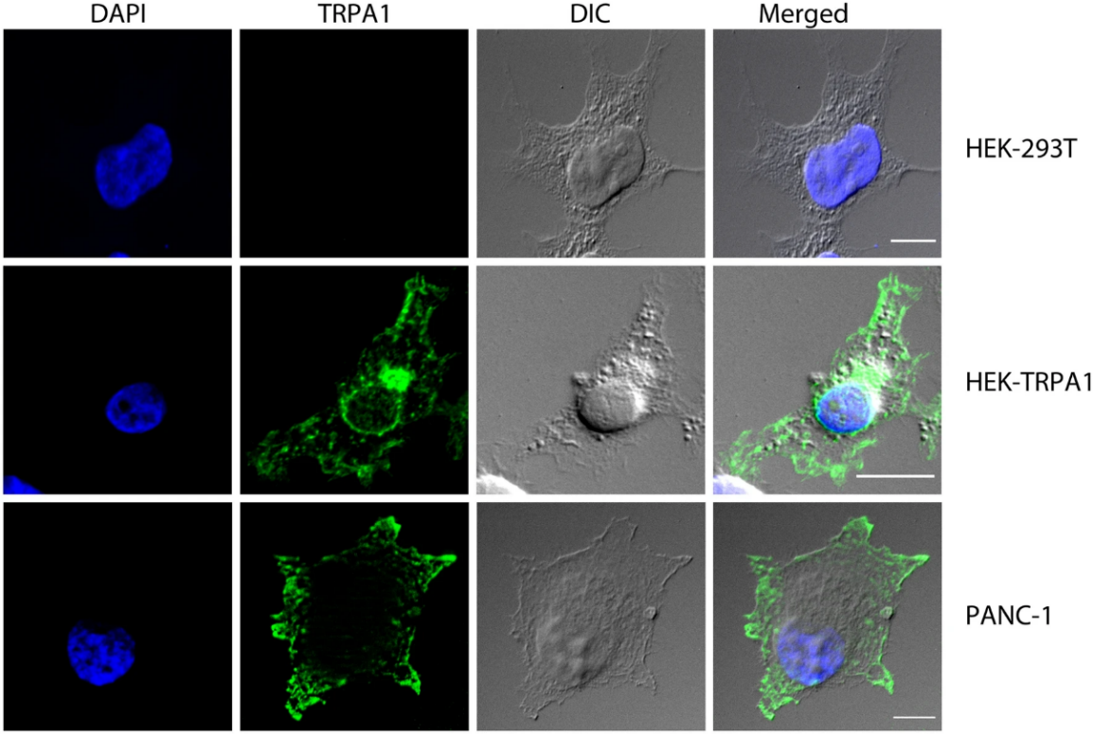
Figure 1. Expression of TRPA1 Protein in PDAC Cells: A. Immunofluorescence of fixed Panc-1 and HEK-293 T Cells either transfected or un-transfected with pcDNA3.1 Plasmid encoding human TRPA1. Cells were stained with mouse monoclonal TRPA1 primary antibody (green), whereas DAPI nuclear staining is shown in blue. Scales are included in each image. Bars represent 10 µm. Notes: Reproduced with permission from Ref. [18]. Copyright 20211 Nature Portfolio.

Slide 20
Results and Discussion
Pancreatic Ductal Adenocarcinoma (PDAC) is one of the most lethal forms of human cancer with a dismal prognosis; the median survival time for patients not surgically treated is less than one year, and only a tiny fraction of patients respond to conventional chemotherapy [1-3]. New treatment approaches are, therefore, urgently needed. One type of TRP channel, TRPV1, has been exciting because it senses heat and noxious stimuli in cells [18]. Through interaction with a ligand called capsaicin, TRPV1 also plays a role in regulating the release of pain-relieving chemicals in the brain, which suggests that it may also play a role in cancer pain. Studies have shown that activating TRPV1 by capsaicin can suppress the growth of cancer cells in a process known as apoptosis, but little is known about the mechanism by which this occurs.

Slide 21
Recent studies have uncovered new details about the functional interaction between TRPV1 and the nearby protein BCL2, which protects cells from death in response to stress or injury [11-15]. This interaction appears to be regulated through the nuclear receptor peroxisome proliferator-activated receptor gamma (PPARγ), expressed at high levels in pancreatic tumors and associated with poor patient outcomes. These findings suggest that blocking the interaction between TRPV1 and BCL2 may be a promising strategy for inhibiting tumor growth in pancreatic cancer patients. We will present the results of these studies and discuss their potential therapeutic implications for treating pancreatic cancer [12-16,18].

Slide 22
Tumor therapy has shifted to focus on neoadjuvant targeted immunotherapy and ion channel therapy. The advances in diagnosis and treatment have improved survival rates for many forms of cancer due to multiple efforts in this area. However, this is not the case for PDAC, where despite strenuous efforts by researchers, survival has yet to improve in those patients significantly. In recent years, considerable data have been accumulated in studying TRP channels. In particular, the variety of scientific work regarding their expression in tumors and their potential contributions to the development and progression of various cancers, including PDAC [2-5]. Studies show that these channels are a culprit in developing PDAC and a possible therapeutic target that could support conventional therapies to combat this intractable disease. Although much remains unanswered, each TRP subfamily plays a role in this disease. Which requires further studies on the TRP family as many possibilities may arise [15,16].

Slide 23
Conclusions
PDAC is a highly lethal tumor, and its incidence rate has increased steadily in the past few decades. Moreover, there are no effective treatments for it, and therapies that do exist are ineffective because the cancer cells have become resistant to them. Targeting TRP channels as a new strategy for treating PDAC shows promising results in preclinical studies. However, additional research is necessary to completely comprehend this approach's therapeutic capabilities and safety.

Slide 24
This brief review summarizes current knowledge of the molecular role of TRP channels in the development and progression of pancreatic ductal carcinoma.
to identify potential therapeutic interventions

Slide 25
Thank you

