Slide 1
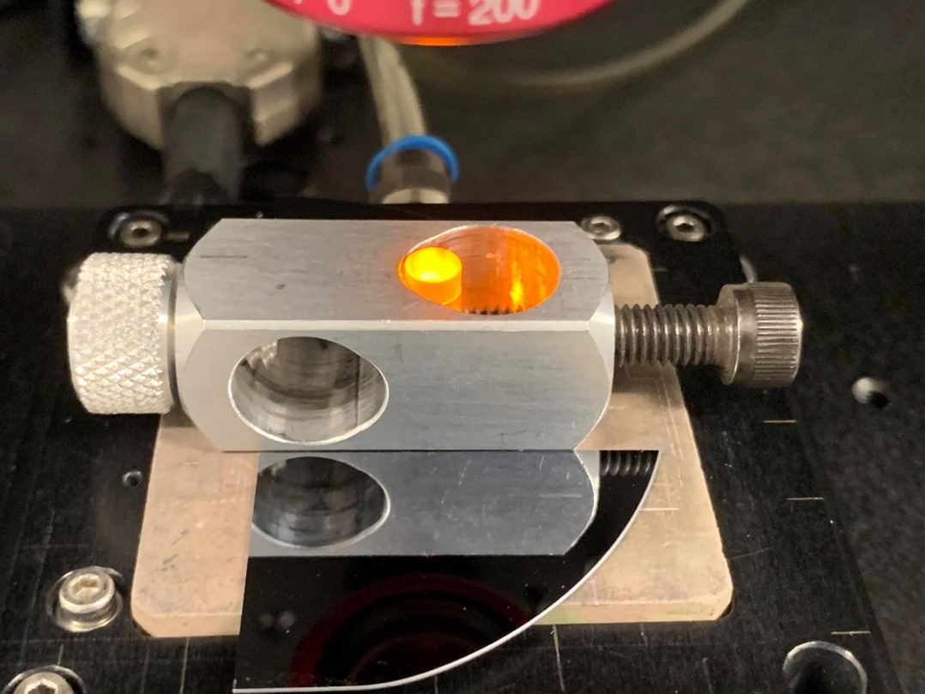
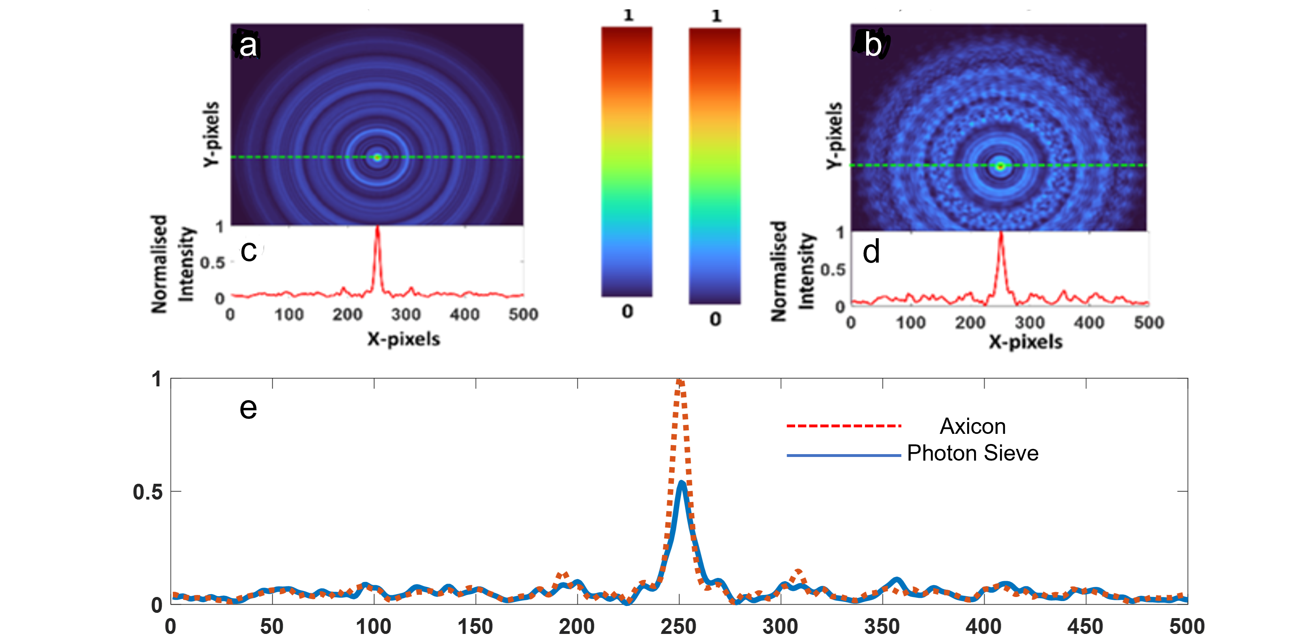
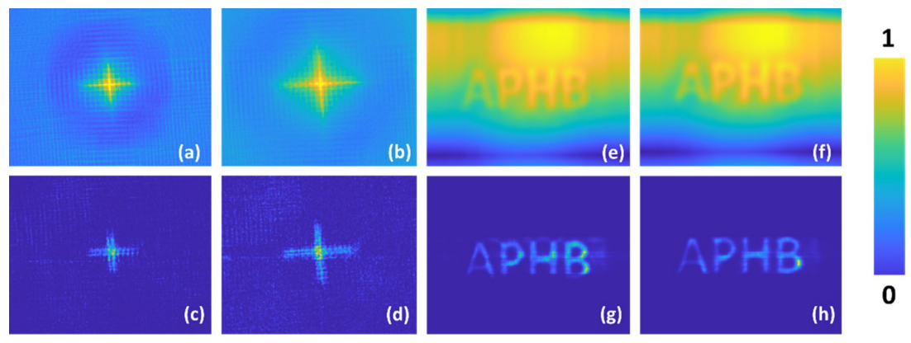
Imaging with Diffractive Axicons rapidly milled on Sapphire by Femtosecond Laser Ablation
Daniel Smith · Soon Hock Ng · Molong Han · Tomas Katkus · Vijayakumar Anand · Saulius Juodkazis
Single pulse burst femtosecond laser fabrication will produce a flatter and smoother profile of axicons milled on sapphire compared to a pulse overlapped fabrication which will result in a damaged and a much rougher surface.
The fabrication of large area (sub-1 cm cross-section) micro-optical components in a short period of time (~ 10 min) and with lesser number of processing steps is highly desirable and cost-effective.
We show manufacturing of three configurations the conventional axicon, a photon sieve axicon (PSA) and a sparse PSA directly milled onto a sapphire substrate.
Debris was removed using IsoPropyl alcohol and potassium hydroxide and amorphous sapphire was redeposited under incoherent illumination to test the components for optical viability.
A non-linear optical filter was used for cleaning noisy images which were generated by diffractive optical elements.
Laser
Mirror
PHAROS Laser (from Light Conversion, Lithuania)
Conditions: 200kHz, λ = 1030nm, 2.5W average power, 230fs pulse duration, and Mitutoyo Plan Apo NIR infinity corrected objective lens (0.14NA)
Two pulse bursts per ablation spot (with an exception for the axicon that did not use a pulse burst)
Conditions on Sample: Attenuated to 5 μJ to achieve the design ablation depth, spot diameter of d=8.9 μm, and Pulse energy of 69 TW/cm² at a fluence of 16 J/cm²
This is markedly larger than the ablation threshold of sapphire at ~2 J/cm² and ~10 TW/cm².
Laser
Lens
Ejection
Sapphire Glass
Optical microscope images of the axicon (a), PSA (b), and sparse PSA (c).
The axicon image (a), there are stitching errors which were later fixed.
Optical Profilometer results of the axicon (a) and the sparse PSA (b).
Depth of ablation was 360 nm for the axicon and 420 nm for the sparse PSA.
Axicon has a very binary (two step) level to it while the sparse PSA has a more gaussian shape to each pulse.
In the cases where multiple bursts were used the holes of the axicons and PSA’s contained ripple artifacts.
Intensity distribution obtained for an axicon (a) and PSA (b) with their corresponding locally normalised intensity profiles of the line data (c) and (d).
Comparison of universally normalised intensity profile of the line data for both axicon and PSA (e).
Intensity pattern observed at a distance v from the diffractive optical element is given as a convolution of the complex amplitude with the quadratic phase function Q(1/v):
$$I_{v}\left(\overline{r_{s}};\overline{r_{0}},u\right)={\left|C_{1}\sqrt{I_{0}}L\left(\frac{\overline{r_{0}}}{u}\right)Q\left(\frac{1}{u}\right)e^{−j\left(Φ_{DOE}\right)}⊗Q\left(\frac{1}{v}\right)\right|}^{2}$$
The fabrication time was only 10 min using the femtosecond fabrication method for a large area of 5 mm × 5 mm.
The method of fabrication enhanced imaging capabilities and we believe this direction of research will enable the fabrication of large area structures suitable for incoherent illumination and astronomical imaging applications.

