Slide 1
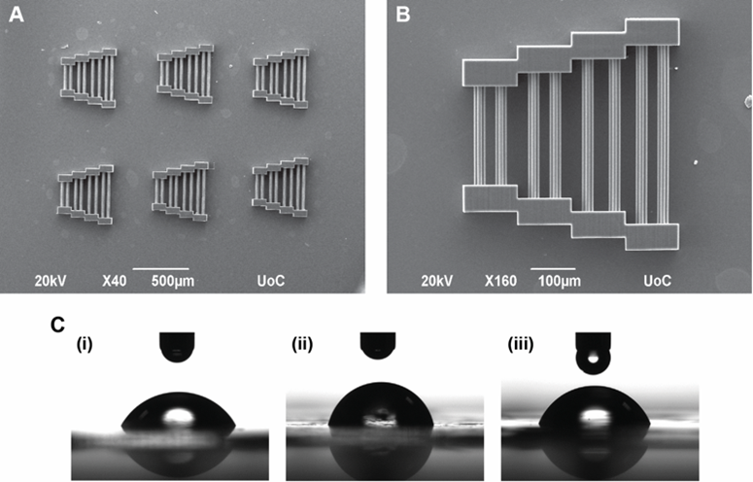
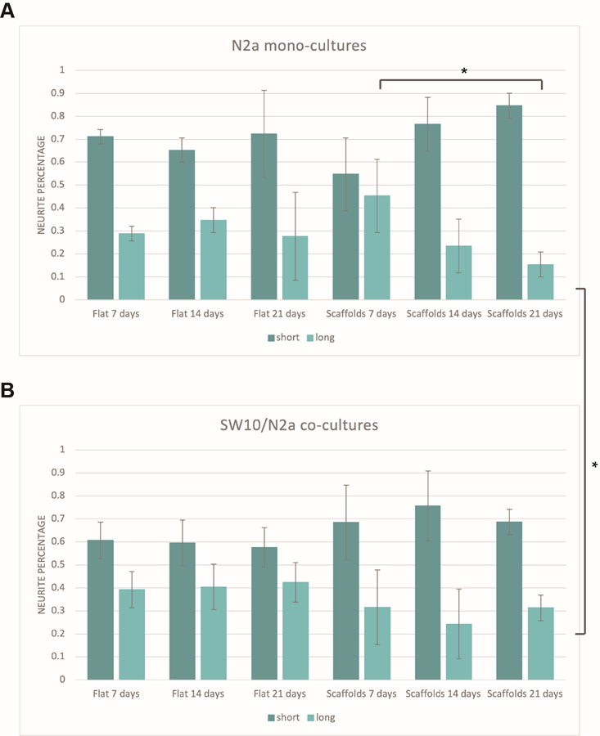
3D scaffolds via Multi-Photon Polymerization as a co-culture system for application in Peripheral Nervous System Regeneration.
Antonis Kordas^{1,2,*}, Phanee Manganas¹, Maria Farsari¹,Anthi Ranella¹
1Institute of Electronic Structure and Laser, Foundation for Research and Technology-Hellas (FORTH-IESL), 100 Nikolaou Plastira Street, Heraklion, 70013, Greece
2Department of Materials Science and Technology, University of Crete, Vassilika Vouton, Heraklion, 71409, Greece
^{*antkor89@iesl.forth.gr}
Introduction
Peripheral Nervous System (PNS) damage is oftentimes responsible for various neurodegenerative diseases that affect millions of people globally. Research interest has focused on the fabrication of scaffolds that can be used as culture substrates for the development of autografts for PNS treatment. Our interest revolves around the fabrication of such scaffolds via Multi-Photon Lithography (MPL). A novel scaffold geometry was used for the culture of glial Schwann (SW10) cells and murine Neuro-2a (N2a) cells both in in vitro mono-cultures and co-cultures. Cell responses such as adhesion, migration, orientation and proliferation were monitored and the effect of scaffold topography was examined compared to flat glass cultures which served as controls [1]. Our findings show that scaffold topography can affect cell responses, especially cell orientation and neurite outgrowth and directionality in a predetermined manner. Furthermore, the presence of SW10 cells benefit the growth of longer neurites, a valuable asset for bridging PNS trauma gaps in case of practical applications in the future.
Results
A
B
DAPI, phalloidin
Sample | MK/ Undeveloped | SBB/ Developed | SBB/ Undeveloped
Film 1 | 61.71° | 76.15° | 66.83°
Film 2 | 64.79° | 70.36° | 63.71°
Film 3 | 61.54° | 79.07° | 67.07°
Average | 62.68° | 75.19° | 65.87°
Standard deviation | 1.83° | 4.43° | 1.88°
Scaffolds fabricated via MPL using a hybrid organic/ inorganic material and two Photoinitiators (Pis), Michler’s ketone and Sudan Black B [1] as a means to quench autofluorescence [2] (A, B). Contact angle measurements of thin films with both PIs.
N2a differentiation. Percentage of short (<40μM) and long (>40μM) neurites for N2a mono-cultures (A) and SW10/N2a co-cultures (B). Both neurite populations are stable on flat glasses, whereas long neurites decrease over time on scaffolds in the case of N2a mono-cultures. The phenomenon is alleviated in the respective co-culture environment, highlighting the benefit of the SW10 presence for long neurite outgrowth. (n=3, *p<0.05)
C
DAPI, phalloidin, Tuj1
DAPI, phalloidin, Tuj1, Synaptophysin
Cell culture experiments of SW10 and N2a cells on flat glass coverslips and scaffolds monitored with Confocal (upper) and Scanning Electron Microscopy (lower) imaging for three timepoints (7, 14, 21 days). SW10 mono-cultures (A), N2a mono-cultures (B) and SW10/N2a co-cultures (C) were compared for cell orientation and neurite directionality. Cells migrate and saturate the scaffolds over time while exhibiting an orientation dictated by the scaffold topography compared to flat glasses which exhibit a random cell orientation and neurite outgrowth. Scale bars: Confocal images 30 μM, SEM images 10 μM.
References
[1]: Kordas A., Manganas P. et al., Materials 2022, 15, 4349-4365,https://doi.org/10.3390/ma15124349
[2]: Flamourakis, G. et al., Opt. Mater. Express 2021, 11, 801, doi:10.1364/OME.418269
1
2
Funding

