Slide 1
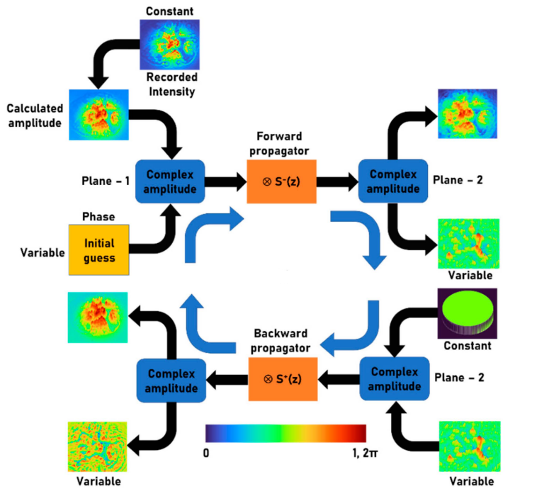
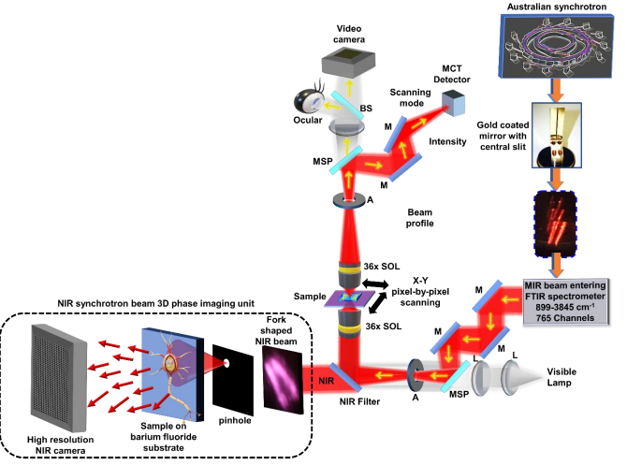
Three-dimensional Phase Imaging with Near Infrared Synchrotron Beam Using Phase-Retrieval Algorithm
Molong Han1,†, Daniel Smith1,†, Soon Hock Ng1, Tomas Katkus1, Aravind Simon John Francis Rajeswary2, Periyasamy Angamuthu Praveen2, Mark J Tobin3, Jitraporn Vongsvivut3, Saulius Juodkazis1,4 and Vijayakumar Anand1,2,*
1Optical Sciences Center, Swinburne University of Technology, Melbourne 3122, Australia;
2 Institute of Physics, University of Tartu, W. Ostwaldi 1, 50411 Tartu, Estonia;
3 Infrared Microspectroscopy (IRM) Beamline, ANSTO ‒ Australian Synchrotron, Clayton, Victoria 3168, Australia;
4WRHProgramInternational Research Frontiers Initiative (IRFI) Tokyo Institute of Technology, Nagatsutacho, Midoriku, Yokohama 226-8503, Kanagawa, Japan
†The authors contributed equally to this work; *vijayakumar.anand@ut.ee;
SUMMARY
METHOD
Near-infrared (NIR) synchrotron beam has been extracted and used for three-dimensional (3D) phase imaging.
A pinhole was inserted in the path of the fork shaped NIR synchrotron beam and the Airy diffraction pattern was aligned with biochemical samples
The diffracted intensity distribution was captured using an image sensor sensitive to NIR.
A phase retrieval algorithm was used to estimate the 3D phase distribution from the recorded intensity distribution
There are two planes of interest namely sample plane and sensor plane with two complex amplitudes ψ1 and ψ2 respectively with their intensities either known or measurable
Initially, assuming phase variable is zero at detector plane, the complex amplitude ψ1 can be simply expressed as √𝐼𝑜 (phase = 0). The complex amplitude at specimen plane ψ2 can be obtained by convolution of ψ1 and a forward spherical propagator 𝑆−(𝑧) = exp[−𝑗2𝜋𝑹/𝜆].
The resulting complex amplitude’s magnitude is replaced by the Airy intensity distribution or a constant valued matrix and the phase is retained.
This modified complex amplitude is propagated to the sensor plane using a spherical propagator 𝑆+(𝑧)= exp[𝑗2𝜋𝑹/𝜆]
The process will be repeated until estimation of phase images
EXPERIMENT
Optical configuration of the IRM system
IR beam extracted from the storage ring using a gold-coated mirror with a central slit has a fork shaped intensity distribution, which is focused using a Schwarzschild condenser on the sample[1]
After passing through the sample, the beam is refocused by a Schwarzschild IR reflecting objective
The beam then is collected by an MCT detector used for imaging in the single pixel scanning mode
Visible light is also aligned collinearly with the synchrotron-IR beam for alignment of the sample during beam alignment in the microscope
Figure 2 Schematic of the phase-retrieval algorithm[4]
RESULTS
The results obtained for two samples: randomly arranged latex beads with an average diameter of 15μm and an insect wing
Figure 1: Schematic of the Australian synchrotron’s IRM system and the attached synchrotron NIR phase imaging module (shown in the dotted line box). [4]
Figure 3: phase imaging results of both latex beads sample (top) and insect wing sample (bottom): (a) Intensity image, (b) amplitude image, (c) phase image, and (d) reference image of the bead samples. [4]
Attached NIR phase imaging module
The high frequency filter is used to remove high-frequency components and extract the NIR beam.
For getting a uniform intensity distribution, a pinhole was aligned with the maximum intensity region NIR beam and the Airy diffraction pattern was used to illuminate the biochemical sample.
The phase information was extracted from this recorded intensity distribution using the phase-retrieval algorithm [5-7].
CONCLUSION
A single shot, interferenceless phase imaging technique has been developed and demonstrated in the IRM system of the Australian Synchrotron for the first time.
The phase-retrieval used in this approach has a rapid convergence of 2-4 iterations which may allow real-time phase imaging with only a slight decrease in the temporal resolution
References:
[1] Cheeseman, S.; Truong, V.; Vongsvivut, J.; Tobin, M.J.; Crawford, R.; Ivanova, E.P. Applications of Synchrotron-Source IR Spectroscopy for the Investigation of Insect Wings; Intechopen: Rijeka, Croatia, 2019
[2] Anand, V., Katkus, T., Linklater, D.P., Ivanova, E.P., Juodkazis, S., “Lensless Three-Dimensional Quantitative Phase Imaging Using Phase Retrieval Algorithm,” J. Imaging 6(9), 99 (2020).
[3] Hai, N., Rosen, J., “Phase contrast-based phase retrieval: a bridge between qualitative phase contrast and quantitative phase imaging by phase retrieval algorithms,” Opt. Lett. 45(20), 5812-5815 (2020).
[4] Han, M., Smith, D., Ng, S. H., Katkus, T., John Francis Rajeswary, A. S., Praveen, P. A., Bambery, K. R., Tobin, M. J., Vongsvivut, J., et al., “Single shot lensless interferenceless phase imaging of biochemical smples using synchrotron near Infrared Beam,” Biosensors 12(12), 1073 (2022).

