Slide 1
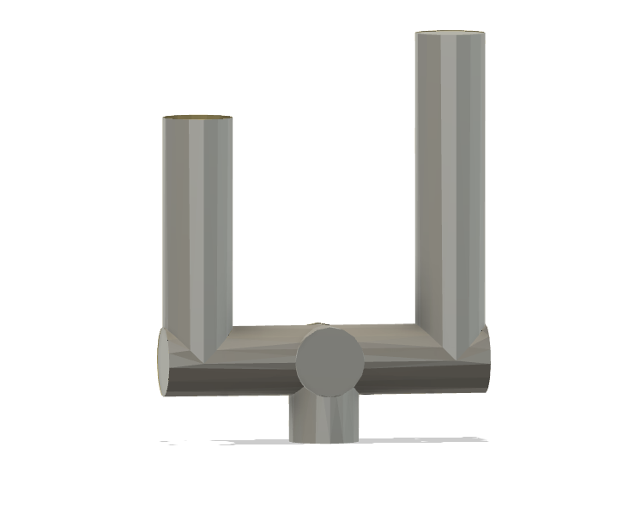
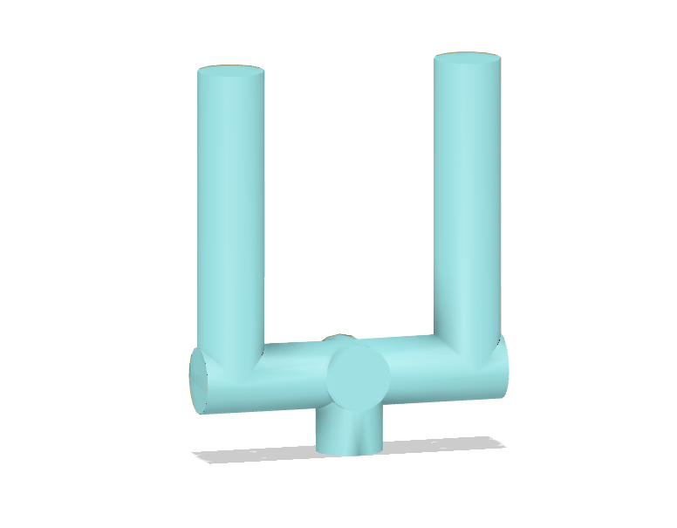
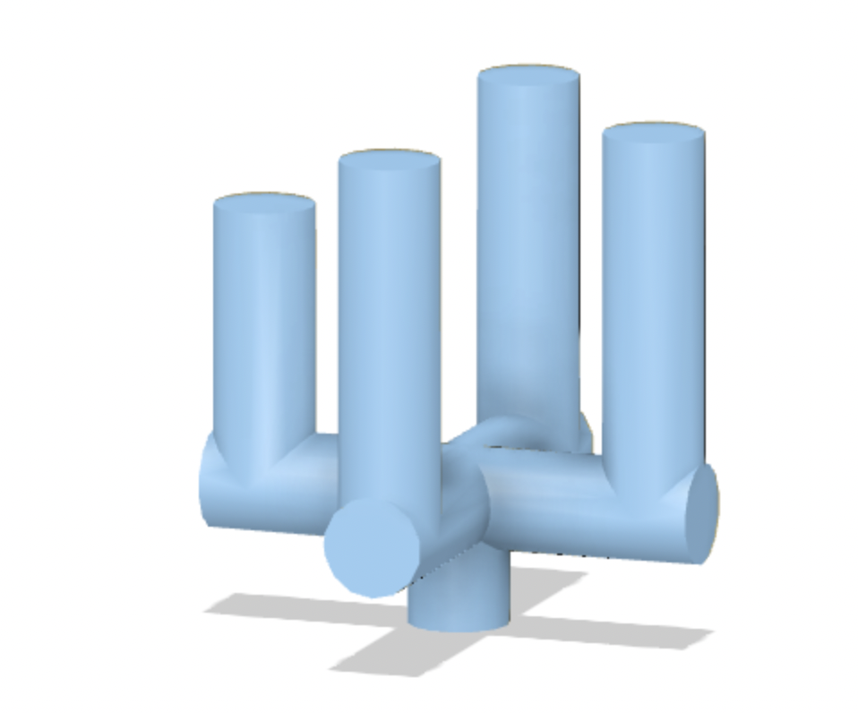
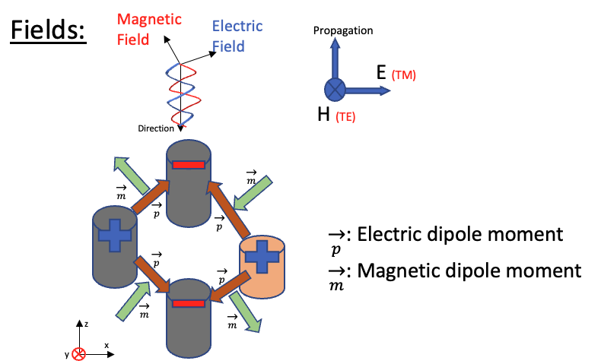
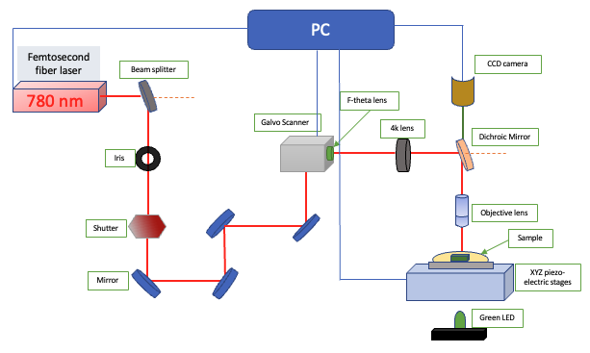
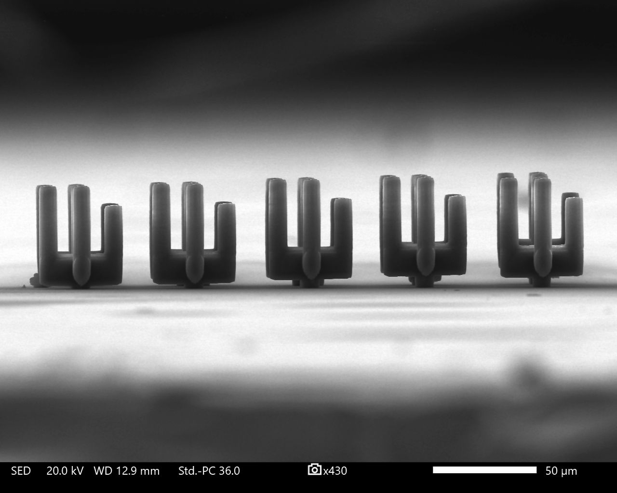
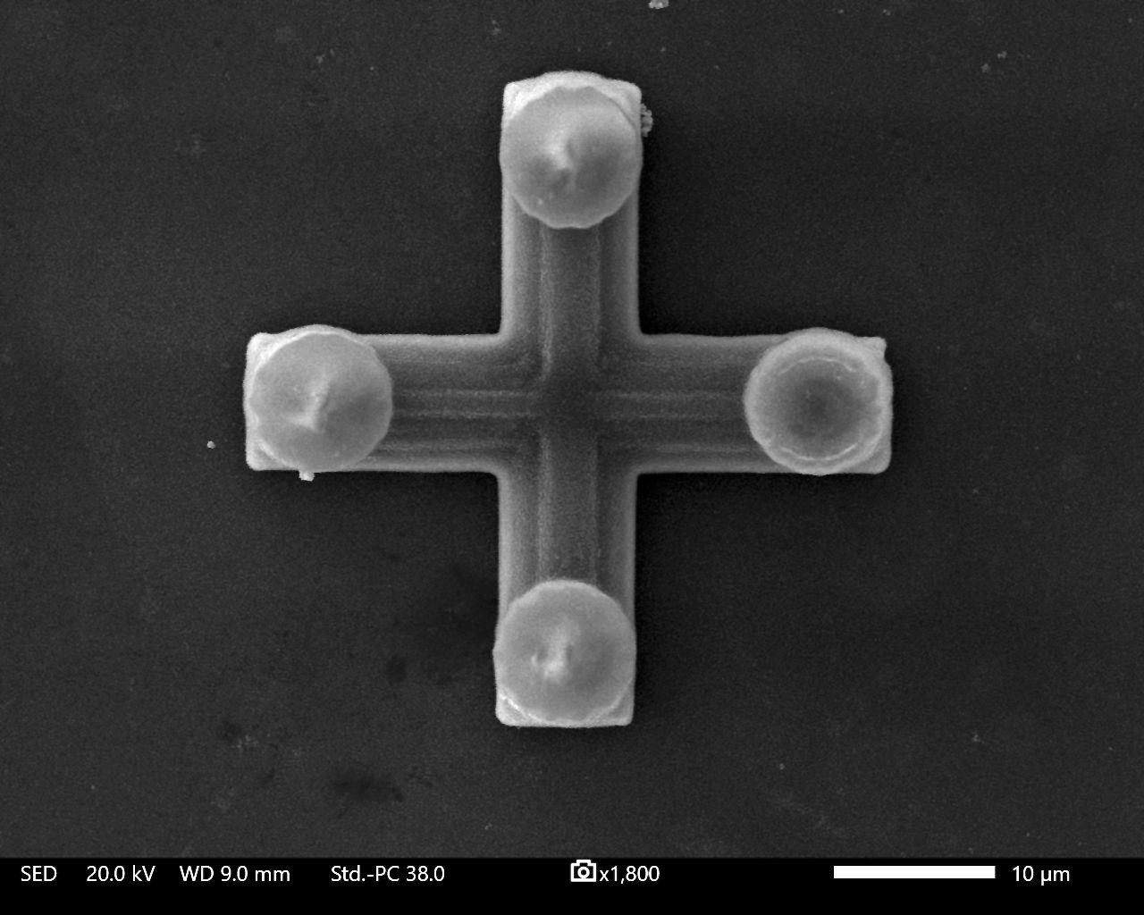
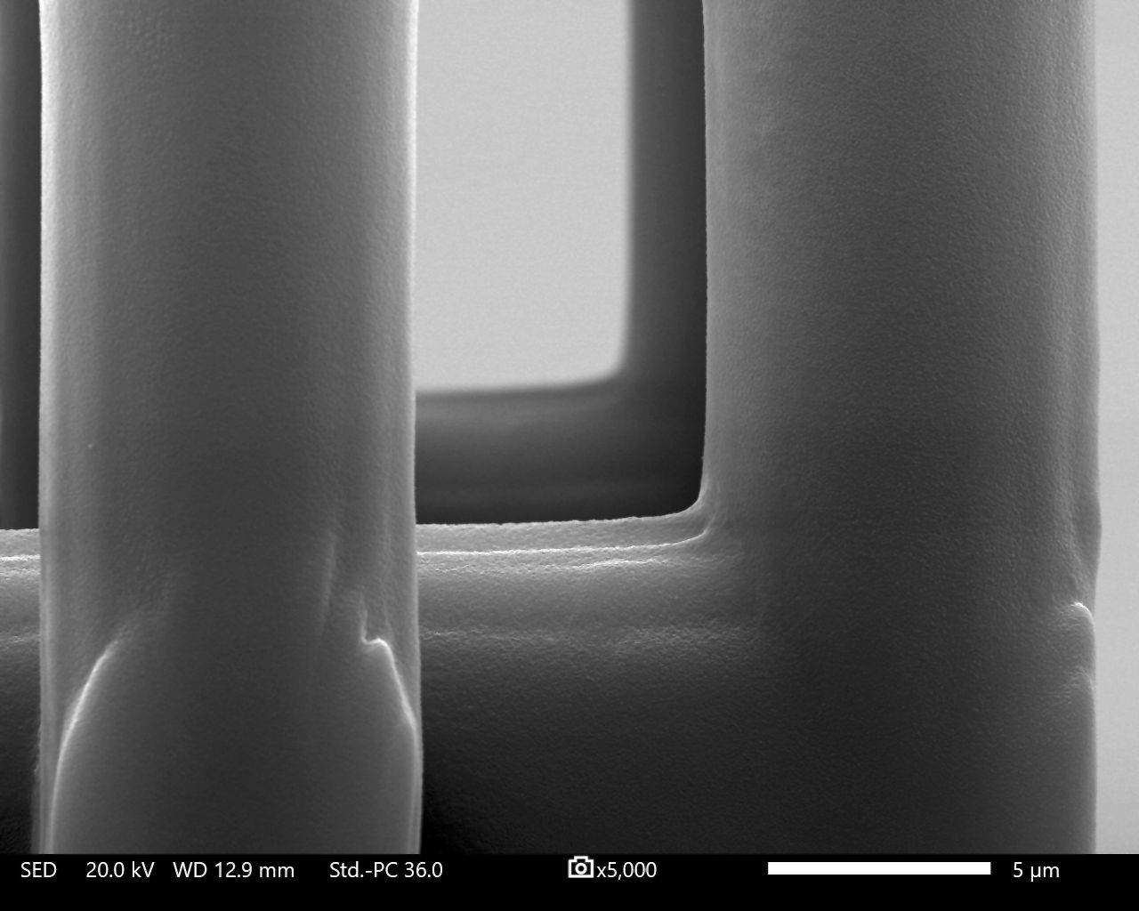
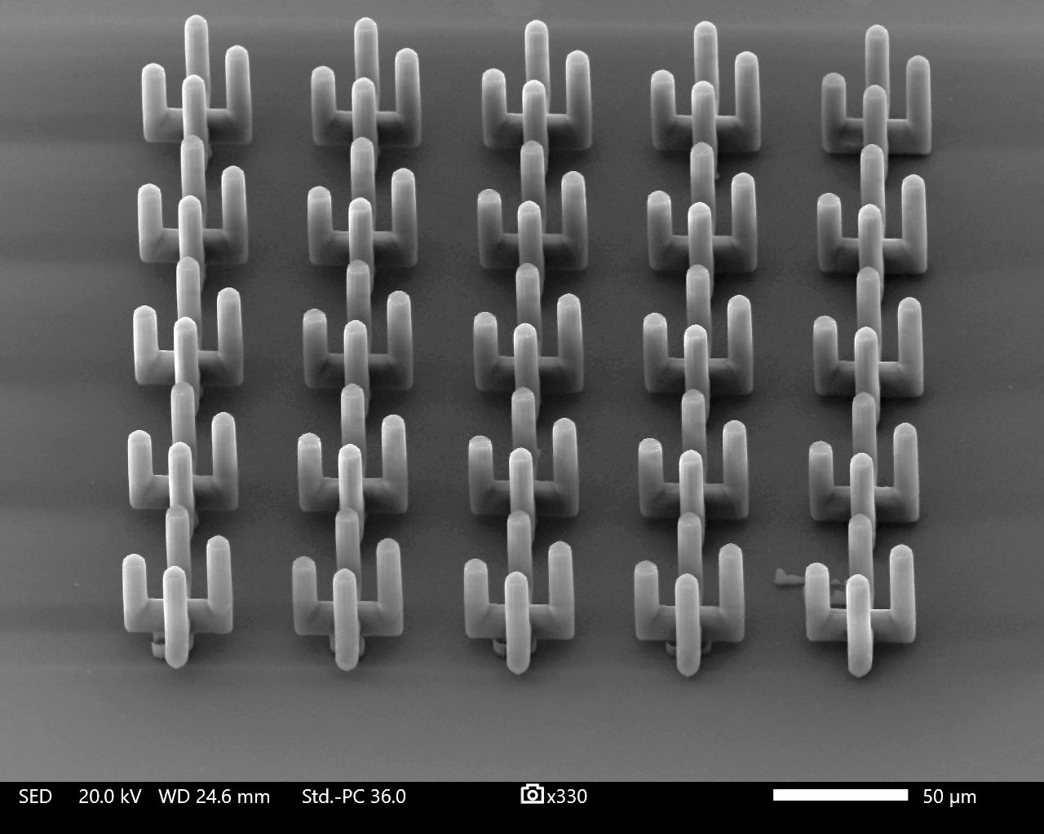
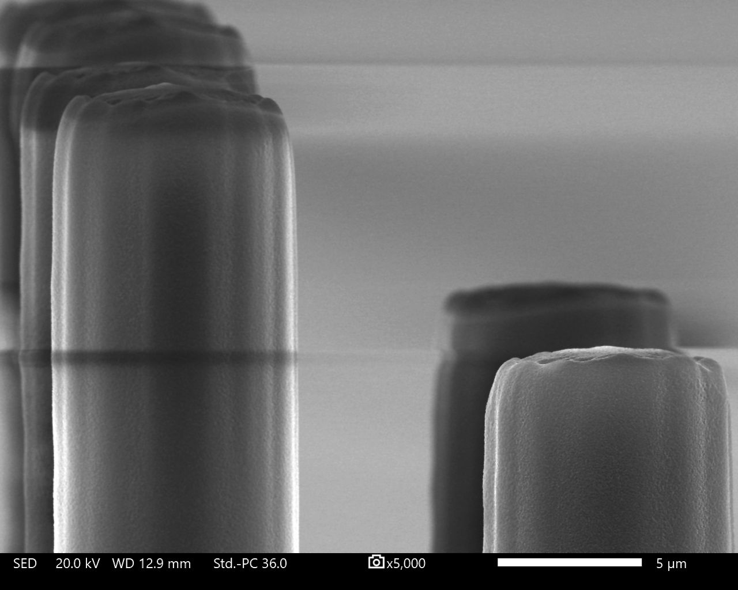
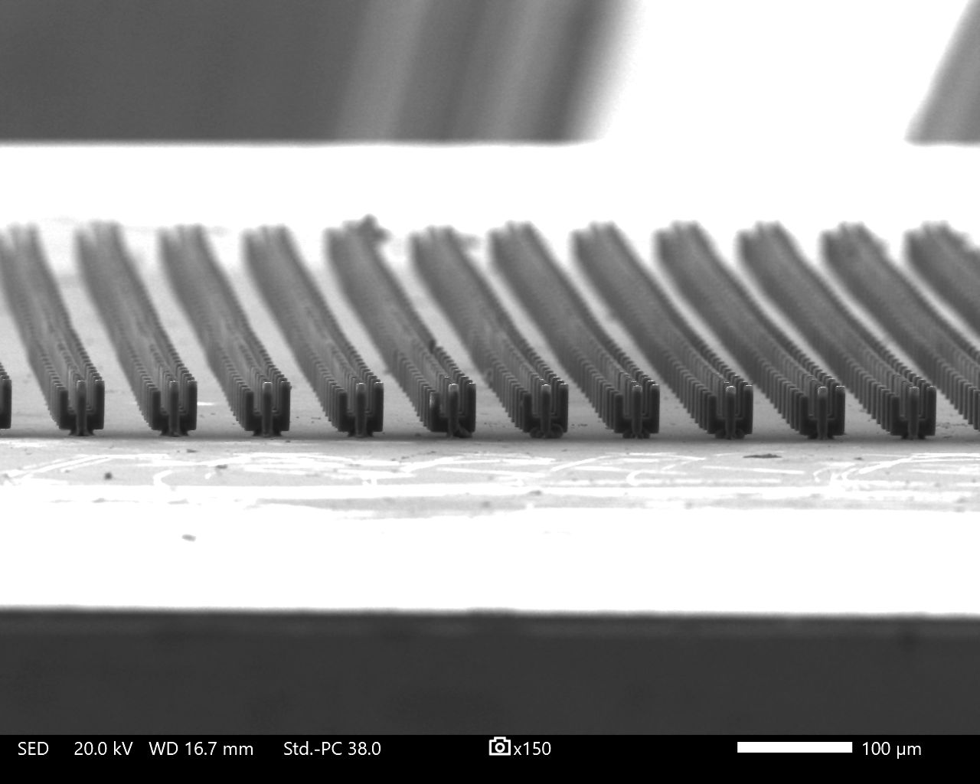
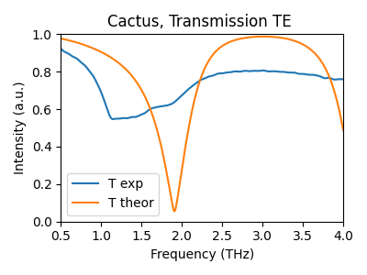
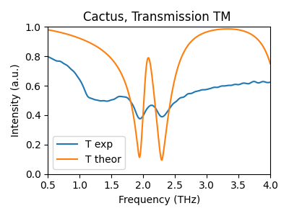
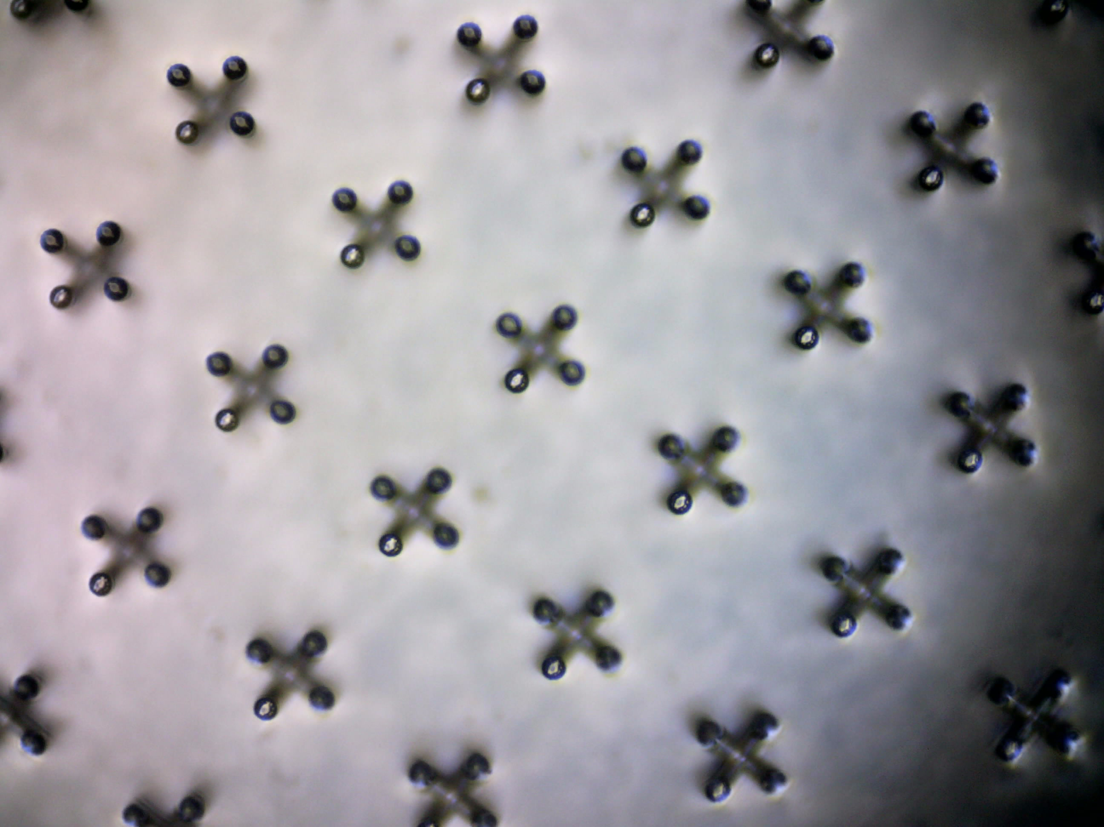
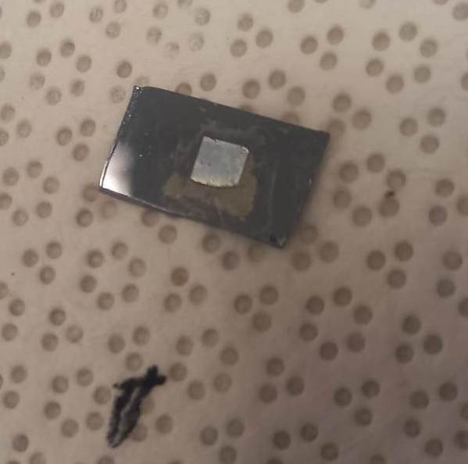
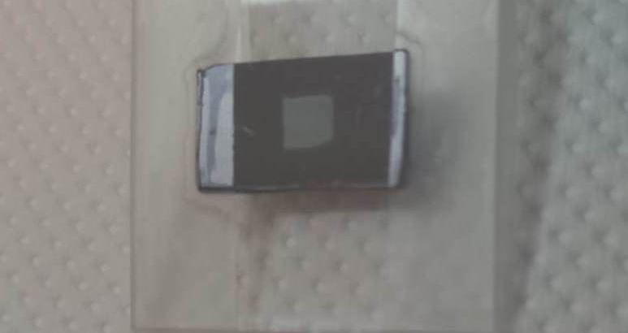
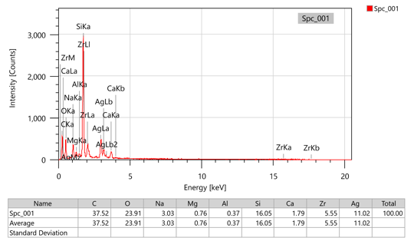
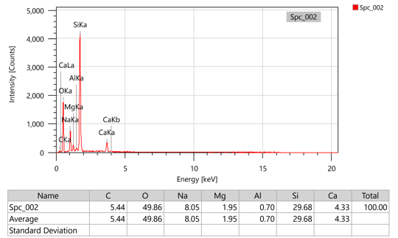
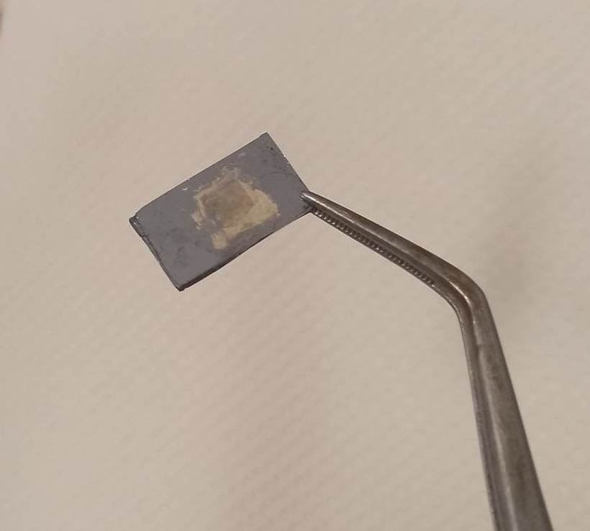


Fabrication and analysis of 3D low THz metamaterials
S. Papamakarios^{1,2} *, O. Tsilipakos^{2,3}, A. Koulouklidis², S. Tzortzakis^{2,3}, M. Kafesaki^{2,3}, M. Farsari² *
Department of Physics, University of Crete, Vassilika Vouton, Heraklion, 71409, Greece
Institute of Electronic Structure and Laser, Foundation for Research and Technology – Hellas (FORTH – IESL) , 100 Nikolaou Plastira Street, Heraklio, 70013, Greece
Department of Materials Science and Technology, University of Crete, Vassilika Vouton, Heraklion, 71409, Greece
* spapamakarios@physics.uoc.gr
Introduction
Materials and methods
Metamaterials are artificially designed materials with properties that derives from their sub-wavelength structure. Optical metamaterials enable strong light-matter interaction over a broad range of the electromagnetic spectrum not achievable by any existing material in nature. Using MPL for metamaterial research is further underlined by demonstrating a procedure to process metamaterials operating at low THz.
As a photosensitive material for the MPL an organic – inorganic photopolymer SZ2080™[1] was used. The structures were further processed using selective electroless plating to cover the polymer with silver via chemical procedure[2] in order to create a metallo-dielectric material. Simulations were done first with FDTD to define the optimal geometry and experimental measurements of S-parameters conducted after MPL process.
State of the art metamaterial design
x TM(0,0)
k
y TE(0,0)
y TE(0,0)
x TM(0,0)
Asymmetric U-SRR
Symmetric U-SRR
Electromagnetically Induced Transparency (EIT)
  SEM images
3D THz metamaterial filter for low THz
Fig 1. Image of metallic metamaterial.
Fig 2. SEM image of fabricated metamaterial.
Fig 3. Results for TE mode
Fig 4. Results of TM mode.
  Selective electroless silver coating
Fig 1. Images of the fabricated structure.
Fig 2. SEM image of silver coating.
Table 1. EDX measurement on the fabricated structure.
Table 2. EDX measurement on the substrate.
Funding
This research project has received funding from the EU's H2020 framework programme for research and innovation under grant agreement NFFA-Europe-Pilot (n. 101007417)
References
Farsari, M., Chichkov, B. Two-photon fabrication. Nature Photon 3, 450–452 (2009). https://doi.org/10.1038/nphoton.2009.131
Sakellari, I., Yin, X., Nesterov, M. L., Terzaki, K., Xomalis, A., Farsari, M., Advanced Optical Materials 2017, 5, 1700200. https://doi.org/10.1002/adom.201700200

