Slide 1
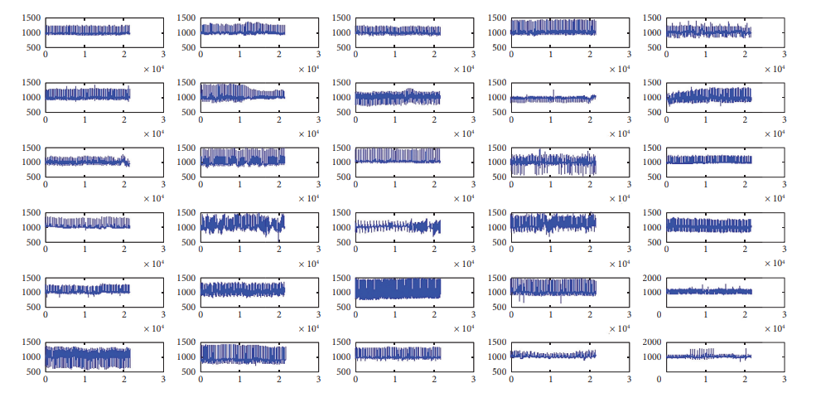
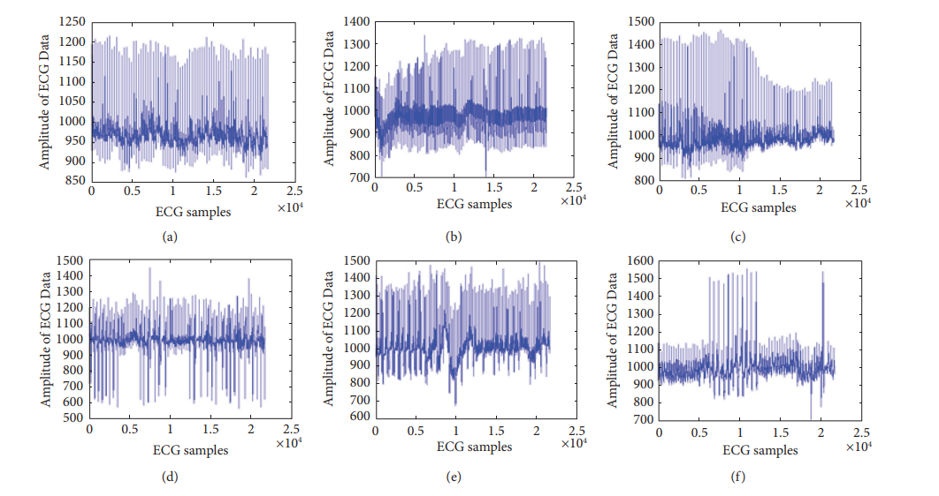
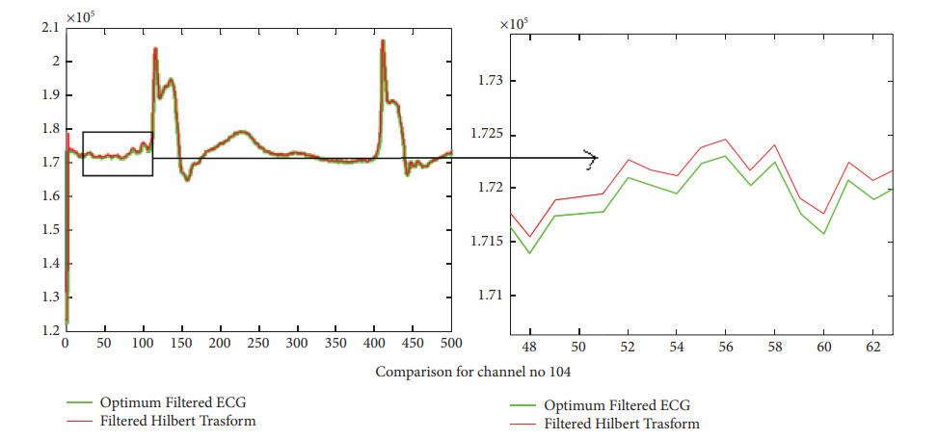
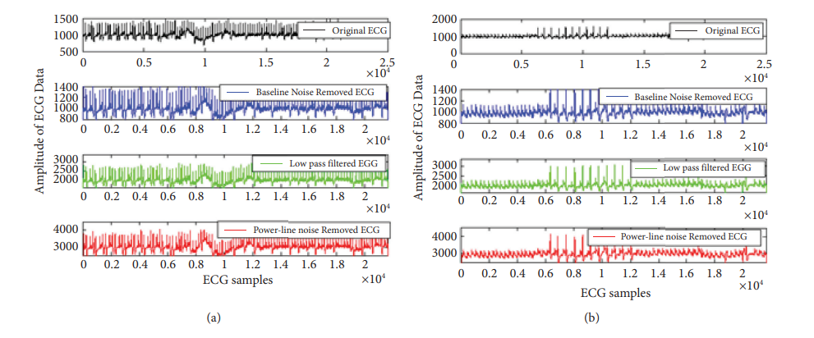
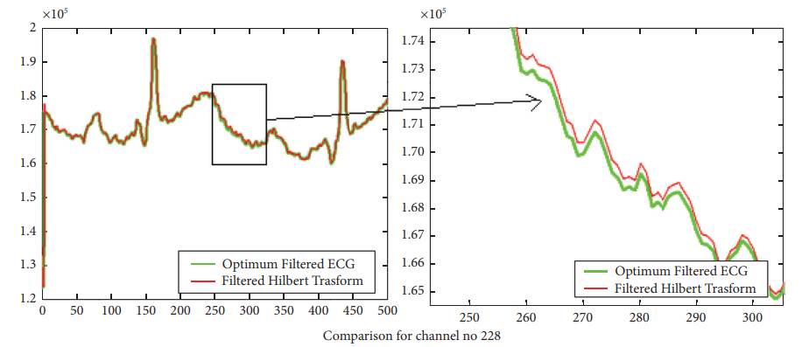
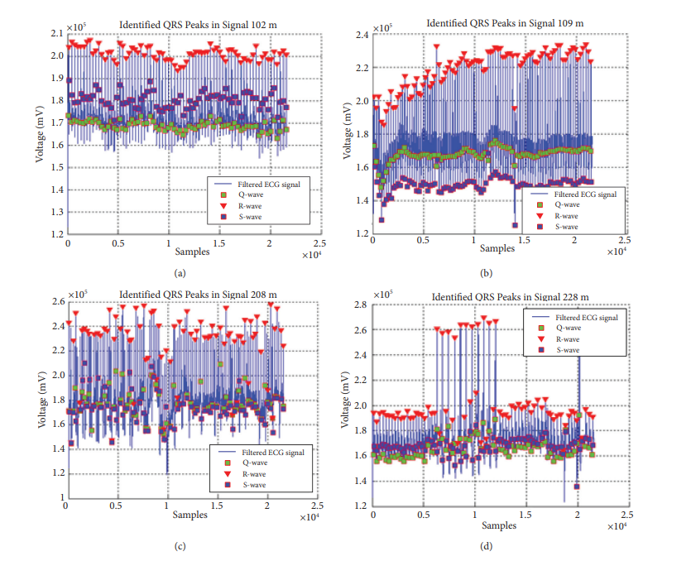
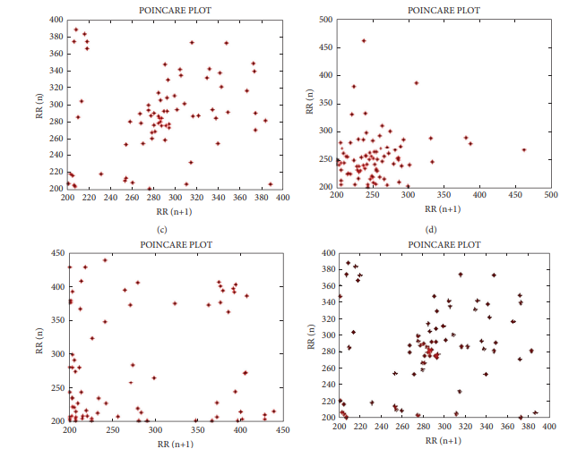
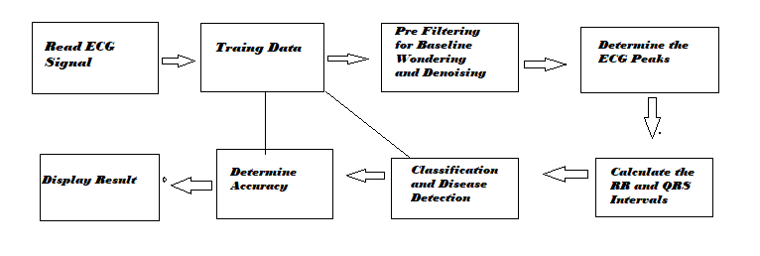
An Efficient Designing of IIR Filter for ECG Signal Classification Using MATLAB
N.Manjula1, Dr. Ngangbam Phalguni Singh2 and Dr. P. Ashok Babu*
K L Deemed to be University 1,2 and Institute of Aeronautical Engineering*
INTRODUCTION
RESULTS & DISCUSSION
Comparative analysis for Statistics parameters
The electrocardiogram (ECG) is a biological signal that is frequently employed and plays a significant role in cardiac analysis.
In this article, a brand-new method for classifying and detecting QRS peaks in ECG data based on artificial intelligence is provided.
The integration of the ECG signal data is proposed using a reduced order IIR filter design using the min-max method.
Heart rate and ECG signals are used to evaluate a healthy heart. A cardiac arrhythmia is recognized if we record an ECG from a patient and there is any nonlinearity.
The main focus of this study is on removing baseline uncertainty and power line interferences from the ECG signal.
Outside electromagnetic field incursion, noise, power line interference (PLI), which comprises crucial cardiac foundations, frequency determination, and signal superiority.
It is advised to solve the issue of contaminated noise removal because it improves accuracy and is crucial for the ECG data.
Using IIR Filter Design Algorithm to find Transfer function coefficients are optimized in a sequential manner, as demonstrated in the sequential Min-Max optimization technique.
Results of Optimized Filter ECG Design: Simulation Results of QRS Peak Detection in MATLAB ECG Image Classification
Figure 5: For perceptual result representation, six distinct ECG data with various feature difficulties
Figure 2: Enter data from the 5.556-second ECG Figure 3: For perceptual result representation, six distinct Figure 4 : Hilbert transform for channel number 105.
arrhythmia database of 35 people recorded ECG data with various feature difficulties
Figure 5: For the 3500 samples, ECG signal pre-processing is plotted for the Figure 6:The channel number 228's R peak detection efficiency
(a) 101th ECG data and (b) 106th ECG data.
Time Domain HRV Parameter Analysis Results of HRV analysis
Figure 7: Results of the suggested optimum IIR filter technique for Figure 8: Results of HRV analysis
QRS peak identification for four ECG signals
Below Table shows that comparative analysis for statistics parameters of existing method with proposed method.
Ref. No. | Accuracy | QRS peak detection | RR interval | HRV Analysis
Y. Kaya et al, Journal Biomedical Research,2017 | 85% | No | NO DETECTED | No
Y. Kaya and H. Pehlivan, International Conference. on IEEE ,2015 | 85.6% | No | NO DETECTED | No
M. S. Manikandan et al, Journal Biomedical Signal Processing and Control,2012 | 88% | No | NO DETECTED | YES
H. Kaur and R. Rajni,Wireless Personal Communications, 2017. | 89% | No | NO DETECTED | No
V. Verma and S. S Rathore, International Journal of Advances in Engineering & Technology, 2015. | 90% | YES | DETECTED | YES
A. K. Dohare et al, Computers & Electrical Engineering, vol. 40, no. 5, pp. 1717– 1730, 2014 | 91% | YES | DETECTED | NO
L. S. Sargar et al, J. Healthcare Eng. 2017 | 92.67% | YES | DETECTED | YES
Proposed work | 96.87% | YES | DETECTED | YES
OBJECTIVES
Objectives of Research:
Designing an efficient IIR filter for ECG signals to identify heart problems was the main focus of the design, analysis, and implementation of the following subsystems are categorized as the work flow in order to create an effective model for ECG analysis.
implementation of modules such arithmetic circuits for filters used in ECG signal classification as well as the construction of parallel prefix circuits.
creating an algorithm that can identify the difficult QRS problem in real-time ECG classification, we may further investigate the effective filter utilized in ECG signal classification.
Pan- Tompkins Peak Detection Approach & IIR Filter Design
REFERENCES
There are numerous strategies created to enhance the effectiveness peak detection and classification efficiency in two current filtering techniques—Pan-Tompkins and a 60 order IIR filter.
Y. Kaya, H. Pehlivan, and M. E. Tenekeci, “Effective ECG beat classification using higher order statistic features and genetic feature selection,” Journal Biomedical Research, vol. 28, pp. 7594–7603, 2017.
Y. Kaya and H. Pehlivan, “Feature selection using genetic algorithms for premature ventricular contraction classification,” in Proceedings of the Ninth International Conference. on IEEE Electrical and Electronics Engineering, pp. 1229–1232, Bursa, Turkey, November 2015.
M. S. Manikandan and K. P. Seaman, “A novel method for detecting R-peaks in electrocardiogram (ECG) signal,” Journal Biomedical Signal Processing and Control, vol. 7, pp. 118–128, 2012.
H. Kaur and R. Rajni, “On the detection of cardiac arrhythmia with principal component analysis,” Wireless Personal Communications, vol. 97, no. 4, pp. 5495–5509, 2017.
V. Verma and S. S Rathore, “Comparative study of qrs complex detection by threshold technique,” International Journal of Advances in Engineering & Technology, vol. 8, Article ID 22311963, 2015.
A. K. Dohare, V. Kumar, and R. Kumar, “An efficient new method for the detection of QRS in electrocardiogram,” Computers & Electrical Engineering, vol. 40, no. 5, pp. 1717– 1730, 2014.
L. S. Sargar, M. M. Gharat, S. N. Bhat, and U. R. Bagal, “Automated detection of R-peaks in electrocardiogram,” International Journal of Scientific Engineering and Research, vol. 6, pp. 1265–1269, 2015.
V. Roy and S. Shukla, “Designing efficient blind source separation methods for EEG motion artifact removal based on statistical evaluation,” Wireless Personal Communications, vol. 108, no. 3, pp. 1311–1327, 2019.
V. Roy and S. Shukla, “A methodical health-care model to eliminate motion artifacts from big EEG data, JOEUC, big data analytics in business,” Healthcare & Governance, vol. 29, pp. 1546–2234, 2016.
T. Sharma and K. K. Sharma, “QRS complex detection in ECG signals using the synchrosqueezed wavelet transform,” IETE Journal of Research, vol. 62, no. 6, pp. 885–892, 2016.
Optimum Reduced Order IIR Filter Design
Figure 1: Image detection and classification methods
CONTACTS
N.Manjula, Research Scholar, ECE Department, Koneru Lakshmaiah Education Foundation (K L Deemed to be University), Andhra Pradesh; n.manjula@iare.ac.in

