Slide 1
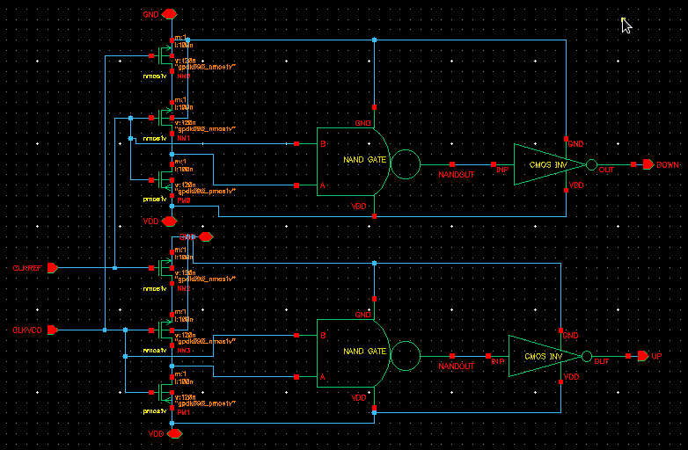
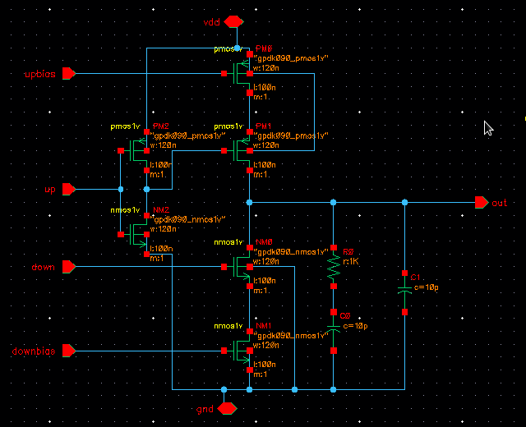
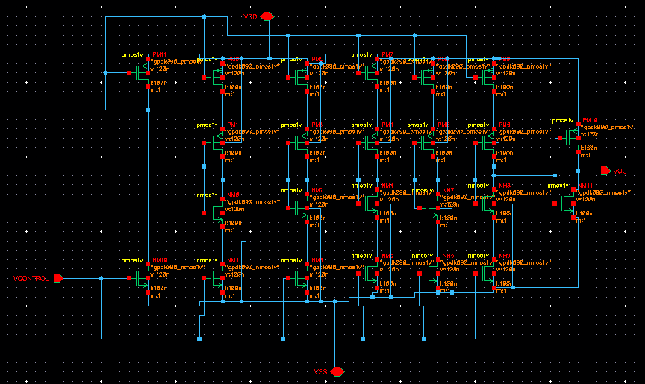
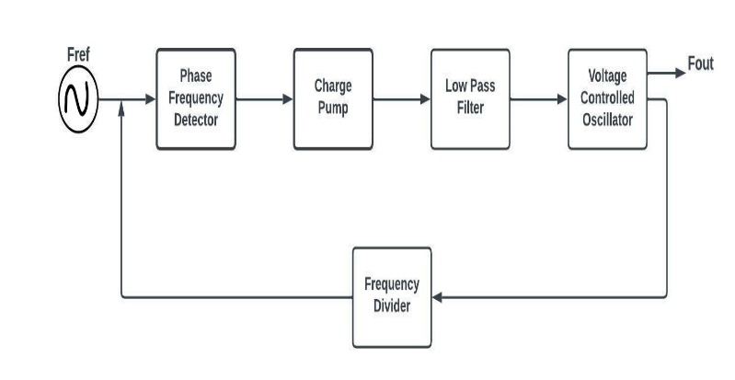
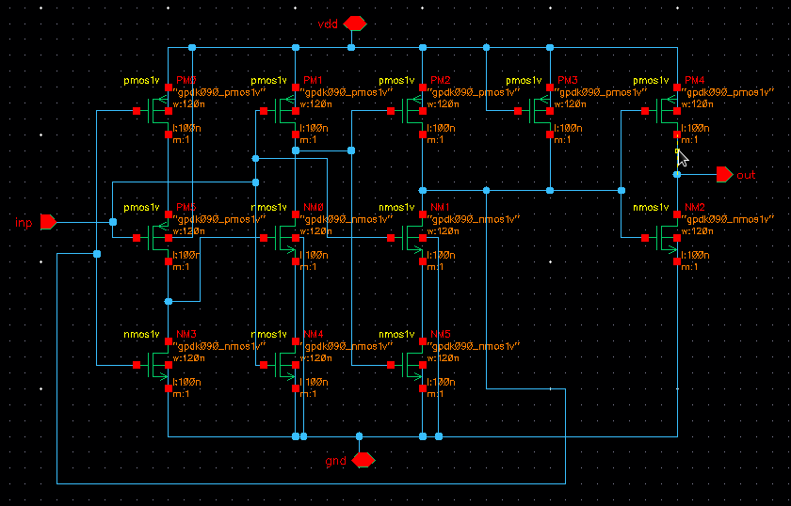
LOW POWER PHASE LOCKED LOOP
Chandra Keerthi Pothina , Chella Santhosh , Ngangbam Phalguni Singh , M.Ravi Kumar and J Lakshmi Prasanna
Department of Electronics and Communication, Koneru Lakshmaiah Education Foundation, Guntur India
1. INTRODUCTION
3. DESIGN IMPLEMENTATION
5. COMPARISON BETWEEN PROPOSED AND EXISITNG PLL DESIGN
A PLL is used in all SOC devices, it has a negative feedback loop that controls the phase of the output signal with the input signal along with phase error.
It mainly consists of four blocks called phase frequency detector, charge pump with low pass Filter, a voltage controlled oscillator and a frequency divider.
(ϵ_{r} = 4.4)
 | Existing PLL | Proposed PLL
Number of transistors | 56 | 48
Voltage supply | 1.8 V | 1.8 V
Operating frequency | 1 GHz | 1 GhHz
Power consumption | 4.2mW | 194.24 µW
Technology Node | 90nm | 90nm
2. METHODOLOGY
Fig 2. Schematic of Phase frequency detector
A PLL is designed using 90 nm CMOS technology node with 1.8V supply voltage.
PLL design has power consumption as low as 194.26µW with better transient analysis and DC analysis in an analog-to-digital environment.
The proposed PLL design provides the best solution for many applications where a PLL is required due to its high performance but has to be accommodated in less area and low power consumption than state-of-the-art methods.
6. CONCLUSION
From the analysis the proposed PLL design has 14% decrease in number of transistors with reduced area and 1000 times less power consumption. So, the proposed PLL can be used effectively used in low power digital electronic applications and compact devices.
Fig 3. Charge pump with low pass filter
7. References
P. Patil and V. Ingale, "Design of a Low Power PLL in 90nm CMOS Technology," in IEEE 5th International Conference for Convergence in Technology, 2019.
G. Bhargav, G. Prasad, S. Canchi and B. Chanikya, "Design and analysis of phase locked loop in 90nm CMOS," in In 2016 Thirteenth International Conference on Wireless and Optical Communications Networks (WOCN) (pp. 1-7). IEEE., 2016.
S. A. K. A. U. &. X. Adesina, N. O., , "An Ultra-Low Power MOS2 Tunnel Field Effect Transistor PLL Design for IoT Applications.," in Electronics and Mechatronics Conference (IEMTRONICS) (pp. 1-6). IEEE, 2021.
Fig 4. Schematic of voltage controlled oscillator
Fig 1. Block diagram of PLL
Low power consumption, low area has been achieved by optimising the design of individual components of the PLL circuit.
Fig 5. Schematic of frequency divider

