Slide 1
Advanced driver fatigue detection by integration of OpenCV DNN module and Deep learning
Allanki Srinivas
Muzammil Parvez
R S Ernest Ravindran

Slide 2
ABSTRACT
Road safety is significantly impacted by drowsiness or weariness, which is a primary contributor to auto accidents. If drowsy drivers are informed in advance, many fatal incidents can be avoided. Over the past 20 to 30 years, the number of road accidents and injuries in India has been rising alarmingly. According to the experts, the main cause of this issue is that drivers who do not take frequent rests when travelling long distances run a great danger of becoming drowsy, which they frequently fail to identify early enough. There are several drowsiness detection techniques that track a driver's level of tiredness while they are operating a vehicle and alert them if they are not paying attention to the road. This study describes a noncontact way for determining a driver's tiredness utilising detecting techniques.

Slide 3
PROBLEM IDENTIFICATION
Drowsiness is a condition that exists between being awake and asleep and may be defended by the steady decline in cortical cognitive power. Additionally, a desire or tendency to sleep is connected to it.
Human performance factors essential to safe driving, such as response time, attentiveness, and information processing, are impacted by drowsiness.
Thus, for professional or specific drivers, a real-time drowsy driver evaluation system that alerts the driver when the first signs of exhaustion arise can prevent collisions by avoiding and minimizing sleep episodes.
In this study, a technique for sleepiness detection based on adjustments in image processing is proposed.

Slide 4
DRAWBACKS FOR EXISTING MODEL
Lack in categorization.
Poor decision-making support.
High in computational complexity may lead wrong classification.
Cannot be able to support large databases.

Slide 5
PROPOSED WORK
The CNN object detection framework is the first object detection framework to provide competitive object detection rates in real-time proposed.
After the face is detected using CNN , the region containing the eyes and mouth has to be separated. An image which taken inside a vehicle includes the driver’s face.
The input image is given as the input image so that the identification of the driver's drowsiness is analyzed and detected based on the given test sample image.
Use of OpenCV DNN module helps in detecting face during occlusions and side faces which is used as another parameter in detecting drowsiness.

Slide 6
ADVANTAGES OF PROPOSED SYSTEM
High in accuracy because of using OpenCV DNN module for face detection.
Modified CNN approach provide better accuracy compare with other works.
Detection is done even when eyes and mouth are not detected and by using face as the primary parameter during this case.

Slide 7
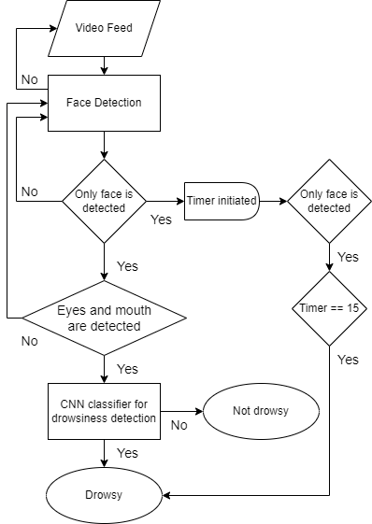
ARCHITECTURE DIAGRAM

Slide 8
CONCLUSION
For face detection, it was shown that the OpenCV DNN module outperformed Viola Jones, Dlib, and MTCNN.
The categorization process employs a modified CNN. The accuracy rate of the system is 96.8%. By evaluating the validation accuracy while using the validation dataset for model training, the model was proven to be accurate.

Slide 9
FUTURE WORK
The detection can be improved by using an infrared camera for low-light situations.
Counting frequent yawns over a certain amount of time might also help in identifying drowsiness.
Utilize a multi-model machine-learning approach and include additional modalities, such as the audio channel, in addition to the video frames, to enhance performance.

