Slide 1
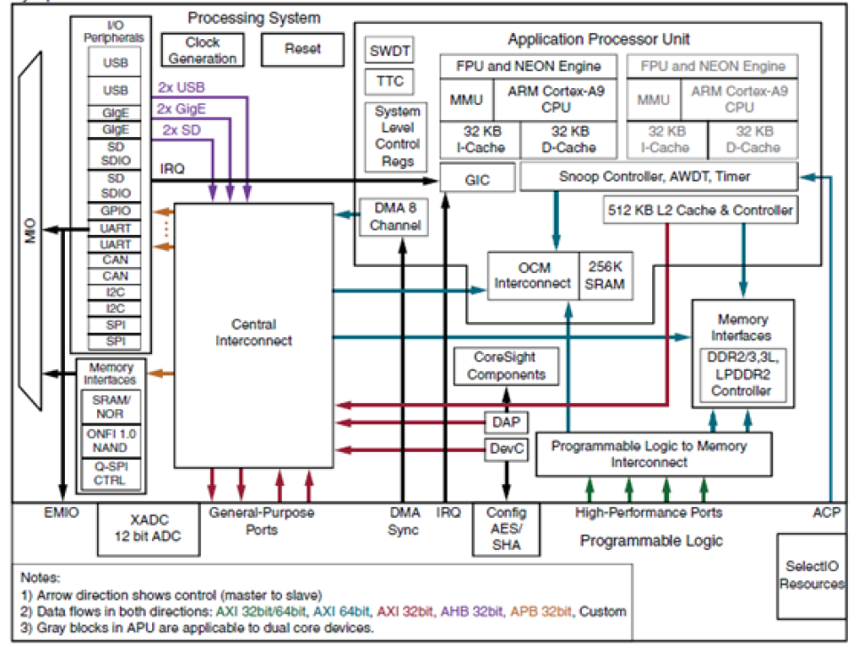
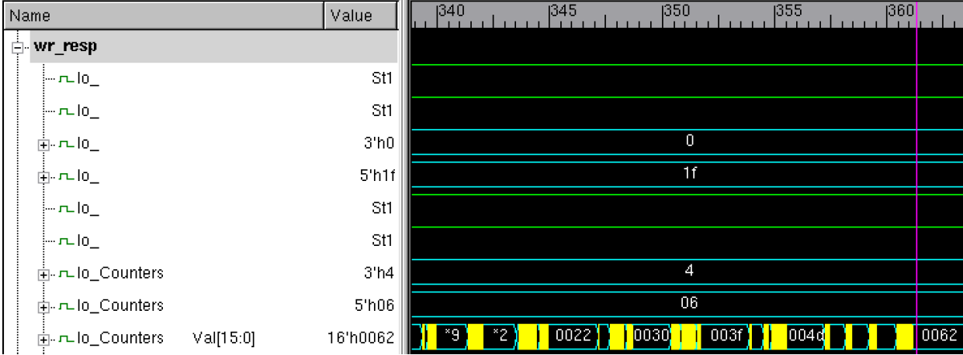
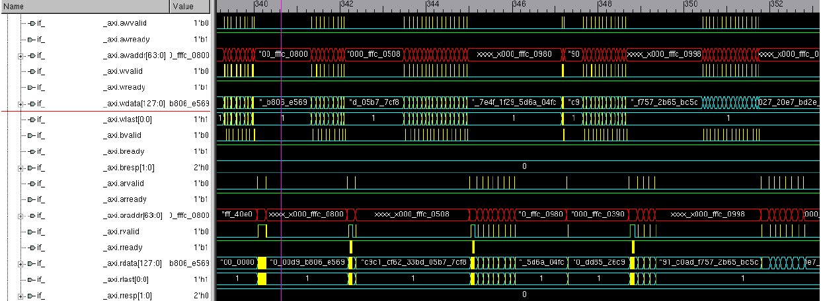
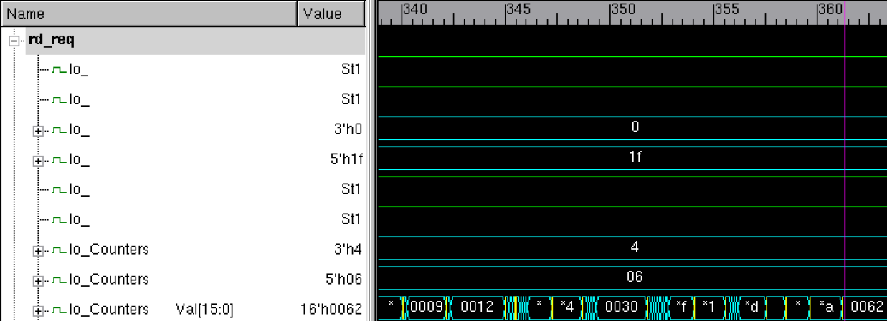
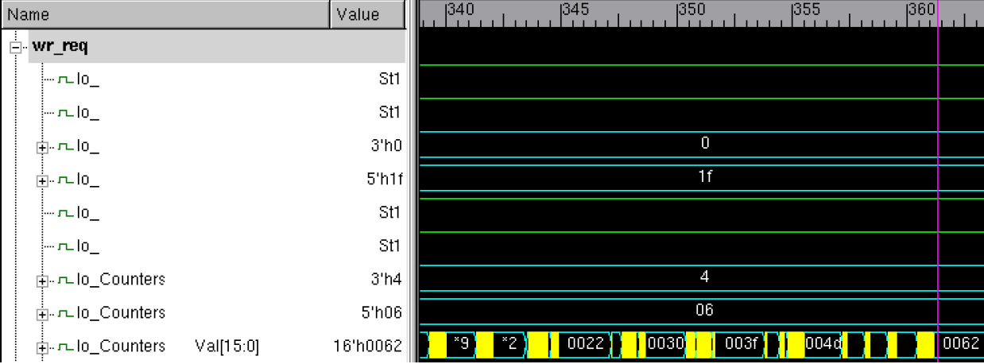
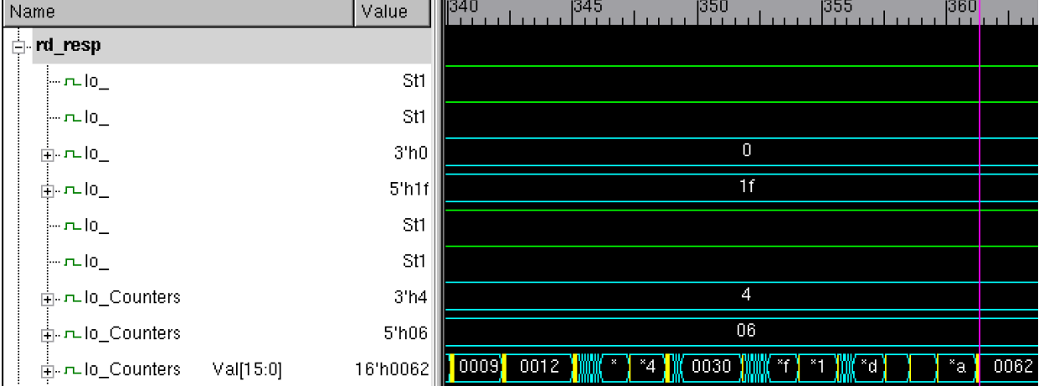
Verification of SoC using Advanced Verification Methodology
Pranuti Pamula, Durga Prasad Gorthy, Phalguni Singh Ngangbam and Aravindhan Alagarsamy,*
Multi-Core Architecture Computation (MAC) Lab, Department of ECE, Koneru Lakshmaiah Education Foundation, Andhra Pradesh,522501
AMD, Hyderabad,500081
INTRODUCTION
Results
SOC Architecture
In the past few decades, there has been tremendous progress in semiconductor industry from printed circuit boards to a multi-million gate design i.e., a System on Chip.
SoC provides faster and reliable implementation design with low cost per gate and considerably low power consumption.
In addition to this, it also offers a smaller physical size and with greater design security.
The functional verification of the design is done by using system verilog and UVM testbench which includes creation of testcases, assertions and checkers for verifying different functionality as per the design specifications.
A unique functional block which is present on the interconnect to slave interface is verified by using combination of checkers and test sequences.
Trace monitoring of the transactions on AXI interface of the interconnect is done by programming different operational pointers and filters.
Figure 1: Configuration of Pointers
Figure 2: Write operation of AXI Burst Transfer
Figure 4: Read Response on AXI Burst Transfer
Figure 3: Read operation of AXI Burst Transfer
Challenges in verification
REFERENCES
With devices getting smarter day by day, the complexity of operation shave gone up. Interaction points with users have increased. Some IoT based smart devices now continuously collect and process information.
Reduction in available verification time
Wrongly capturing specifications
Usage scenarios for Devices
Power consumption of devices
Security
Co-verification of hardware and software
Analogue -digital amalgamation
Najm, Farid, and Jay Abraham. "Accounting for very deep sub-micron effects in silicon models." EEdesign Magazine (2001).
Tuomi, Ilkka. "The lives and death of Moore's Law." First Monday (2002).
Xilinx (2017), ‘Zynq-7000 all programmable soc data.
P. Ghosh and R. Srivastava, “Case Study: SoC Performance Verification and Static Verification of RTL Parameters,” IEEE Proc 20th International Workshop on Microprocessor/SoC Test, Security and Verification (MTV), pp. 65–72, 2019.
Noguera, Juanjo, and Rosa M. Badia. "System-level power-performance trade-offs in task scheduling for dynamically reconfigurable architectures." Proceedings of the 2003international conference on Compilers, architecture and synthesis for embedded systems. 2003
Spear, Chris. SystemVerilog for verification: a guide to learning the testbench language features. Springer Science & Business Media, 2008.
Figure 6: Write Request Transfers
Figure 5: Burst Traffic on AXI Interface
Figure 9: Read Request Transfers
Latest Trends in verification
Simulation
Mixed signal verification
Verification and Power dependencies
Data Analytics
Checking inter-connectivity
Figure 7: Write Response Transfers
Figure 9: Read Response Transfers

