Slide 1
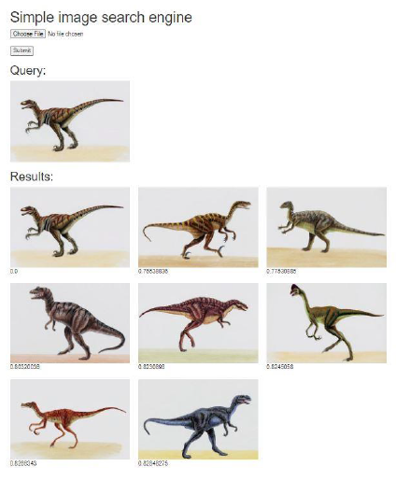
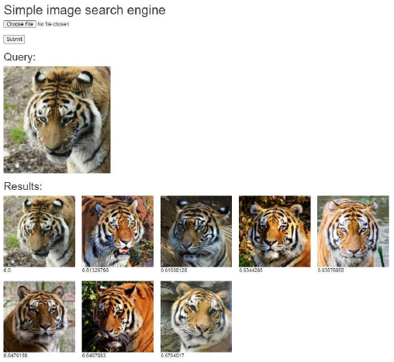
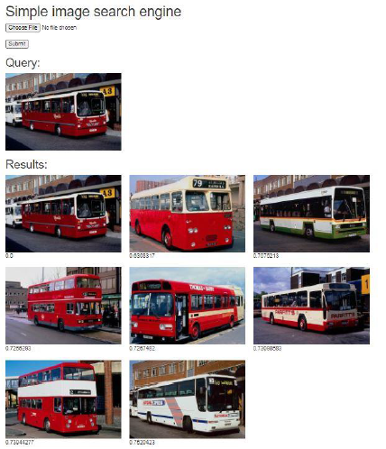
IMPLEMENTATION OF CONTENT-BASED IMAGE RETRIEVAL USING ARTIFICIAL NEURAL NETWORKS Sarath Chandra Yenigalla ¹, Srinivas Rao K ² and Phalguni Singh Ngangbam² K L Deemed to be University ^{1,2}
Introduction
Image retrieval systems enable the browsing, searching, and retrieval of 26 images from a large database of digital images.
Image retrieval include 27 the addition of metadata such as captioning, keywords, titles, or descriptions to images, which 28 can be used for retrieval.
CBIR utilizes computer vision to retrieve images based on similarities in their contents, such as textures, colors, and shapes, to a user-supplied query image or user-specified image features, thereby avoiding the use of textual descriptions.
Content-based image retrieval (CBIR) is the application of computer vision techniques to the 5 image retrieval problem, which is the challenge of searching for digital images in large 6 databases.
CBIR is also known as query by image content (QBIC).
CBIR is opposed to 7 traditional concept-based approaches that rely on metadata such as keywords, tags, or 8 descriptions associated with the image.
Results and discussion
Retrieved images with Euclidean distance
Accuracy outputs of SVM,CNN,KNN
Table: accuracy of algorithms
Algorithm | Corel 1k | Animal | Dinosaur
KNN | 60% | 60% | 60%
CNN | 50% | 50% | 50%
SVM | 80% | 80% | 80%
CBIR Architecture
Contact
Sarath Chndra Y, Research Scholar, ECE Department, Koneru Lakshmaiah Education Foundation (K L Deemed to be University), Andhra Pradesh; sarathcy2000@gmail.com , Ph.no:8978057647

