Slide 1
New medical imaging, Physics, Medical Need and Commercial Viability
Zoltan Vilagosh
Swinburne University of Technology

Slide 2
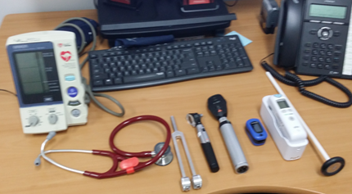
Things Change Slowly in Medical Land…
Pulse Oximeter

Slide 3
Nuclear Medicine – 1950’s
Ultrasound – 1960’s
CT – 1970’s
MRI - 1980’s
Things Change Slowly in Medical Land…

Slide 4
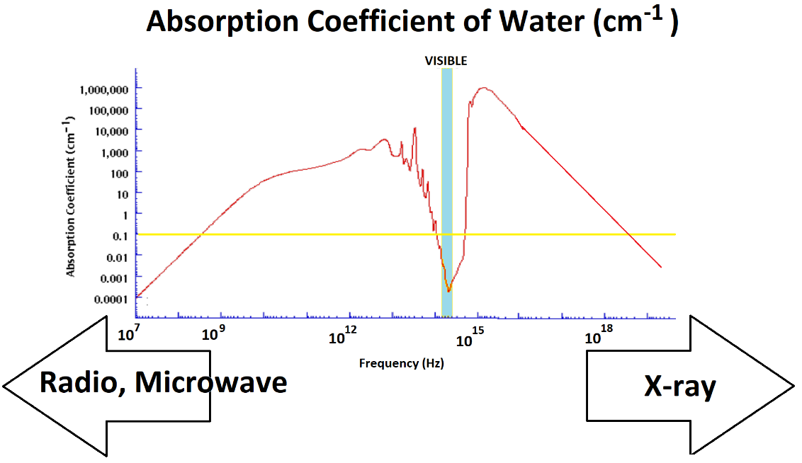
The dead hand of Physics

Slide 5
The dead hand of Physics
Deep body imaging only with frequencies under the yellow line (absorption coefficient of <0.1/cm)

Slide 6
Radio waves and microwaves are utilised by electrocardiography, electroencephalography and MRI
The dead hand of Physics
Diagnostic X-rays, CT scans, Nuclear Scans

Slide 7
GHz, THz, Infrared frequencies
The dead hand of Physics
Diagnostics of surface lesions, destroying surface lesions like melanoma – dial the depth of destruction by selecting frequency of the radiation.

Slide 8
Ultrasound
The dead hand of Physics
Penetration decreases with increased frequency
Resolution increases with increased frequency
Air is a poor conductor of high frequencies (conductive gel, long time with trained operator, inconsistency)

Slide 9
Medical Need
Core hydration meter

Slide 10
Medical Need
Techniques that replace a procedural intervention with an imaging modality
Of the patients with positive fecal occult blood test, 58% will have normal colonoscopy

Slide 11
Medical Need
Techniques that improve accuracy to avoid procedural intervention
Accuracy of MRI for knee cartilage lesions between 15% and 60%

Slide 12
Medical Need
Better techniques that show how things work, not just how they look
Cardiology is good at this, the rest not so good – problems with field of view

Slide 13
The physics may be right, the need is there, but they will not pay!
Commercial viability
MRI is expensive but they pay – the information is really important
What would I pay for a hydration meter?
$100 ? Probably …
$10,000? Not likely…

Slide 14
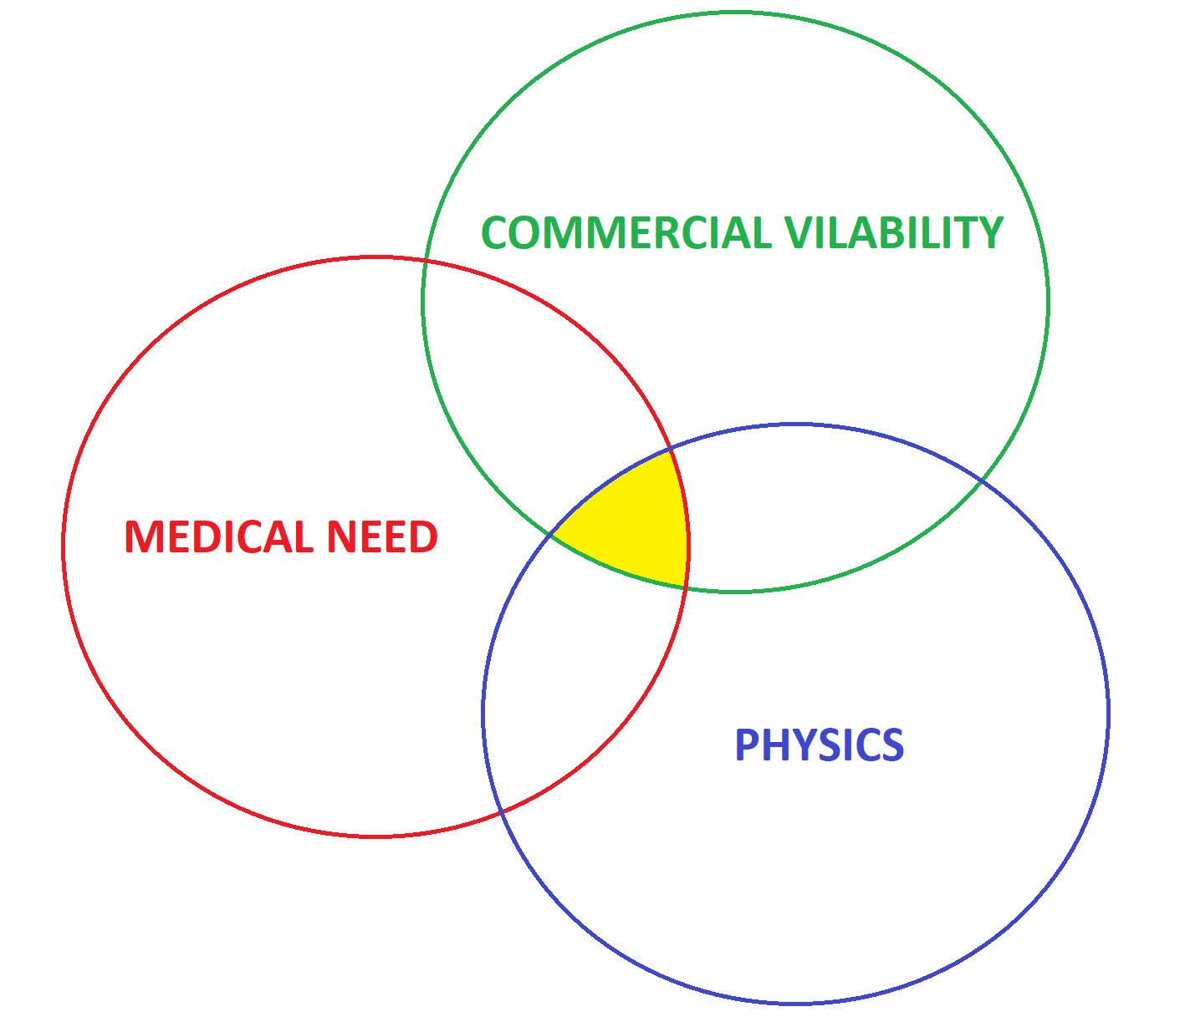
The sweet spot

