Slide 1
Assessment of Flood Frequency pattern in a complex mountainous terrain using the SWAT model Simulation
The 7th International Electronic Conference on Water Sciences
Adaptive Water Resources Management in an Era of Changing Climatic, Environmental and Social Conditions
Nada Joumar
Amal Markhi
Jamal Eddine Stitou El Messari
Lahcen Benaabidate
Email: joumarnada@gmail.com

Slide 2
Summary
Introduction
Material and methods
Study area description
SWAT model
Input data
Set up
Calibration
Results
3. Flood Frequency Analysis
Definition
Results
3. Conclusion

Slide 3
Introduction
Extreme events such as floods are one of the most dangerous meteorological hazards affecting the Mediterranean countries. N’fis is a typical semi-arid catchment. Flood risk assessment of this type of catchments requires the development/application of modern methodologies, which in many cases, should overcome the lack of suitable field data.
This study includes Hydrological simulation of the N’fis watershed using SWAT model.
Assessment of the flood risk using comparison of the statistical probability distributions, such as Generalized Extreme Value (GEV), Log-Pearson type 3 (LP3), and Gumbel (EV1).

Slide 4
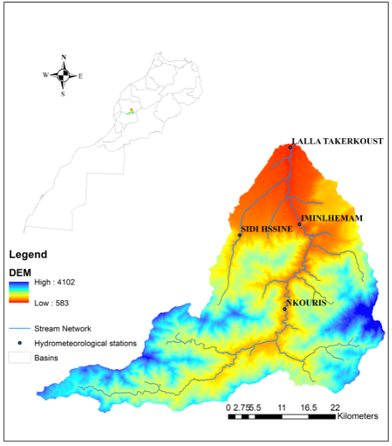
Material and Methodology
Study area description:
N’fis is a subbasin of the Tensift watershed that drains a total area of 1270 km². It is a mountainous watershed located in the part of High Atlas of Marrakech geographic area. More specifically on the northern flank of the central massif west of Toubkal between 30.5 and 31.2 ° North and between longitudes 7, 55 ° and 8, 40 ° W.
The watershed’s elevation ranges from 583 m to 4102 m and a mean elevation of 1868m.
Figure . the location of N’fis watershed and the hydrometeorological stations

Slide 5
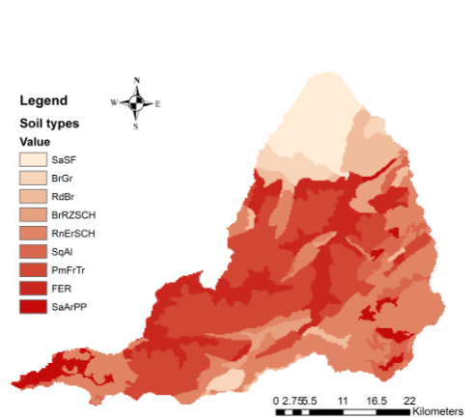
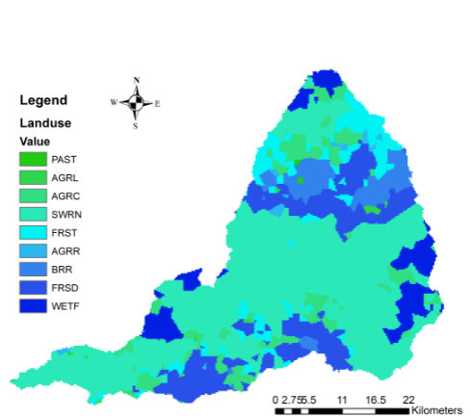
Figure. Soil map, N’fis watershed.
Figure. Landuse map, N’fis watershed
The watershed is 94% rural land and only 6% urban.
The dominant soil type is zonal brown soils on shale socle (79.3 %)
Notes:
area of the basin is rural land and only 6% urban.

Slide 6
Precipitation mm
Figure. Average annual precipitation in Iguir N’kouris, Immin lhemmam, Lalla Takerkoust and Sidi Hssin
The basin’s general climate is semi-arid, The weather is characterized by hot ( max: 46°) and dry summers then cold (min: -7.4°C) humid winters. The annual rainfall ranges from 254.1mm in low altitude to 796,9mm in high altitudes..
Notes:
. The spatio-temporal variability of precipitation is noticeable

Slide 7
Two dams were constructed on N’fis river.
Moulay yacoub el mansour ( 70Mm3) in the upper stream,
Lalla takerkoust (53.6Mm3) downstream at the foothills
Figure. Location of the Moulay Yacoub and Lalla Takerkoust Dams, N’fis watershed.

Slide 8
SWAT Model
Continuous, physically based, and semi-distributed Model.
The hydrology
Contaminant transport
Predict the impact of land management practices on:
Sediment yield
SWAT subdivides a watershed into subbasin connected by a stream network, and further delineates HRUs (Hydrological response units) consisting of unique combinations of land cover, soils and slopes within each sub-basin.

Slide 9
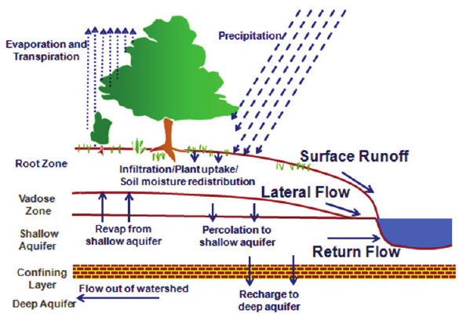
Water balance equation:
SWt is the soil water content (mm),
SW0 is the water available to plants (mm),
Rday is the daily precipitation (mm),
Qsurf is the surface runoff (mm),
Eα is the evapotranspiration (mm),
Sweep is the percolation (mm),
Qgw is the low flow (mm)
t is the time (days).
Figure. Hydrological balance description in SWATcheck.

Slide 10
Input Data
Data | Source | Spatial resolution | Temporal resolution
DEM | STRM- United States Geological Survey (USGS) https://earthexplorer.usgs.gov/ | 30 m | -
Land use Map | (MODIS) Land Cover Type (MCD12Q1) | 500 m | Yearly
Soil Map | Tensift Basin Hydraulic Agency (TBHA) | ArcInfo format (scale 1:100000) | -
Soil Data | Field work (Markhi et al., 2019) | ArcInfo format (scale 1:100000) | -
Observed Hydrometeorology | Tensift Basin Hydraulic Agency (TBHA) | - | Daily
Table : Geo-spatial datasets.

Slide 11
SWAT Model Setup
Meteorological data
Precipitation 4stations
Temperature 1Station
GIS data
DEM
Soil data
Land use
Observed data
Stream Flow
Setup SWAT model
New parameters
simulation
Calibration using SWAT-Cup, SUFI2
Well conducted
No
Yes
End

Slide 12
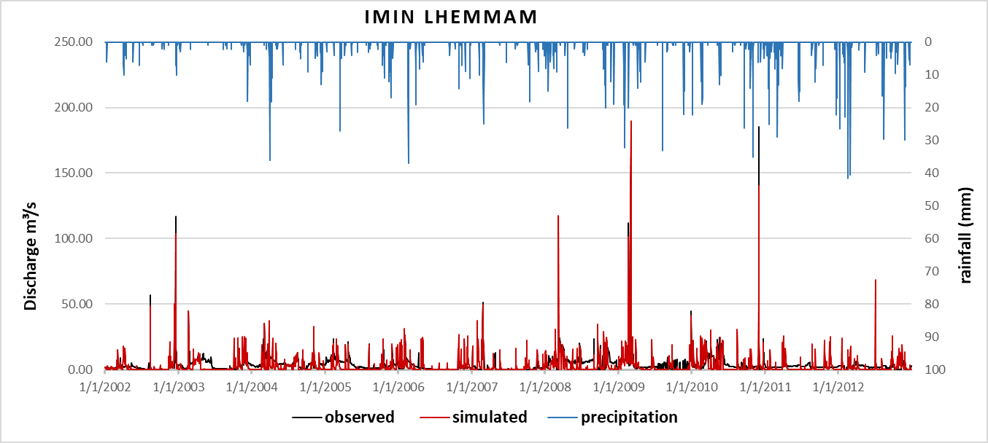
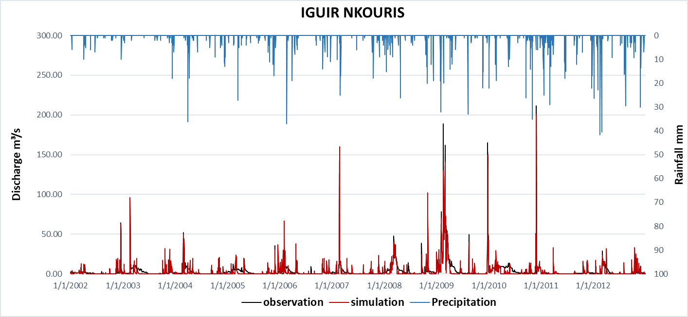
Calibration Results
Figure. Daily simulated and observed discharge (m³/s) for the period (2002-2012) Imin lhemmam station.
Figure. Daily simulated and observed discharge (m³/s) for the period (2002-2012) Iguir Nkouris station.

Slide 13
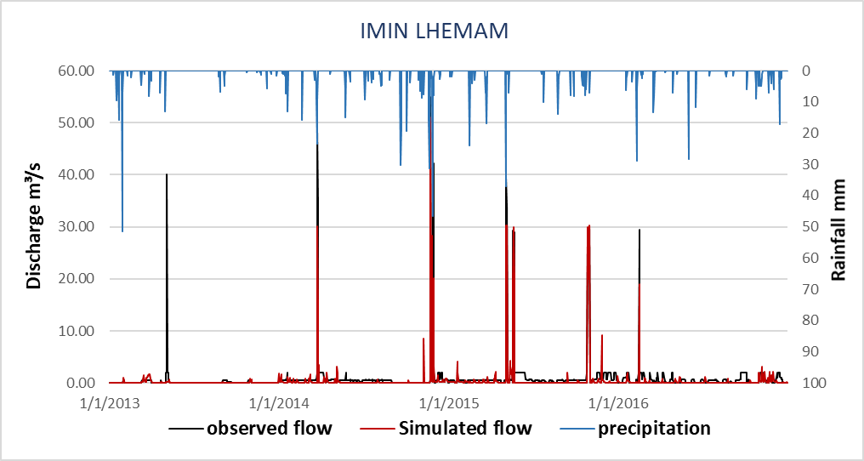
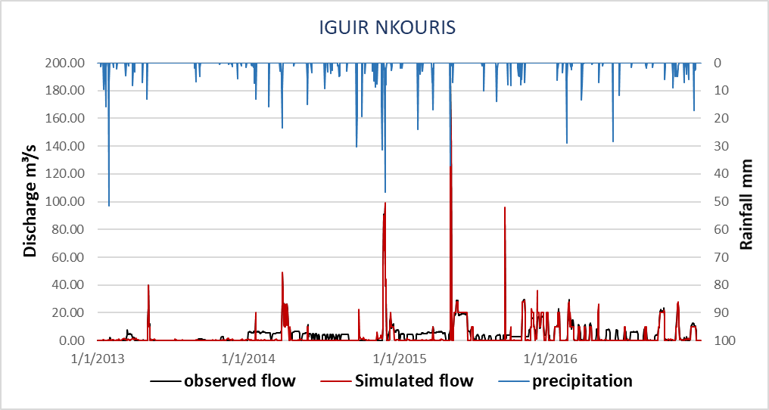
Validation Results
Figure. Daily validated discharge (m³/s) for the period (2013-2016) Imin Lhemmam station.
Figure. Daily validated discharge (m³/s) for the period (2013-2016) Iguir Nkouris station.

Slide 14
Parameter_Name | Description | Rank | Fitted Value | Min value | Max value
CN2.mgt | SCS Curve number | 5 | -0.192 | -0.2 | 0.2
ALPHA_BF.gw | Baseflow factor [days] | 1 | 0.62 | 0 | 1
GW_DELAY.gw | Groundwater delay time (days) | 6 | 424.7 | 30 | 450
GWQMN.gw | Threshold depth of water in the shallow aquifer required for return flow to occur [mm] | 3 | 1.24 | 0 | 2
GW_REVAP.gw | Revap coefficient | 10 | 0.11 | 0 | 0.2
ESCO.hru | Soil Evaporation compensation factor | 4 | 0.87 | 0.8 | 1
EPCO.hru | the plant uptake compensation factor | 16 | 0.96 | 0.8 | 1
CH_N2.rte | Manning's "n" value for the main channel. | 12 | 0.17 | 0 | 0.3
CH_K2.rte | Effective hydraulic conductivity in main channel alluvium. | 2 | 22.5 | 5 | 130
SOL_AWC(1).sol | Available water capacity [mm H2O/mm soil] | 7 | -0.16 | -0.2 | 0.4
SOL_K(1).sol | Saturated hydraulic conductivity parameter | 13 | 0.64 | -0.8 | 0.8
SOL_BD(1).sol | soil bulk density | 14 | -0.3 | -0.5 | 0.6
SFTMP.bsn | Snowfall temperature (°C). | 8 | -4.8 | -5 | 5
SMFMX.bsn | Maximum melt rate for snow during the year | 17 | 7.37 | 1.4 | 7.5
DEEPST.gw | Initial depth of water in the deep aquifer (mm H2O) | 9 | 41000 | 0 | 50000
LAT_TTIME.hru | Lateral flow travel time (days) | 15 | 39.59 | 0 | 180
Statistical Results
Statistical evaluation parameters | Imin lhemam |  | Nkouris |  | conditions
 | Calibration | Validation | Calibration | Validation
NSE | 0.51 | 0.56 | 0.54 | 0.62 | satisfactory >0.5
PBIAS | 16.4 | 15.3 | 22.9 | 21.03 | satisfactory 25%
RMSE | 4.00 | 3.25 | 3.72 | 3.12
Table. results of statistical evaluation for the daily calibration
Table. results of best fitted parameters for calibration

Slide 15
Flood Frequency analysis
Extreme events : Floods or Droughts
Magnitude of extreme events is related to their frequency of occurrence.
50 years of annual discharge (m3 /s) (1966 to 2016) were used for deriving the flood frequency curve by applying the commonly used probability distribution functions which are the Gumbel Distribution (EV), Log Pearson Type 3 and Generalized Extreme Value Distribution (GEV).
Gumbel (EV I)
Log Pearson III
Generalized Extreme Value Distribution (GEV) (3)
μ = shape parameter (−∞ < α < ∞)
σ = scale parameter (β > 0)
σ = scale parameter (σ > 0)
k = shape parameter
μ = location parameter
α = shape parameter (α > 0)
β = scale parameter (β ≠ 0)
γ = location parameter
Γ(β) =The Gamma distribution function for the parameter β.

Slide 16
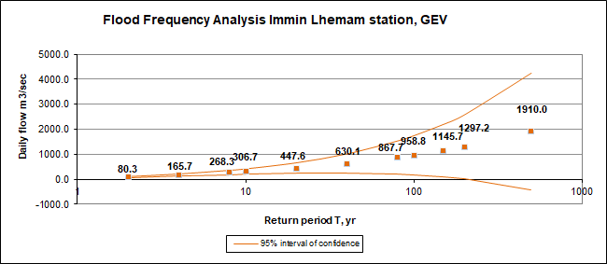
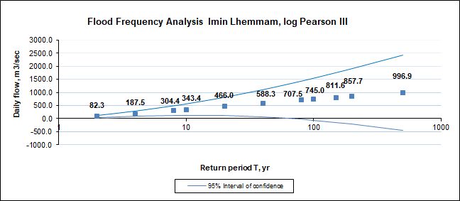
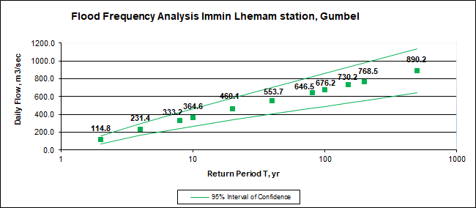
T | log Pearson III | Gumbel | GEV
Kolmogorov-Smirnov | 0.978 | 0.179 | 0.141
Anderson-Darling | -8.009 | 4.524 | 2.763
Table. Goodness-of-fit test result for Imin lhemmam
Figure. Flood frequency analysis GEV, N’fis watershed using data from Imin lhemmam station of the period 1966-2016
Figure. Flood frequency analysis log Pearson III, N’fis watershed using data from Imin lhemmam station of the period 1966-2016
Figure. Flood frequency analysis Gumbel (EVI), N’fis watershed using data from Imin lhemmam station of the period 1966-2016

Slide 17
Conclusion
The SWAT (Soil and water assessments tool) model managed to simulate adequately the poorly gauged N’fis watershed.
Comparing the goodness‐of‐fit Gumbel, GEV and LP3 distributions for flood frequency analysis in Nfis watershed, the GEV distribution shows good results and appears to be the more suitable one.
For study limitation include the data scarcity and also the SWAT model is not being able to capture the single events and reach the high peaks of flow during dry period. These results are reflected in the statistical evaluation values of the model.
Future scope : the SWAT model is able to help in the sediment yield simulation which can also be used in land management of the watershed.

Slide 18
Thank you
Email: joumarnada@gmail.com

