Slide 1
Amelioration of Glioblastoma multiforme by the combination of Simulation microgravity and Oncolytic Viral therapy.

Slide 2
Introduction
Glioblastoma multiforme is the most common aggressive malignant primary brain tumor affecting approximately 3.19 per 100,000 persons in the United States with an incidence 1.6 times higher in males compared to females.
This is the highest incidence among malignant brain tumors. Incidence is highest in the northeast and lowest in the south-central region of the United States. Whites have the highest incidence rates for GBM.GBM is more common in males compared to females(3.97 vs. 2.53).(1)

Slide 3
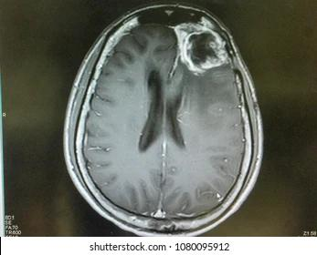
Fig 1 :
MRI showing Glioblastoma in the left frontal lobe of the brain.. Reproduced with permission from
https://www.shutterstock.com/image-photo/mri-brain-show-left-frontal-gliblastoma-1080095912

Slide 4
Introduction
GBM usually arises from the glial cells known as astrocytes and it is commonly located in the supratentorial region (cortical lobes),usually affecting the frontal lobe. It is multiformed grossly.
Microscopically gross transverse sections how areas of hemorrhage and necrosis, pleomorphic nuclei and cells, pseudopalisading necrosis, and microvascular proliferation(2)
A unique feature of this tumor is its rapid local growth and spread making the prognosis very poor with a 5-year survival rate less than 5 %.(1)

Slide 5
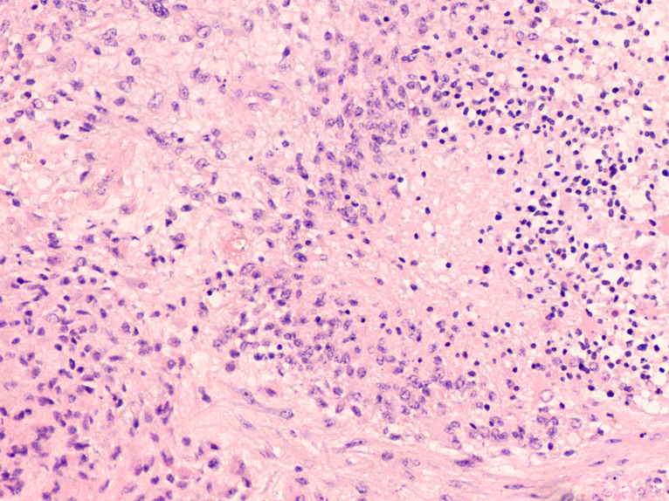
Fig 2:
Microscopic image showing histology of a glioblastoma multiforme (GBM). Necrosis and vascular proliferation are diagnostic features of this high grade malignant tumor. Reproduced with permission from
https://stock.adobe.com/search?load_type=search&native_visual_search=&similar_content_id=&is_recent_search=&search_type=usertyped&k=glioblastoma+multiforme&asset_id=271680381

Slide 6
The etiology of Glioblastoma multiforme
Multiple risk factors have been linked to GBM such as exposure to radiation, a weak immune system, and increased age. The median age of diagnosis of 64 years. It is uncommon in children accounting only approximately 3% of all brain and CNS tumors reported among individuals aged 0 to 19 years. Other risk factors include high socioeconomic status. Decreased susceptibility to allergy and the use of anti-inflammatory medications have been linked to increased risk for GBM. (1)
Several genetic and molecular mechanisms have been identified to play a role in the development of GBM. Primary de novo GBM without evidence of a less malignant precursor is associated with Epidermal Growth Factor Receptor (EGFR)over-expression, pleitrophin mutation, and loss of chromosome 10. Secondary GBM arising from a low grade astrocytoma or anaplastic astrocytoma is associated withIDH1 mutations, TP53 mutations causing alpha synclean protein over expression; the same protein involved in Parkinson's disease , and chromosome 19q loss (3),(4),(5),(6)

Slide 7
Fig 3 :
Primary GBM
EGFR over expression
Pleitrophin mutation
Secondary GBM
IDH 1 mutation
TP 53 mutation
Schematic diagram to represent the genetic and molecular mechanisms of primary and secondary glioblastoma multiforme (GBM).
GBM: Glioblastoma multiforme
EGFR: Epidermal Growth Factor Receptor (EGFR)

Slide 8
Methods- Hypothesis:
We hypothesize that the growth of malignant glioma cells will be aborted by the application of a combination of simulated microgravity and oncolytic viral therapy.
Malignant glioma cells (Takeda, 2009) in Dulbecco’s modified medium supplemented by penicillin (100 units/ml), streptomycin (100 micrograms/ml), 10% fetal bovine serum, white blood cells, granulocyte-monocyte colony stimulating factor (GMSCF), and parvovirus H1 at 37 º C with a humidified 5% CO2 atmosphere will be placed in a simulated microgravity using a clinostat-based three-dimensional (3D) culture system. The necrosis of malignant glioma cells week by verified by inverted contrast phase and quantum microscopy, flow cytometrymitochondrial membrane potentials. After two weeks of this intervention, all malignant glioma cells will be dead.

Slide 9
Results- Consequences of the hypothesis
Evidence from in vitro, animal and clinical studies were collected and evaluated.
The data described in the next slides suggest that our hypothesis could provide a new therapy for glioblastoma multiforme. We aim to conduct an experiment to confirm this hypothesis and, if confirmed, to conduct clinical trials

Slide 10
Discussion
A) Simulated microgravity effect on tumor cells :
1- Simulated microgravity effects on Glioblastoma multiforme:
Multiple studies have been conducted by Gliolab at Kentucky state University to examine the effect of microgravity during spaceflights on different tumor cells including GBM and the results showed that microgravity caused decreased cell proliferation, decreased secretory activity, and induction of apoptosis(10). Simulated microgravity can be produced on earth by floating or using a device to generate gravitational waves in 3 dimensions resulting in an environment with an average of 10⁻³ G called 3D clinostat(11)

Slide 11
Discussion
A study was conducted in Japan to examine the effects of simulated microgravity using a 3D clinostat on cell proliferation of glioblastima multiforme, mitochondrial activity and sensitivity of tumor cells to cisplatin; a chemotherapy drug. Various cell lines were used in this study, including the D54MG (human glioma; wild p53), U251MG (human glioma; mutant p53), and T98G (human glioma; mutant p53) cell lines. The samples were divided into 2 groups; C group; cells under 100 G force and CL group; cells incubated in 1 G force generated by a 3D clinostat. An inverted phase contrast microscope was used to examine the morphological changes in tumor cells. The fluorescent dye rhodamine123 was used to measure the mitochondrial membrane potential. A Define first FACS caliber flow cytometer was used to measure cell cycle distribution.
The results of this experiment showed that after 3 days, simulated microgravity induces cell growth inhibition by worsening mitochondrial activity and increases the sensitivity of tumor cells to cisplatin,12)

Slide 12
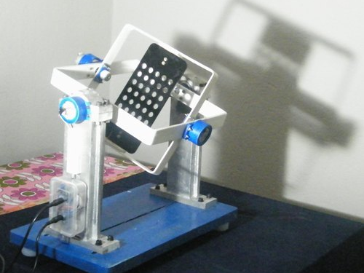
Fig 4:
This figure shows a 3D clinostat device used to generate gravitational waves in 3 dimensions resulting in an environment with an average of 10⁻³ G

Slide 13
Discussion
2- Simulated Microgravity effects on Thyroid Cancer cells :
Different ESA ground-based facilities, including the RPM and the 2D and 3D clinostat S-g, have been used to expose thyroid cancer cells. These exposures have resulted in a variety of changes in the exposed TCC, including early changes to the cytoskeleton, ECM, focal adhesion molecules, proliferation, the rate of apoptosis, migration, and growth ([13, 14, 15, 16, 17, 18) The development of MCS was the main discovery. After varying exposure times, the examined TCC and cells from other cancers (such as breast carcinoma and prostate carcinoma) developed in r- and s-g in the form of 3D MCS ( 19, 20, 21, 22, 23, 24, 25, 26).

Slide 14
Discussion
B)Oncolytic Viral Therapy:
1- Melanoma and HSV-1:
A new promising treatment for cancer is oncolytic viral therapy, in which a virus or a genetically modified virus is injected into tumor cells directly or via a systemic route (eg, intravenously) to induce direct lysis of tumor cells and/or systemic induction of an immune response against the tumor cells.
A clinical trial on advanced melanoma showed that tumor was lysed by a genetically modified herpes simplex virus type 1 (HSV-1) encoding granulocyte-macrophage colony-stimulating factor (GM-CSF). This virus is called Ltalimogenelaherparepvec and is expected to be approved by the FDA in the near future. (28

Slide 15
Discussion
2- Glioblastoma multiforme and Parvovirus H1:
Parvo virus H1 (12)which has been used in experiments on glioblastoma multiforme due to its kinetics being able to cross the blood brain barrier.(29
Multiple factors are involved in clearing the viral particles in glioblastoma cells such as TRAF3, INF-related factor 3, INF7 and RIG-1. These factors activate JAK-STAT pathway which activate PKR pathway leading to termination of protein synthesis and cell death .(16) The other mechanism by which Parvovirus H1 cause glioblastoma cell death is induction of a systemic immune response , multiple cytokines such as type 1 INF , TNF alpha, INF gamma and IL-12 which play a role in stimulation of antigen presenting cells(APCs) such as dendiritic cells then activation of T-helper cells CD 4 and C-cytotoxic cells CD 8 occurs leading to tumor cell lysis.(30

Slide 16
Discussion
C) Limitations of our hypothesis :
Unfavorable results would be decreased efficacy due to the inhibitory effects of microgravity on the human immune system which is one of the mechanisms oncolytic viruses utilize to abort the growth of tumor cells. We suggest adding Immune stimulants such as GM-CSF to escape this inhibitory effect.

Slide 17
Conclusion
The treatment of Glioblastoma multiforme remains a challenge. We are pleased to publish our hypothesis that could offer a novel therapy for this highly malignant CNS tumor. We aim to conduct an experiment to confirm this hypothesis and, if confirmed, to conduct clinical trials.

Slide 18
References
1)Ostrom QT, Gittleman H, Farah P, Ondracek A, Chen Y, Wolinsky Y, et al. CBTRUS statistical report: Primary brain and central nervous system tumors diagnosed in the United States in 2006-2010. Neuro Oncol [Internet]. 2013 [cited 2022 Mar 23];15 Suppl 2(suppl 2):ii1-56. Available from: https://academic.oup.com/neuro-oncology/article/15/suppl_2/ii1/1042185?login=false
2)D’Alessio A, Proietti G, Sica G, Scicchitano BM. Pathological and molecular features of glioblastoma and its peritumoral tissue. Cancers (Basel) [Internet]. 2019 [cited 2022 Mar 23];11(4):469. Available from: https://www.mdpi.com/2072-6694/11/4/469
3)Wrensch M, Fisher JL, Schwartzbaum JA, Bondy M, Berger M, Aldape KD. The molecular epidemiology of gliomas in adults. Neurosurg Focus [Internet]. 2005 [cited 2022 Mar 23];19(5):E5. Available from: https://thejns.org/focus/view/journals/neurosurg-focus/19/5/foc.2005.19.5.6.xml
4) Ryskalin L, Biagioni F, Morucci G, Busceti CL, Frati A, Puglisi-Allegra S, et al. Spreading of Alpha Synuclein from Glioblastoma Cells towards Astrocytes Correlates with Stem-like Properties. Cancers [Internet]. 2022 Mar 10 [cited 2022 Jul 22];14(6):1417. Available from: https://www.ncbi.nlm.nih.gov/pmc/articles/PMC8946011/
‌5)Elshourbagy T, Brašić JR, Syed AB. Guidelines for the Diagnosis and Treatment of Parkinson’s Disease. Biology and Life Sciences Forum [Internet]. 2021 [cited 2022 Jul 22];9(1):9. Available from: https://www.mdpi.com/2673-9976/9/1/9/htm

Slide 19
References
6) Elshourbagy T, Syed AB, Amer MAM, Brasic JR. Precision medicine to identify optimal diagnostic and therapeutic interventions for Parkinson’s Disease. Medical Science and Discovery. 2021 Sep 11;8(9):514–9. Available from : https://doi.org/10.36472/msd.v8i9.595
7) Yong RL, Lonser RR. Surgery for glioblastoma multiforme: striking a balance. World Neurosurg [Internet]. 2011 [cited 2022 Mar 23];76(6):528–30. Available from: http://dx.doi.org/10.1016/j.wneu.2011.06.053
8) Barani IJ, Larson DA. Radiation Therapy of Glioblastoma. In: Cancer Treatment and Research. Cham: Springer International Publishing; 2015. p. 49–73
9) Fernandes C, Department of Medical Oncology, Centro Hospitalar de São João, Porto, Portugal, Costa A, Osório L, Lago RC, Linhares P, et al. Current standards of care in glioblastoma therapy. In: Glioblastoma. Codon Publications; 2017. p. 197–241
10) Harvard.edu. [cited 2022 Apr 9]. Available from: https://ui.adsabs.harvard.edu/abs/2012cosp...39..274C/abstract

Slide 20
References
11) Topal U, Zamur C. Microgravity, stem cells, and cancer: A New Hope for cancer treatment. Stem Cells Int [Internet]. 2021 [cited 2022 Mar 23];2021:1–9. Available from: http://dx.doi.org/10.1155/2021/5566872
12) Takeda M, Magaki T, Okazaki T, Kawahara Y, Manabe T, Yuge L, et al. Effects of simulated microgravity on proliferation and chemosensitivity in malignant glioma cells. Neurosci Lett [Internet]. 2009;463(1):54–9. Available from: http://dx.doi.org/10.1016/j.neulet.2009.07.045
13, Svejgaard, B.; Wehland, M.; Ma, X.; Kopp, S.; Sahana, J.; Warnke, E.; Aleshcheva, G.; Hemmersbach, R.; Hauslage, J.; Grosse, J.; et al. Common Effects on Cancer Cells Exerted by a Random Positioning Machine and a 2D Clinostat. PLoS ONE 2015, 10,
e0135157.
14) Warnke, E.; Pietsch, J.; Wehland, M.; Bauer, J.; Infanger, M.; Görög, M.; Hemmersbach, R.; Braun, M.; Ma, X.; Sahana, J.; et al. Spheroid formation of human thyroid cancer cells under simulated microgravity: A possible role of CTGF and CAV1. Cell Commun. Signal. 2014, 12, 32. [
15) Kopp, S.; Warnke, E.; Wehland, M.; Aleshcheva, G.; Magnusson, N.E.; Hemmersbach, R.; Corydon, T.J.; Bauer, J.; Infanger, M.; Grimm, D. Mechanisms of three-dimensional growth of thyroid cells during long-term simulated microgravity. Sci. Rep. 2015, 5, 16691.

Slide 21
References
16) Grimm, D.; Bauer, J.; Kossmehl, P.; Shakibaei, M.; Schöberger, J.; Pickenhahn, H.; Schulze-Tanzil, G.; Vetter, R.; Eilles, C.; Paul, M.; et al. Simulated microgravity alters differentiation and increases apoptosis in human follicular thyroid carcinoma cells. FASEB J. 2002, 16, 604–606. [
17) Kossmehl, P.; Shakibaei, M.; Cogoli, A.; Infanger, M.; Curcio, F.; Schönberger, J.; Eilles, C.; Bauer, J.; Pickenhahn, H.; Schulze-Tanzil, G.; et al. Weightlessness induced apoptosis in normal thyroid cells and papillary thyroid carcinoma cells via extrinsic and intrinsic pathways. Endocrinology 2003, 144, 4172–4179
18) Infanger, M.; Kossmehl, P.; Shakibaei, M.; Schulze-Tanzil, G.; Cogoli, A.; Faramarzi, S.; Bauer, J.; Curcio, F.; Paul, M.; Grimm, D. Longterm conditions of mimicked weightlessness influences the cytoskeleton in thyroid cells. J. Gravit. Physiol. 2004, 11, P169–P172.
19 ) Grimm, D.; Infanger, M.; Westphal, K.; Ulbrich, C.; Pietsch, J.; Kossmehl, P.; Vadrucci, S.; Baatout, S.; Flick, B.; Paul, M.; et al. A delayed type of three-dimensional growth of human endothelial cells under simulated weightlessness. Tissue Eng. Part A 2009, 15, 2267–2275
20 ) Freed, L.E.; Langer, R.; Martin, I.; Pellis, N.R.; Vunjak-Novakovic, G. Tissue engineering of cartilage in space. Proc. Natl. Acad. Sci. USA 1997, 94, 13885–13890

Slide 22
References
21) Morey-Holton, E.R.; Globus, R.K. Hindlimb unloading of growing rats: A model for predicting skeletal changes during space flight. Bone 1998, 22, 83s–88s.
22) Borst, A.G.; van Loon, J.J.W.A. Technology and Developments for the Random Positioning Machine, RPM. Microgravity Sci. Technol. 2008, 21, 287
23) . Melnik, D.; Krüger, M.; Schulz, H.; Kopp, S.; Wehland, M.; Bauer, J.; Baselet, B.; Vermeesen, R.; Baatout, S.; Corydon, T.J.; et al. The CellBox-2 Mission to the International Space Station: Thyroid Cancer Cells in Space. Int. J. Mol. Sci. 2021, 22, 8777
24) Pietsch, J.; Ma, X.; Wehland, M.; Aleshcheva, G.; Schwarzwälder, A.; Segerer, J.; Birlem, M.; Horn, A.; Bauer, J.; Infanger, M.; et al. Spheroid formation of human thyroid cancer cells in an automated culturing system during the Shenzhou-8 Space mission. Biomaterials 2013, 34, 7694–7705.
25) Ma, X.; Pietsch, J.; Wehland, M.; Schulz, H.; Saar, K.; Hübner, N.; Bauer, J.; Braun, M.; Schwarzwälder, A.; Segerer, J.; et al. Differential gene expression profile and altered cytokine secretion of thyroid cancer cells in space. FASEB J. 2014, 28, 813–835.

Slide 23
References
26) Infanger, M.; Kossmehl, P.; Shakibaei, M.; Bauer, J.; Kossmehl-Zorn, S.; Cogoli, A.; Curcio, F.; Oksche, A.; Wehland, M.; Kreutz, R.; et al. Simulated weightlessness changes the cytoskeleton and extracellular matrix proteins in papillary thyroid carcinoma cells. Cell Tissue Res. 2006, 324, 267–277
27)Carmeliet G, Nys G, Bouillon R. Microgravity reduces the differentiation of human osteoblastic MG-63 cells. J Bone Miner Res [Internet]. 1997;12(5):786–94. Available from: http://dx.doi.org/10.1359/jbmr.1997.12.5.786
28)Zawit M, Swami U, Awada H, Arnouk J, Milhem M, Zakharia Y. Current status of intralesional agents in treatment of malignant melanoma. Ann Transl Med [Internet]. 2021 [cited 2022 Mar 23];9(12):1038. Available from: http://dx.doi.org/10.21037/atm-21-491
29) Martuza RL, Malick A, Markert JM, Ruffner KL, Coen DM. Experimental therapy of human glioma by means of a genetically engineered virus mutant. Science [Internet]. 1991;252(5007):854–6. Available from: http://dx.doi.org/10.1126/science.1851332
30) Kaufman HL, Kohlhapp FJ, Zloza A. Oncolytic viruses: a new class of immunotherapy drugs. Nat Rev Drug Discov [Internet]. 2015 [cited 2022 Mar 23];14(9):642–62. Available from: https://www.nature.com/articles/nrd4663

