Slide 1
Estimating the potential evapotranspiration of Egypt using a regional climate model and a high-resolution reanalysis dataset
Samy Ashraf Anwar¹ and Irida Lazić²
¹Egyptian Meteorological Authority, Qobry EL-Kobba, Cairo P.O. Box 11784, Egypt
²Faculty of Physics, Institute for Meteorology, University of Belgrade, Dobračina 16, 11000 Belgrade, Serbia
*Correspondence: ratebsamy@yahoo.com

Slide 2
Content
Introduction
Data and Methods
Results
Discussion and Conclusion

Slide 3
Introduction
Potential evapotranspiration (PET) plays an important role in the global terrestrial hydrology cycle is used for calculating the water needs of different crops and assessing hydrological and meteorological droughts, water balance analysis, and designing and operating irrigation projects. Therefore, availability of long-term records of PET or projecting the future PET under different global warming scenarios is important.
There are recommends the Penman-Monteith (PM) model to compute the PET because it is based on the physical exchange of water and energy between vegetation and atmosphere. However, it requires a large number of meteorological variables which may not be available for a long time for a variety of locations. Further, uncertainty of the involved meteorological variables may induce a source of uncertainty in the computed PET.
Studies reported that Hargreaves-Samani (HS) can be recommended directly after PM and it can operate on daily/monthly time scales.
The main goal of this study was to calibrate and verify calibrated HS equation over area of Egypt, since the HS equations hasn’t been calibrated in Egypt till present day. Estimation of PET was done with high-resolution regional climate model RegCM4.
Liu, Yuan, et al. "The divergence between potential and actual evapotranspiration: An insight from climate, water, and vegetation change." Science of The Total Environment 807 (2022): 150648.

Slide 4
Introduction
Main study aims:
Examine the influence of lateral boundary condition on the simulated PET with respect to ERA5-land derived product (ERA5). RegCM4 with spatial resolution 25-km was used to compute the PET using the HS for the period 1979-2017 and was driven by Era-Interim dataset (EIN15) and NCEP/NCAR reanalysis version 2 (NNRP2).
Address the added value of the calibrated HS equation (relative to the original version) in comparison with the ERA5;
Validate the calibrated HS equation (versus the original version) by examining the climatological annual cycle of the simulated PET with respect to ERA5 at specific locations in Egypt.

Slide 5
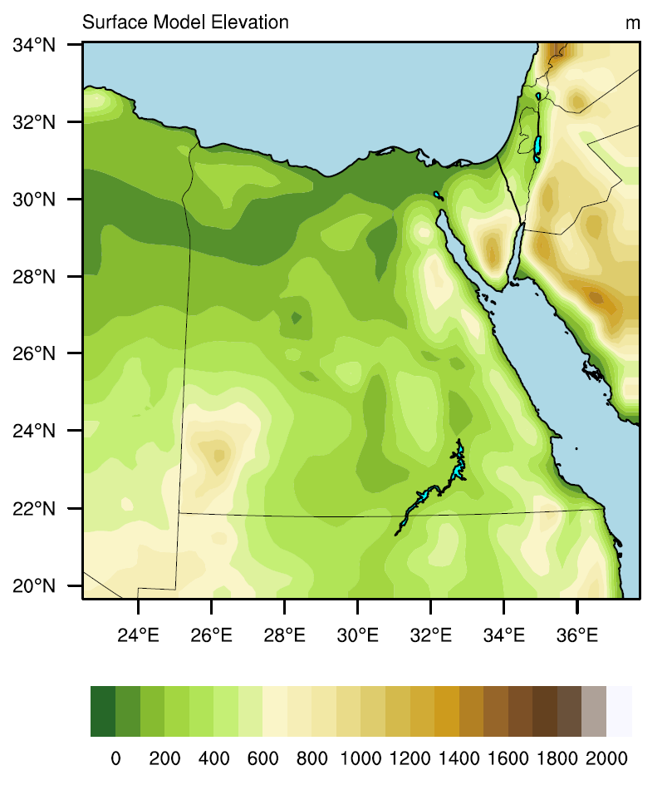
Data and Methods
Study Area
Model Description and Experiment design
This study used the Abdus Salam International Centre for Theoretical Physics (ICTP) regional climate model version 4.7 (hereafter RegCM-4.7.0). The RegCM is a broad community used it for conducting long term simulations and future regional climate projections in Intercomparison projects. The RegCM4 model domain (figure 1) was customized with grid spacing of 25 km with 60 grid points in both zonal and meridional directions centered at 27° latitude and 30° longitude. Also, the following physical schemes were used in the present study: Emanuel convection scheme over land and ocean, and Holtslag boundary layer scheme. The first two years were considered as spin-up to properly initialize the RegCM4 model, so the actual analysis starts at 1981 and ends at 2017.
Figure 1 shows the model domain and surface elevation (in meters)
Important note:
As we can see in the results, there is no significant difference between the two simulations. Therefore, RegCM4-EIN15 simulation was taken as an example to examine the added value of the calibrated HS equation compared to ERA5.
Examine the influence of lateral boundary condition on the simulated PET
Era-Interim reanalysis (EIN15)
1.5 degrees
Regional Climate Model RegCM4
Potential Evapotranspiration (PET)
NCEP/NCAR reanalysus (NNRP2)
version 2, 1.8 degrees

Slide 6
Data and Methods
2.) Examine added value of the calibrated HS equation
Several attempts have been done to obtain a reasonable bias of the calibrated HS equation (using ERA5 as the observational dataset). It was found that switching the radiation coefficient from 0.0135 to 0.0105 gave promising results more than calibrating the temperature coefficient (17.8). Note that SW (global incident solar radiation) is expressed in units of mm ${day}^{−1}$ to show how much energy is used to evaporate water and T2m is the 2-m mean air temperature (in °C).
Default HS equation:
Regional Climate Model RegCM4
${PET}_{HS}=0.0135 ×SW×(T2m+ 17.8)$
calibration
high resolution ERA5-land reanalysis dataset
0.1 degrees (ERA5)
Calibrated HS equation:
${PET}_{HS}=0.0105 ×SW×(T2m+ 17.8)$
But first before assessing the performance of the RegCM4 (in simulating the PET), it is important to quantify the RegCM4 model bias concerning the simulated SW and T2m (as inputs of the HS equation) in respect with ERA5land (0.1 $°$resolution) and ERA5 (0.25$°$resolution) dataset.
In the results, it can be showed that the PET spatial pattern is more consistent with the SW than T2m. Therefore, calibrating the SW coefficient is more effective than T2m.

Slide 7
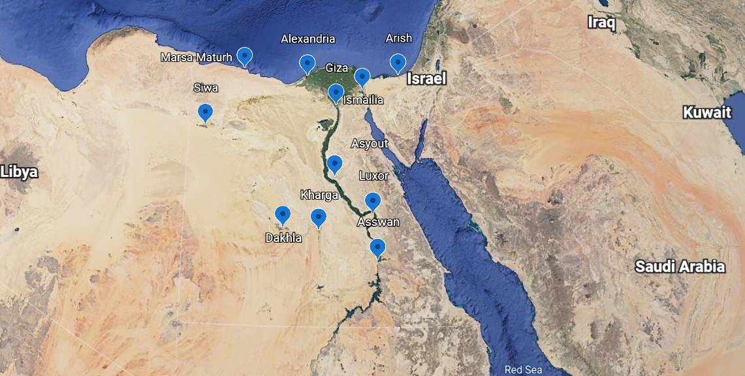
Data and Methods
3) Validate the calibrated HS equation (versus the original version) by examining the climatological annual cycle of the simulated PET with respect to ERA5 at specific locations in Egypt.
Station observation is a major source to monitor the PET changes both spatially and temporary. However, availability of long-term record wasn’t feasible to evaluate the RegCM4 performance (before and after calibrating the HS equation) in this study.
Recently, a new high-resolution global gridded PET (hPET) product was developed. This product uses the hourly meteorological variables provided by the offline land model of the ERA5 reanalysis product. Also, it adopts the PM equation to compute the PET and it is integrated over the period 1981-2021 in 0.1 degree grid spacing over the global land area. In the present study, monthly mean PET data was used to evaluate the RegCM4 performance both spatially and for locations in Egypt defined by in the Figure above.
Locations in Egypt for which the PET values were examined
Regional Climate Model RegCM4
VS
ERA5
PET_{HS}
PET_{HSnew}
PET_{ERA5}

Slide 8
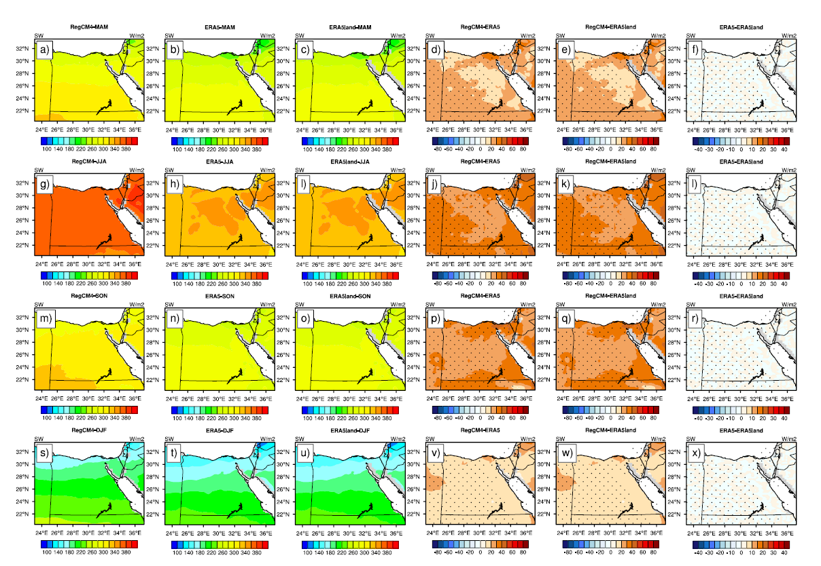
Results
Quantify the RegCM4 model bias concerning the simulated SW (as input of the HS equation)
From Figure S1 it can be noticed that the RegCM4 is able to reproduce the spatial pattern of the SW with respect to ERA5 and ERA5land in all seasons.
Also, the RegCM4 overestimates the SW in the MAM season by 10-30 W m⁻². In the JJA and SON, the RegCM4 bias ranges from 20 to 40 W m⁻². Lastly in the DJF; the RegCM4 bias becomes 10-20 W m⁻² with respect to both products.
Further, there is no noted difference between ERA5 and ERA5land in all seasons.
It can be noted that the RegCM4 bias is maximized in the JJA and SON and it is minimized in the DJF.
Figure S1. The figure shows the global incident solar radiation over the period 1981–2017 (SW; in W m⁻²; hereafter RegCM4) for: MAM season in the first row (a-f); JJA in the second (g-l); SON in the third (m-r), DJF in the fourth (s-x). For each row, RegCM4 is on the left, followed by ERA5. ERA5land is in the third from left, RegCM4 minus ERA5, RegCM4 minus ERA5land and the difference between ERA5 and ERA5land. Significant difference/bias is indicated in black dots using student t-test with alpha equals to 5%. Please note that RegCM4 model was driven by EIN15.

Slide 9
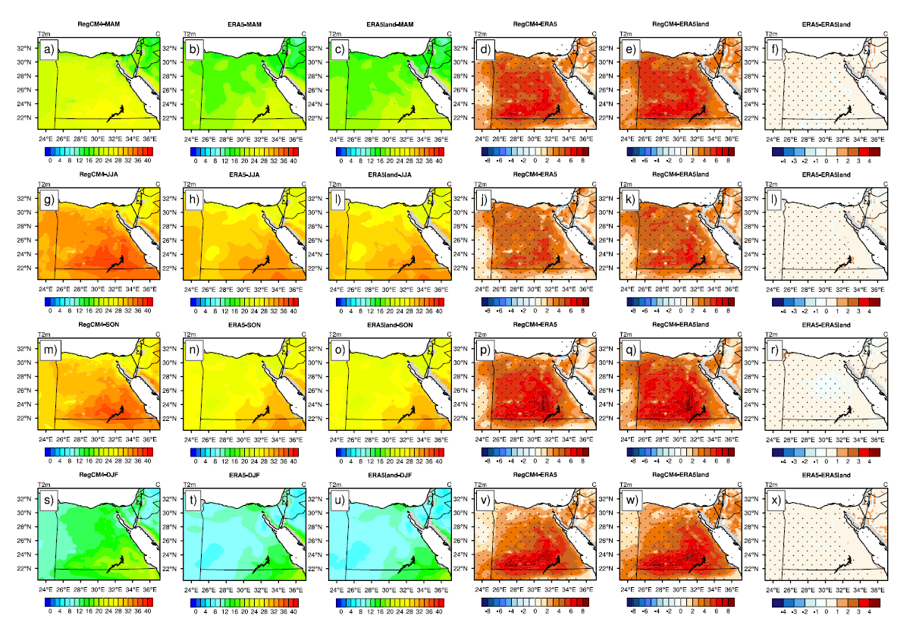
Results
Quantify the RegCM4 model bias concerning the simulated T2m (as input of the HS equation)
From Figure S2, like the SW, the RegCM4 shows a good ability to capture the spatial pattern of the simulated T2m with respect to reanalysis products in all seasons.
Also, there is no observable difference between ERA5 and ERA5land; which means that resolution of the observational dataset doesn’t affect the evaluation of the RegCM4.
In addition, obvious warm-bias is noted in the four seasons ranging from 3 to 7°C with mostly pronounced warm bias during the summer. Such noted bias can be attributed to the fact that majority of Egypt is shown as desert leading to low specific/relative humidity. As a result, the convective activity is affected producing low total cloud cover (not shown); high SW approaching the earth surface and eventually warming the earth surface and adjacent air layer close to the earth surface. Another reason is that Holtslag scheme is characterized by high-turbulent activity leading to enhancement of the warming effect produced by the SW.
Figure S2. The figure shows the 2-m mean air temperature over the period 1981–2017 (T2m; in °C; hereafter RegCM4) for: MAM season in the first row (a-f); JJA in the second (g-l); SON in the third (m-r), DJF in the fourth (s-x). For each row, RegCM4 is on the left, followed by ERA5. ERA5land is in the third from left, RegCM4 minus ERA5, RegCM4 minus ERA5land and the difference between ERA5 and ERA5land. Significant difference/bias is indicated in black dots using student t-test with alpha equals to 5%. Please note that RegCM4 model was driven by EIN15.

Slide 10
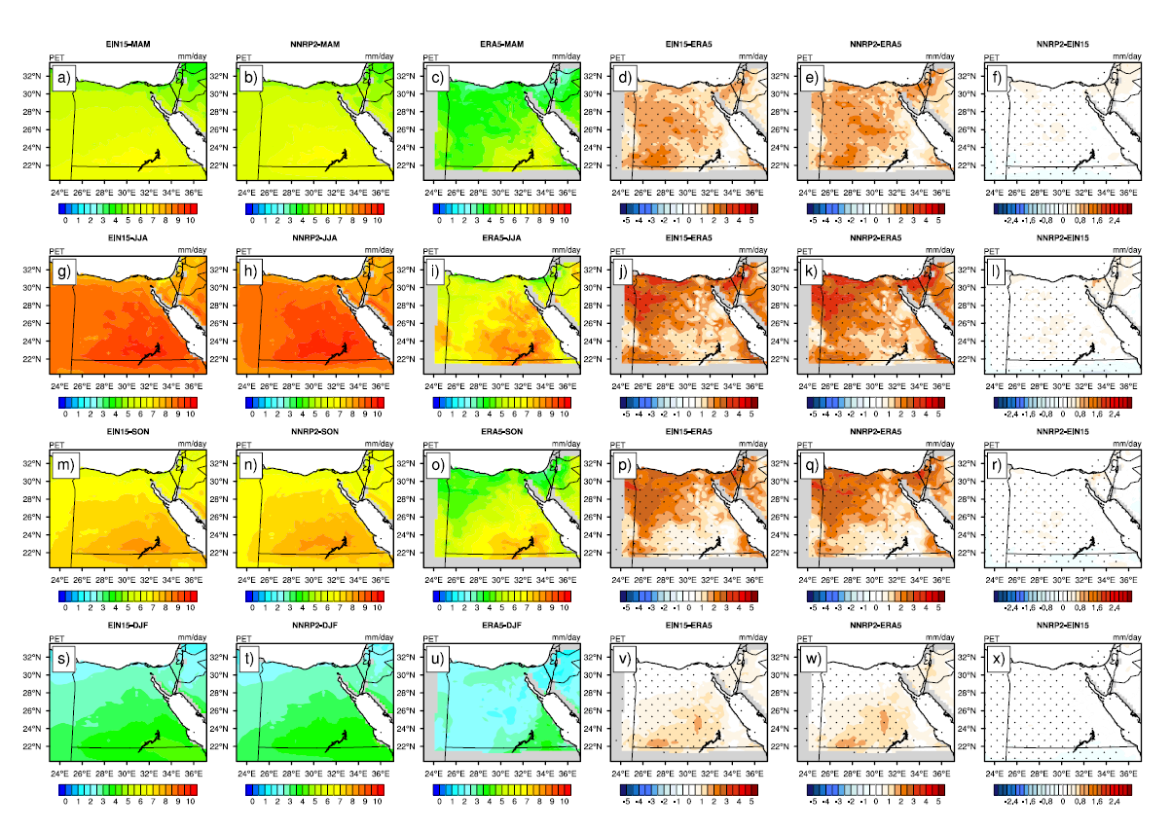
Results
To examine the influence of the lateral boundary condition on the simulated PET, non-calibrated HS equation was used to compute the PET. Figure 4 shows the simulated PET (by the RegCM4 driven by EIN15 and NNRP2 respectively) with respect to the ERA5.
It can be noted that the RegCM4 shows a good concise in reproducing the spatial pattern of the simulated PET in comparison with the ERA5 product. Also, it can be observed that there is no significant difference between EIN15 and NNRP2 in all seasons. Such behavior can be attributed to two reasons:
1 – RegCM4 has a similar performance when it is driven either by EIN15 or NNRP2 and
2 – RegCM4 physical parameterization dominates over the lateral boundary condition.
It can be noted that the PET spatial pattern is more consistent with the SW than T2m. Therefore, calibrating the SW coefficient is more effective than T2m.
Figure 2. The figure shows the potential evapotranspiration over the period 1981–2017 (PET; in mm day⁻¹) for: MAM season in the first row (a-f); JJA in the second (g-l); SON in the third (m-r), DJF in the fourth (s-x). For each row, EIN15 is on the left, followed by NNRP2. ERA5 is in the third from left, EIN15 minus ERA5, NNRP2 minus ERA5 and the difference between NNRP2 and EIN15. Significant difference/bias is indicated in black dots using student t-test with alpha equals to 5%.

Slide 11
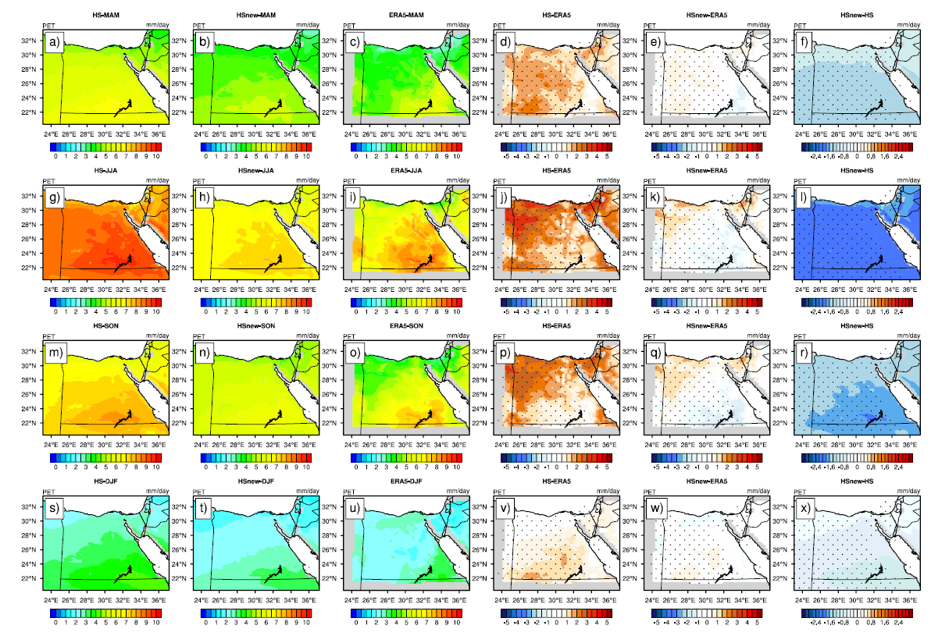
Results
Added value of calibrated HS equation
As noted above, that there is no significant difference between the two simulations driven with EIN15 and NNRP2. Therefore, RegCM4-EIN15 simulation was taken as an example to examine the added value of the calibrated HS equation compared to ERA5.
In general, both simulations are able to capture the spatial pattern of the simulated PET against the ERA5. However, HSnew shows added value over the HS in all seasons particularly in the JJA. Such value is indicated in two points: better ability to reproduce the PET spatial pattern relative to HS and the RegCM4 bias is significantly reduced in all seasons (particularly in the JJA) compared to the HS.
Overall, it can be noted that the added value of the Hsnew (over HS) can be arranged according to season in the following order: 1 – JJA; 2 – SON; 3 – MAM and 4 – DJF. These findings are in agreement with the results reported in Figure 2.
Figure 3. The figure shows the potential evapotranspiration over the period 1981–2017 (PET; in mm day⁻¹) for: MAM season in the first row (a-f); JJA in the second (g-l); SON in the third (m-r), DJF in the fourth (s-x). For each row, HS is on the left, followed by HSnew. ERA5 is in the third from left, HS minus ERA5, HSnew minus ERA5 and the difference between HSnew and HS. Significant difference/bias is indicated in black dots using student t-test with alpha equals to 5%.

Slide 12
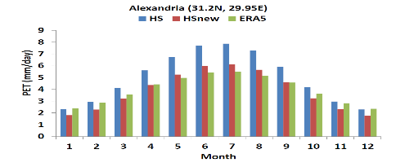
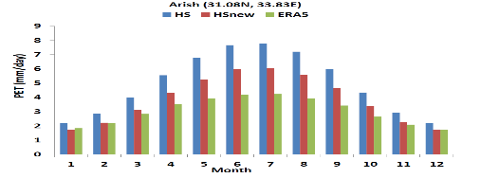
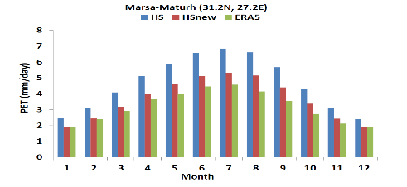
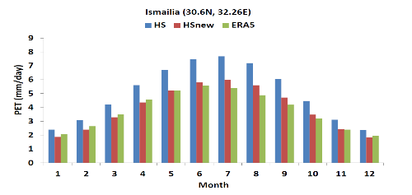
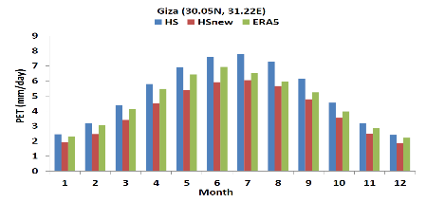
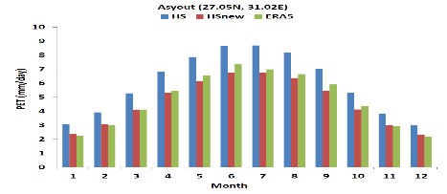
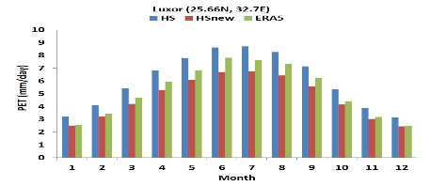
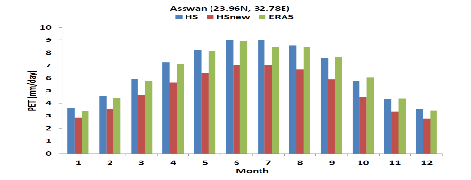
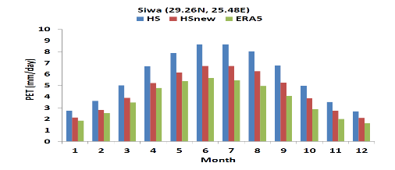
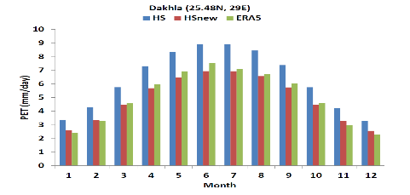
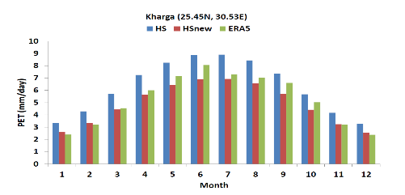
Results
3) Validate the calibrated HS equation (versus the original version) by examining the climatological annual cycle of the simulated PET with respect to ERA5 at specific locations in Egypt.
To further explore the added value of the calibrated HS, the climatological annual cycle (Figure 6) of the simulated PET of the HS, HSnew (compared to ERA5) was plotted for locations reported in Data and Methods.
From Figure 6, it can be observed that performance of HS/HSnew varies with location and month.
For instance, the HS is close to ERA5 in months January, February, November and December; while HSnew is close to ERA5 for the rest of months in Alexandria.
For Arish, Marsa-Maturh and Ismailia; HSnew is closer to ERA5 than HS.
In Giza and Asswan, the situation is quite different because HS performs better than HSnew in all months.
Further, HSnew shows an improved performance over HS in Assyut.
Also, the situation in Luxor is similar to the one observed in Alexandria.
Finally in Siwa, Dakhla and Kharga, HSnew shows an improved performance (relative to the HS) in comparison with the ERA5.
Figure 4. The figure shows the climatological annual cycle of the simulated PET for HS, HSnew compared to ERA5 for different cities in Egypt

Slide 13
Discussion and Conclusion
Regarding the influence of lateral boundary condition on the simulated RegCM4 PET, the results showed that switching between EIN15 and NNRP2 didn’t show a considerable impact on the simulated PET.
Calibrating the HS coefficients over Egypt indicate a considerable improvement in estimating the PET (relative to the original equation) when it is compared with ERA5. Such improvement is confirmed by a significant low mean bias, particularly in the JJA season.
On a point-scale, the HS/HSnew performance varies with location and month and over majority of locations, the RegCM4 shows a good performance using the calibrated HS equation. Nevertheless, the calibrated HS model can be recommended to construct a regional map of PET of Egypt, predict the daily PET for locations (where station observations are not available) and project the future PET under different global warming scenarios.

Slide 14
Thank you for your attention!

